Slide 1
Structure Report Templates for Cancer Clinical Trials
David Clunie
PixelMed Publishing

Slide 2
Characteristics of DICOM SR
Structured coded, text and numeric information with image/3D coordinate references
General recursive structure layered on top of DICOM data elements
Tree/DAG of “content items” (nodes)
Node is (named) container or name-value pair
All names, most values, are coded

Slide 3
Templates “constraint” content
Patterns & value sets for particular purposes
“Root” templates define entire content
e.g., “Mammography CAD” template
“Sub-templates” define content for sub-tree
e.g., “Single Image Finding” template
Current (2011+Sups+CPs) PS 3.16
290 templates (TIDs)
884 value sets (context groups, CIDs)

Slide 4
Template Identification
Can be challenging
May be explicit (esp. for root template)
May require pattern recognition
Top-down parsing not necessarily unambiguous
Regardless of template
specific patterns easily recognizable
specific information easily extractable
e.g., XPath

Slide 5
Template as Semantic Model
Consider template as similar to a class
Includes (contains) other templates (classes)
Design approach
define model (e.g., UML or C++ class)
make matching template definition
implement class to serialize/de-serialize as XML then SR, or SR directly

Slide 6
Clinical Trial Concepts
“Subjects”
patients, animals, specimens
identification, characteristics
“Readers” (and “adjudicators” etc.)
human or machine or hybrid
identification, characteristics (e.g., role, version)
“Time points”
imaging procedure at defined lifecycle stage
Identification, characteristics (baseline, random)

Slide 7
Clinical Trial Tasks
Read
localize (organ, vessel, tissue, etc.)
categorize (target (measurable), non-target, …)
describe (irregular, enhancing, …)
measure (size, intensity, texture,…)
infer (malignancy probability, disease progression)
Compare
adjudicate
reach consensus

Slide 8
Clinical Trial Workflow
Work lists
Scheduling readers
by individual or by role
load balancing
Series of steps
sequential revelation (unblinding)
locking +/- hindsight changes
Reads performed in sequence
2 radiology then adjudication, oncology, QC

Slide 9
Clinical Trial Data Management
Data to feed statisticians
May be all or subset of data acquired
May be image-referenced or separate
“Cleaning”
“Locking” (prior to interim or final analysis)
Store/interchange in either or both:
database
documents (like set of DICOM SRs)

Slide 10
Clinical Trial Audit Trail
For EVERY data element
Who, what, when, where, why …
Multiple successive changes
Simultaneous changes to multiple elements
In document, metadata, database, or all?
Lifecycle management of “documents”
Human readable rendering mechanism
DICOM SR predecessor references

Slide 11
DICOM Standard Templates
Developed mostly for clinical not clinical trial use cases so far, e.g., CAD, US OB, Cardiac
Strong on measurement
coded sites, types, variants of measurements
size, intensity, function, etc.
coordinates (2D, 3D), image and seg references
Weak on clinical trial/experimental
context - readers, roles, time points
concepts – response assessment (PD,PR,SD,…)

Slide 12
Template Design Questions
Scope of one object vs. multiple vs. exclude
one subject (no debate)
one or multiple readers?
one or multiple time points (comparison)?
measurements?
image references?
questions & answers (response assessments)?
audit trail and provenance?
“Session” or “Subject” orientated?

Slide 13
Private Templates & Codes
Private templates can re-use
standard sub-templates
standard value sets (context groups)
standard codes (SNOMED, DCM, LOINC, RadLex)
Private value sets (in standard templates)
Private codes
where no suitable external lexicon or exact match
e.g., (RP-100019, 99RPH, “Time Point Name”)

Slide 14
QIICR Slicer Considerations
“Session” rather than “subject” oriented
Record measurements & image relationship
Capturing “questions & answers”
requires configurable information & UI – exclude?
Time point identity
is study date/id sufficient, or more ? where from?
longitudinal comparison – date based only?
Provenance & audit trail
creation – who (reader ID, ?role), when
editing – who, what, when, why – non-trivial

Slide 15
Reusable Templates – TID 1410
TID 1410 Planar ROI Measurements:
“a general structure to report one or more measurements for some metric, e.g., density, flow, or concentration, over a planar region of interest in an image … may be specified by an SCOORD on an image, or by a Segmentation Image”

Slide 16
Reusable Templates – TID 1420
TID 1420 Volumetric ROI Measurements:
“a general structure to report one or more measurements for some metric, e.g., density, flow, or concentration, over a volumetric region of interest in a set of images or a Frame of Reference … may be specified by a set of SCOORDs on an image set representing a volume, by a volumetric Segmentation Image, by a volume defined in a Surface Segmentation, or by a SCOORD3D”

Slide 17
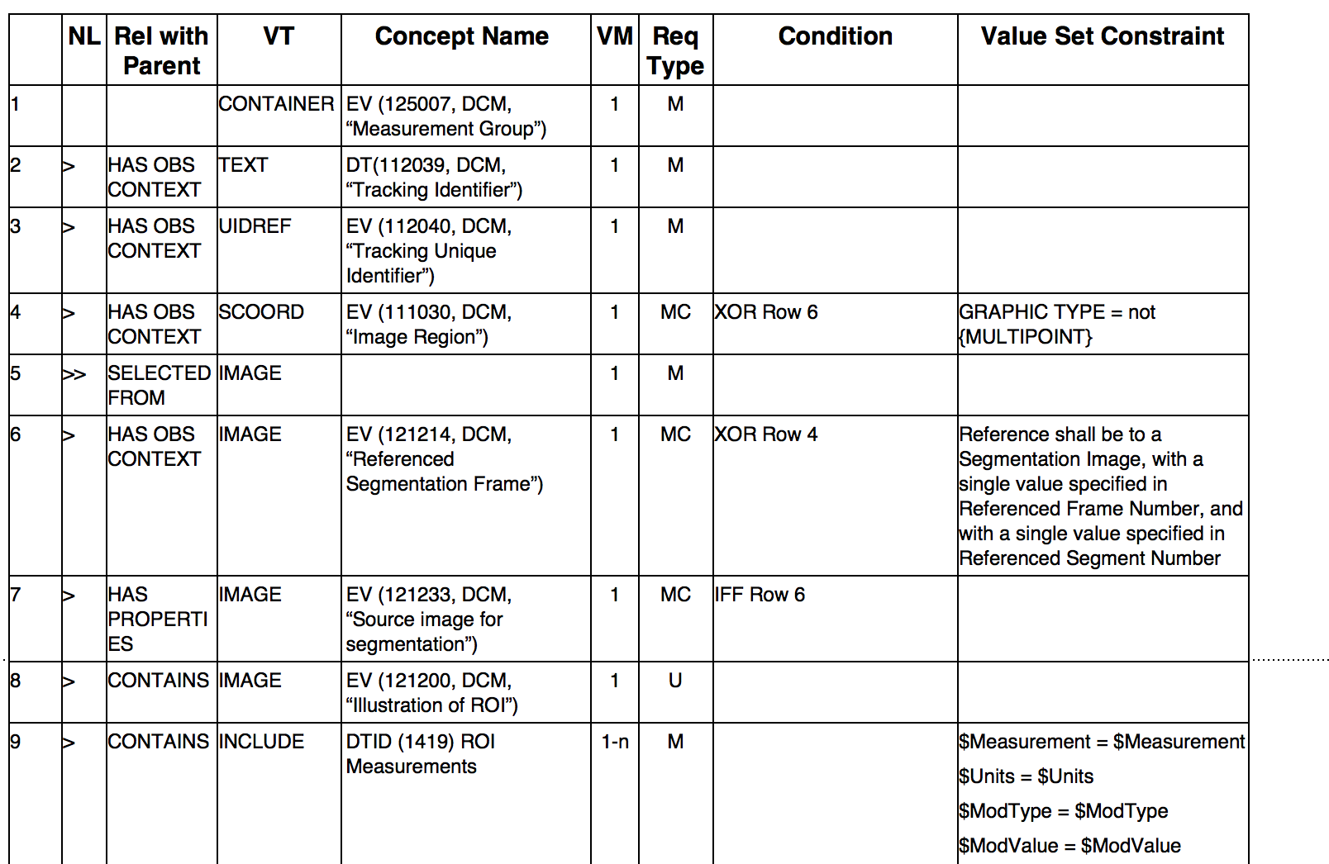
TID 1410 Planar ROI Mx

Slide 18
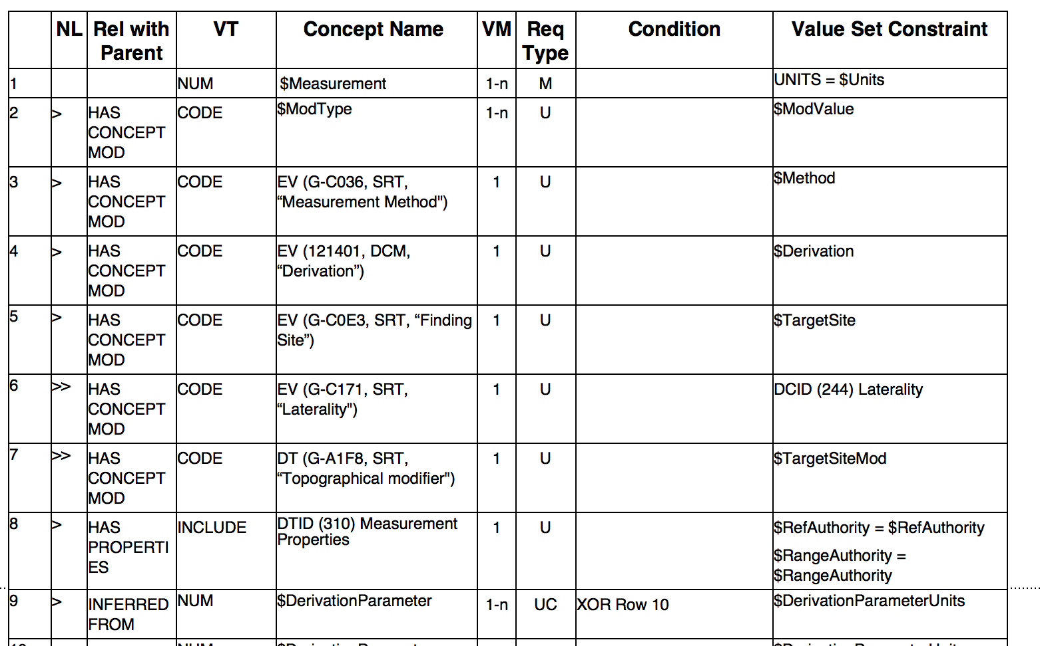
TID 1419 ROI Measurements

Slide 19
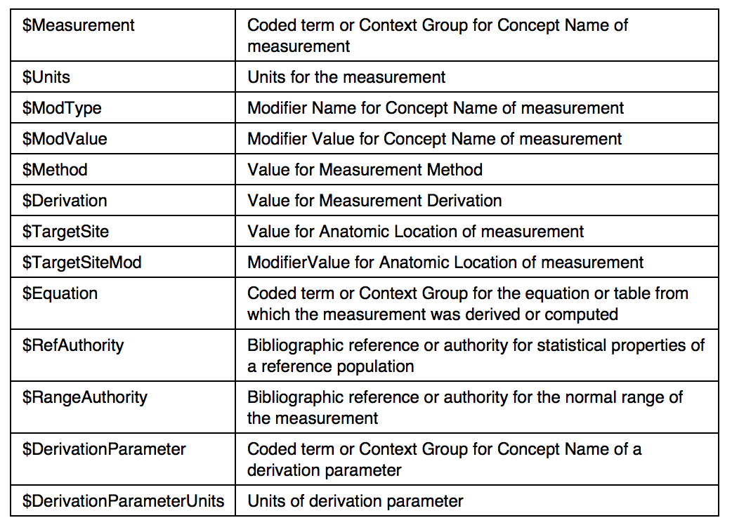
TID 1410 Parameters

Slide 20
Concepts of Measurements
Can be very general
size-related – (G-D705, SRT, “Volume”)
intensity-related – (RP-100107, 99RPH, “SUVbw”), (112031, DCM, “Attenuation Coefficient”)
modified – (R-00317, SRT, “Mean”)
Can be very specific (pre-coordinated)
(8818-7, LN, “Right ventricular ejection fraction by MR”)
Units are separate (and can be constrained)
e.g., (mm, UCUM, “mm”), ([hnsf’U], UCUM, “HU”)
Meaning may be internationalized
e.g., (112031, DCM, “Coefficient d’atténuation”)

Slide 21
Which Sub-Templates?
For measurements
For description of findings?
For description of images – “Image Library”?
For description of subject (header identifies)
For description of reader
Flat list or hierarchical?
Recursive/referential (finding derived from other findings)?

Slide 22
Which Sub-Templates – Simple
For measurements – YES
For description of findings? – NO
For description of images – NO
For description of subject – NO
For description of reader – YES
Flat list or hierarchical? – FLAT
Recursive/referential? – NO

Slide 23
Save/Restore Slicer “State”
Distinguish use case from mining for results
Results don’t even need to be stored in “state” object, since can be recalculated – just need references and methods
Can/should one (SR) object do both?
Hiding a “blob” (of binary or XML)?
Versus translating into SR-style content items and trees?
Right way versus easy way – re-use potential

Slide 24
Revisit Use-Cases
SR “customers”
who will produce the SR? workstation (only)
who will consume the SR? workstation, statistics, …
Slicer-centric view
Interoperable view
Converge on single (simple, extensible) template for interoperability
interchange of quantitative results, methods and image references between similar workstations
e.g., Slicer vs. ClearCanvas NWU vs. syngo.via, etc.

Slide 25
Codes to use for Slicer
Traditionally, each project makes up its own list of string values and LUT indices
e.g., “necrotic region of tumor”, “left hippocampus”, etc.
works, but no interoperability of tools or concepts or re-use of existing ontologies (e.g. knowledge that “precentral gyrus” is part of “frontal lobe” is part of “brain”, or is “primary motor cortex” is “motor cortex”)
Standard lists available
DICOM, SNOMED, FMA, RadLex, QIBO
varying comprehensiveness of supporting ontology
Mapping of Slicer LUT and Brain Atlas LUT done

Slide 26
Codes to use for Slicer
Could just hardwire in specific plugins
Perhaps better to de-reference to dictionary support module +/- network interfaces to terminology services (e.g., Bioportal.org)
Used in both SR (totally code dependent) and SEG (coded description of segments is required)
When no suitable standard/external code, can make up a private code (e.g., Slicer supplied, or user supplied) – need support tools in order to do this correctly

Slide 27
Annotated References
An early article discussing concepts and issues: Cancer Inform. 2007; 4: 33–56: “DICOM Structured Reporting and Cancer Clinical Trials Results”: http://www.ncbi.nlm.nih.gov/pmc/articles/PMC2666949/
An implementation used in a proprietary tool at my former company: “Encoding of Oncology Clinical Trial Read Results in DICOM SR - Abbreviated QIBA 1C Content”: http://qibawiki.rsna.org/images/f/fc/ClinicalTrialResults_20111123_QIBA.doc
CP 1112 “Add SR Structure for ROI Measurements”: ftp://medical.nema.org/medical/dicom/final/cp1112_ft.pdf

