Slide 1
SlicerRT
Csaba Pinter, Andras Lasso
Laboratory for Percutaneous Surgery, Queen’s University, Kingston, ON, Canada

Slide 2
SlicerRT in numbers
Started in January 2012
5 extensions
36 modules
74 automatic tests
2550 commits
13 contributors (5 current)
> 12,000 total number of downloads
3,964 for 4.4.0 stable

Slide 3
SlicerRT ecosystem
Streamlined applications
Utilities
3D Slicer
SlicerRT core
Several former SlicerRT features integrated:
Subject hierarchy, DICOM export, Transform visualizer, etc.
Common RT software tools:
DICOM-RT, Dose/Contour analysis, Beam planning, Batch processing
Acts as a platform

Slide 4
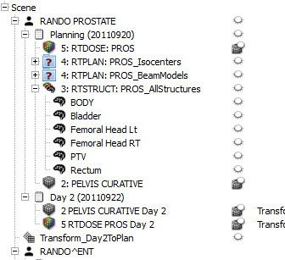
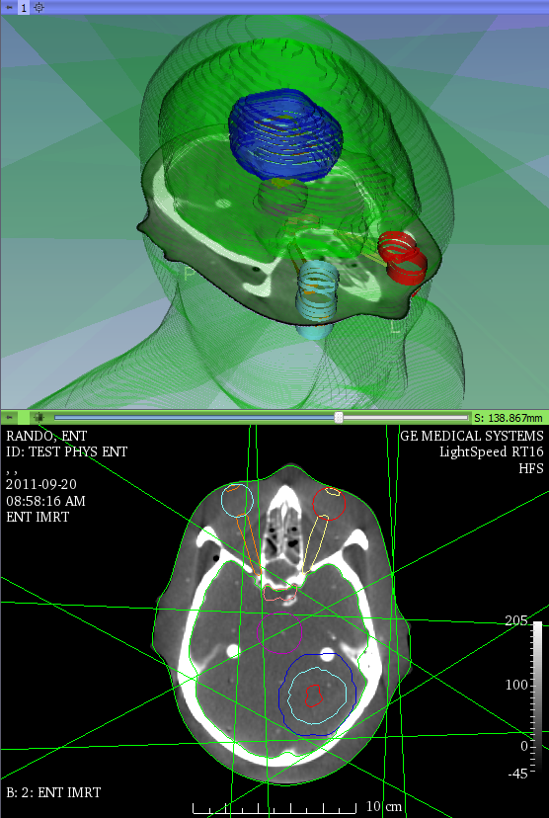
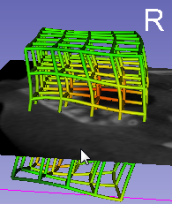
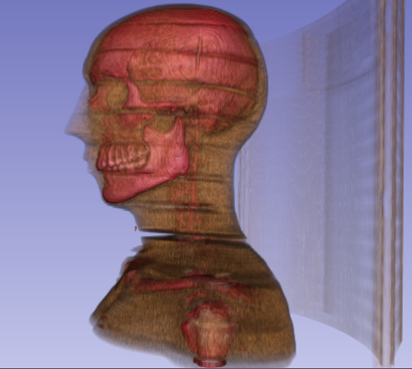
SlicerRT core highlights
DICOM-RT
DICOM-SRO
Multi-fraction data handling
registration
Multi-fraction data view
Load and visualize DICOM-RT
Advanced visualizations

Slide 5
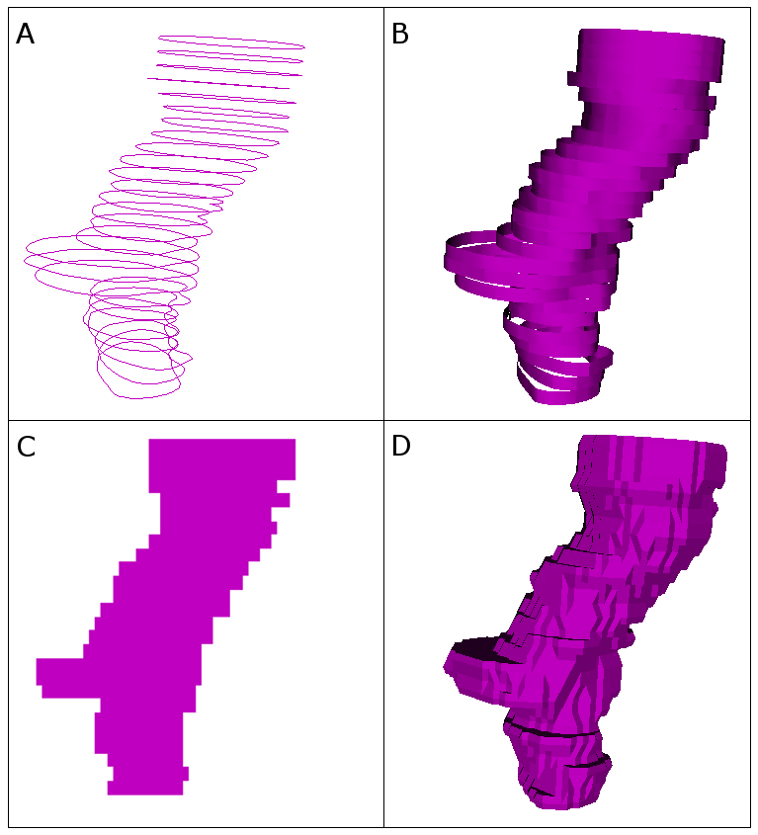
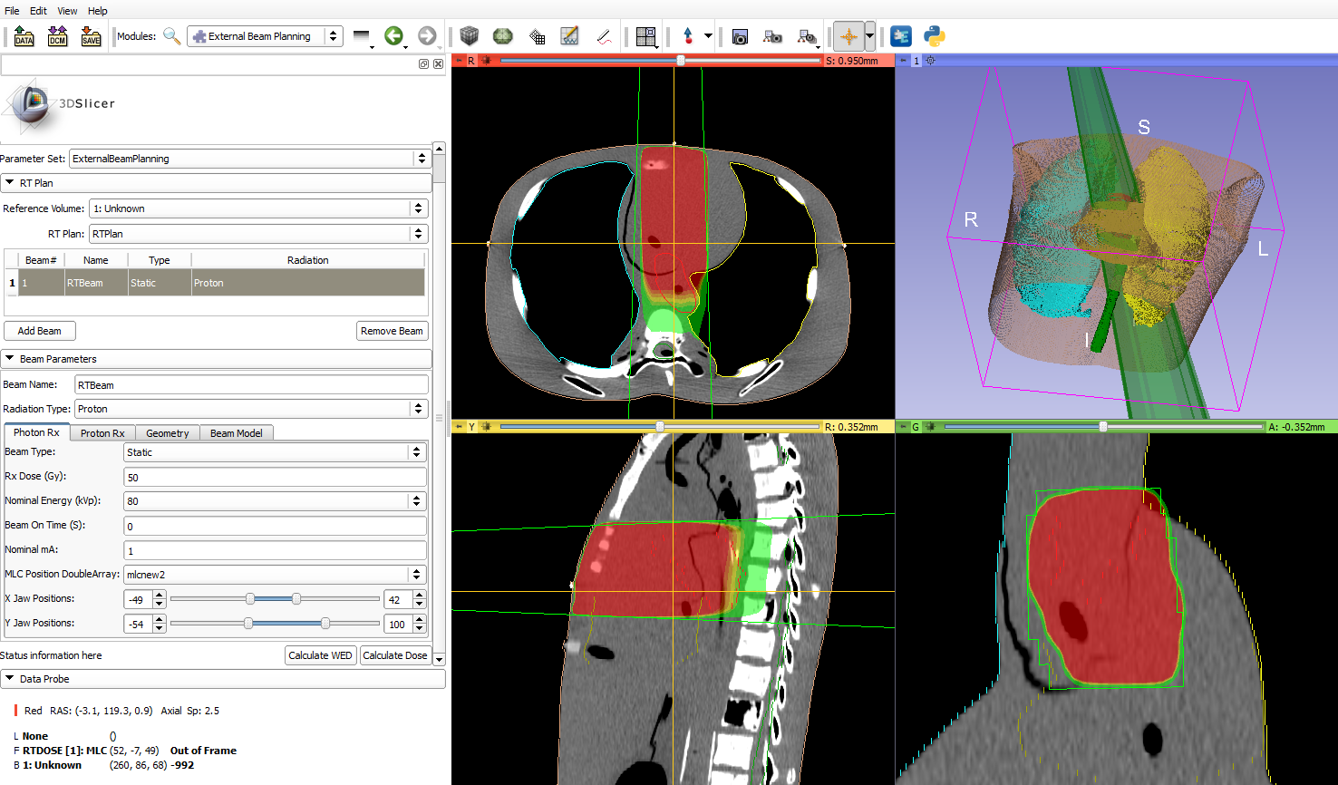
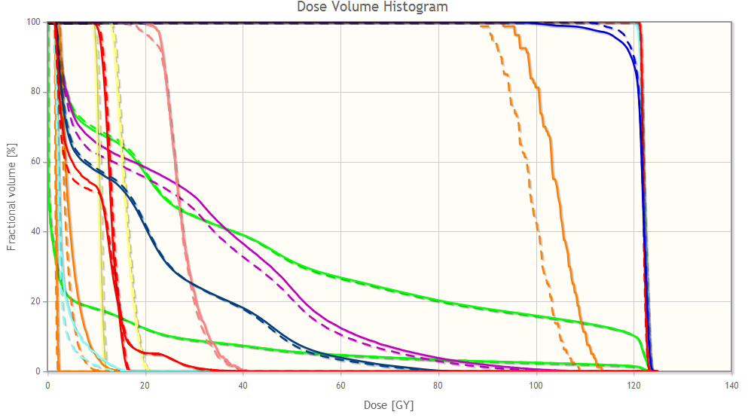
SlicerRT core highlights
Contour analysis
Multi-representation support
Morphological operators
Comparison methods
Dose analysis
DVH calculation, comparison
Gamma dose comparison
Dose accumulation
Isodose surfaces
External beam planning platform
Contour representations
Dose-volume histogram
External beam planning

Slide 6
Matlab bridge
Running Matlab functions directly from 3D Slicer
Takes input from the data loaded into Slicer
Transfers and shows the results in Slicer when MATLAB execution is completed
GUI is generated automatically from a standard command-line interface definition XML file
no GUI programming needed
No building of 3D Slicer or MEX files, etc. are needed

Slide 7
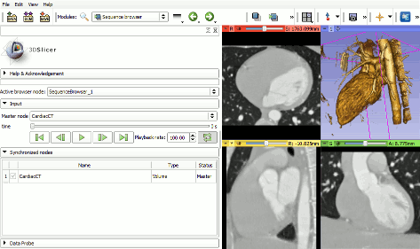
Sequences
Create and visualize of higher-dimension data nodes
RT: Multi-fraction datasets, 4D CT
Sequence browser for selection and playback
Synchronized or real-time visualization
In 2D and/or 3D
Handling of whole fraction dataset in each sequence node
Playback of a 4D cardiac CT dataset

Slide 8
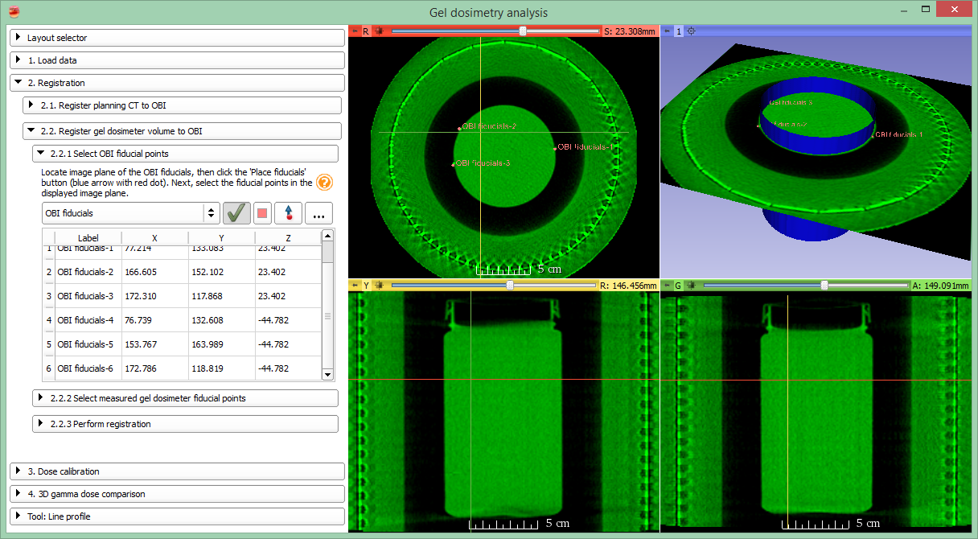
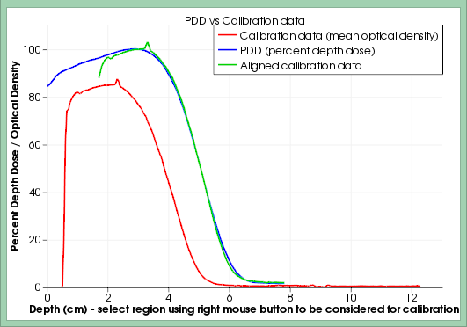
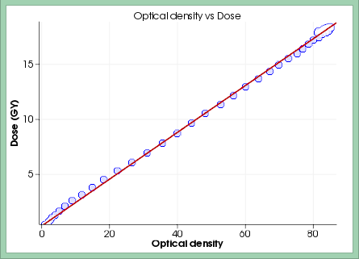
Gel dosimetry analysis
“Slicelet”
Workflow-based
Full 3D gel dosimetry
Simplified user interface
Collaboration with KGH, Kingston, ON
Alexander et al., IC3DDose, 2014

Slide 9
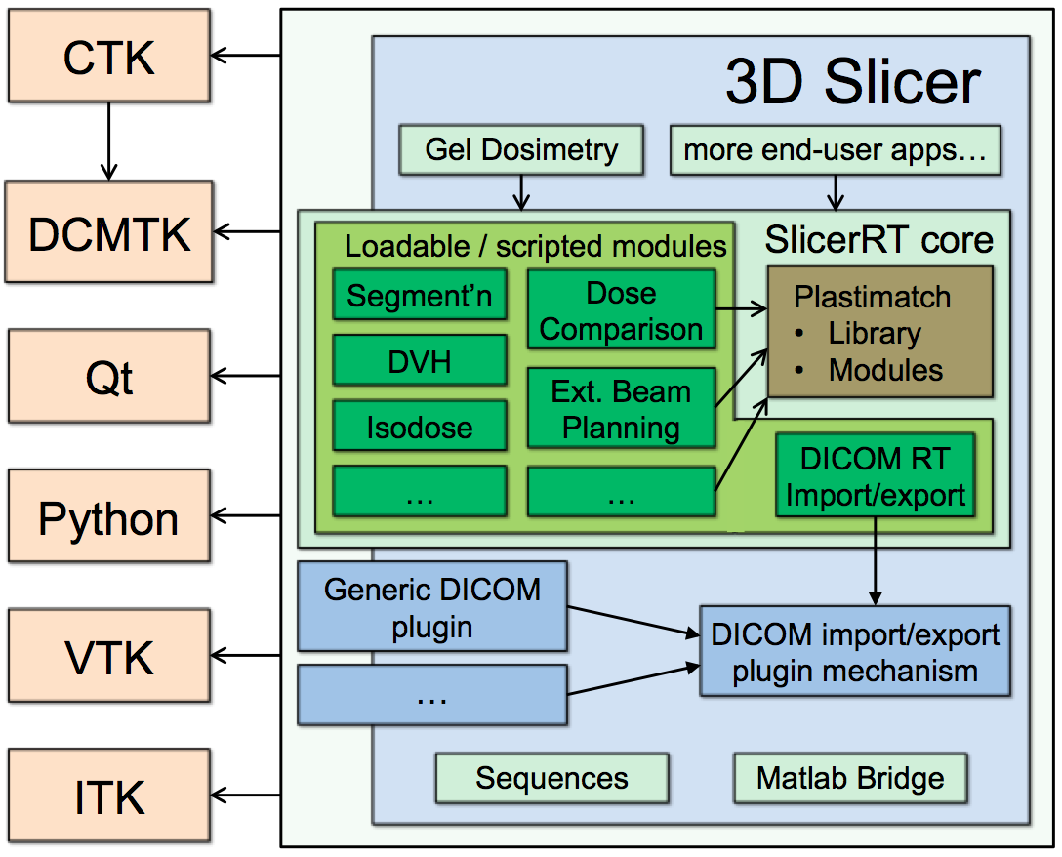
SlicerRT architecture

Slide 10
Good practices
Follow Slicer conventions
Coding rules for painless reading and integration
Separate MRML, Logic, Widgets, Module classes
Keep track of Slicer commits and follow changes
Automatic testing: both logic and workflow
Identify regressions caused by own commits
Detect failures due to Slicer core changes
Create re-usable widgets where applicable
Usage from various places, easier testing

Slide 11
Good practices cont’d
Use the best fitting module type
CLI for very simple data flow scenarios
C++ for complex UI or core features
Python for everything else
Create slicelets for workflow-based applications
Much easier for users
Easier maintenance due to restricted workflow
Tutorials are a good way to lure new users

Slide 12
Bad practices
Mix Qt and VTK in C++
Always use the proper containers
MRML node member vars in MRML nodes
Problems with scene changes
Avoid “fix numbers”
If you implement something for two objects in a rigid manner, you will have a problem if you’ll need to handle a third one

Slide 13
Good to know
It is possible to
use superbuild in extensions
define dependencies between extensions
have the extension index use the latest revision
have C++ “library” classes for python modules
call C++ from python and vica versa
get cumulative download statistics (DeveloperToolsForExtensions / ExtensionDownloadStatistics module)

Slide 14
Future work
Integration of Segmentations into Slicer core
vtkOrientedImageData and ~Resample
Pure-VTK segmentation object
Multiple segments and representations
Segmentations module
MRML, Storage, Displayable managers, Widgets, etc.
Editor
External Beam Planning platform
Pluggable for arbitrary dose engines

Slide 15
Thank you!
Website: http://slicerrt.org
Email: csaba.pinter@queensu.ca

Slide 17
Appendix

Slide 18
Bringing ideas and tools together
Routine
XiO®
Pinnacle³
Eclipse™
...
Data transfer
Conversions
2D/3D visualization
Dose analysis
Contour analysis
Segmentation, Registration
DICOM-RT
...
Research
http://SlicerRT.org

