Slide 1
Increasing the Impact of
Medical Image Computing :
Current Activities and
Future Opportunities

Slide 2





Increasing the Impact of Medical Image Computing :
Current Activities and Future Opportunities
Ron Kikinis M.D.
Robert Greenes Distinguished Director of Biomedical Informatics, Dept. of Radiology, BWH
Professor of Medical Image Computing, FB 3, Uni Bremen
Professor of Radiology, Harvard Medical School
Founding Director, Surgical Planning Laboratory, Brigham and Women’s Hospital
Institutsleiter, Fraunhofer MEVIS
Principal Investigator, National Alliance for Medical Image Computing, and Neuroimage Analysis Center,
Collaboration Director, National Center for Image Guided Therapy

Slide 3
Acknowledgement
I received input and contributions from many members of the 3D Slicer community
However, mistakes are my fault
In addition to the contributors mentioned in the individual slides I would like to thank:
Steve Pieper, Michael Halle, Tina Kapur, Kirby Vosburgh, Stephen Aylward

Slide 4
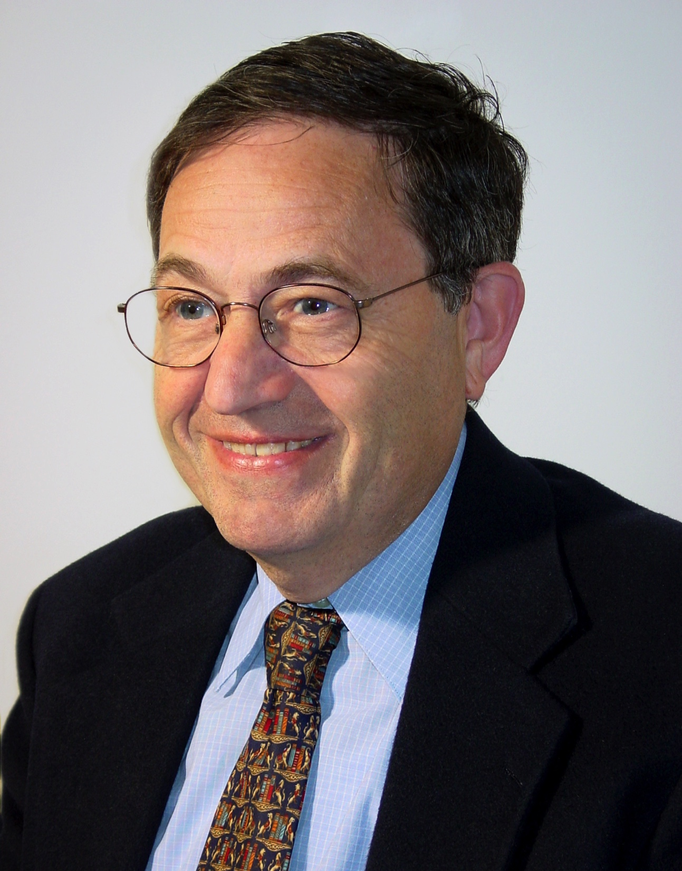
In Memoriam
Ferenc A. Jolesz
May 21, 1946 – December 31, 2014
Mentor and friend
"Ferenc A. Jolesz" by Michael Halle

Slide 5
Introduction
NAMIC had a good run for over a decade
  We have worked towards establishing a platform for medical image computing to enable research and commercial use
  Algorithm science
  Translational science

Slide 6
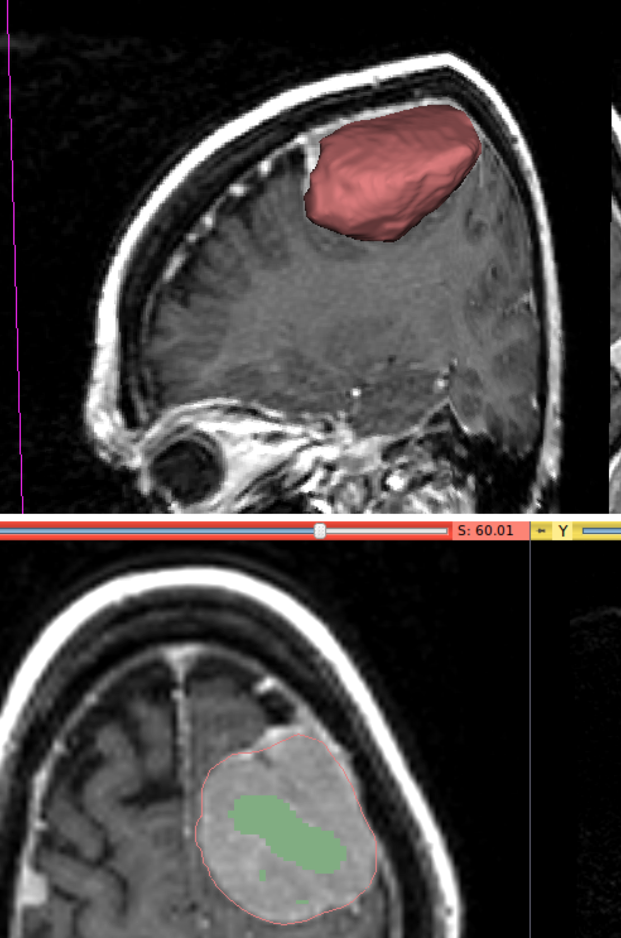
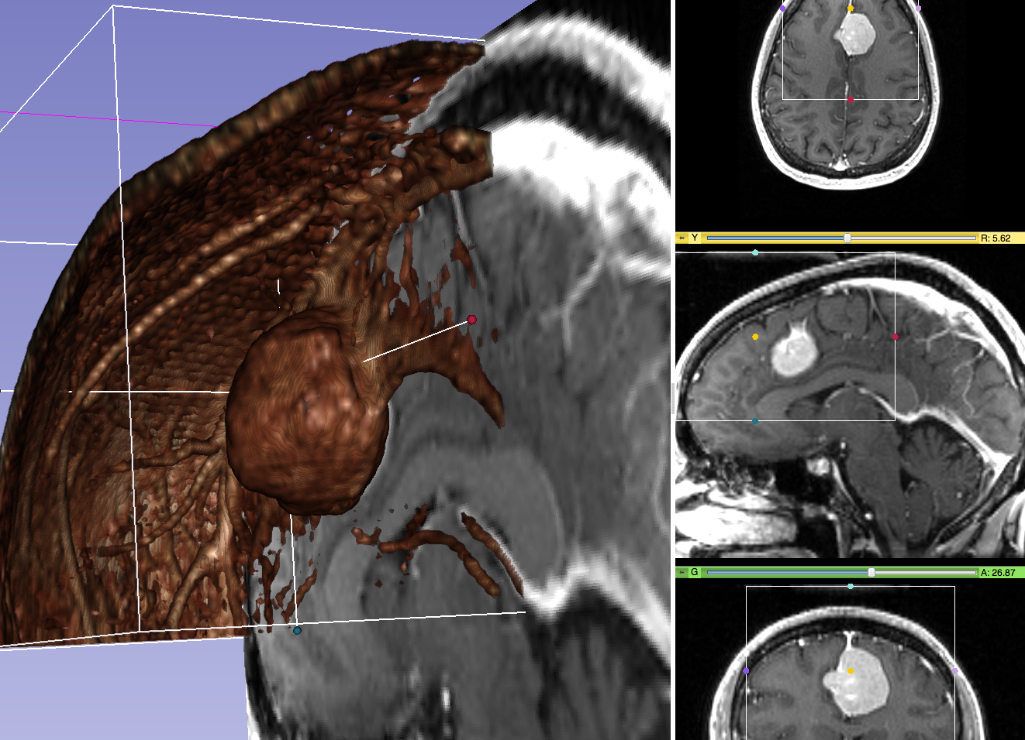
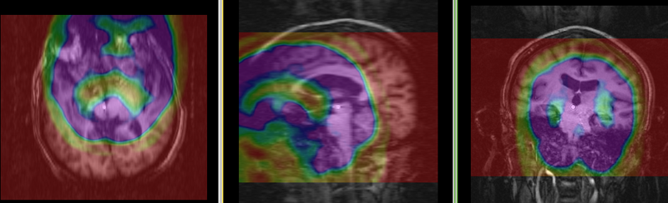
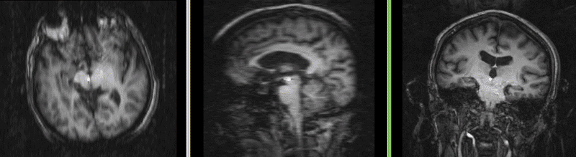
What is MIC
Goal: extraction of clinically relevant information and knowledge from medical images using computational methods such as:
  image segmentation
  image registration
  image-based physiological modeling
  visualization
http://wiki.slicer.org/slicerWiki/index.php/Documentation/Nightly/Modules/RobustStatisticsSegmenter
result
initialization
before
MIC=Medical Image Computing
after
Volume rendering
https://en.wikipedia.org/wiki/Medical_image_computing
http://wiki.slicer.org/slicerWiki/index.php/Documentation:Nigh
tly:Registration:RegistrationLibrary:RegLib_C14

Slide 7
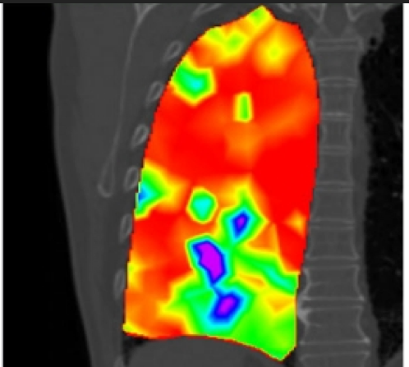
Increasing Importance of MIC
More applications
  Discovery, Diagnosis
  Therapy monitoring
More data and complexity
  Gigabytes to terabytes
  fMRI, molecular
  imaging, dMRI, 4DUS
Translational infrastructure is needed
Risholm P., Ross J., Washko G.R., Wells III W.M. Probabilistic Elastography: Estimating Lung Elasticity. Inf Process Med Imaging. 2011;22:699-710. PMID: 21761697. PMCID: PMC3249413.

Slide 8
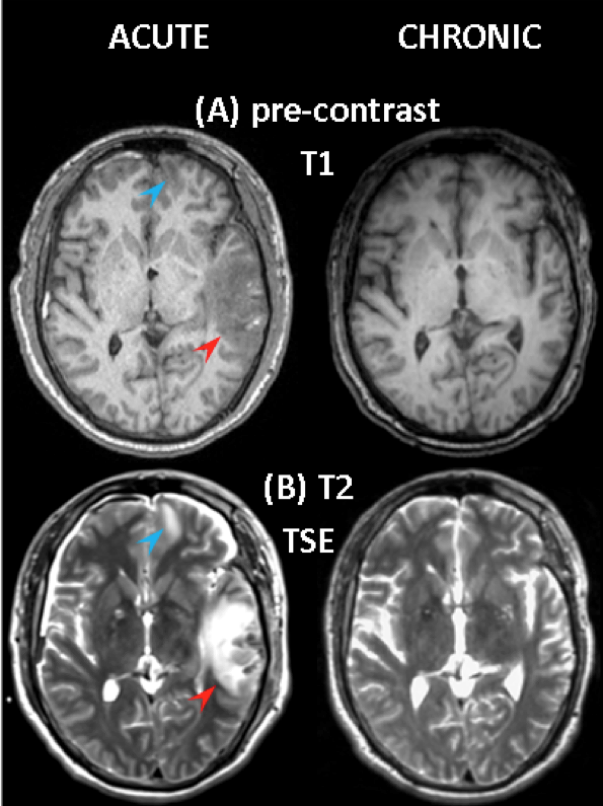
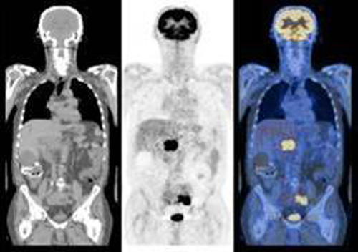
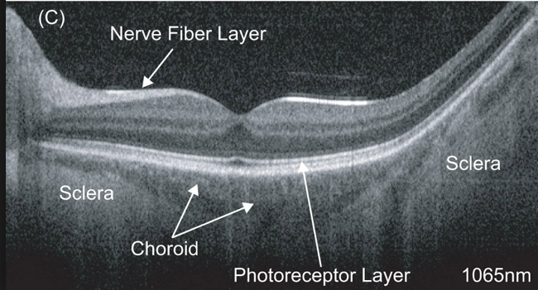
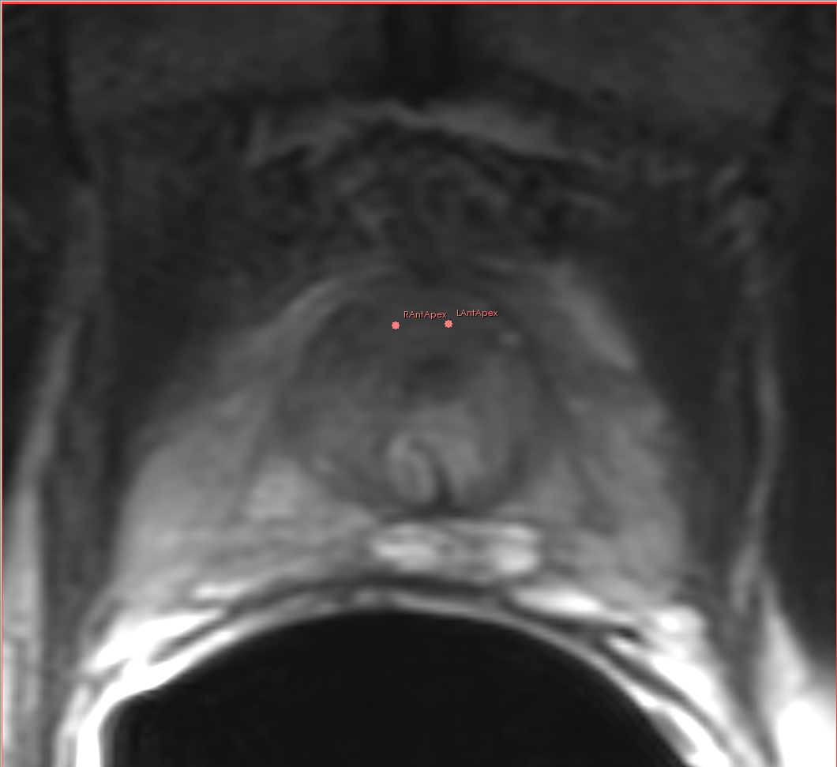
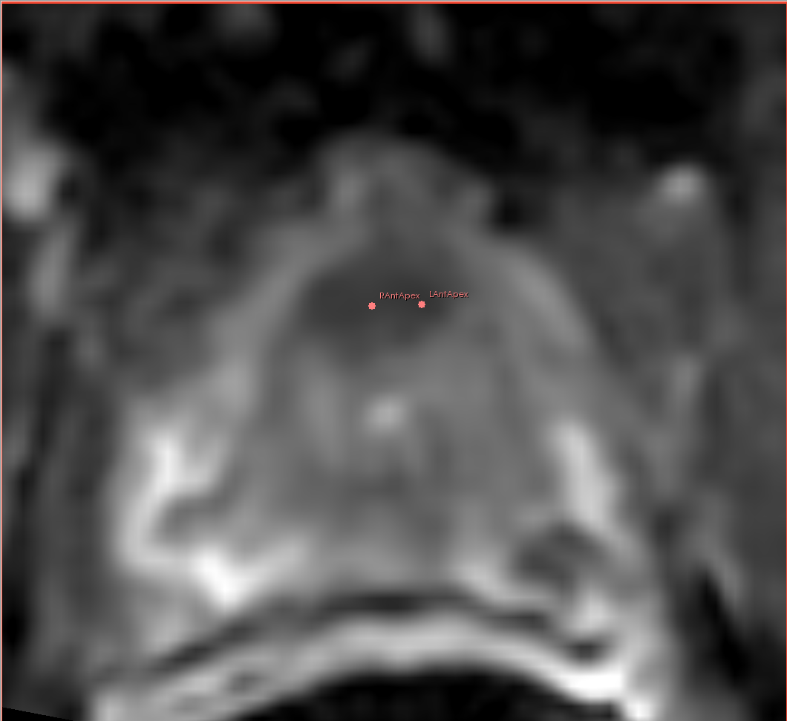
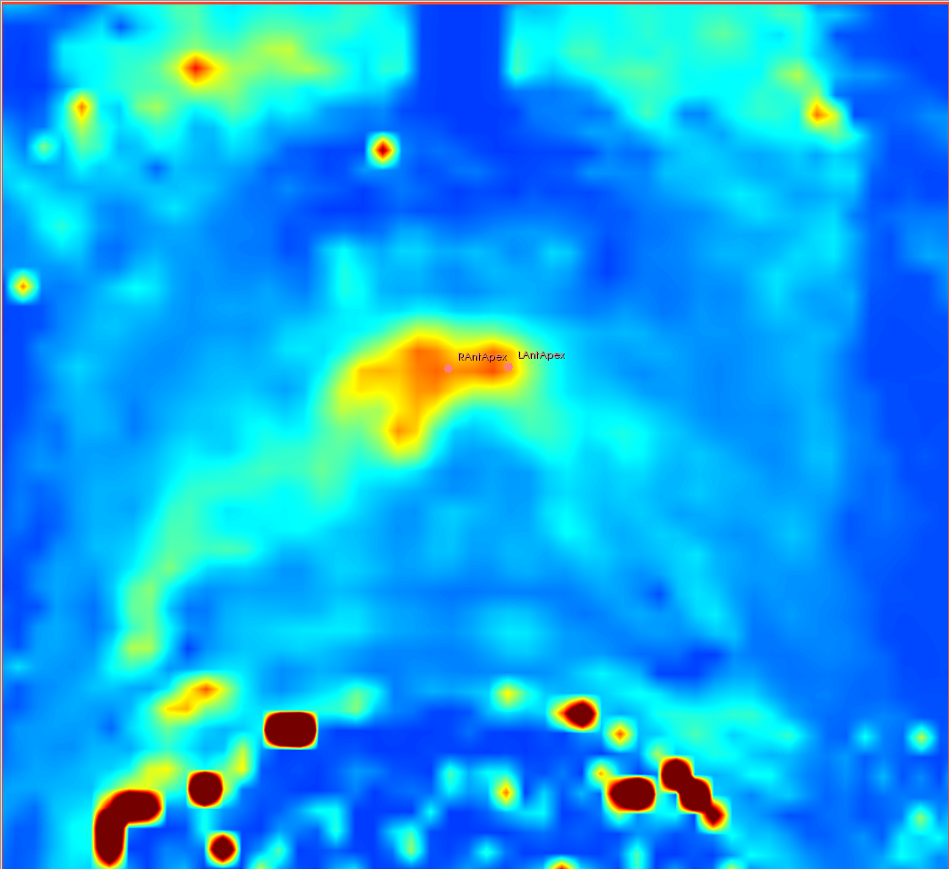
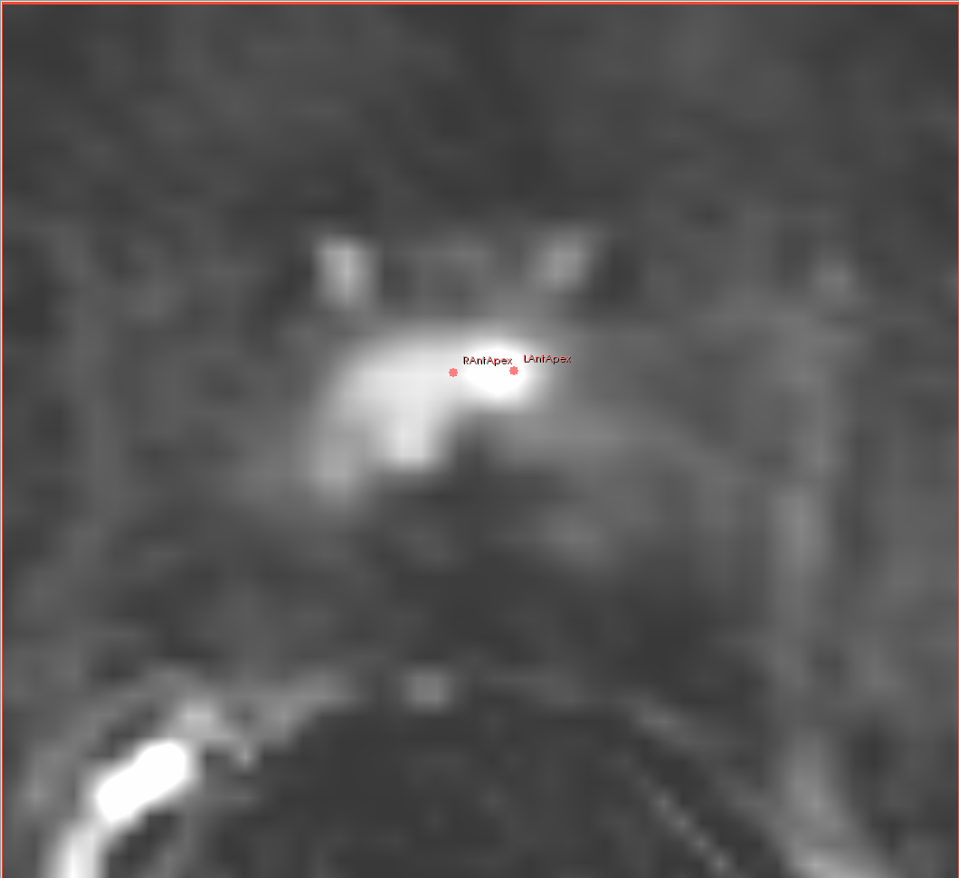
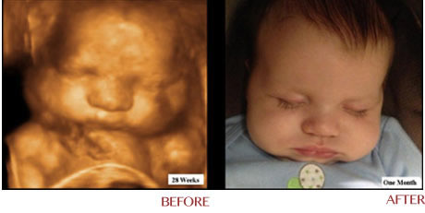
Advancement Continues
PET CT:
http://nucmed.wikispaces.com/Wendt+Talk+6
MR Images:
P. Vespa,
J. Alger,
UCLA
OCT: http://spie.org/x88950.xml?pf=true&ArticleID=x88950
T2w
ADC
Many modalities
Complex MRI:
Fedorov et al. 2012. JMRI. 36(4):987–992.
X ray radiography
Magnetic resonance imaging (MRI)
Nuclear medicine
Computed Tomography
Tomography
Ultrasound
Optical Coherence Tomography
Photoacoustic imaging
Thermography
Light Microscopy
  Bright, dark field
  Phase contrast
  Fluorescence
  Confocal
K^{trans}
subtract
4D Ultrasound: http://ultrasoundcarespecialist.com/html/anib_3d4d.html
Chubby
Cheeks

Slide 9
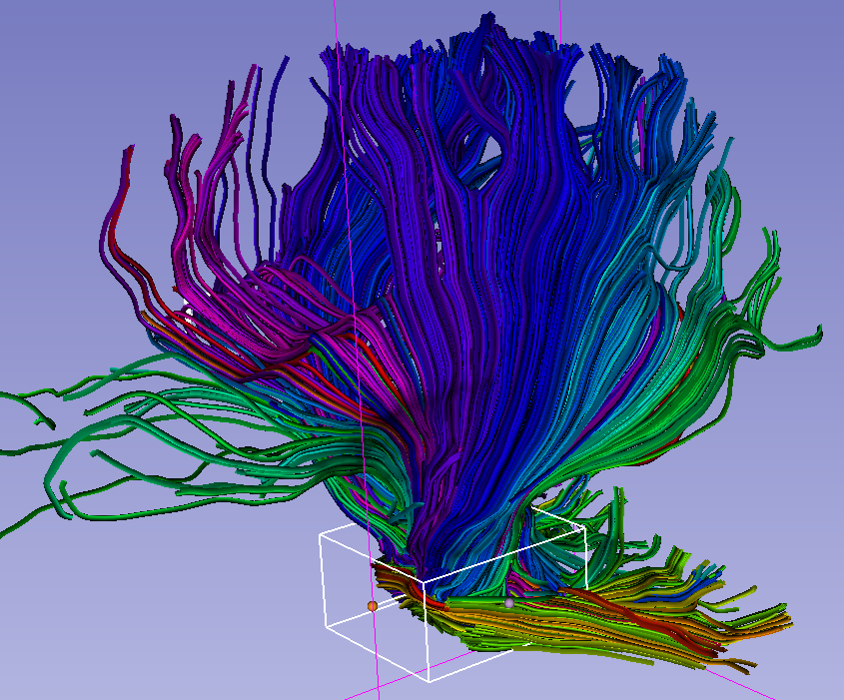
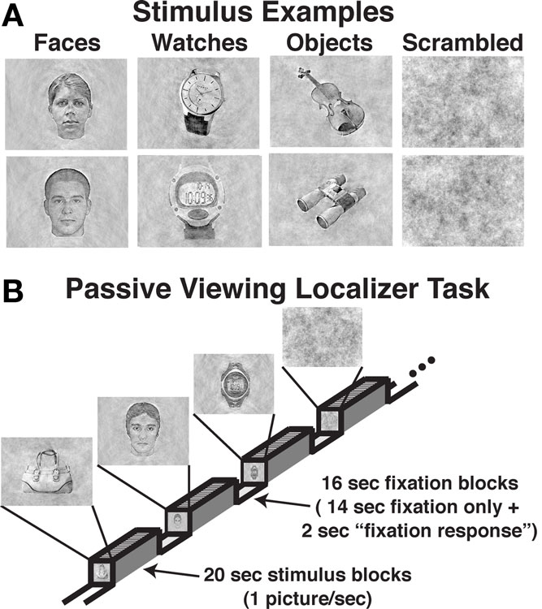
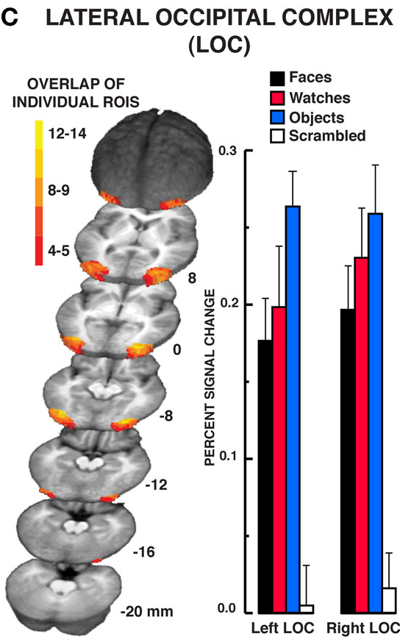
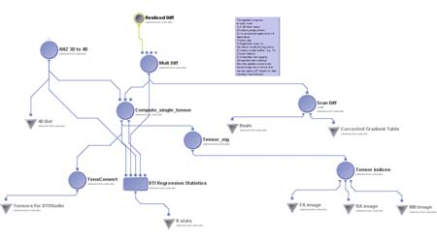
Complexity Increases
fMRI dMRI
DTI streamlines: http://wiki.slicer.org/slicerWiki/index.php/Slicer4:VisualBlog
http://www.frontiersin.org/human_neuroscience/10.3389/fnhum.2010.00181/full
DTI processing: http://www.loni.ucla.edu/~ophillip/DTIPipelines.html

Slide 10
The Process of Translation
Technological prototype
Tools for biomedical research
Clinical tools
Can it be done?
Innovative, not robust, usually single developer
Should it be done?
Usability, robustness, portability and openness
For every patient
FDA approved, supported, closed source

Slide 11
Translation
Problem: The valley of death
  Lack of incentives for translation from prototype to biomedical tool
  Scientist: Doesn’t help my academic promotion
  NIH reviewers: Not innovative
  Companies: Too risky because it is not proven
Solution: A mountain of opportunities
  3D Slicer was evolved by the NAMIC community to make translation easier
    Easy-to-use generic capabilities like display, I/O and common algorithms
    Low barriers for extension and distribution

Slide 12
3D Slicer
Transformed by NAMIC
Made possible by a community
Technological capabilities in lockstep with innovation and discovery (details follow ☺ )

Slide 13

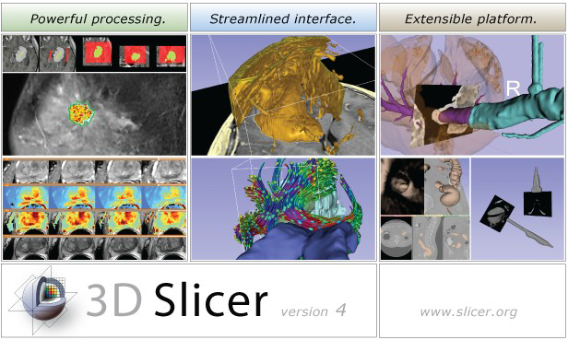

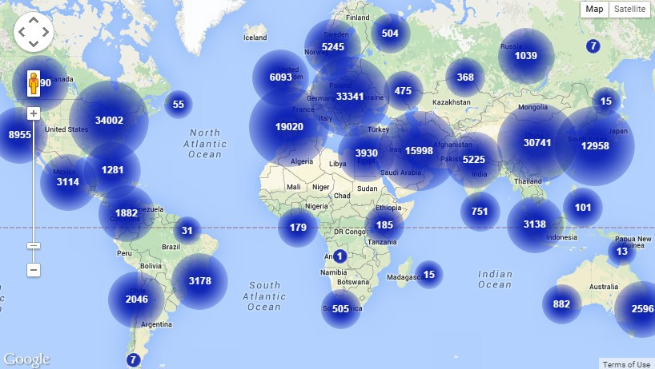
Evolution of 3D Slicer
D. Gering’s master thesis (in the mid 90’s)
Since then: multi million investment by NIH
The rate of downloads is increasing
  2012: 500/week
  2015: 1000/week
3D Slicer downloads
www.slicer.org

Slide 14
The Fruits of NAMIC
The core of 3D Slicer is professionally engineered and tuned for high performance
An increasing number of NIH funded projects use 3D Slicer
Growing community of users and developers

Slide 15
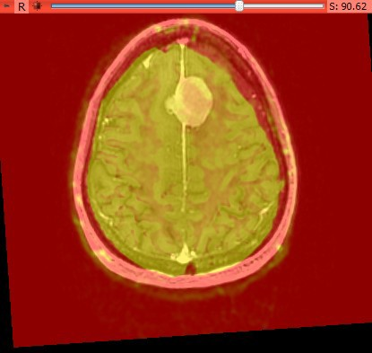
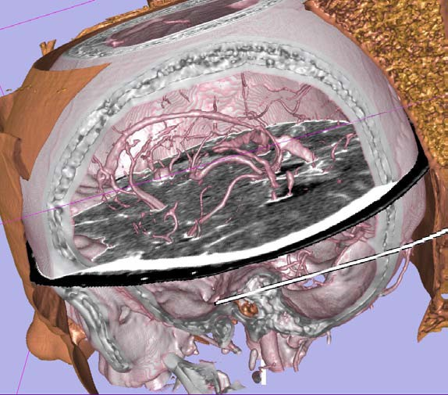
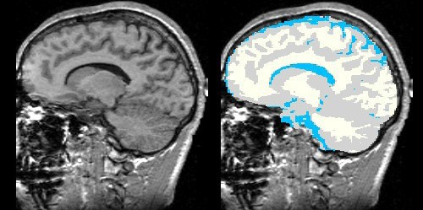
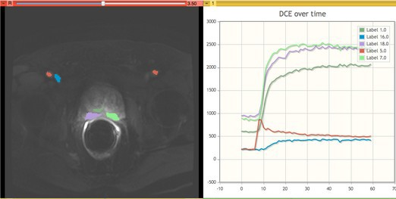
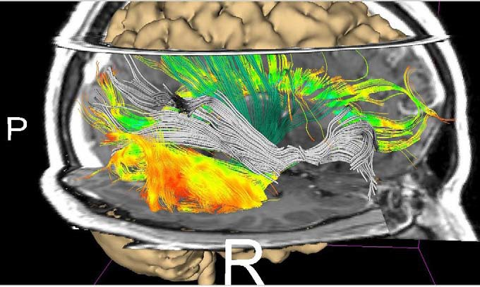
The Engines of Slicer
Segmentation
Registration
Volume rendering
Tractography
Dynamic analysis

Slide 16
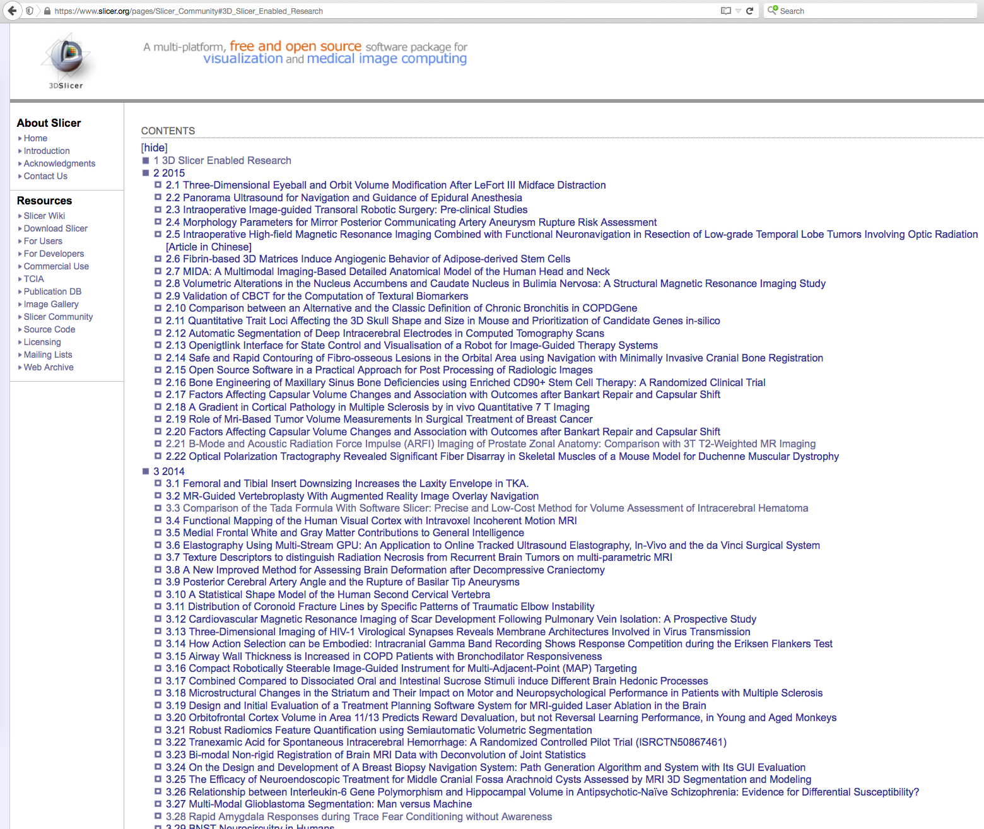
Slicer Enables NIH Research
Hundreds of papers published using
3D Slicer
https://www.slicer.org/pages/Slicer_Community

Slide 17
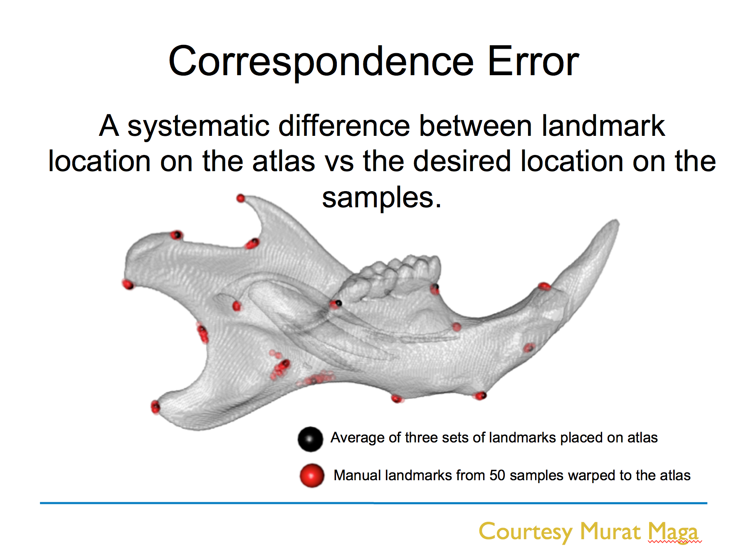
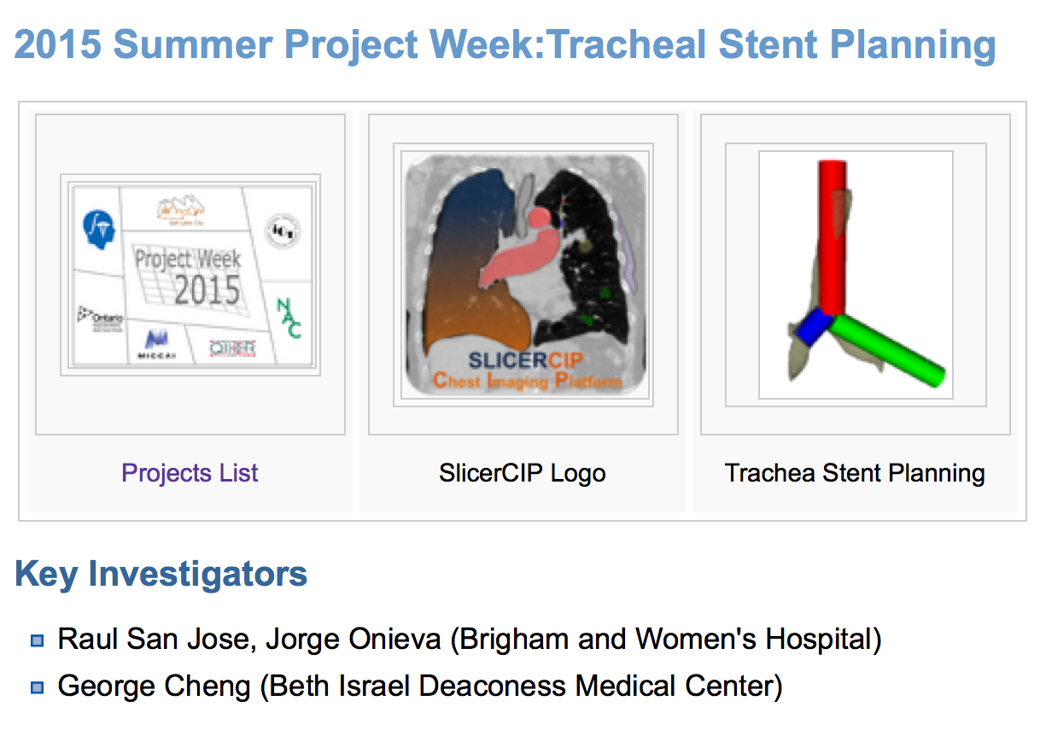
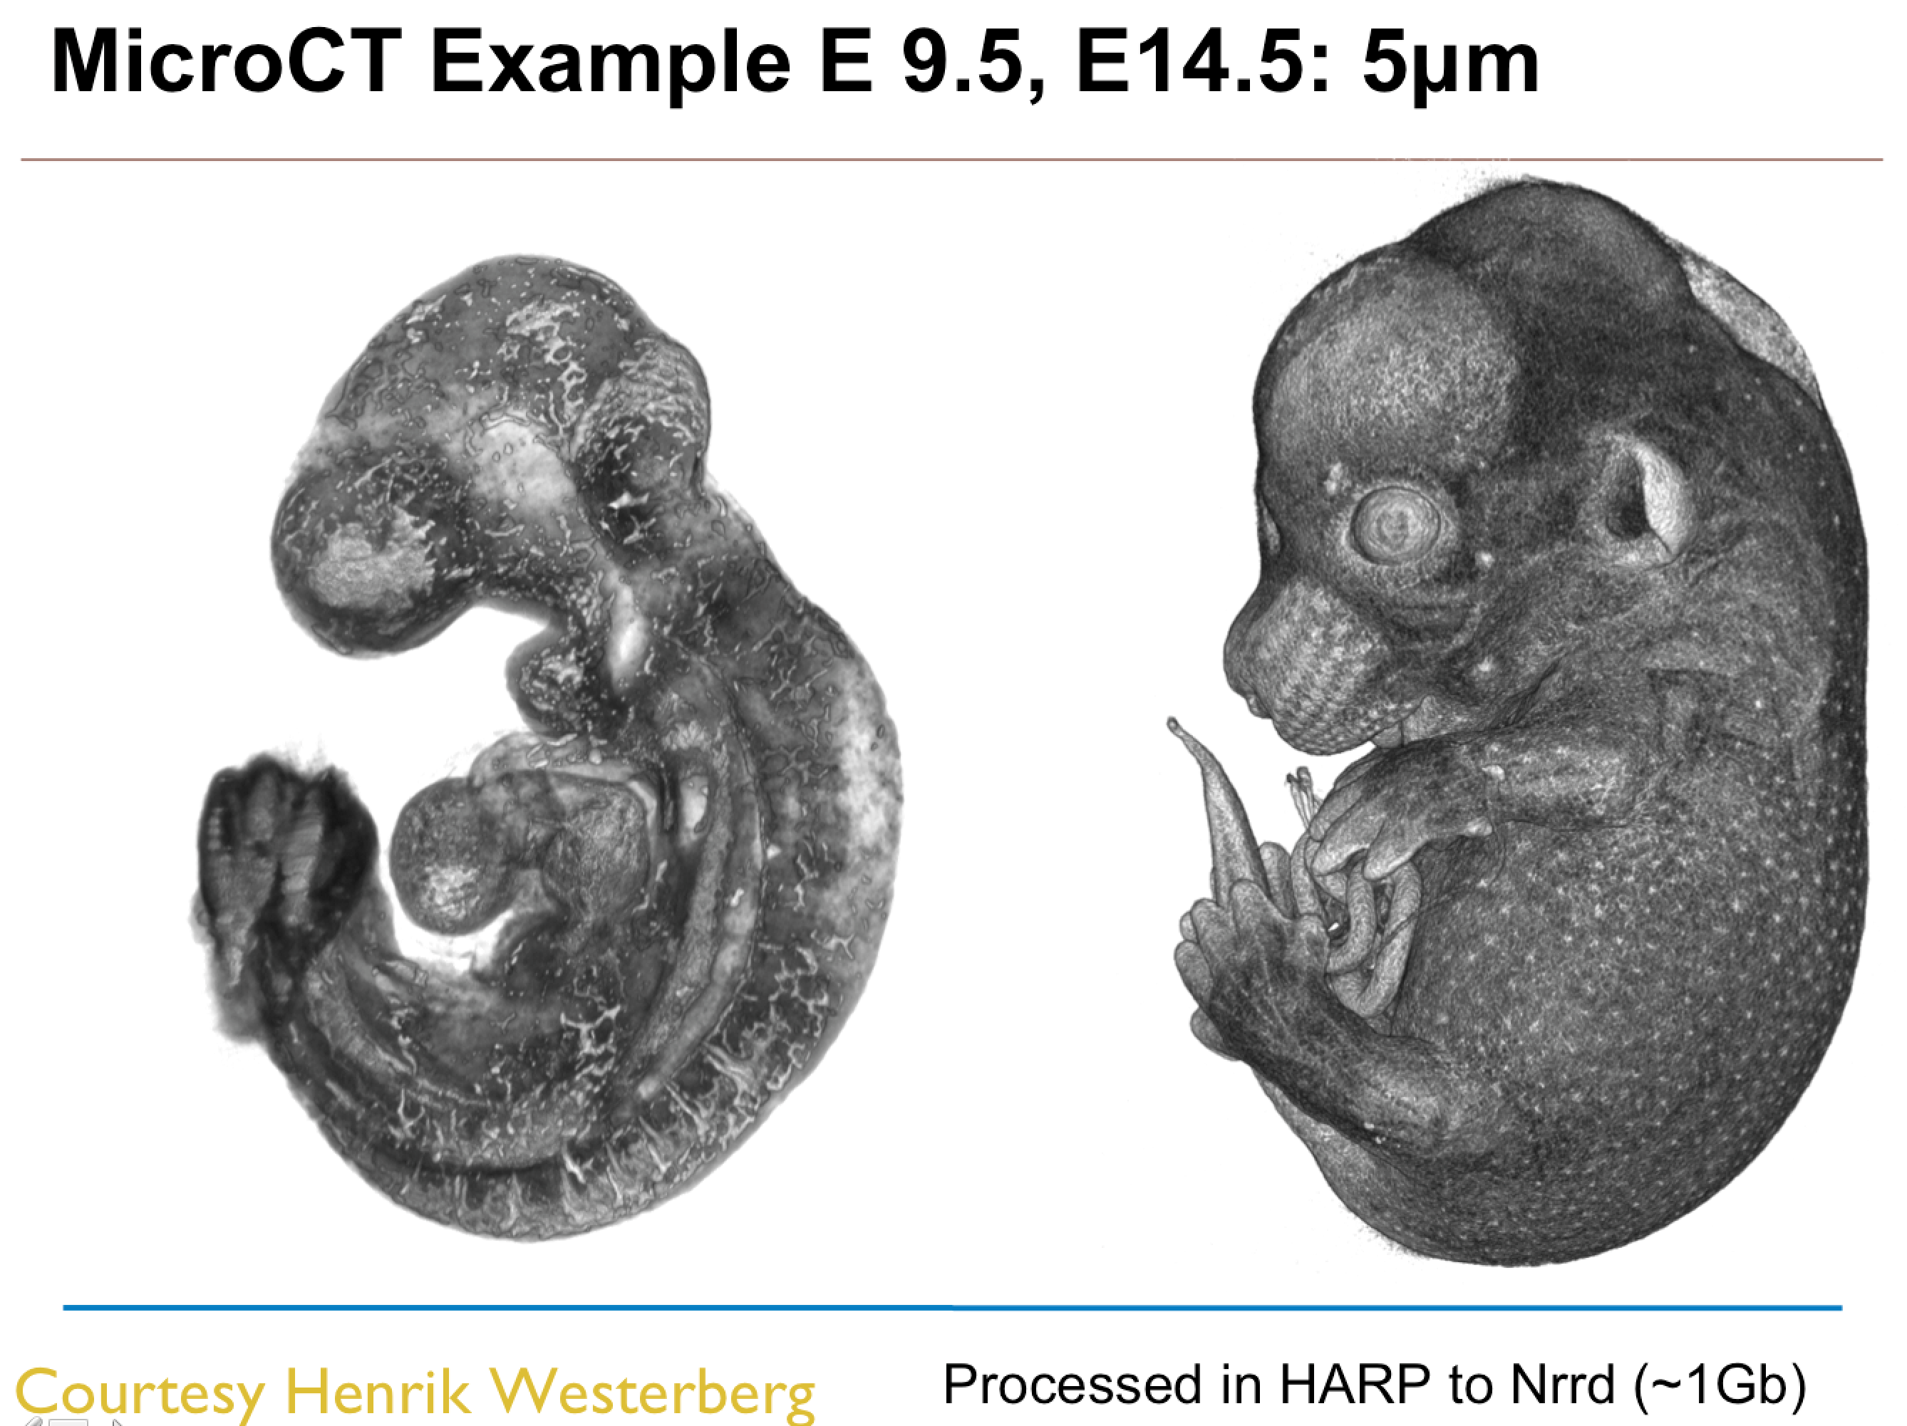
Novel Uses
New imaging methods and applications drive novel ways to use Slicer. E.g.:
Animal imaging
3D printing
….
Mouse Embryo
OPT (optical projection tomography)
Micro CT
Mouse images courtesy of S. Pieper

Slide 18
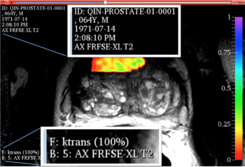
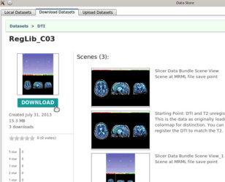
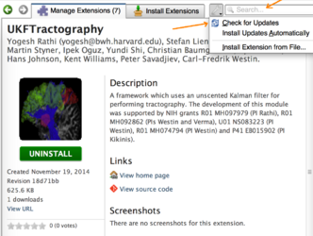
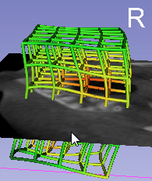
Slicer Addresses Unmet Needs
Stability and longevity
Unique combination of
high level features:
  Usable by non-programmer
  Free
  Open source
  Modular
  Multi-platform
  Customizable UI
  Extensible
  Business-friendly license (BSD)
Notes:
One of the measures of user interest isy the number of downloads.

Slide 19
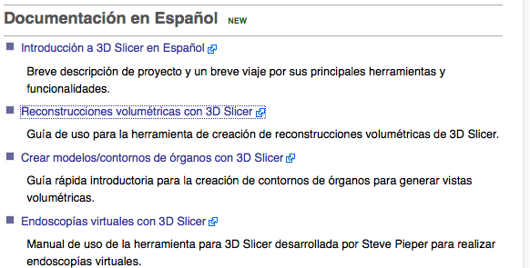
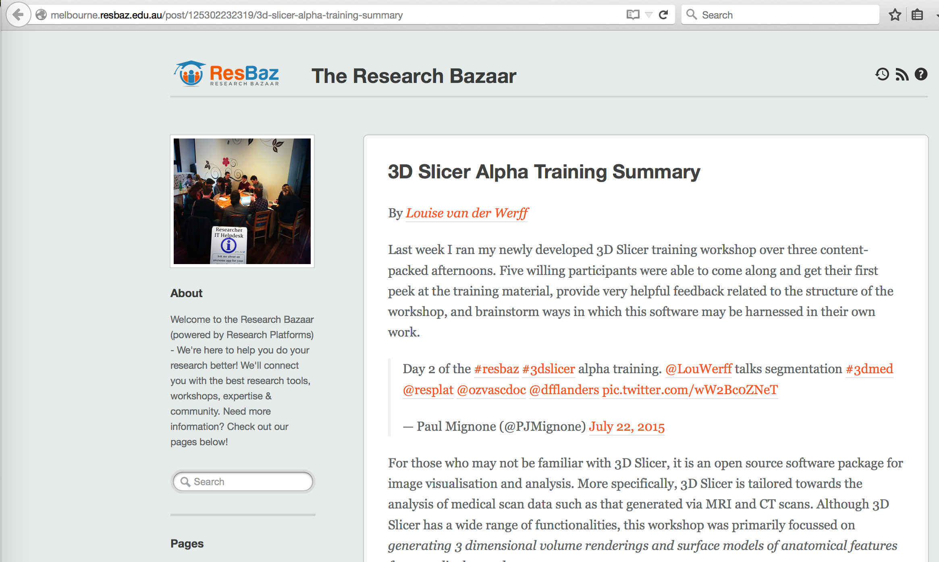
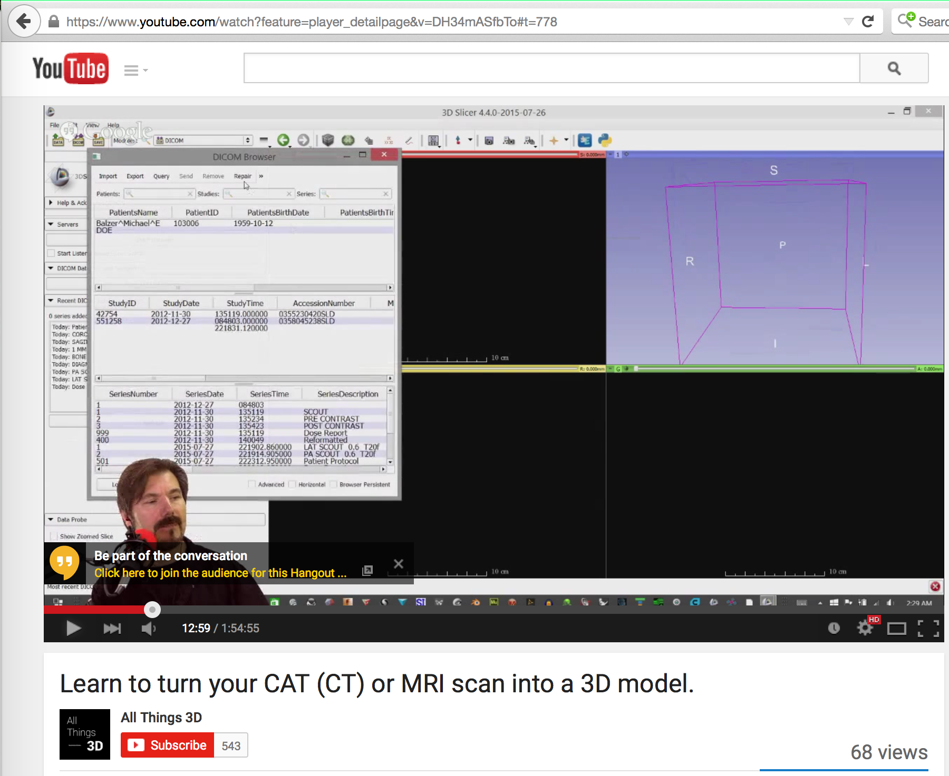
Slicer User Community
Increasing use of Slicer is reflected in a large number of publications
Volunteer contributions include participation in the mailing list and providing training materials

Slide 20
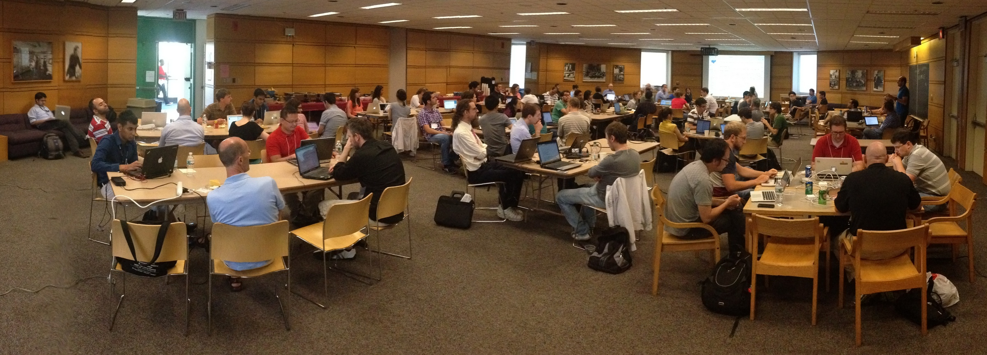
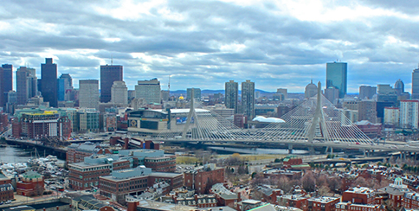

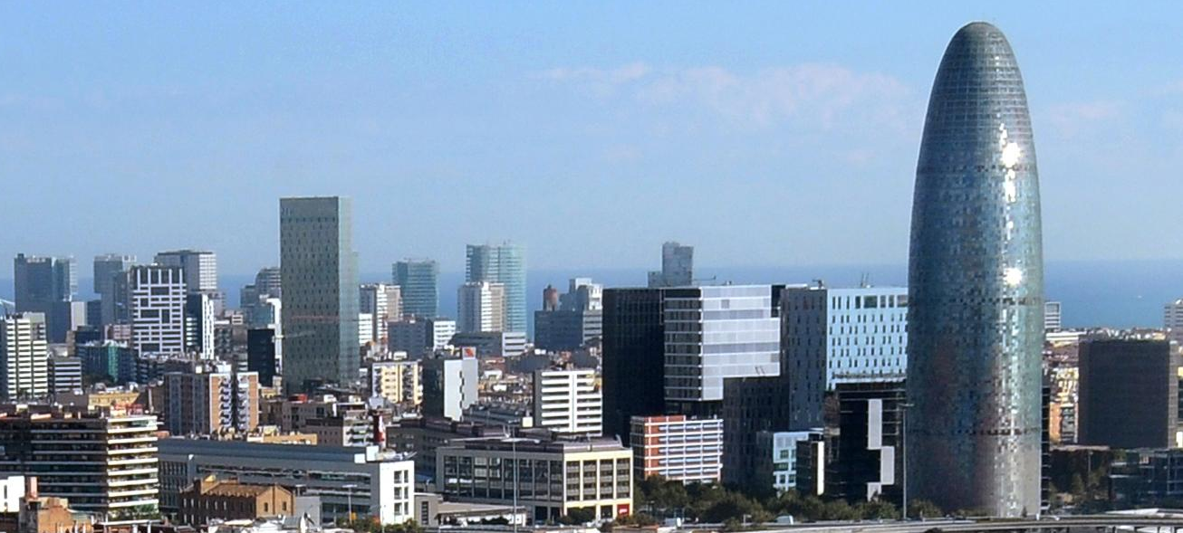
Slicer Developer Community
Worldwide, distributed community
Internet based technologies for development and communication
Face-to-face meetings
twice a year
play a critical role

Slide 21
What it Takes: Under the Hood

Slide 22
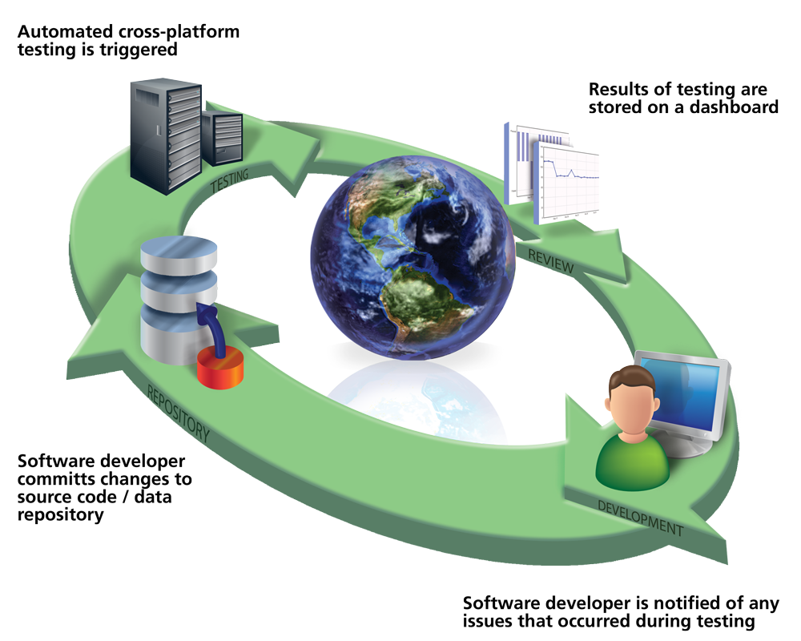
Software Engineering Process
Community driven engineering
QA: more than 600 tests
Extreme programming: publish early, publish often
Graphic courtesy of JC Fillion-Robin, Kitware

Slide 23
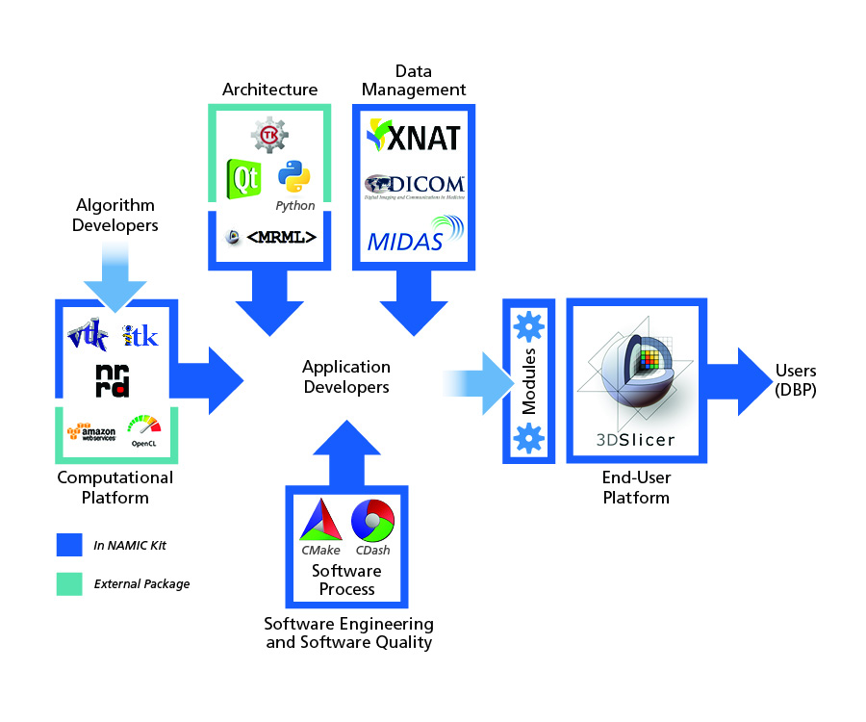
The Slicer Ecosystem
Major building blocks: VTK, ITK, CTK, Qt, Python, Teem, PythonQt, ...
Key infrastructure: CMake, CTest, CDash, MediaWiki, GitHub….
Distribution mechanisms:
Extension manager for software distribution, data store for data distribution
Slicer for end-users
Graphic courtesy of JC Fillion-Robin, Kitware

Slide 24
Core Engineering Activities
Ongoing need for maintenance to keep Slicer attractive to end-users and developers
Maintenance means:
Review contributed code
Porting to new OS releases
Update software components such as ITK and VTK
Investigate and resolve bug reports
Maintain factory machines
Monitor and troubleshoot extensions
Maintain download servers and data bases
Update wiki pages
Write tutorials
Answer emails
….

Slide 25
The Uses of Slicer

Slide 26
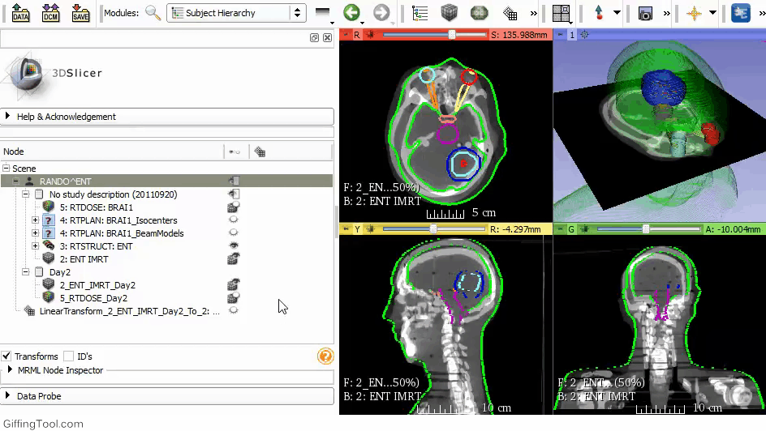
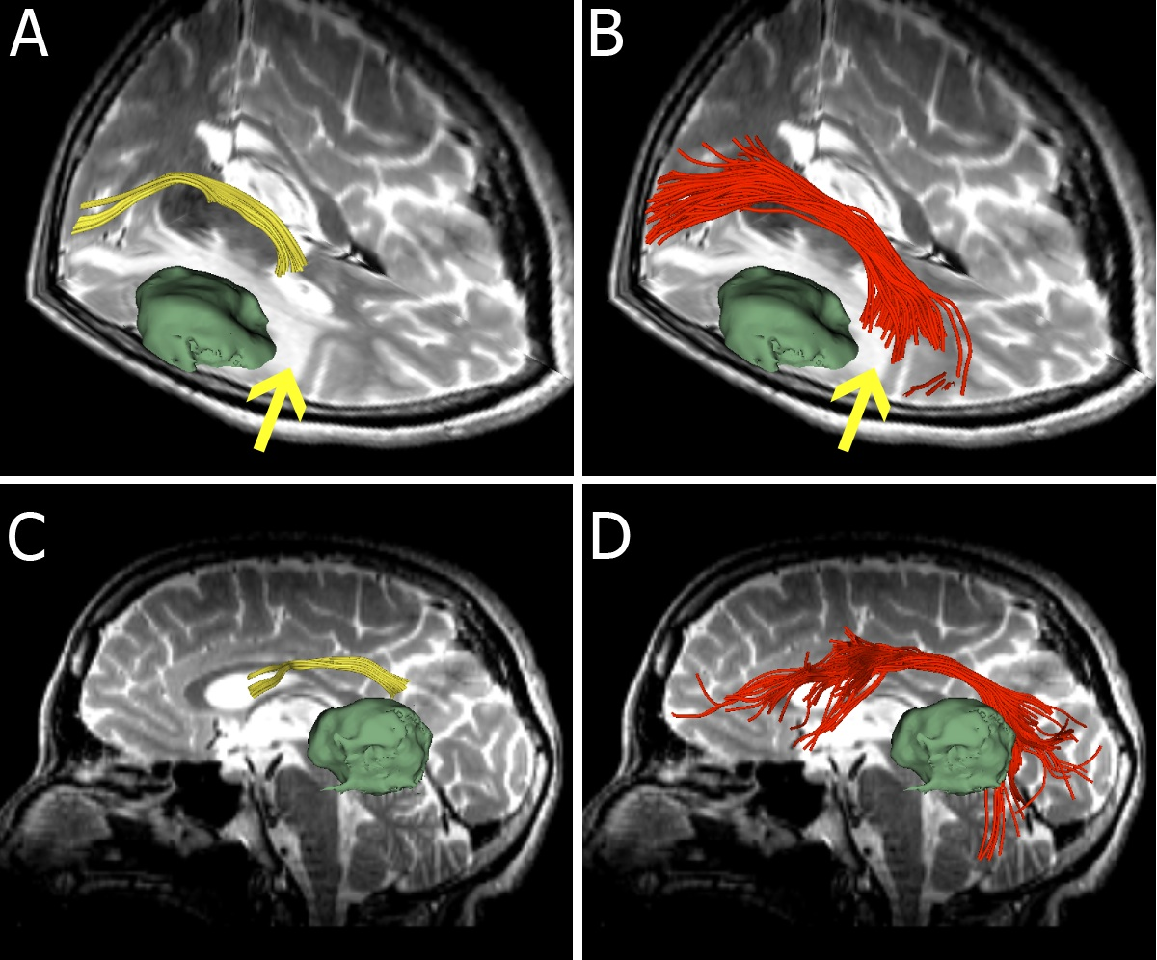
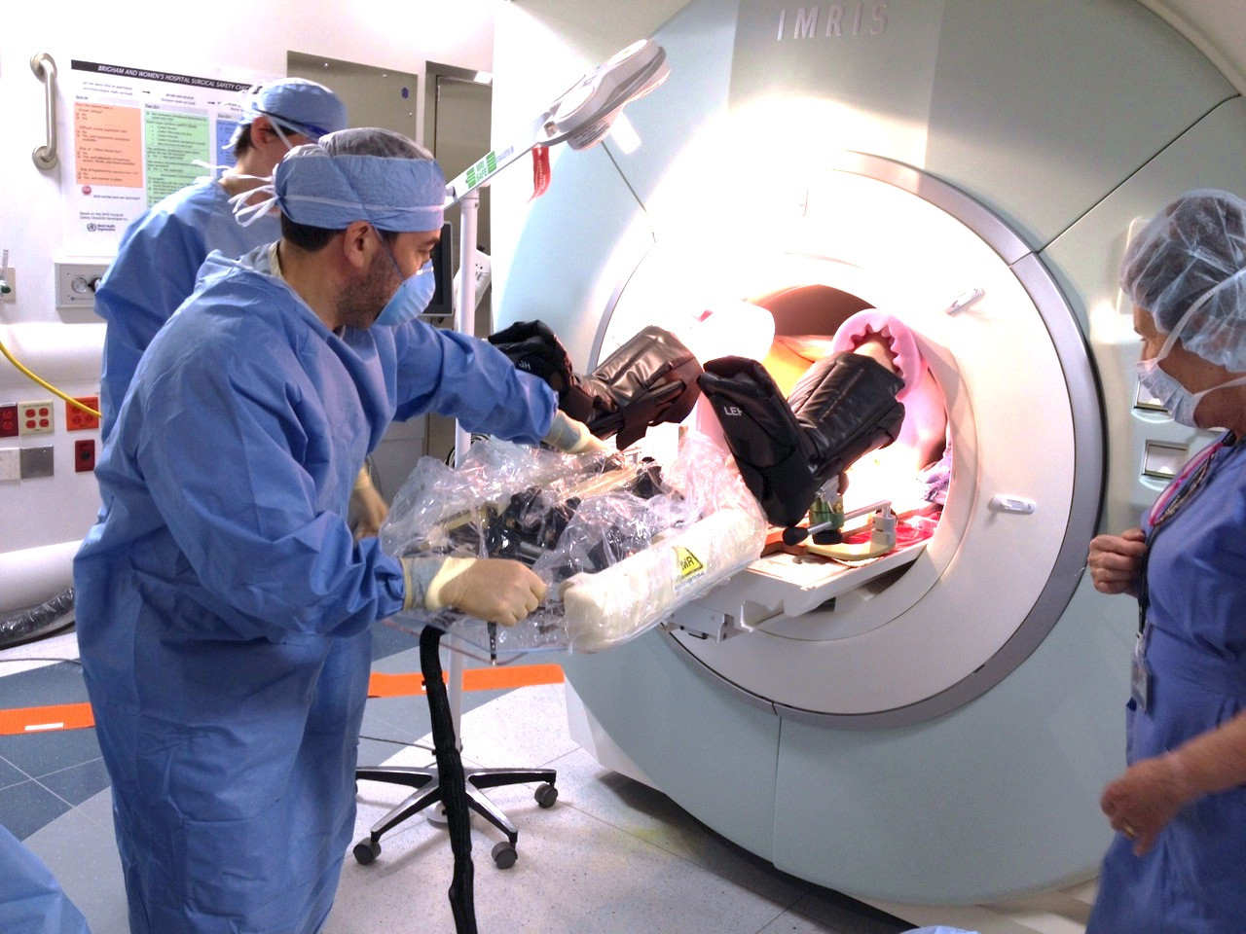
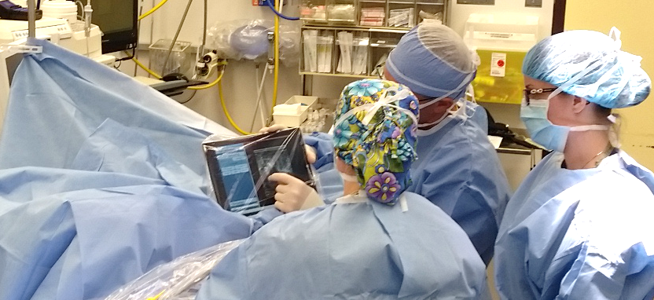
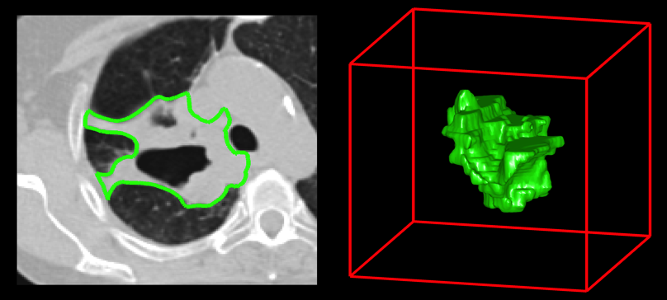
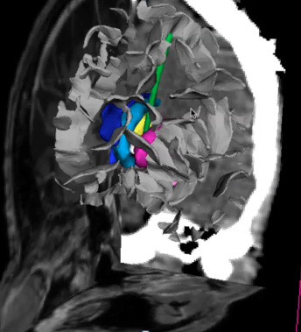
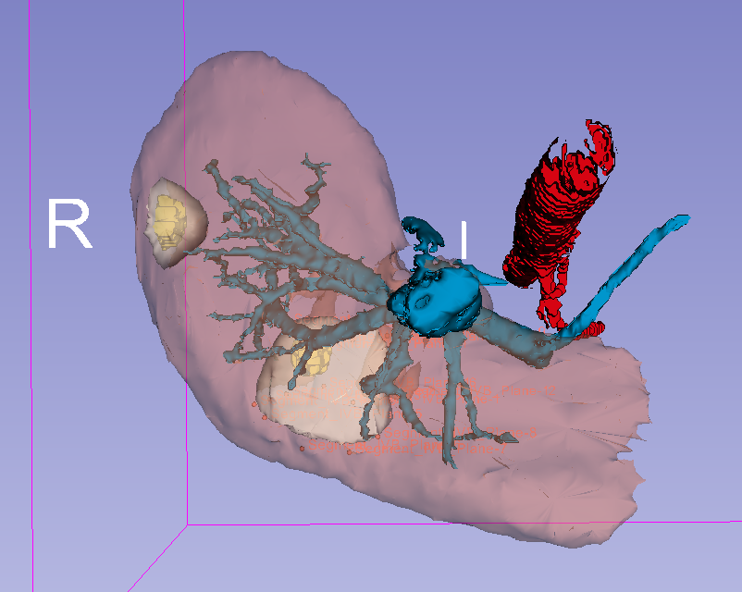
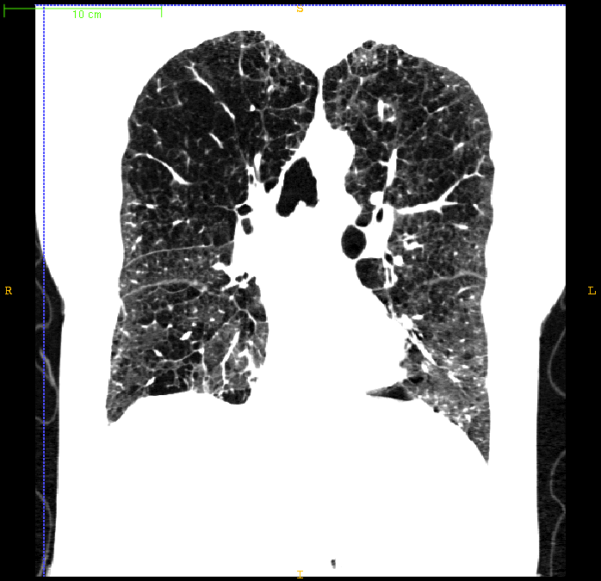
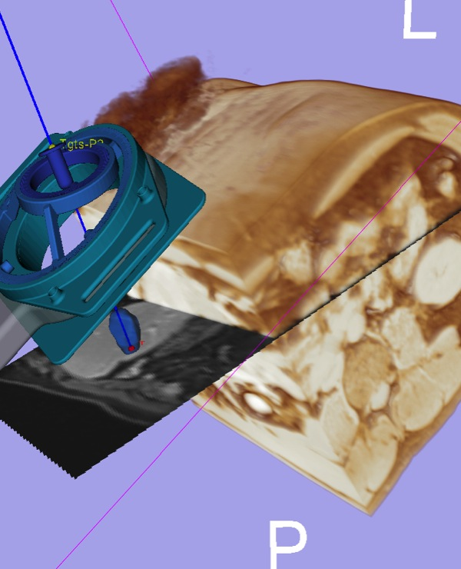
Examples of Clinical Projects
Radiation dose calculations
Prostate procedures
Tracking peritumoral white matter fibers
Breast cancer surgery guidance
Diagnosis of Different Tumors in Lung Cancer
Clinical users drive creation of technology
Diagnosis of Osteoarthritis Degeneration
Model-Guided Deep Brain Simulation
Quantitative assessment of COPD
Surgical navigation
Liver procedures
Slide courtesy of L. Cevidanes

Slide 27








Toolmakers Use Slicer
SlicerCIP (Raul San Jose Estepar)-R01HL116931, R01HL116473
SlicerCMF (Lucia Cevidanes, Martin Styner, Beatriz Panagua)-R01DE024450
SlicerProstate (Clare Tempany)-U01 CA151261, R01 CA111288, U24 CA180918, P41 EB015898
SlicerRadiomics (Hugo Aerts)-U01CA190234, U24CA194354
QIICR (Andriy Fedorov)-U24CA180918
SlicerGyn – Pelvic floor research (John DeLancey, U Michigan) P50HD044406, R01HD038665, P30AG024824
OpenIGTLink (Junichi Tokuda)-R01EB020667
SlicerTractography (Lauren O’Donnell)-Promising impact score
SlicerIGT (Gabor Fichtinger, Andras Lasso, Tamas Ungi)-Ontario Govt. funded
SlicerRT (Csaba Pinter, Gabor Fichtinger, Greg Sharp)-Ontario Govt. funded
SlicerDBS (Pierre Jannin)-French Govt. funded
IASEM (Bradley Lowecamp)-NLM intramural funding
Bender (Stephen Aylward)-AFRL
VesselView (Stephen Aylward)-R44CA165621
Slicer remote rendering (Al Johnson)-P41EB015897

Slide 28










Companies Use Slicer
Known commercial activities range from use “as is” to full blown product development:
Xstrahl (small animal radiation product)
mebio (radiology product, prostate guidance)
SonoVol (ultrasound product) (R43CA192482...)
Novartis (quantitative imaging clinical trials)
New Frontier (navigation system)
KUKA (surgical robotics)
Siemens (diagnostic and interventional research)
Canon (robotic interventions)
GE (research and products)
NDI (trackers for surgical navigation)
Isomics (research, consulting)
Kitware (research, consulting)
  10+ Slicer based projects in the past two years
  5 commercial products being launched

Slide 29





SonoVol A: "Case Study"
SonoVol is a spinout from UNC Chapel Hill’s Joint Department of Biomedical Engineering.
Grad student and professor designed some robotic hardware for improved preclinical ultrasound imaging
Needed a software interface for controlling hardware, and viewing image data.
Ryan Gessner
Paul Dayton
Product vision
Improved “MRI-like” field of view
Ability to study anatomical context of tumors over time
High throughput acquisitions
Multi-modality registration
Improved blood vessel quantification

Slide 30

Hardware development
Funding sources:
2014
NSF – Phase 1 STTR
2015
NIH-NCI – Phase 1 SBIR
NSF Phase 1B
UNC – Carolina Kickstart
$
Robotic hardware design
Motion control system
Transducer development for vascular imaging
Anesthesia and rodent homeostasis support
Physio-data sensor integration
Contrast agent syringe pump
Webcam integration for multi-modality registration
$
Accelerated product development by leveraging 3D Slicer
Software development
Real time streaming of ultrasound data
Image viewer
3D registration of image data
Image analysis (tumor sizing)
Vascular tortuosity assessment
Report generation
Data management
Product sales anticipated in 2016

Slide 31
Slicer Today 1
3D Slicer is a success story:
  Robust software
  Many users
  Many developers
There are many opportunities to evolve and increase impact

Slide 32
Slicer Today 2
Current funding pattern will not sustain maintenance at the level needed, and our capabilities are eroding (slowly)
Lack of centralized support will lead to:
  Fragmentation of the community, which in turn leads to reduction of openness
  Loss of focus: Each application project drives its own priority
  Slowed quality and pace of research
Notes:
Fragmentation of community = if regular updates don’t occur, then need for new technologies, individuals will create their own “updated” version.
As the community fragments, efforts go more and more to specialized versions, and resource sharing is weakened and efforts are diluted
Quickly, the value of previous investments are lost. This happens abruptly, when software is not shared.
All of the above leads to duplication of effort, reduced sharing, reduced ability to replicate and build on prior results, and therefore slower pace of research.

Slide 33
Core Engineering
The core software engineering team is funded through a number of disconnected projects.
Available funding amounts to 4.5 FTE. This is the breakdown in 2015:
    NAC: 0.75 FTE (IC: EB)
    NCIGT: 0.25 FTE (IC: EB)
    QIICR: 0.5 FTE (IC: CA)
    Kitware: 1 FTE (multiple IC’s)
    Queen’s University: 2 FTE (mostly Canadian funding)
This is not enough for the work needed. We are behind in many important maintenance tasks:
Update software components and propagate the changes in Slicer (e.g. Qt)
Investigate and resolve bug reports (several hundred bugs pending)
Maintain factory machines (need to migrate to the cloud)
Monitor and troubleshoot extensions
Update documentation, write tutorials

Slide 34
Example: Update Software
Maintenance problem: Keeping software components such as libraries and toolkits up to date.
Example:
  Slicer 4.4 uses Qt 4.x (vintage ~2005)
  Qt 5 was released 2012
Why is this important?
  Qt 4 is “end of life”. New OS features are not supported. (e.g., pop-ups do not work well)
  Qt 5
    leverages new features such as support for multi-finger gestures on touch screens
    has better performance
    enables improved programmer productivity

Slide 35


Example: Fixing Bugs
Maintenance problem: Insufficient funding to fix bugs in the core
Assigned to nobody

Slide 36
Future Directions for Slicer
Options are:
Protect the investment, keep Slicer stable: Maintenance only
Start from scratch: new ideas, architectures and technologies
Hybrid approach

Slide 37
Exciting Technologies
Examples of ideas, architectures and technologies
The Cloud
  NoSQL data bases: Images and data anywhere, securely
  Novel modes of collaboration
  Instant clusters
WebGL and JavaScript
  Zero footprint viewers
  Browsers, tablets, phones
Hardware and software
  GPU’s
  New OS feature

Slide 38
How To Do It Right
Adopt technologies with impact
Adopt a workable business model
Are there templates for success from which we can learn?
A incomplete review of platforms in the field

Slide 39
Templates For Success 1
ImageJ: De facto standard for microscopy. Large community of users and developers, narrow leadership.
Platforms that are free for research and proprietary for commercial activities
  Analyze: Lost impact
  Osirix: Strength as a DICOM viewer
  MeVisLab: Developer platform. I am heavily involved
  ClearCanvas: Popular as a DICOM viewer. Turbulence with open source
  FSL: popular scripting platform for pipelines

Slide 40
Templates For Success 2
Toolkits are for developers only
VTK
  maintained for a decade with funding from the HPC community, non HPC aspects were neglected
  NIH maintenance grant begins to address this
ITK
  Community based governance
  Architectural refresh after 10 years has injected new energy into the effort

Slide 41
Lessons From the Successful
Strong leadership is a feature common to all successful platforms
A possible classification:
  Level 1: Project linked to a single person
  Level 2: Decade-long project linked to a single group: ITK Snap, Freesurfer….
  Level 3: Long-term community based effort
    Based on a dispersed community
    Led by a capable group with a shared vision
    Grounded in a deep understanding of the application space
    Slicer, ITK

Slide 42
Slicer Today Is a Level 3
Large community: ~1000 downloads per week, 50+ people contributed code during the last year
Core leadership is dispersed: Boston, Queens and Chapel Hill
Portfolio of active application projects

Slide 43
The Impact of NAMIC
2005-2014 NAMIC
  Slicer evolves from level 1 to level 3
Post NAMIC
  “Ecosystem” of Slicer based NIH funded projects continues to grow
  Community continues to grow

Slide 44
Where Do We Go From Here?
Enable researcher by turning concepts into tools
The Slicer model has been successful for over 15 years
Keep Slicer relevant through the right amount of change
  Too little change → Slicer stagnates
  Too much change → Slicer becomes
  unattractive for developers

Slide 45
Vision For The Future
The scope of biomedical applications and technical capabilities continues to expand
Use application-pull to remain relevant.
Update the architecture judiciously (Goldilock)
A well-maintained core is needed for currently funded applications to fully leverage 3D Slicer as a platform and to protect NIH’s investment
I am looking for recommendations where to apply for funding for the core engineering
Notes:
The Goldilock principle: not too hot, not too cold

Slide 46
The Toolmaker Projects
The following section contains short vignettes about the projects that use Slicer as a platform.

Slide 47

Open source diffusion MRI technology for brain cancer research
U01 application with promising score
Unlike other popular dMRI packages, the community software package 3D Slicer is uniquely positioned to enable novel clinical research in brain cancer because it was designed from the start for patient-specific cancer research

Slide 48
U01 Aims
Aim 1: Extend diffusion MRI infrastructure and interoperability
Aim 2: Create cancer research workflows with feedback from clinical collaborators
Aim 3: Document, test, and release software to the community

Slide 49
Proposed Features
Proposed Feature | Aim | Utility for Cancer Research
speed, robustness, usability improvements | 1 | improve ease of use and handle increasingly large datasets
load, visualize multishell dMRI data | 1 | improve access to advanced dMRI data
split multishell data into shells | 1 | enable diverse processing of advanced dMRI data
open-source DICOM tractography I/O library | 1 | future interoperability with commercial software
sophisticated tractography | 2 | improve anatomical accuracy of tracts
improved tracking in cases of edema or infiltration | 2 | improve anatomical accuracy of tracts
identification and visualization of key fiber tracts | 2 | provide clinically relevant visualization
visualization of fiber tracts relative to the tumor | 2 | provide clinically relevant visualization
computation of tissue microstructure parameters | 2 | provide information about tumor cellularity and borders

Slide 50
Tracking through Edema
DTI single tensor
UKF multi-tensor
Z Chen, Y Tie, O Olubiyi, L Rigolo, A Mehrtash, I Norton, O Pasternak, Y Rathi, AJ Golby, LJ O’Donnell. "Reconstruction of the arcuate fasciculus for surgical planning in the setting of peritumoral edema using two-tensor unscented Kalman filter tractography." NeuroImage: Clinical 7 (2015): 815-822.

Slide 51



Radiomics Informatics Platform
HARVARD
MEDICAL SCHOOL
Advanced Radiomics System implemented in 3D-Slicer
(ITCR: U24CA194354-01)
PIs: Hugo Aerts,
John Quackenbush
Development of a publicly available radiomics platform with the objective of automated extraction of imaging features (biomarkers)
Platform designed to be open, generalized, portable, and widely applicable across image modalities and cancer types.
Flexible platform usable by both image analysis experts (e.g. engineering scientists) and non-experts (bioinformatics / physicians)
Validate developments by integrating radiomics, genomics, and clinical data to evaluate prognostic performance and examine associations

Slide 52





Representative CT images of Lung Cancer
Tumors are different
Medical imaging can capture these phenotypic differences
Notes:
- Quantify

Slide 53
Radiomics: Quantify the tumor phenotype
Convert Images to mineable data in high throughput (radiomics)
Area=1201.6 mm²
Perimeter=152.4 mm
Volume=2615 mm³
Surf. area=1099.33 mm²
Surf. Area/volume=0.42 mm⁻¹
Density, Necrosis
Mean = 19.33 HU
SD = 76.59 HU
Min = -249 HU
Max = 118 HU
Spiculations
Slope at margin =133.5±31.3 HU/mm
Low density inclusions
Rel. vol.= 0.21 mm³
Number=110
Volume=4.89±8.35 mm³
*Lambin et al.Eur J Cancer 2012
*Kumar et al. Magn Reson Imaging 2012

Slide 54





Radiomics Informatics Platform

Slide 55



OpenIGTLink and Robotics
Noby Hata, Junichi Tokuda
Department of Radiology
Brigham and Women’s Hospital

Slide 56




Real-time Communication In The OR

Slide 57
Plan for the OpenIGTLink R01*
Support for approved medical devices
Low-latency real-time data streaming
  Ultrasound
  Endoscope
Interoperability with the DICOM standard
*NIH 1R01EB020667-01 OpenIGTLink: A network communication interface for closed-loop image-guided interventions, PI: Tokuda

Slide 58
Contributors/Collaborators
BWH
  Nobuhiko Hata, Clare Tempany, Ron Kikinis, Ferenc Jolesz, Alex Golby, Jayender Jagadeesan, Tina Kapur, Kemal Tuncali, Laurent Chauvin, Isaiah Norton, Wei Wang, Alireza Mehrtash
Queen’s University, Canada
  Gabor Fichtinger, Andras Lasso, Tamas Ungi, Csaba Pinter, Adam Rankin
Johns Hopkins University
  Iulian Iordachita Peter Kazanzides,
Acoustic MedSystems
  Clif Burdette, Paul Neubauer, Tamas Heffter
Worcester Polytechnic Institute
  Gregory Fischer, Hao Su, Gregory Cole, Nirav Patel, Weijian Shang, Gang Li
University College London, UK
  Matt Clarkson
Isomics Inc.
  Steve Pieper
AIST, Japan
  Kiyoyuki Chinzei
Yale University
  Xenophon Papademetris
Kitware, Inc
  Jean-Christophe Fillion-Robin, Julien Finet, Andinet Enquobahrie
Siemens Corporate Research
  Christine Lorenz, Li Pan
Brainlab AG, Germany
  Sven Flossmann
University of Western Ontario, Canada
  Terry Peters, Elvis Chen, Feng Li, Usaf Aladl
Leibniz Universitaet Hannover
  Sebastian Tauscher
KUKA AG
  Thomas Neff, Cyrill Tiesenhausen

Slide 59


Prostate Biopsy robot with Higher degree of freedom
R01CA 111288 (PI Tempany/BWH) Enabling Technologies for MRI-Guided Prostate Interventions
Collaboration with Fischer (WPI), Iordachita (JHU), Burdette (Acoustic Med)

Slide 60

Robot for Ablative Liver Therapy
Research funded by Canon

Slide 61









Quantitative Image Informatics
for Cancer Research (QIICR):
Andrey Fedorov, PhD and Ron Kikinis, MD
Brigham and Women’s Hospital
Harvard Medical School, Boston, MA
fedorov@bwh.harvard.edu
Funded through the ITCR program at NCI

Slide 62

NCI Quantitative Imaging Network (QIN)
“The network is designed to promote research and development of quantitative imaging methods for the measurement of tumor response to therapies in clinical trial settings, with the overall goal of facilitating clinical decision making.”
QIN as of March 2014
http://imaging.cancer.gov/programsandresources/specializedinitiatives/qin

Slide 63

QIN challenges
Data sharing
  Site-specific solutions
  Limited support of common formats
    no agreement what that format should be
  No repositories of annotated image data
Tool sharing
  Tools are generally developed for internal use
  Different levels of maturity
  Not always open source
Individual sites are not tasked with the development of the platform to facilitate sharing

Slide 64



QIICR: Solutions and tools
Clinical researcher is the target user
Standardize on 3D Slicer as the delivery platform
Implement missing “building blocks” as needed
  segmentation
  advanced analysis
  ...
Integrate “building blocks” into end-to-end solutions
Standardize on DICOM for input images and output results serialization
vs
Mercea P, Fedorov A, Pieper S, Beichel R, Park M-A, Hainer J, Kijewski MF, Horky L, Kikinis R, Dickhaus H. Quantification of longitudinal tumor changes using PET imaging in 3D Slicer. In Proc. of Computer Assisted Radiology and Surgery, 2013. Int J CARS 2013 (8) (Suppl 1):S285-S286.
Pohl K, Konukoglu E, Novellas S, Ayache N, Fedorov A, Wells WM, Talos IF, Golby A, Kikinis R, Black PM. A New Metric for Detecting Change in Slowly Evolving Brain Tumors: Validation in Meningioma Patients. Neurosurgery, 2011, 68(1 Suppl Operative), pp.225-233.

Slide 65

Simplified Iowa QIN workflow (pre-QIICR)

Slide 66

Why bother?

Slide 67




Slicer IGT and Slicer RT
Gabor Fichtinger, PhD
Professor, Cancer Care Ontario Research Chair
Andras Lasso, PhD
Associate Director, Lead Software Architect
Tamas Ungi, MD, PhD Lead clinical application developer
Csaba Pinter, MSc
Research Software Engineer
School of Computing, c/a in Surgery, Mechanical and Materials Engineering, Electrical and Computer Engineering,
Queen’s University, Kingston, Ontario, Canada
Funded through a variety of Canadian and US sources
Perk Lab http://perk.cs.queensu

Slide 68


IGT: Complexity without standards
CT IMAGE
FIDUCIALS
STYLUS TIP
US PROBE
US IMAGE
STYLUS REF
NEEDLE TIP
TRACKER
NEEDLE REF

Slide 69












Plurality of devices

Slide 70

Slicer Image-Guided Therapy platform
Open source, used worldwide in 86 countries
SlicerIGT: 24,000 module downloads (past 12 mo)
PLUS: 1,300 build downloads (past 12 mo)
Lasso A, Heffter T, Pinter C, Rankin A, Ungi T, Fichtinger G, PLUS: open-source toolkit for ultrasound-guided intervention systems, IEEE Transactions on Biomedical Engineering, Vol. 61, Issue 10, pp. 2527 – 2537, 2014

Slide 71



Liver surgery navigation
3D models for liver, vessels, tumor, resection margins
Volumetric computations
Integrated with SlicerIGT navigation system
Intra-op measurement and visualization of EM tracking error by Thompson retractor
V Harish, T Ungi, A Lasso, A Macdonald, S Nanji, G Fichtinger, Intraoperative visualization and assessment of electromagnetic tracking error, SPIE Medical Imaging 2015, Orlando, FL, USA, Feb 21-26, 2015, Proc. SPIE 9415, Medical Imaging 2015: Image-Guided Procedures, Robotic Interventions, and Modeling, 94152H

Slide 72






Breast cancer surgery guidance
Goal: reduce chance of positive tumor margins after breast tumor resection
Initial idea to patients in 12 months
  Intra-operative tumor segmentation on ultrasound
  Real-time electromagnetic tumor tracking and cautery navigation
  Table-side control using tablet with customized user interface
Successful lumpectomies on 10 patients
Open:
  Freely available in
  3D Slicer app store
  (LumpNav).
  Works with almost
  any ultrasound and
  tracking system.
  Evaluation in other
  hospitals has
  already started.
Ungi et al., IEEE Trans Biomed Eng, in press

Slide 73

Take-home message
Promote reproducible science by using open platforms
Invest in your science not in duplication of infrastructure
Invest in learning open platforms

Slide 74



SlicerRT
Open-source radiation therapy research platform
Facilitates translational research by providing RT tools and streamlined workflows
Extensions for 3D Slicer
  SlicerRT core is the most downloaded extension
www.SlicerRT.org provides user and developer documentation
Routine
XiO®
Eclipse™
...
...
Research
Notes:
We are given our clinical applications and the routine workflow that we want to fine-tune or improve, such as to automate our image-guided RT protocol or put an adaptive RT idea into practice.
On the other side of the story we have our more radical research goals and software dedicated to research. We might want to use them to implement a completely new protocol nobody else has tried, apply knowledge-based RT components, or make a 3D dosimetry technique part of the daily QA. But tying these components together to a seamless workflow is extremely difficult. A common RT research platform can make our job a lot easier!
We propose SlicerRT to be this common research platform, which can act as a hub for our RT research. It provides a link between these tools to orchestrate the desired research process, besides having powerful features itself.

Slide 75




SlicerRT ecosystem
Streamlined applications
Utilities
3D Slicer
SlicerRT core
Several former SlicerRT features integrated:
Subject hierarchy, DICOM export, Transform visualizer, etc.
Common RT software tools:
DICOM-RT, Dose/Contour analysis, Beam planning, Batch processing
Acts as a platform
Pinter et al., IUPESM World Congress, 2015
Notes:
SlicerRT is not just one tool, it is an ecosystem, containing several components. We build on 3D Slicer, into which we have integrated back some highly useful features.
SlicerRT core provides the common RT software tools, and acts as a platform for higher level developments.
Matlab Bridge gives us the link between Matlab and 3D Slicer, while Sequences offers general support for sequential data management.
Finally, we can build streamlined, workflow-based applications on top of these tools, the first example of which is Gel Dosimetry.

Slide 76



Use case: Dose accumulation
Register anatomical images
Transform whole studies
Accumulate dose
Compute DVH
Collaboration with
PMH, Toronto
Pinter et al., MedPhys, 2012
Evaluate plans using DVH
Convenience features: Transform whole studies with a single click, visualize transforms, anatomy in 3D
Notes:
I'd like to demonstrate the potential of SlicerRT through a few example projects that we conducted on request of various research groups. In a collaboration with Princess Margaret Hospital here in Toronto, they asked us to help automate an image-guided RT protocol, in order to determine the displacement between the original plan and the daily setup, to correct for geometric uncertainty and ultimately improve dosimetric accuracy. SlicerRT supplied the whole workflow: registering the images, calculating the displacement, evaluating the improvement, and exporting the correction to the TPS.

Slide 77


Example use case:
Proton dose calculation
External beam planning
  Arbitrary dose engines
  Using same user interface
  Potentially replace TPS
Evaluate plan
Export plan for delivery
Collaboration with MGH, Boston and CRO, Italy
Desplanques et al., MedPhys, 2014
Notes:
In another project with Massachusetts General Hospital, Boston, and CRO in Aviano, Italy, a proton dose calculation engine was implemented within SlicerRT. In terms of this work, the external beam planning module was created that potentially integrates arbitrary dose computation engines to a common planning interface. These engines may be implemented in a wide range of programming languages, including Matlab, and have the potential to even replace commercial TPSs in low-budget scenarios, such as for Cobalt-60 machines in developing countries.

Slide 78




Example use case:
Gel dosimetry analysis
Full 3D gel dosimetry
Simplified user interface
Collaboration with
KGH, Kingston, ON
Alexander et al., IC3DDose, 2014
Alexander et al., IUPESM World Congress 2015
Notes:
As I mentioned SlicerRT facilitates rapid prototyping of clinically usable tools. Gel dosimetry analysis is the first workflow-based application based on our platform, hopefully in a long line of such programs. It can be run separately fan the main Slicer window, thus allowing a simplified, streamlined interface, so that the user can focus on the task at hand. This application supports the full 3D gel dosimetry workflow, making it easier to use this technique routinely in the clinic. At KGH it reduced processing time from 3-4 hours to around 10 minutes.

Slide 79














Model-Guided Deep Brain Simulation
Pierre Jannin (PI)
ediCIS
INSERM, LTSl
University of Rennes 1, France
pierre.jannin@univ-rennes1.fr
LTSI
Funding agencies: National Research Agency, Rennes University Hospital, Inserm, INCR
Collaborations: University of Strasbourg, Hospital La Pitié Salpétrière Paris, Inria Lille
Notes:
USE CASE

Slide 80
Aims
Maximal decrease of movement disorders with minimal post operative side effects (apathy, emotions)
Support in Clinical phases
  Model based planning
  Intra-operative assistance
  Post operative Evaluation
  Stimulation programming
Decision
Evaluation
Action
Knowledge
  Anatomo-functional understanding
  Prediction of outcome and patient specific treatment
Better Understanding for Better Treatment
LTSI

Slide 81















Fully Automatic Image Processing Workflows
Months before surgery
PyDBS
T1 MR
Inclusion pipeline
Skin
Sulci
Gray matter
AC-PC
T1 and T2 MR
T2 MR
Anatomical atlas
White matter
Ventricles
Basal ganglia
AC-PC
Day of the surgery
Pre-op pipeline
CT-PRE
Frame
Skull
Frame
AC-PC
AC-PC
Frame model
CT-PRE
After surgery
CT-POST
Post-op pipeline
Electrodes
AC-PC
Electrode model
CT-POST
LTSI
[D’Albis, Jannin et al, IJCARS 2014]

Slide 82


Video available at https://medicis.univ-rennes1.fr/imagevideo
LTSI

Slide 83




Pre-operative target planning
Intra operative target optimization
Post operative assessment
Population analysis
LTSI

Slide 84

First clinical trials
More than 80 patients in Rennes ...
A retrospective database of 250 patients
Clinical trial starting in Paris
    Planning twice faster,
    Surgery reduced by 1 to 2h
    Better outcome
      No more hemiparesthesia side effects
      Faster procedures ➔ no infection since then
LTSI

Slide 85






Osteoarthritis Disorders of the Temporomandibular Joint
Supported by
NIDCR and NIBIB R01DE024450
Lucia Cevidanes, DDS, MS, PhD
luciacev@umich.edu
University of Michigan
Beatriz Paniagua, PhD
Beatriz_Paniagua@unc.edu
Martin A. Styner, PhD
styner@cs.unc.edu
University of North Carolina
Steve Pieper, PhD
pieper@isomics.com
pieper@bwh.harvard.edu
Isomics, Inc.

Slide 86


Science and technology in Slicer
3D Slicer as dissemination vehicle for tools needed for 3D imaging dental research: fast quantification, cropping, registration

Slide 87
R01DE024450 “Quantification of 3D Bony Changes in Temporomandibular Joint Osteoarthritis”
Aim 1. Determine a 3D morphology index for aiding diagnosis of TMJ osteoarthritis.
Aim 2. Assess effectiveness of treatment in TMJ osteoarthritis longitudinal cohorts using imaging biomarkers.
Tools for OA developed in 3D Slicer
“The successful completion of the proposed aims will provide a solid platform for wide applicability of this novel quantification methodology in dentistry”

Slide 88
SlicerCMF
Specialized and customized version of 3DSlicer for dental researchers that we named SlicerCMF (Cranio Maxillo Facial).
Remove clutter from the user interface and only expose the set of functionality that is needed.

Slide 89










Server Based Image Libraries
Mouse @ 21 um
0.9 GB
Rat @ 25 um
2.7 GB
Monkey @ 50 um
6.7 GB
Web-based
Visualization
Protocols
(SlicerWeb REST API)
Remote Users
NVIDIA GRID Server
NVIDIA GRID Server
Courtesy Al Johnson

Slide 90


Slide 91





Research Focus
CT
Quant Imaging
Phenome
GWAS
Drug Development
Genome
Clinical
Therapy Planning

Slide 92


Software Platform: Chest Imaging Platform
66 Command Line Tools
130,000 lines of code
Continuous building and testing

Slide 93

CIP Command line toolkit
A suite of command line tools for the processing and analysis of Chest CT images
6 categories
  Particles
  Processing
  Quantification
  Registration
  Segmentation
  Utils

Slide 94



Computational Imaging by Medical Image Analysis
Pulmonary Fissures
Airways
Vasculature

Slide 95
Detection of Emphysema Subtypes
Normal
Mild CLE
Moderate CLE
Severe CLE
PLE
Paraseptal
P. J. Castaldi, R. San Jose Estépar, C. S. Mendoza, C. P. Hersh, N. Laird, J. D. Crapo, D. A. Lynch, E. K. Silverman, and G. R. Washko, “Distinct Quantitative Computed Tomography Emphysema Patterns Are Associated with Physiology and Function in Smokers,” Am. J. Respir. Crit. Care Med., vol. 188, no. 9, pp. 1083–1090, Nov. 2013.

Slide 96
Summary
Our NIH funded projects have enabled a huge range of successful programs, as measured by
  Major NIH supported programs using the core infrastructure
  Thousands of software downloads, worldwide
This is due to an effective operational model with three pillars
  A Leadership Team with a shared belief in communally supported, evergreen infrastructure
  A strongly motivated developer community that develop, share, and maintain software infrastructure at the cutting edge
  A user community that is making its needs known, through effective interactions.
Imaging Technology, algorithms, digital communication, data storage, and processing power continue to advance rapidly
  There is a continued opportunity to use 3D Slicer for effective translation of technology into clinical research and practice.

Slide 97
Vision For The Future
The scope of biomedical applications and technical capabilities continues to expand
Use application-pull to remain relevant. This strategy enables us to capitalize on opportunities as they present themselves
A well-maintained core is needed for currently funded applications to fully leverage 3D Slicer as a platform and to protect NIH’s investment

Slide 98

Thanks For Your Attention
Questions and comments?
http://www.slicer.org

