Slide 1
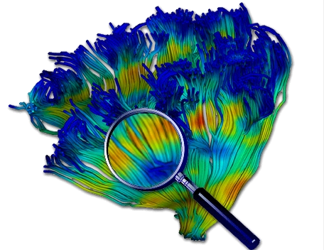
Diffusion Tensor Processing with the UNC-Utah NAMIC Tools
Martin Styner UNC
Thanks to Guido Gerig, UUtah
NAMIC: National Alliance for Medical Image Computing
And many, many folks

Slide 2
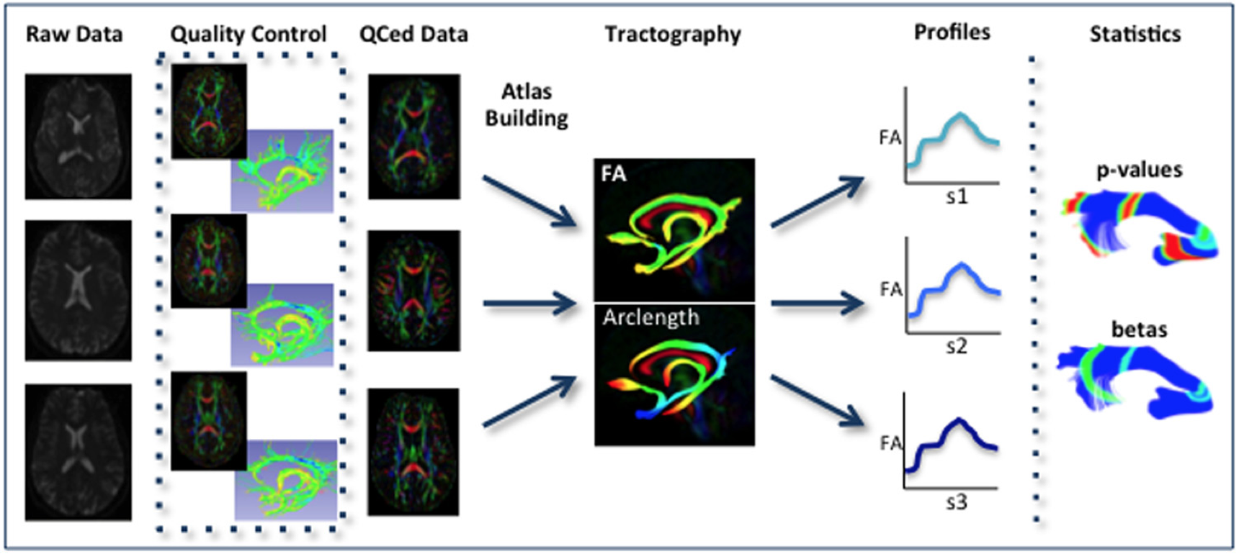
Overview of the UNC – Utah NAMIC pipeline
QC – needs to be done in all studies
Atlas building => needed for most analyses

Slide 3
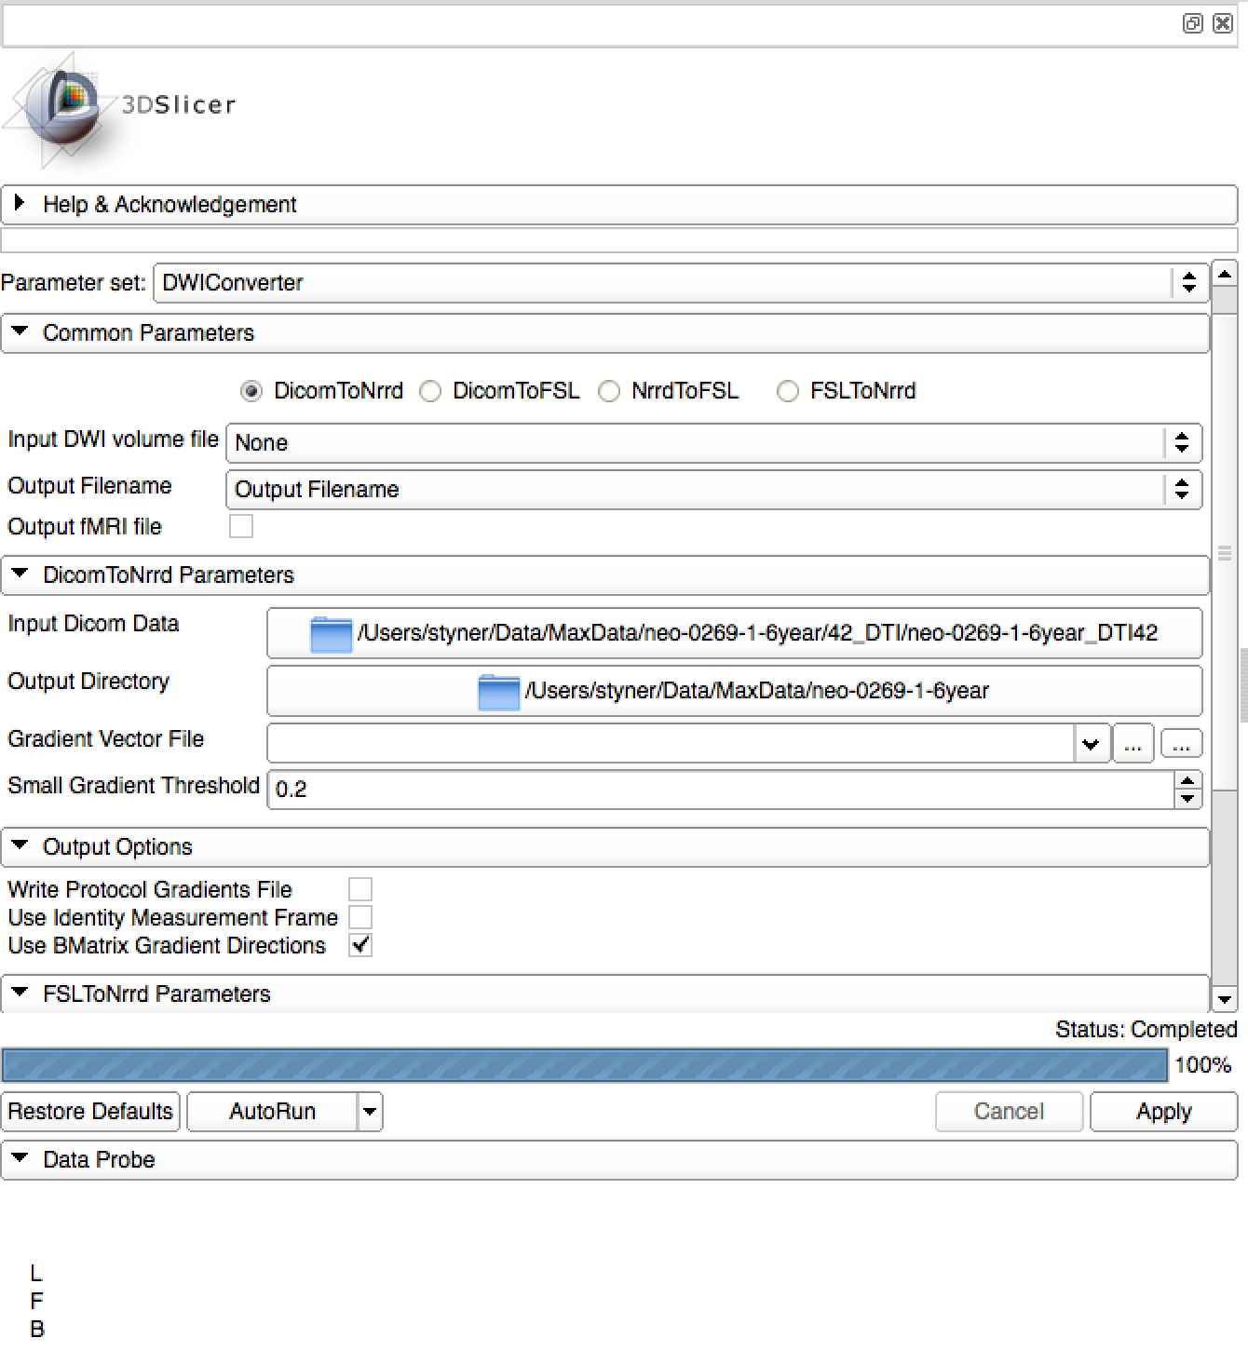
1. Dicom Conversion
DWIConverter in Slicer
  DicomToNrrd
  Use Bmatrix for Siemens data
  Report Bugs (with Datsets)

Slide 4
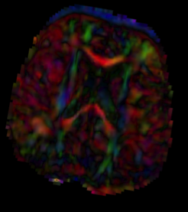
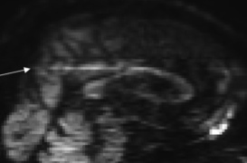
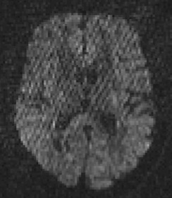
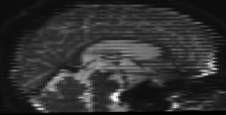
2. QC Diffusion Artifacts
Diffusion images are sensitive to artifacts
Motion
Eddy-current distortions
Noise/SNR issues
Vibrational artifacts
Venetian blind artifacts
“unknown”…
DTIPrep: Bad DWI’s are removed
RESTORE: Bad DWI voxels are down-weighted

Slide 5

DTIPrep
Slicer Extension / Stand Alone (GUI & CLI)
NITRC page: http://www.nitrc.org/projects/dtiprep/
  Additional manual on NITRC page
Protocol based QC
  Protocol defines all the parameters
Automatic report creation
Embed/Cropping of DWI data
  Same size images => simplifies processing
Visualization of gradient scheme
DTIPrep Demo

Slide 6
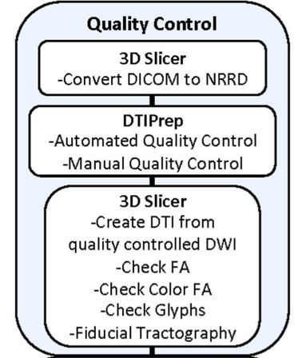
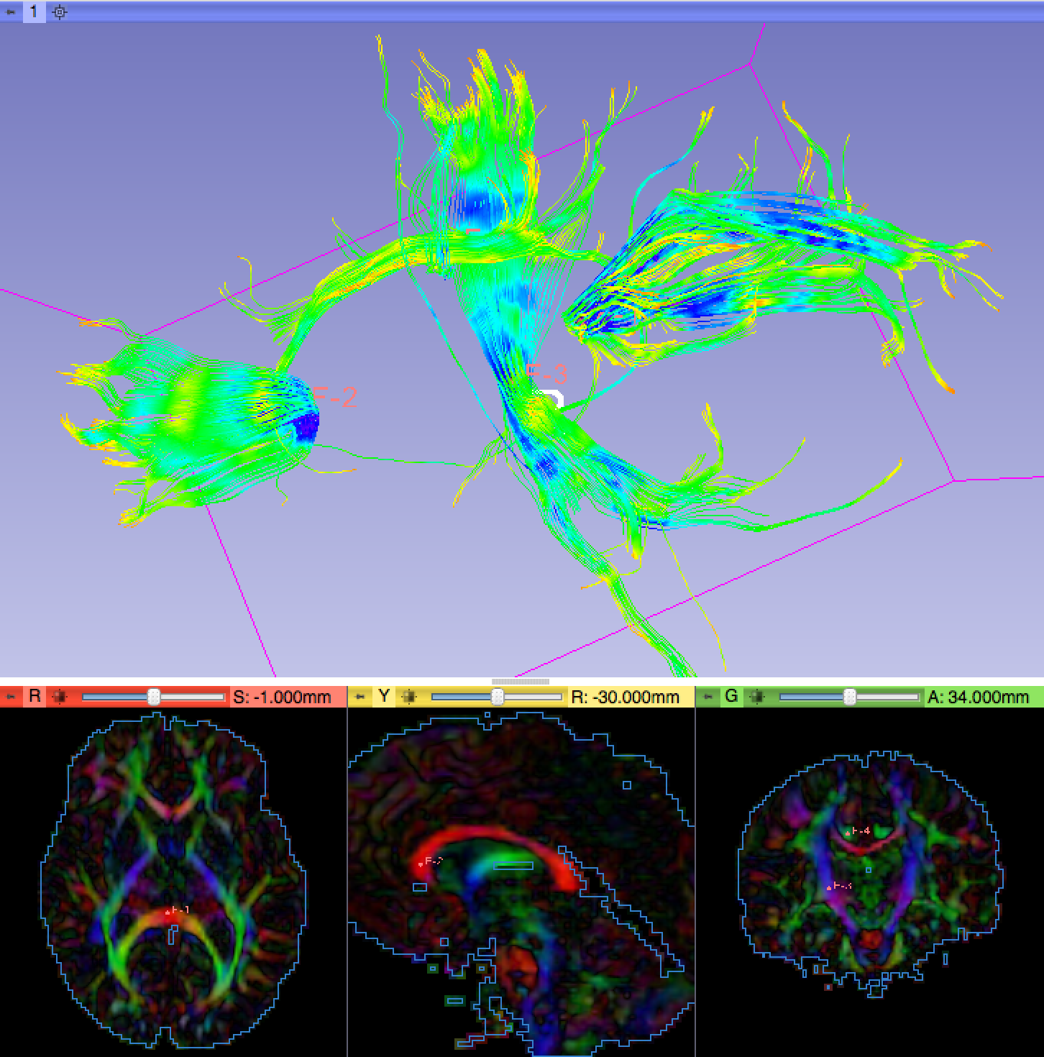
DWI & DTI QC
DWI in DTIPrep
DTI qualitative QC in Slicer
  Create DTI
  Inspect Color FA
  Double check glyph orientation
  Fiducial tractography of major tracts
QC is done

Slide 7
Major Analysis Approaches
3 major approaches
  Regional via structural data or prior atlases (does not need atlas building)
  Voxel-wise over whole brain or white matter skeleton (TBSS)
  Quantitative tractography: Profiles along fiber-tracts

Slide 8
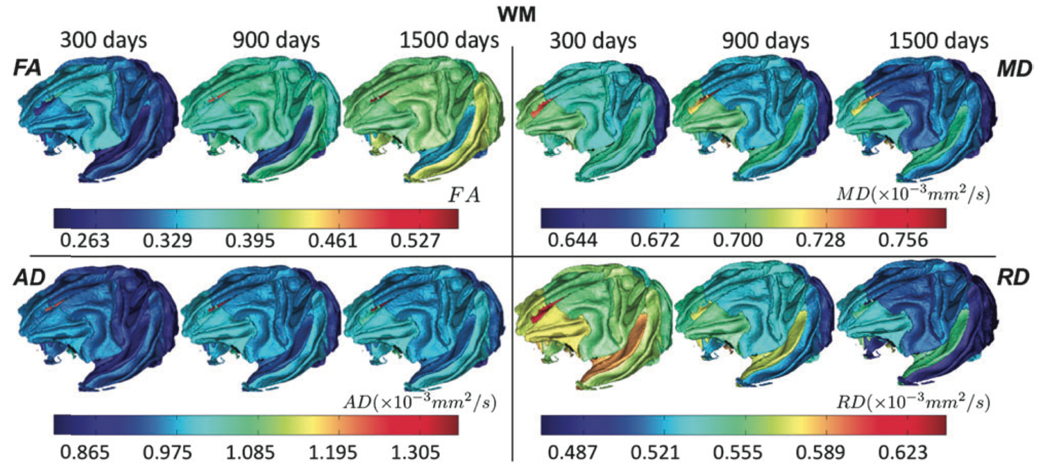
Regional Analysis (I)
Co-registration with segmented structural data
  Deformable registration due to DWI distortions
    Baseline DWI to T2 (ANTS/Brains with smooth def)
    Resampling with ResampleDTILogEuclidean
  Mean vs Median/Quantile stats
    Tensor scalars often non-Gaussian
Macaque brain development via DTI,
Shi, Styner et al, Cerebral cortex, 2013.

Slide 9
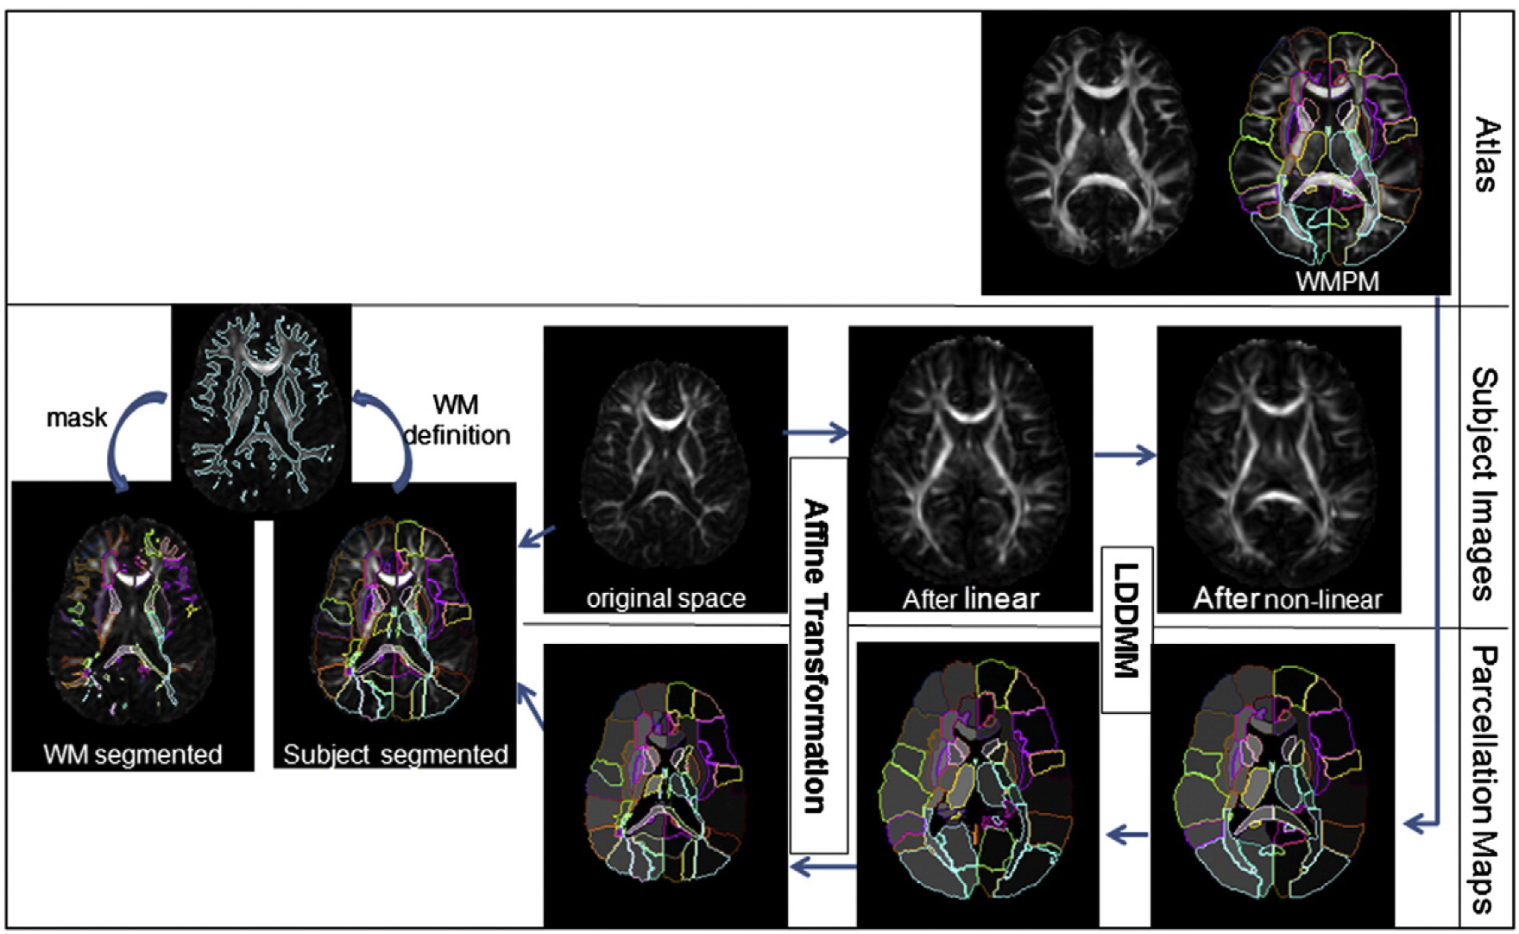
Regional Analysis (II)
Co-registration of atlas
  Atlas with prior regions (Mori atlases)
  Probabilistic regions => probabilistic stats
  Deformable registration
    DTI-Reg (in DTIAtlasBuilder) or ANTS FA to FA
    Use DTIResampleLogEuclidean (in DTIprocess)
Faria,Mori, et al, NeuroImage, Nov. 2010.

Slide 10
Regional Analysis
+ “Simple” processing
+ Robust against imperfect registration
Mixes apples and oranges
  Different tracts within same region
  Different fiber situations (crossing vs single)
Limited localization

Slide 11


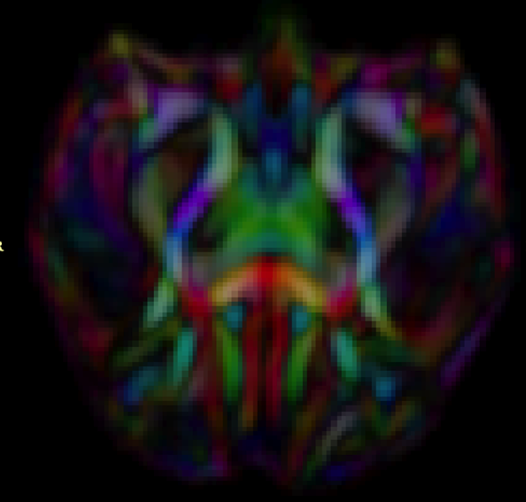

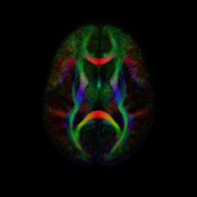
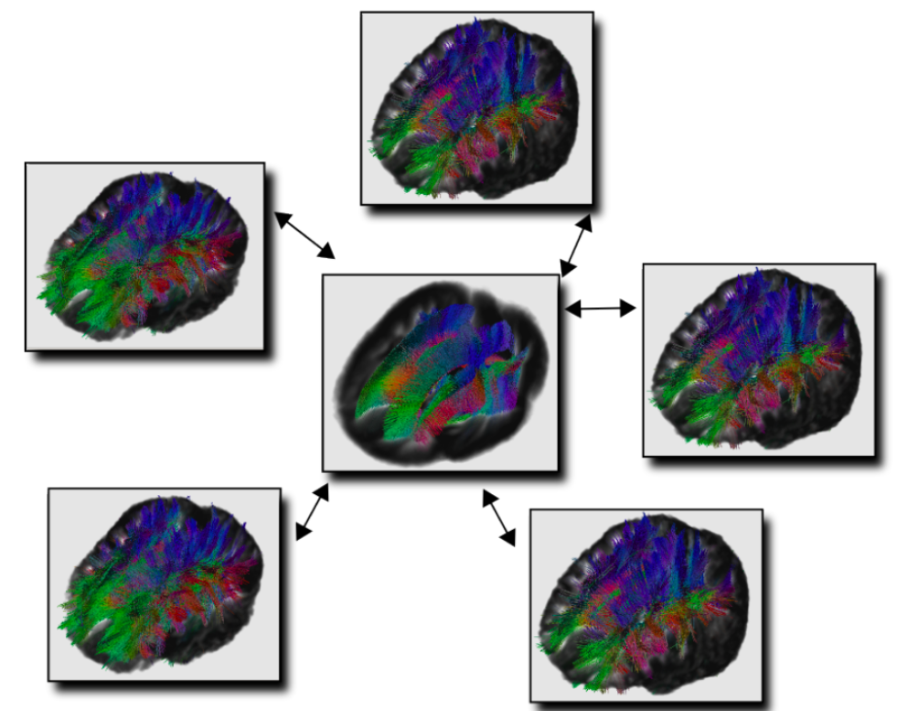
Study Specific Atlases
Reference space
  Best mapping for a given study
SNR increase
Unbiased atlas building (Joshi 2004)
Neonate
1 year
Rhesus (15mo)
2 year
Adult

Slide 12
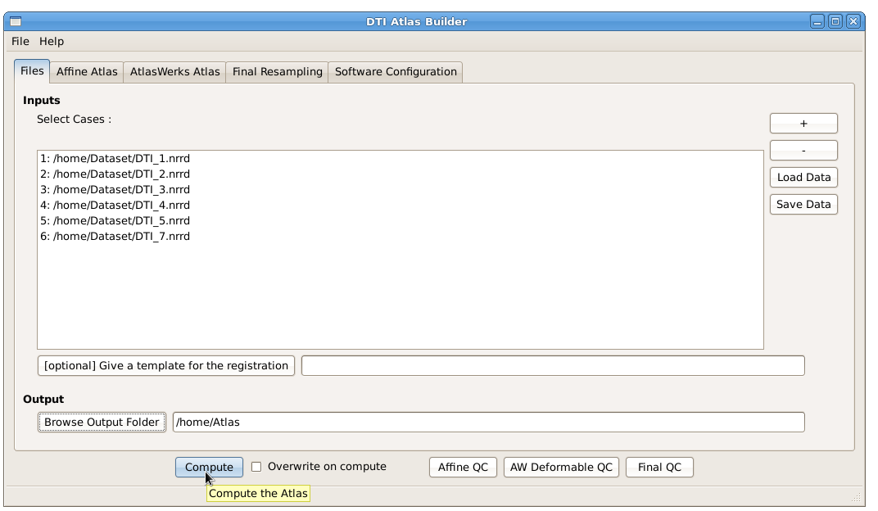

DTIAtlasBuilder
Input Data in CSV format
DTI data needs to be skull stripped

Slide 13
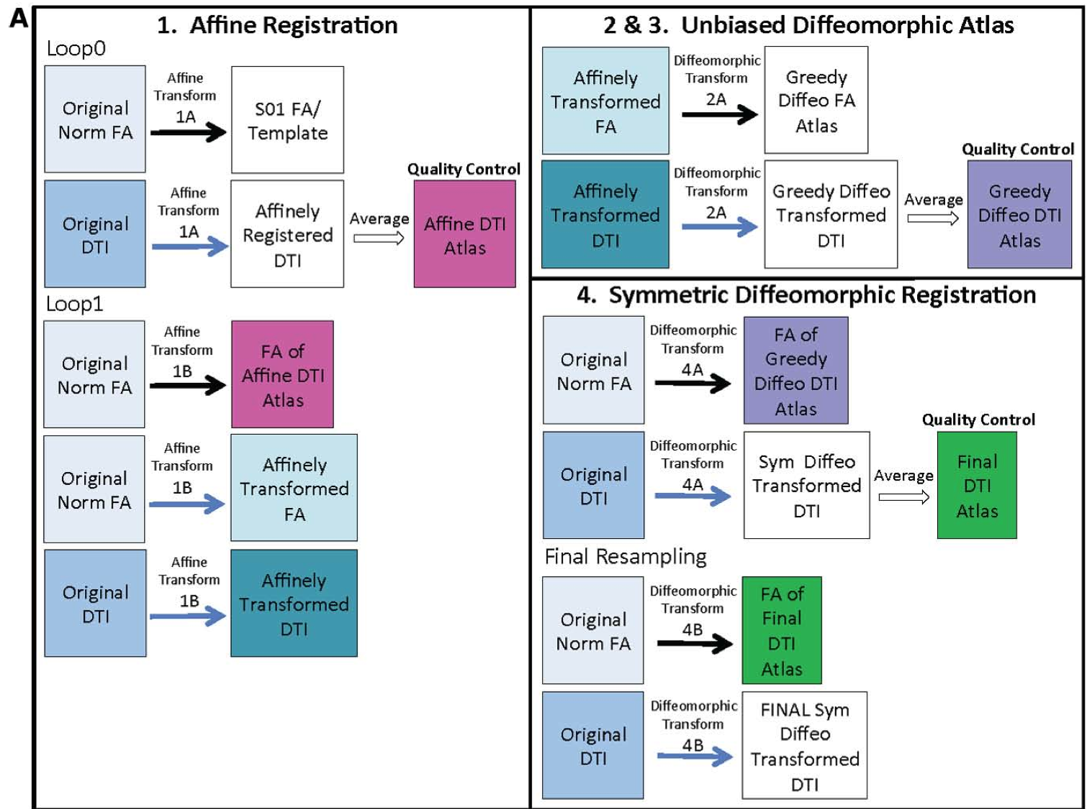
Steps in DTIAtlasBuilder
Steps: affine, unbiased atlas building and refinement
Atlases are generated from norm FA to norm FA registrations
Prior FA template for affine registration step

Slide 14
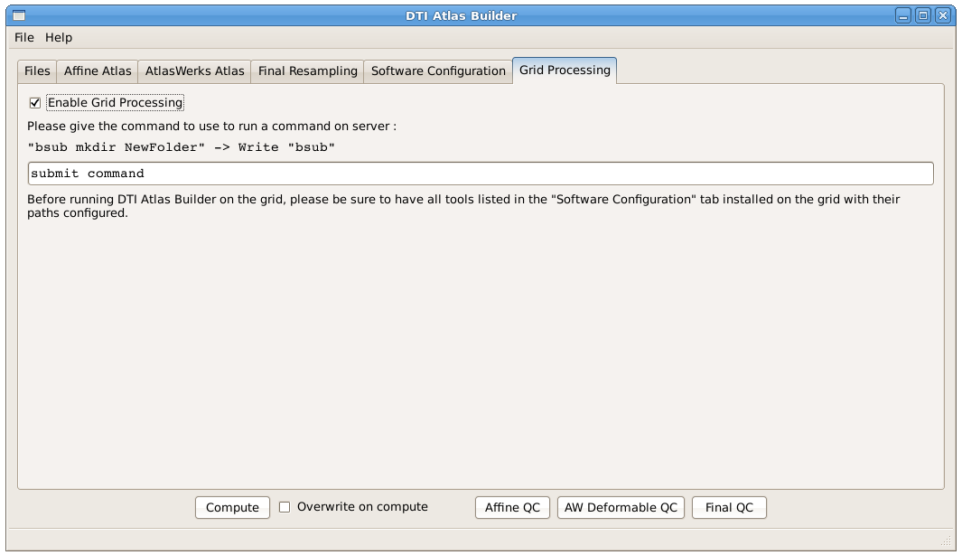
Simple Grid Processing

Slide 15
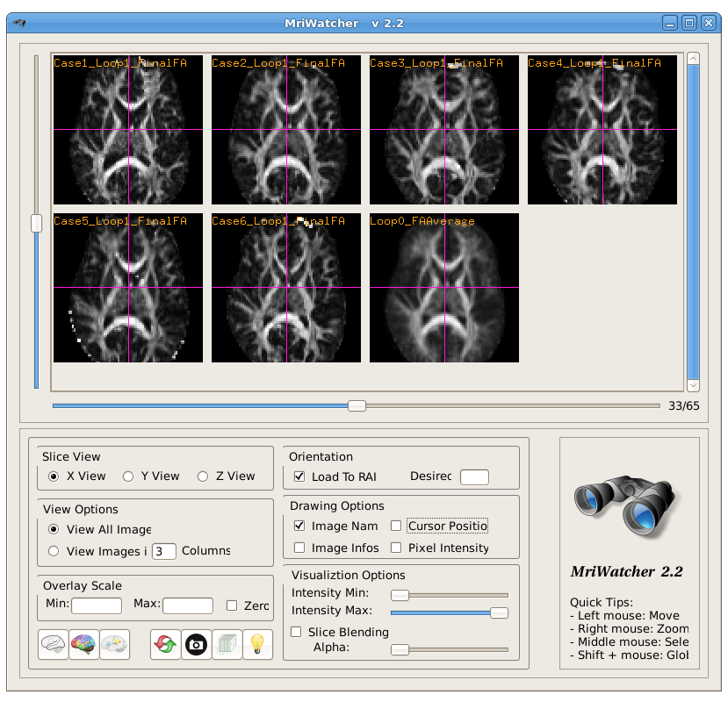
Quality Control with MRIWatcher
Affine QC:
Affine registered FAs and affine average
Final QC:
Final DTI-Reg resampled FAs and final Atlas

Slide 16


Atlas Data Organization
DTIAtlas
1_Affine_
Registration
2_NonLinear_
Registration
3_Diffeomorphic
_Atlas
4_Final_
Resampling
Dataset
.csv
Parameters
.txt
Results
.csv
Script
Loop0
LoopN
First Resampling
Second Resampling
…

Slide 17
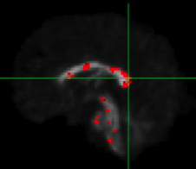
Voxel Based Analysis (I)
Atlas space
Test all voxels => great for hypothesis generation
  FSL or SPM
Needs perfect registration
  Lacks sensitivity & specificity

Slide 18
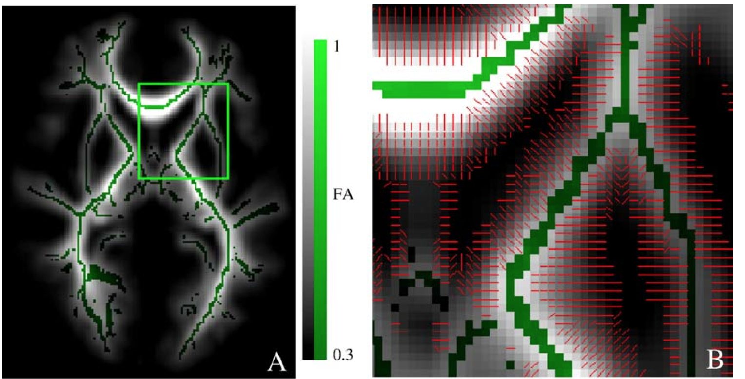
Voxel Based Analysis (II)
TBSS: tract based spatial statistics
  Idea: Analysis on white matter skeleton
  Determine WM skeleton from DTI atlas
  Map max FA values onto skeleton
  Voxelwise analysis on skeleton
Smith, Behrens et al. NeuroImage, vol. 31, no. 4, 2006.

Slide 19
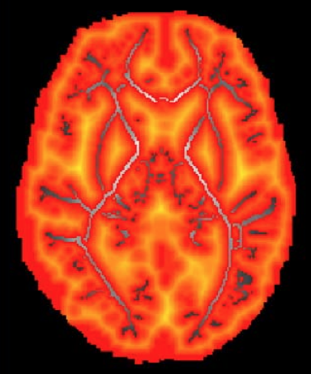
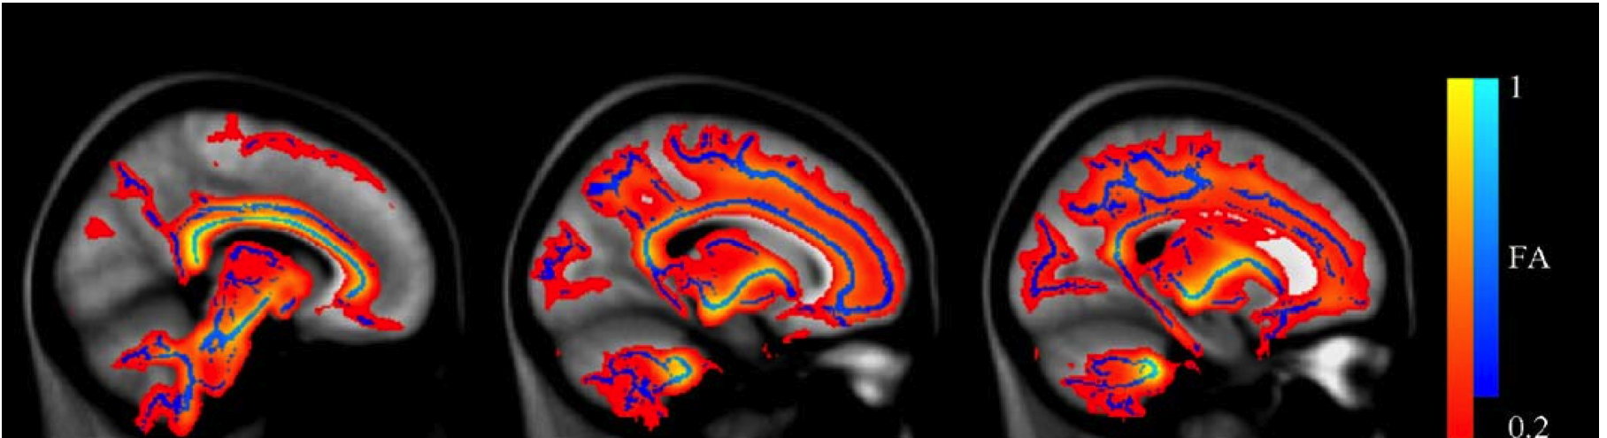
TBSS: Map FA to Skeleton
Find max FA within nearest voxels perpendicular to skeleton
  + Works well with imperfect alignment
  Max FA is less stable
  May mix values from different tracts

Slide 20
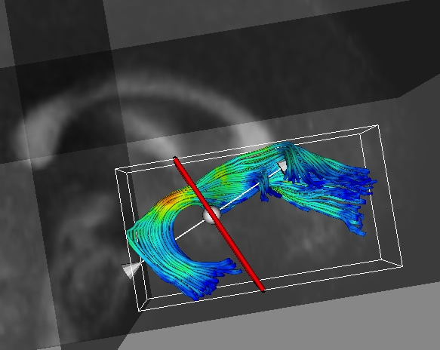
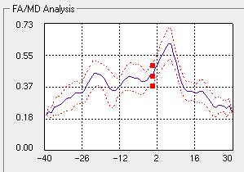
Quantitative Tractography
Use fiber tracts as curvilinear regions
  Average within the whole tract
  Profiles of tensor scalars along tract
Corouge et al. Fiber tract-oriented statistics for quantitative diffusion tensor MRI analysis. Medical Image Analysis 2006.

Slide 21
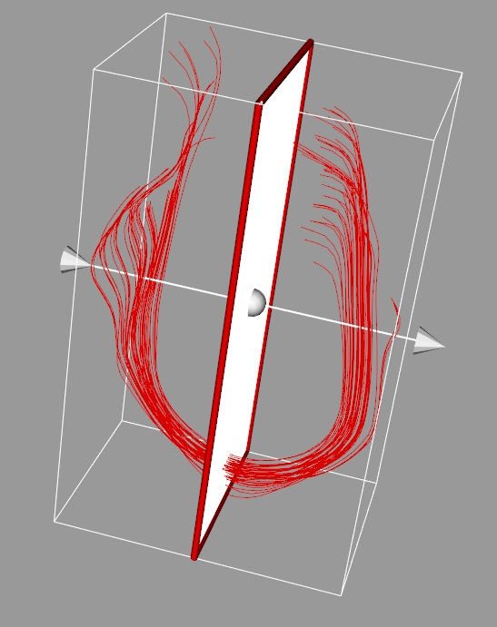
Tractography
Use your favorite Slicer DTI tracking tool
If you want to use higher order tracking
  UKF two tensor tracking
  DTIprocess tool “dwiatlas” creates DWI atlas with DTIAtlas deformation fields
Clean fibers with FiberViewerLight
  Length thresholding
  Cluster via COG, Hausdorff, Mean Distance
  Crop fibers
  Parametrization Plane

Slide 22
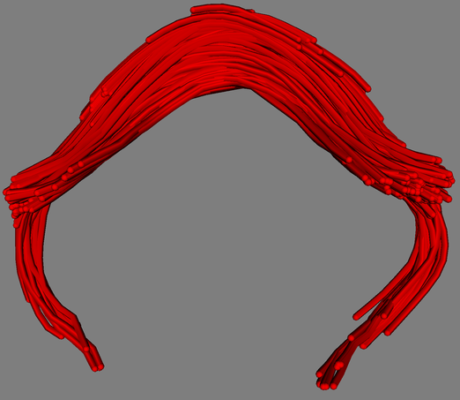
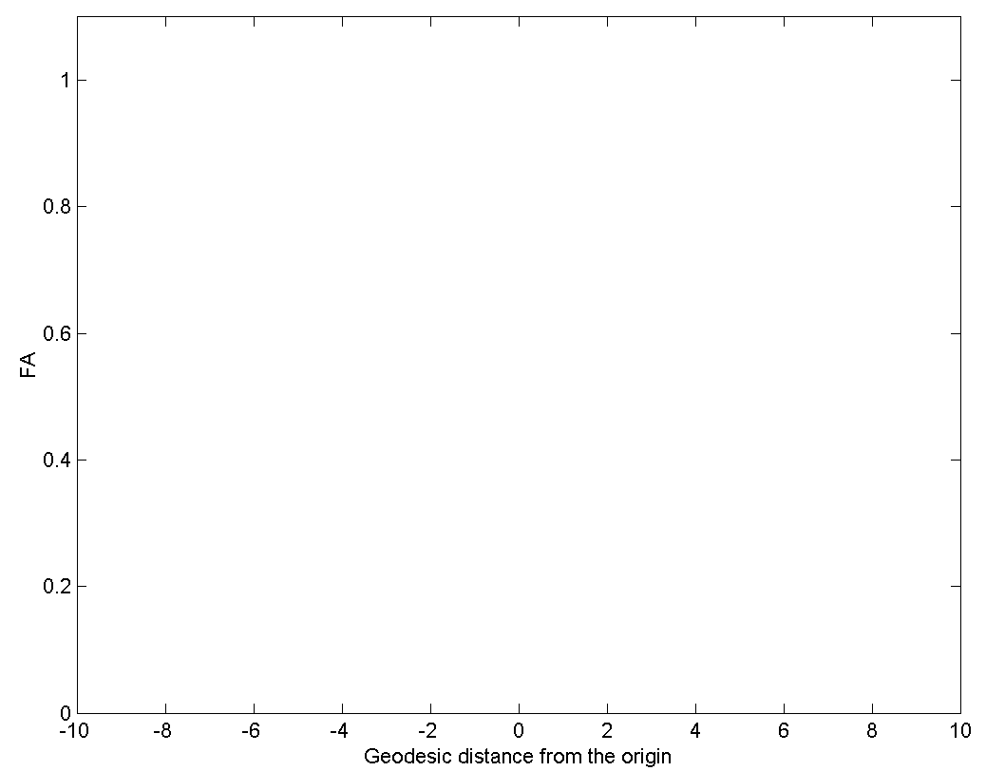
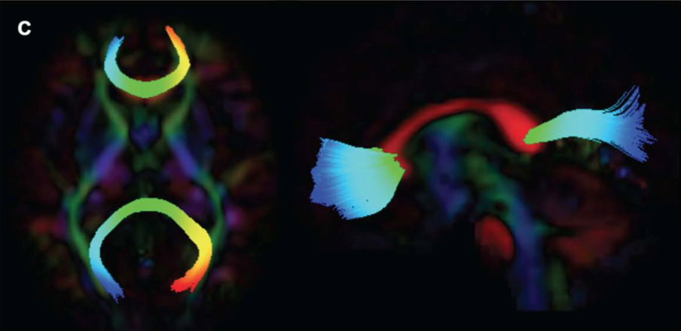
Fiber Parametrization
Origin (anatomical landmark)
Parametrized Fibers in Slicer

Slide 23
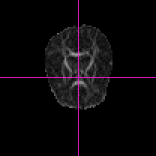
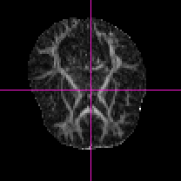
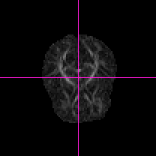
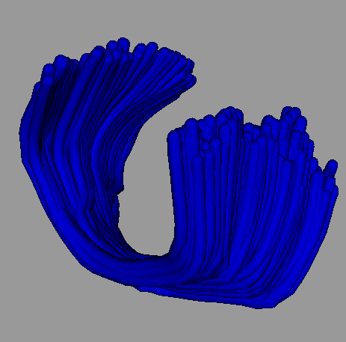
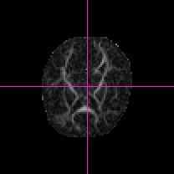
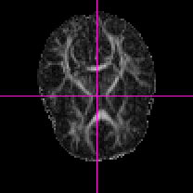
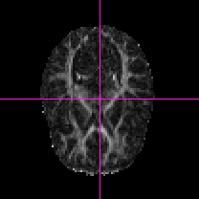
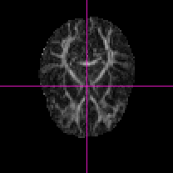
Sampling DTI Data in Original Space

Slide 24
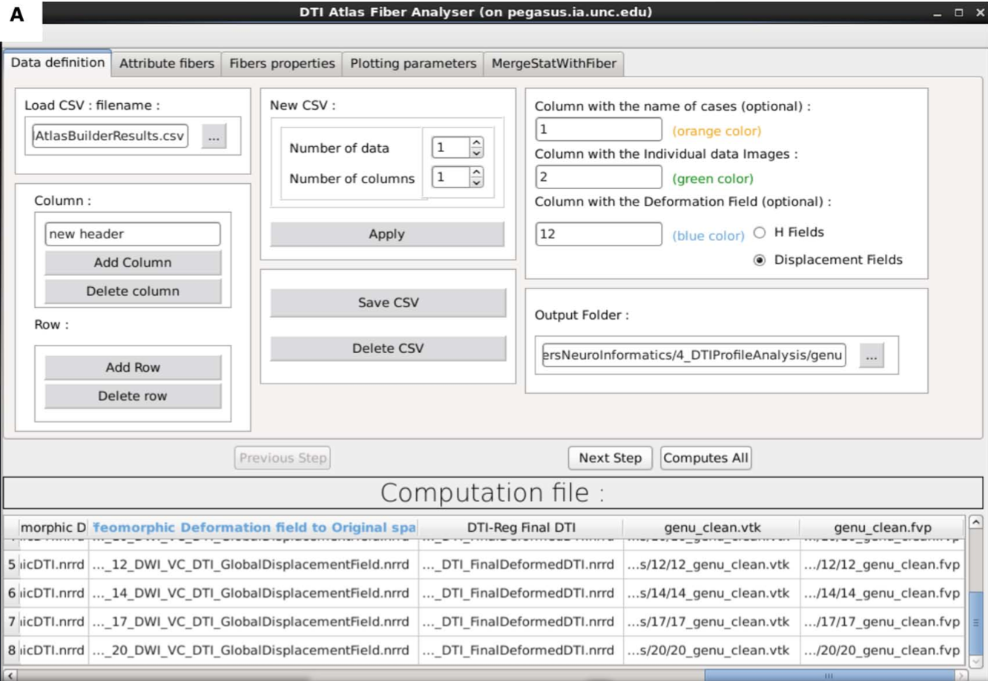
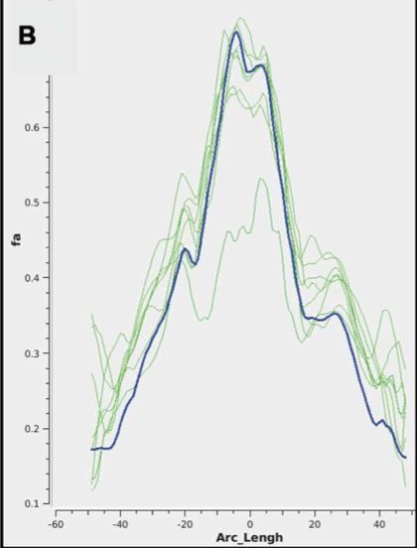
DTIAtlasFiberAnalyzer

Slide 25
Fiber Profile Analysis
Large number of features along tract
  Functional analysis of diffusion tensor tract statistics (FADTTS, Zhu NeuroImage 2011)
  NOT in Slicer, Matlab code (NITRC)
  DTIAtlasFiberAnalyzer maps p-values on fibers
Stats along Fornix tract, group diff (smokers vs non-smokers), controlling for age & gender

Slide 26
Longitudinal DTI Atlas
Two steps atlas building
  Subject-specific unbiased atlas
  Overall atlas across subject-specific atlases
Provides significant reduction in measurement variability
  Single subject in longitudinal & cross-sectional atlases
Splenium in Cross-sectional Atlas
Splenium in Longitudinal Atlas
Notes:
- Splenium tract, one can see that callosum region is surprisingly mature, little change from 2weeks to 6 months
- Longitudinal atlas building significantly reduces within subject variability
Even in longitudinal atlas based analysis (right) potential inconsistencies happen, e.g. center/callosum regions (areas close to location 0) in 3 month old is higher than in 6 mo old
In crosssectional atlas based analysis, large variability overall, here 3mo is higher than 12 mo

Slide 27




Krabbe Leukodystrophy
Rare, lethal genetic leukodystrophy
  Autosomal recessive pattern (not X-linked)
  Worldwide: 1 in 80,000 births.
  Isolated communities: 6 per 1,000 births
Deficiency in galactosylceramidase enzyme
  Buildup of undigested fats affects myelin sheath
  Imperfect growth and development of myelin
  Severe degeneration of mental and motor skills
Lorenzo’s Oil featured similar leukodystrophy
Normal at birth, symptoms usually start 2-6 mts
Fever, uncontrollable crying, seizures, vomiting, spasticity, paralysis, blind, finally death within 2y
Juvenile- and adult-onset cases rare
Escolar 2009 AJNR

Slide 28
Krabbe: Treatment
Therapy (Maria Escolar, U Pittsburgh)
  Myeloablative chemotherapy followed by stem cell transplantation from umbilical-cord blood
  Treatment at Birth, no effect at symptomatic stage
  Survival rate depends on survival of therapy (15 of 17 ~ 88%)
Krabbe’s screening with enzyme test
  New York started August 2006
  Parents often wait, as no damage assessment at neonate
DTI: Assessing damage at birth via DTI
  Illustration of damage to parents? Diagnosis?
  Prediction of developmental outcome for motor abilities

Slide 29
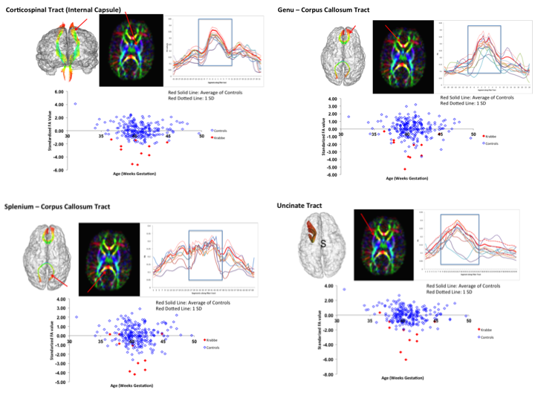
Tract Profile Analysis
In review, unpublished

Slide 30
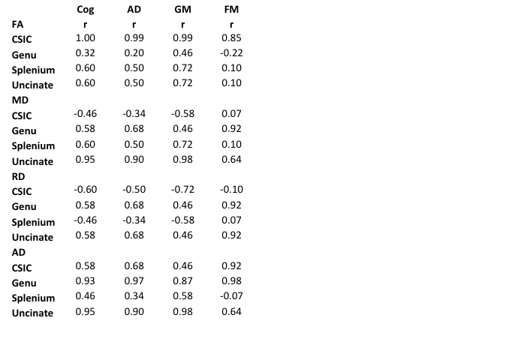
Tract Profile Analysis
In review, unpublished
Spearman correlations
Cog = Cognitive score
AD = Adaptive score
GM = Gross motor
FM = Fine motor

Slide 31
Tract Based Analysis
+ Functional analysis of data
+ High degree of localization
+ Higher sensitivity than voxel-based
Needs accurate atlas building procedure
Needs hypothesis for tract selection
Not fully automatic yet (interactive tractography in atlas space)

