Slide 1

DTI Atlas Registration via 3D Slicer and DTI-Reg
Martin Styner, UNC
Guido Gerig, UUtah

Slide 2
DTI Registration
This tutorial teaches you how
  Load DTI datasets & masks
  Perform a pair-wise registration to a prior atlas via DTI-Reg
    Affine transform and deformable transform
  Save the transformed images and the deformable transform

Slide 3
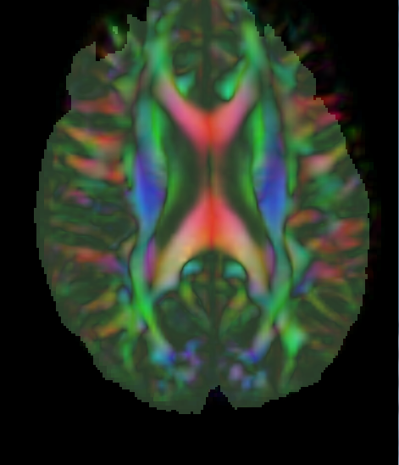
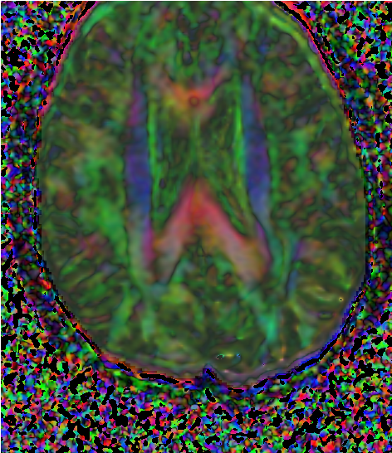
Concept of Registration
Combining information from multiple images requires the geometric relationship between them to be known...

Slide 4
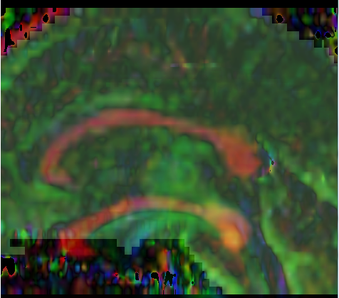
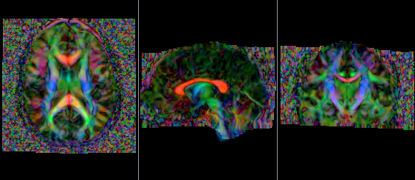
Concept of Registration: Overlay of pair of images
misaligned
aligned

Slide 5
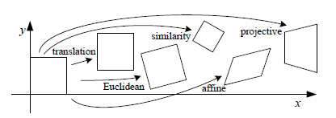
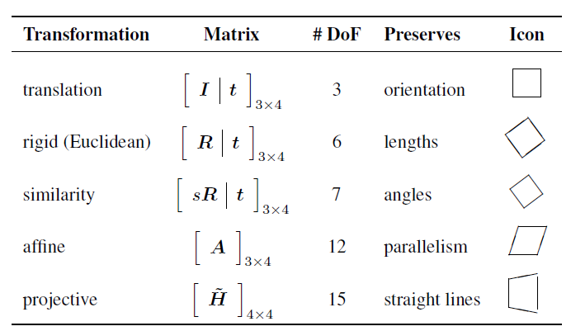
Transformation for Image Registration
Choice of transformations (complexity of transformation, #degrees of freedom
depends on application).
credit: R. Szelisky, Computer Vision

Slide 6

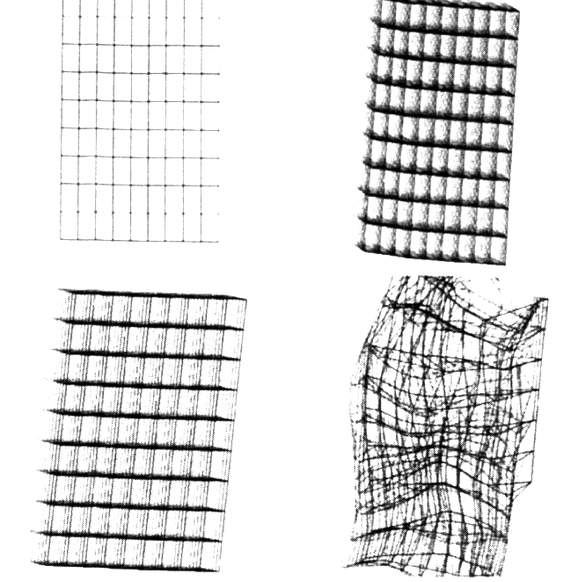

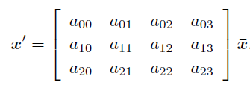
3D Transformations
Linear Transformations (invertible, low DOF):
Translation (3 DOF)
Rigid:
Trans & Rot (6 DOF):
Affine (12 DOF)
Nonlinear, deformable transformations (high DOF):
B-spline (deformable,
grid of control points)
Diffeomorphic (highly deformable,
smooth transformation, invertible)

Slide 7


Co-registration: From linear to nonlinear
Linear registration (affine)
Nonlinear registration (diffeom.)
Example: Registration of DTI to atlas template

Slide 8
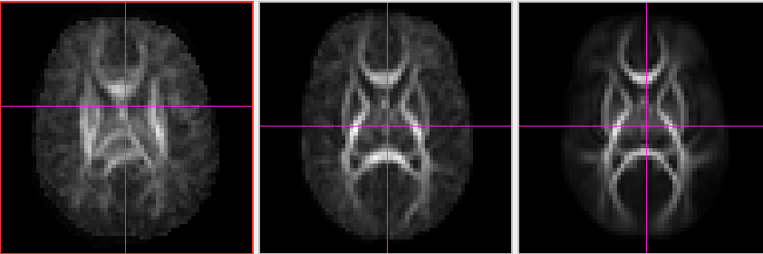
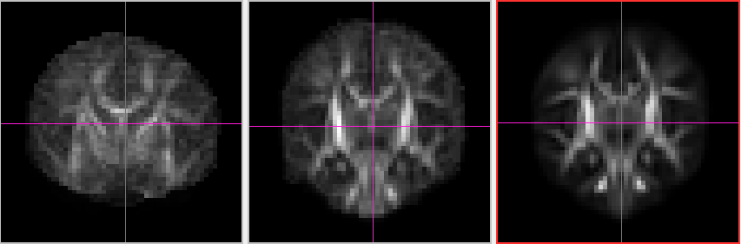
Atlas Building: Averaging registred FA images
Quality (sharpness) of atlas improves with deformable transformations.
raw
linear
nonlinear

Slide 9
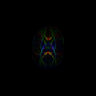
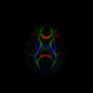
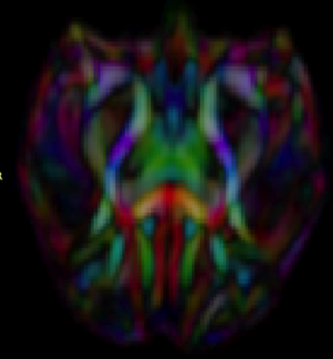
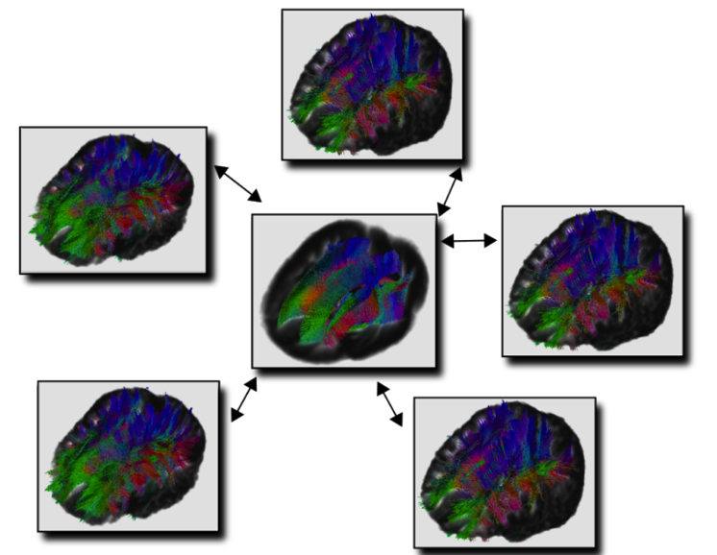
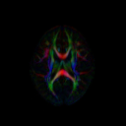
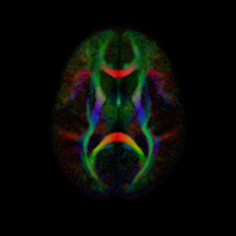
DTI Population Atlases
Definition of standard, normative space
Templates to become available to researchers
Neonate
1 year
Rhesus (15mo)
2 year
Adult

Slide 10
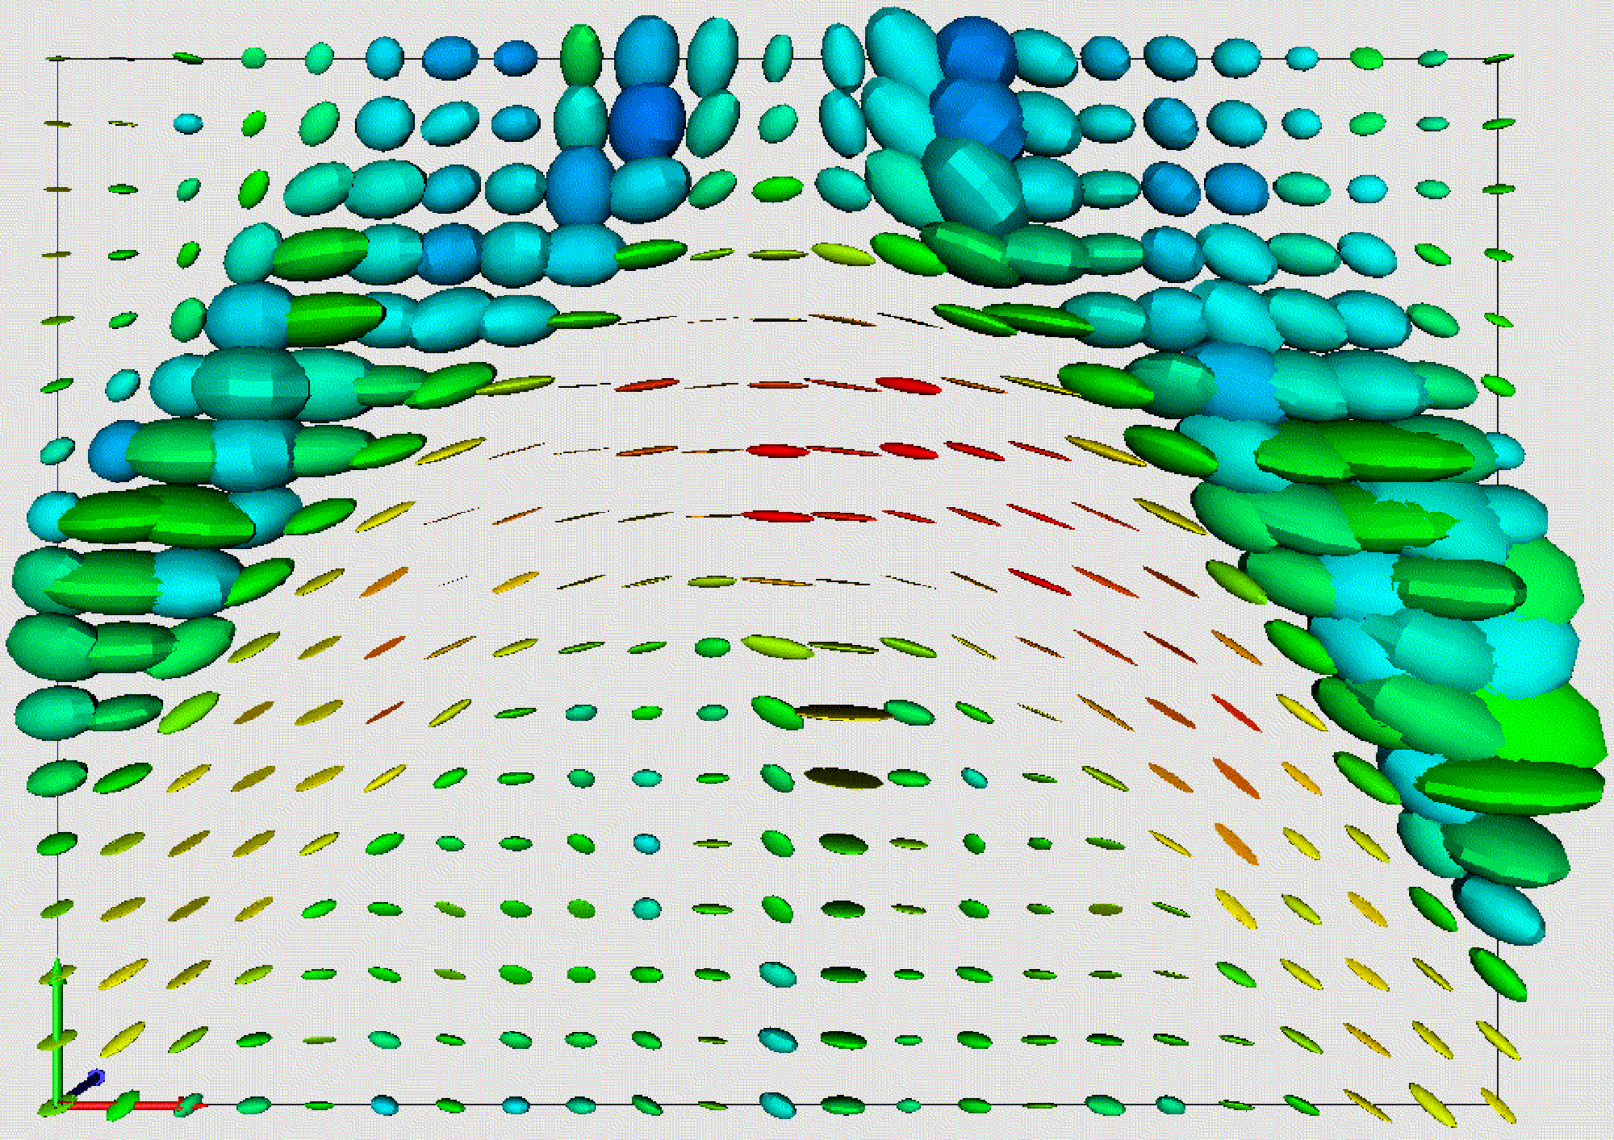
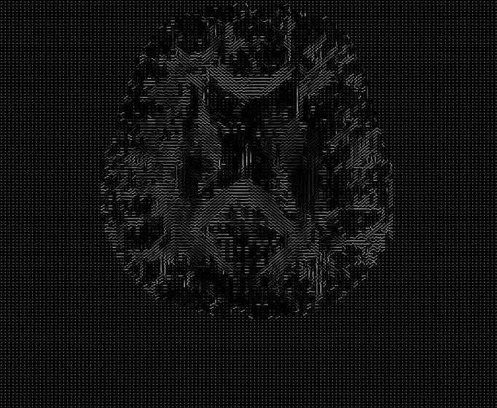
Spatial Transformations of Diffusion Tensors
Principal diffusion directions in anisotropic regions of a DT-MR image slice
Warmer colors indicate higher anisotropy
James Gee, Department of Radiology
University of Pennsylvania

Slide 11
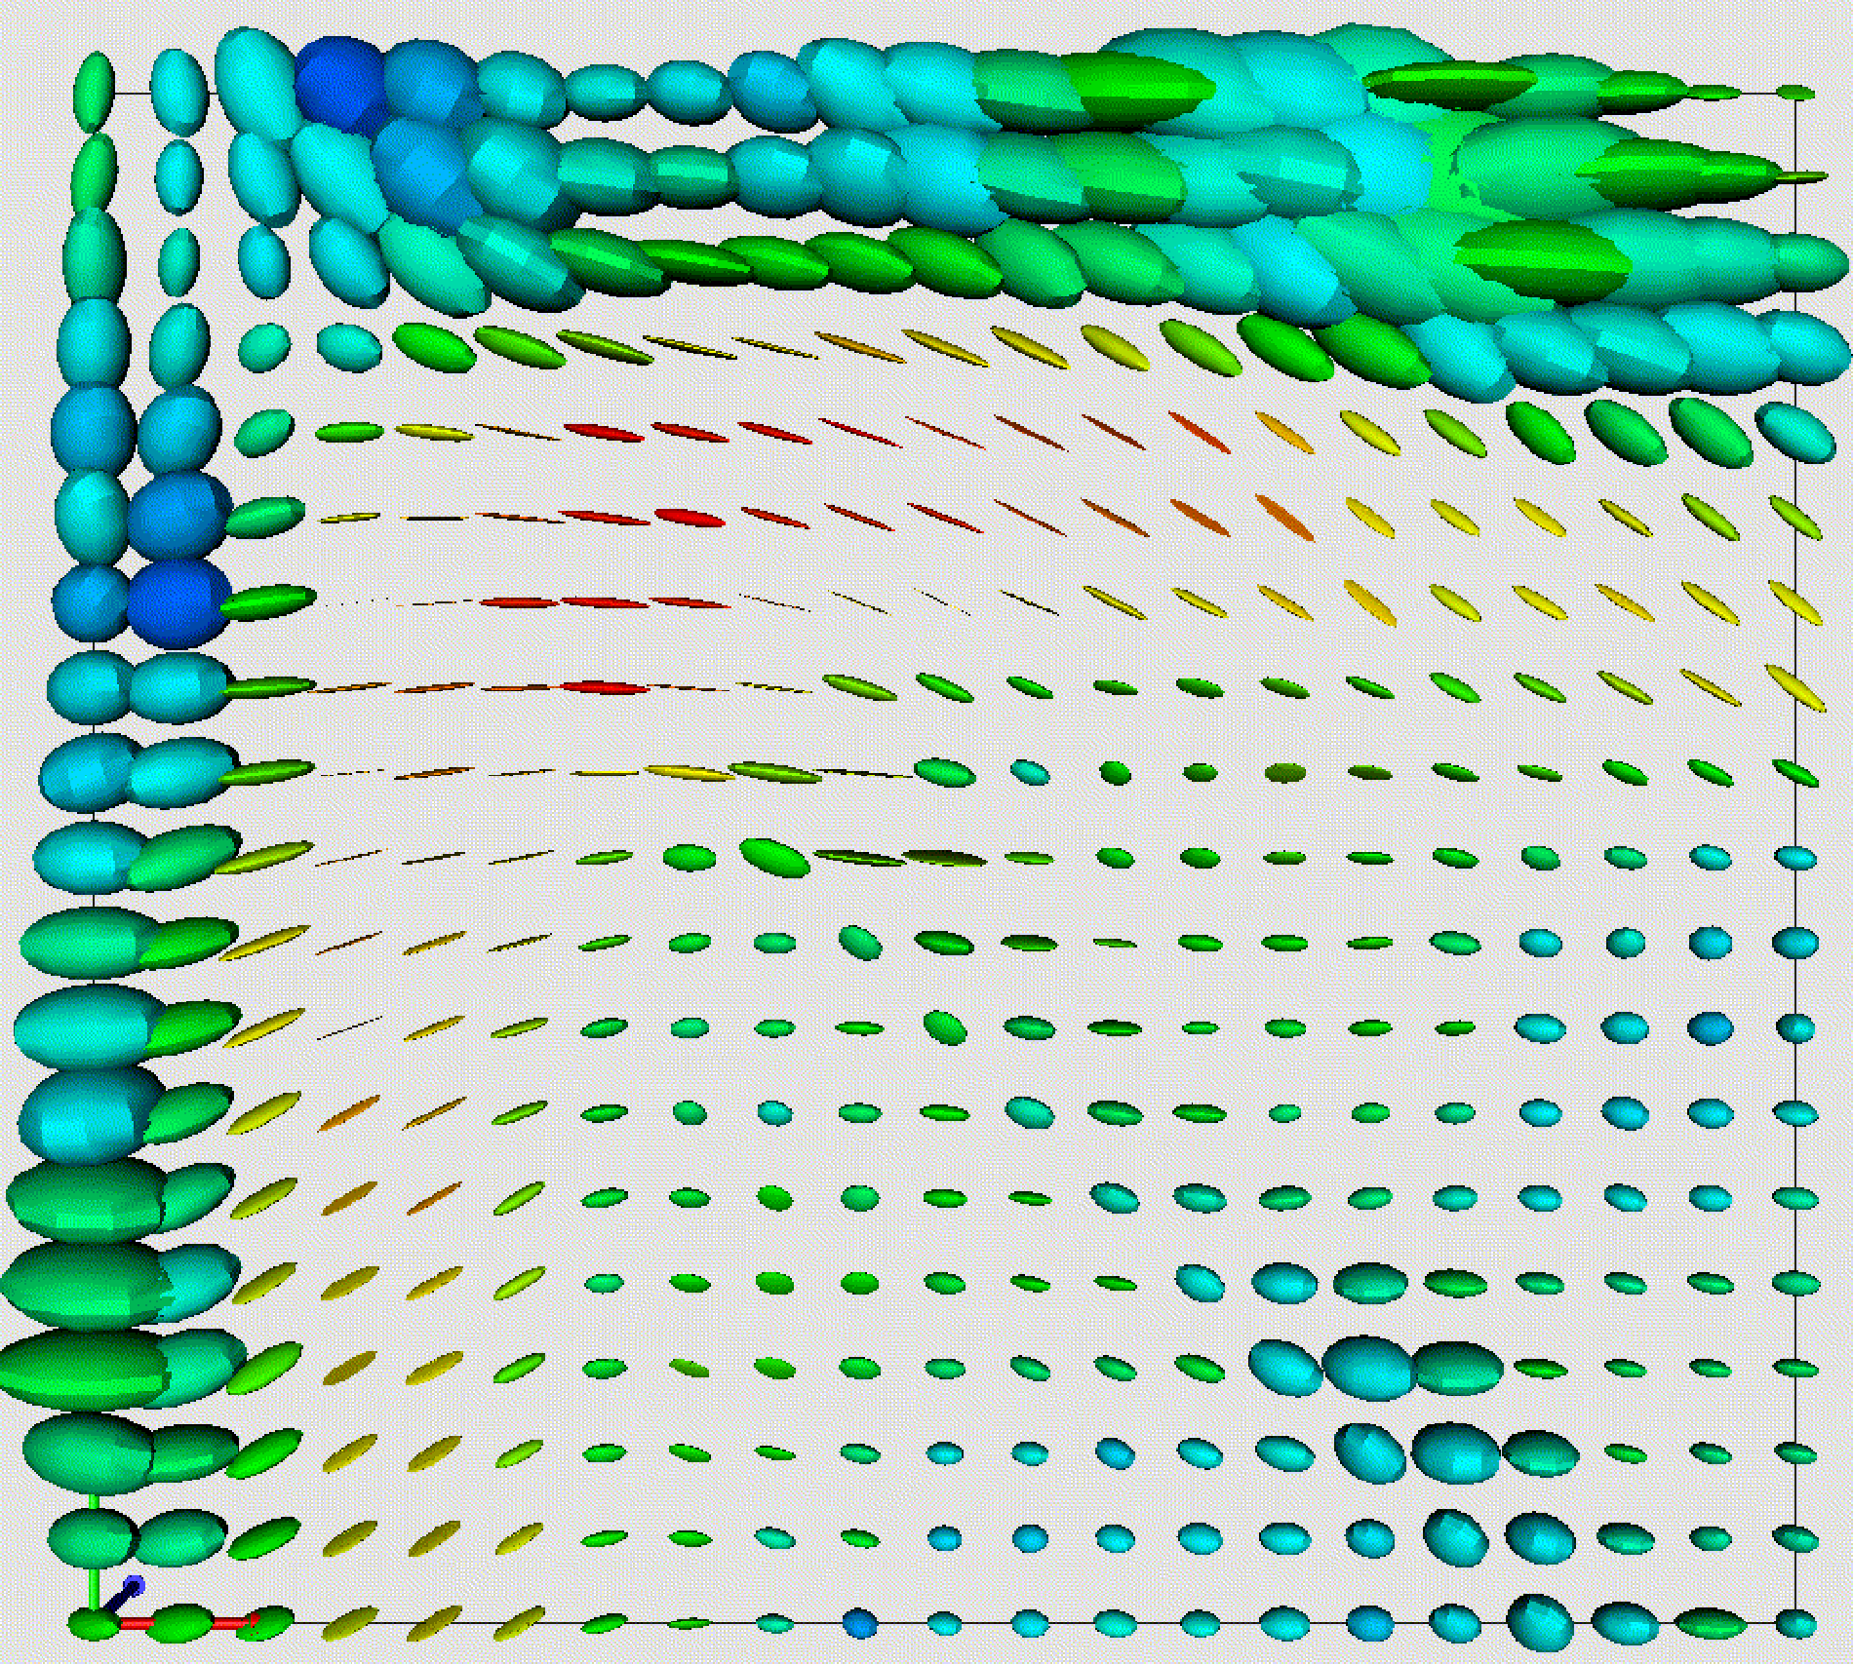
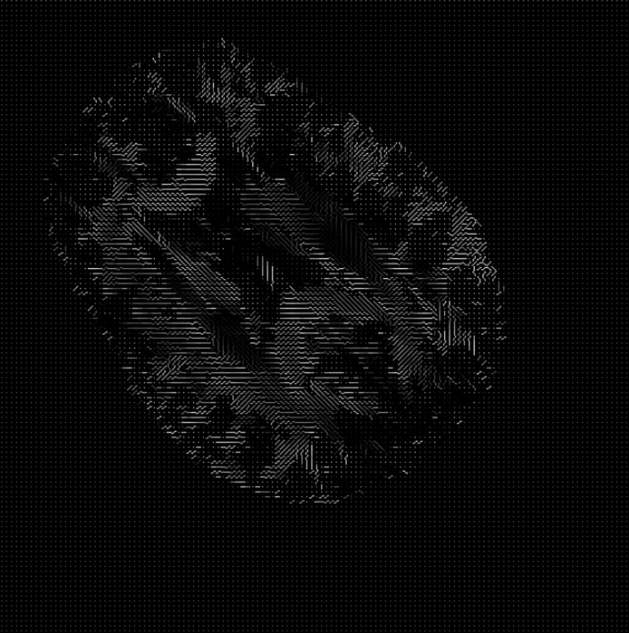
Rotation without DT Reorientation:
Transform voxel grid, leave tensors
  Directional structure
  is lost.
  DTs orientations are no longer consistent with the anatomical structure of the image.
James Gee, Department of Radiology
University of Pennsylvania

Slide 12
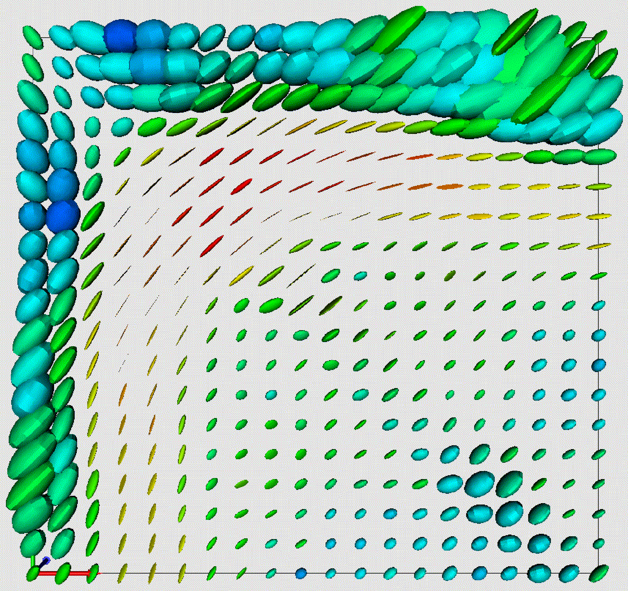

Rotation with DT Reorientation
  D→R·D·R^{T}.
  Directional structure preserved.
  DTs orientations remain consistent with the anatomy.
James Gee, Department of Radiology
University of Pennsylvania

Slide 13
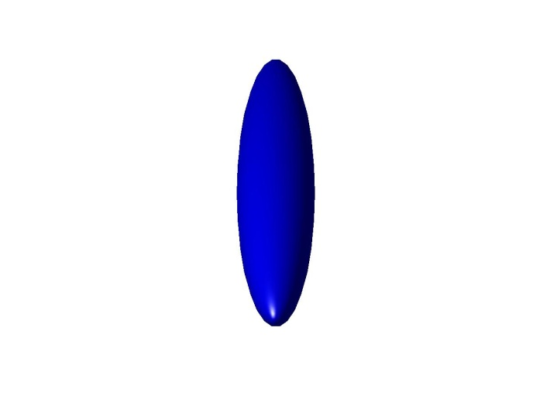
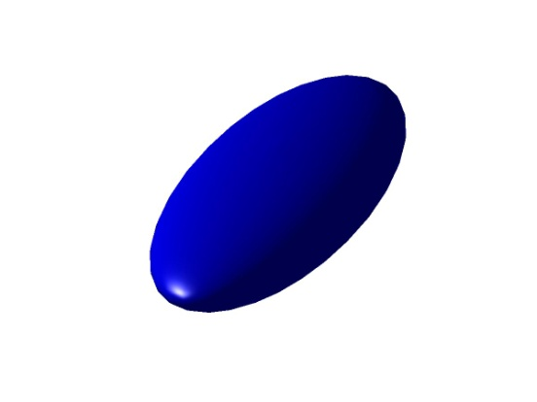
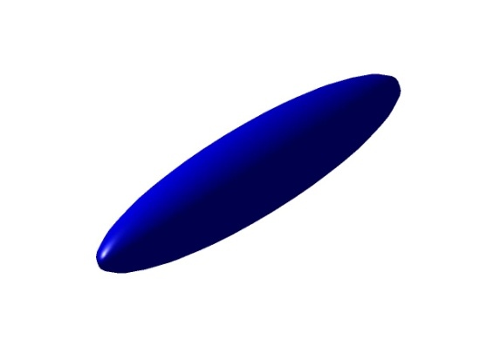
Affine Tensor Transformations
(Alexander et al, MICCAI 1999)
Original
Tensor
Transformed
Tensor
For an affine transformation, , D→F·D·F^{T}?
No...
D→F·D·F^{T}
Finite Strain Estimation
We wish to preserve the shape of the DTs.
But we must reorient them appropriately.
Require R that reflects reorientation due to F.
Decompose F into:
  Rigid rotation, R, and
  Deformation, U:
  F = R·U
  R = F ·(F^{T} ·F)^{-1/2}
Then reorient D using R:
D’ = R·D·R^{T}
D→R·D·R^{T}

Slide 14

Dataset
For this tutorial you will need DTI data files that can be found following this link :
http://hdl.handle.net/1926/1759

Slide 15
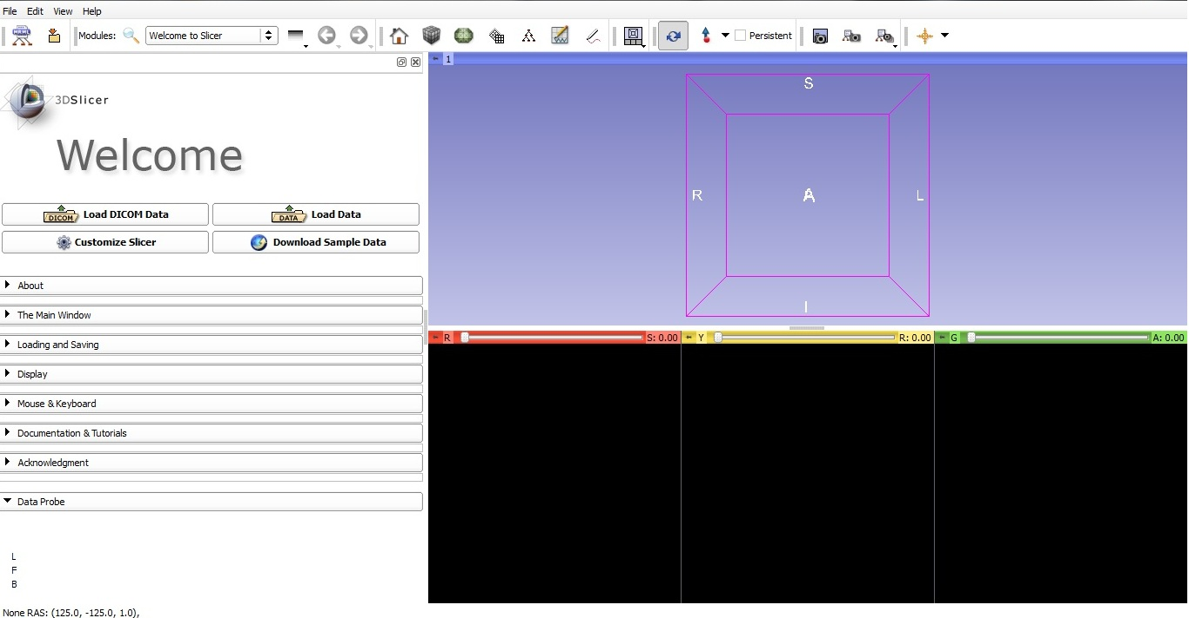
Start Slicer 4
Linux/Mac users :
Launch the Slicer
executable located in
the Slicer4 directory
Windows users :
Select Start→All Programs→Slicer4.0.1→Slicer
Or launch the Slicer executable from Slicer4 directory

Slide 16
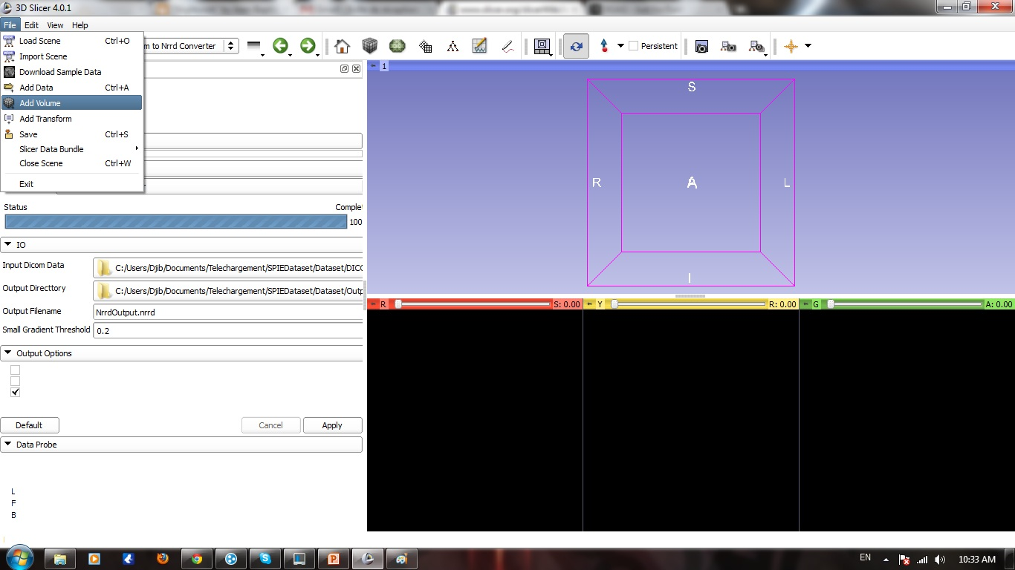
Loading DTI Atlas
Left click on file menu
Left click on Add Volume

Slide 17
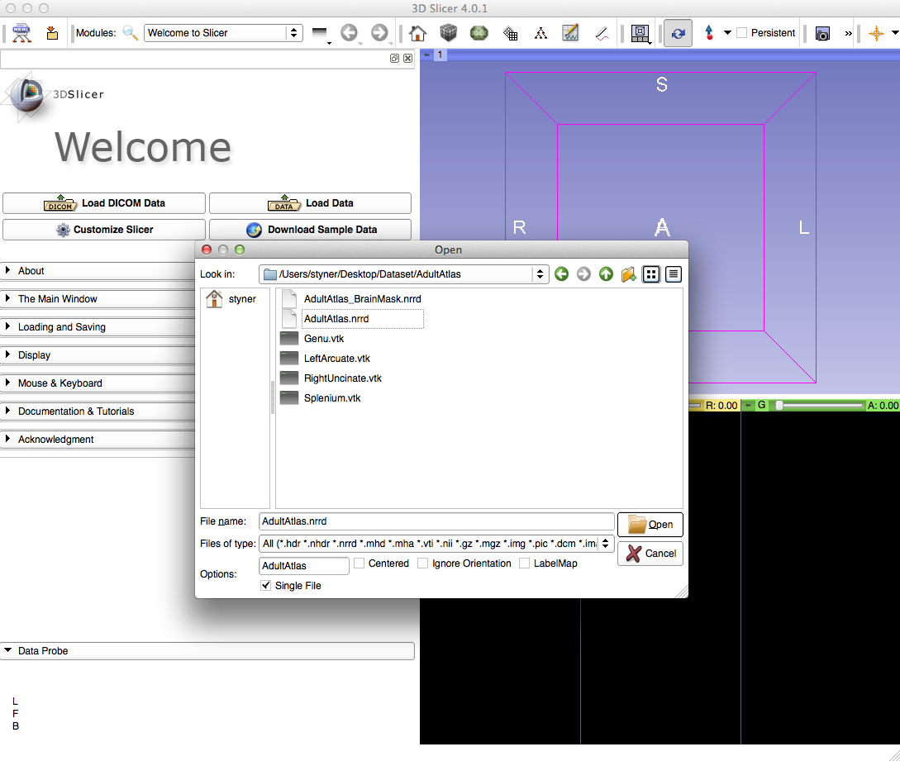
Loading DTI Atlas
Select the AdultAtlas.nrrd volume

Slide 18
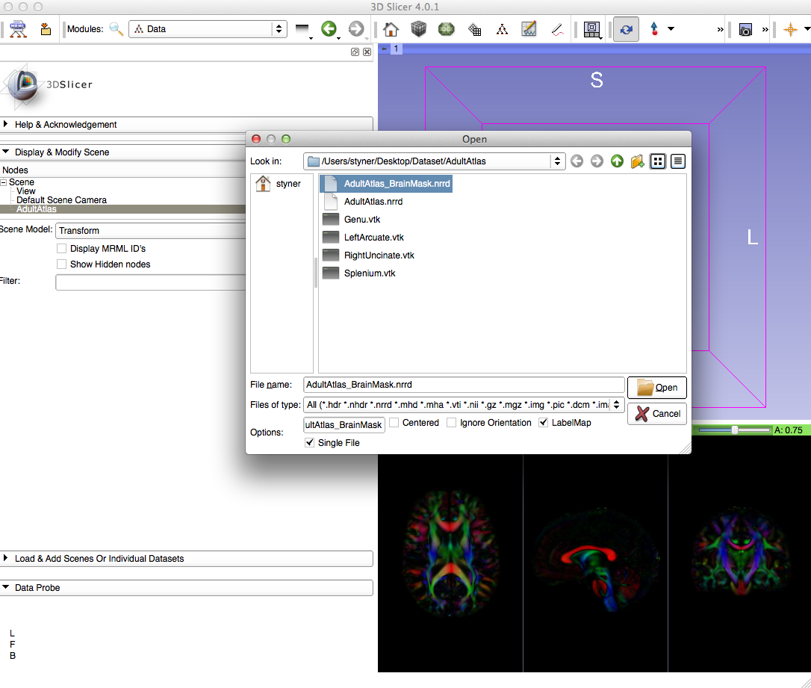
Loading DTI Atlas Mask
Load AdultAtlas_BrainMask.nrrd label map

Slide 19
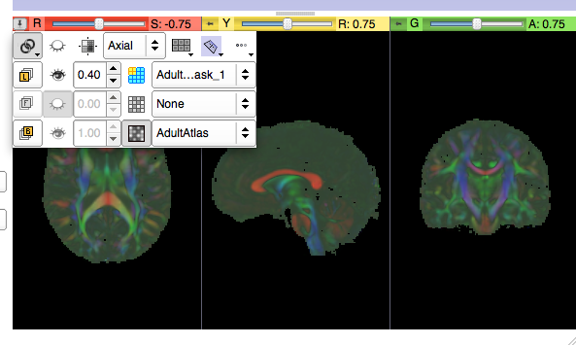
Adjust View
Adjust view to see both mask and atlas
Link all 3 viewers
Opacity change
1
2

Slide 20
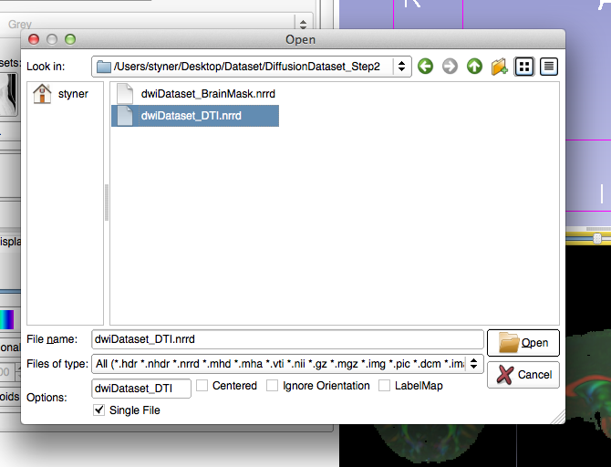
Loading 2nd DTI dataset
File Menu =>Add Volume (or see previous tutorial)
Directory: DiffusionDataset_Step2
Load dwiDataset_DTI.nrrd

Slide 21
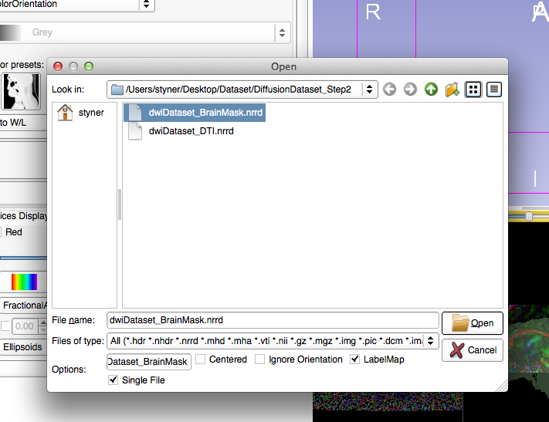
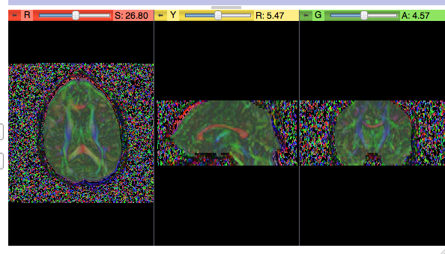
Loading DTI dataset mask
File Menu =>Add Volume (or use from previous tutorial)
DiffusionDataset_Step2
Load BrainMask
“LabelMap” checkbox

Slide 22
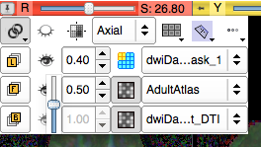
Overlay DTI datasets
How can we check alignment?
Overlay the DTI images!
Select AdultAtlas for Foreground
Set Opacity to 0.5
2
1

Slide 23
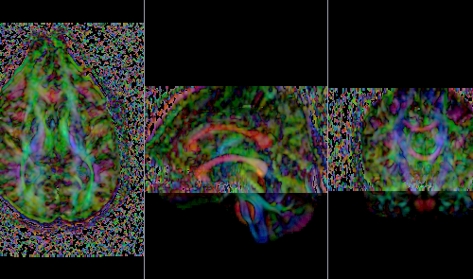
Overlay
Bad alignment: 2 separate corpus callosum

Slide 24
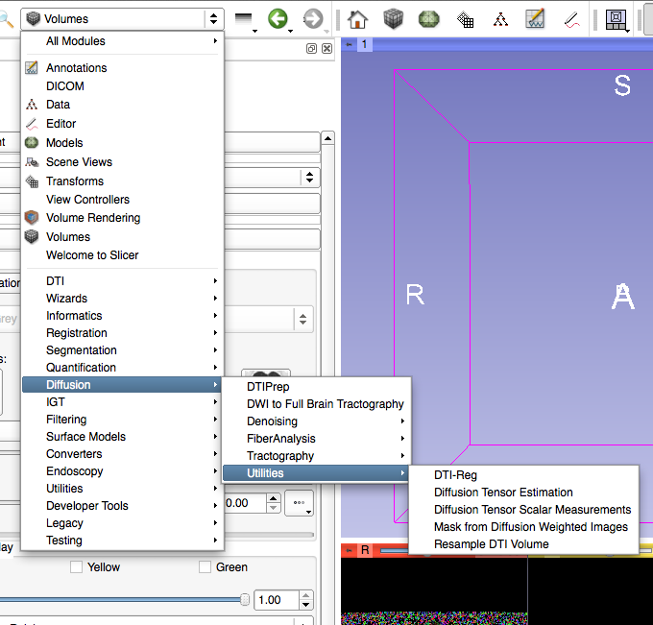
Select DTI-Reg Module
Slicer modules
  Diffusion
  → Utilities
  → DTI-Reg
DTI-Reg: Pairwise DTI registration module
Notes:
Under Welcome to Slicer
Go to Diffusion
Utilities -> DTIreg

Slide 25
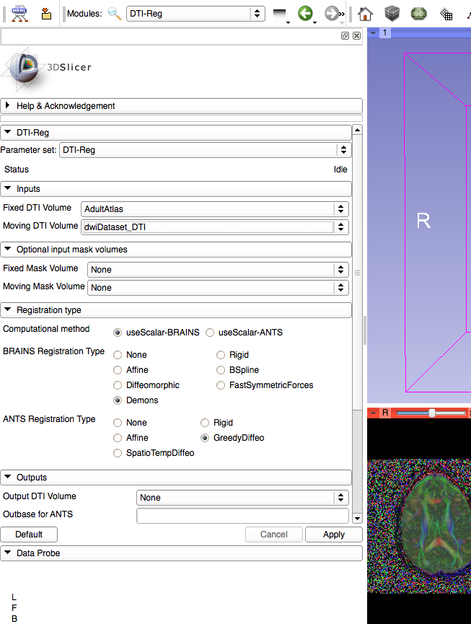
Volumes for Registration
Fixed Volume: Target of registration = AdultAtlas.nrrd
Moving Volume: Image to be transformed: dwiDataset_DTI
1
2

Slide 26
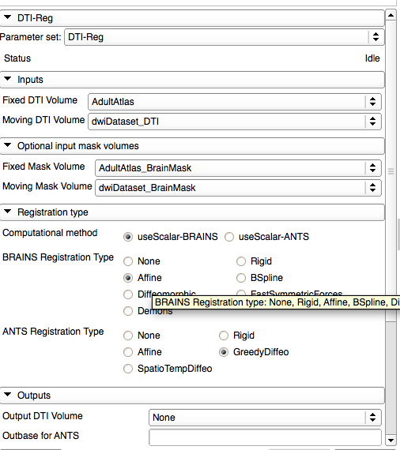
Set Masks for Registration
Set Fixed Mask to Atlas Mask: AdultAtlas_BrainMask.nrrd
Set Moving Mask to dwiDataset Mask: dwiDataset_BrainMask.nrrd
1
2

Slide 27
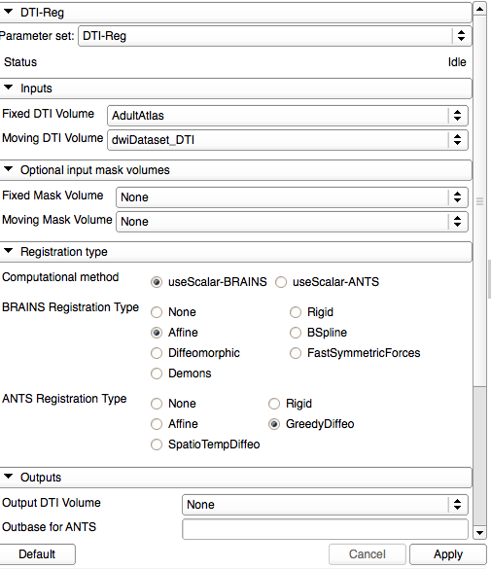
Set Transform to Affine
Set registration transform to Affine
Deformable Registration is performed in 2 steps: Affine followed by nonlinear.
ANTS generally better but much slower

Slide 28
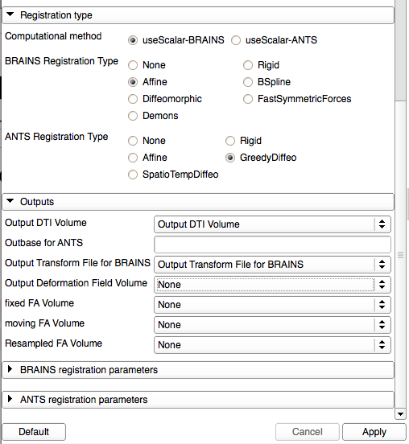
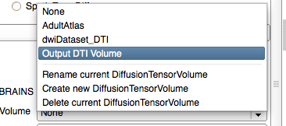
Select Outputs
Create & rename volumes for output
Affinely registered DTI dataset
Affine transform
Apply to run & wait
1
2

Slide 29
Registration
Several pairwise registration methods available.
DTI-Reg supports several registration methods based on normalized FA images:
    Affine, B-spline, Demons-variants from within Slicer
    ANTS as external call
Plan: DTI-TK support
  Registration based on full tensor.

Slide 30
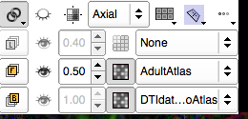
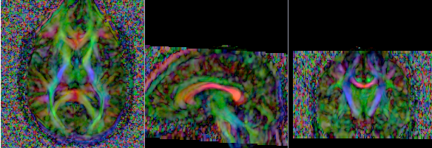
Affine Results
Select DTI-Reg result as background
Result: single corpus callosum, but fuzzy, insufficient registration

Slide 31
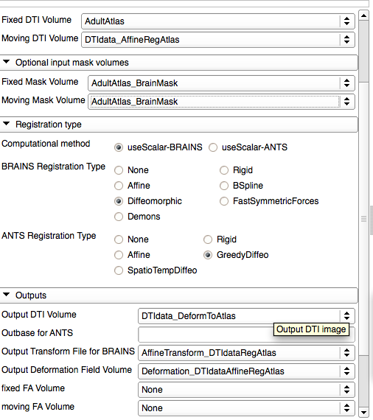
Deformable Registration
Concept: Use affine registration as initialization for deformable registration:
Change moving volume to affinely registered data
Change moving mask to atlas mask
Change registration to Diffeomorphic (Demons)
Create/rename output names for deformable transformation
1
2
3
4
5

Slide 32
Deformable Results
Select DTI-Reg deformable result as background
Result: No longer fuzzy, significantly better registration

Slide 33
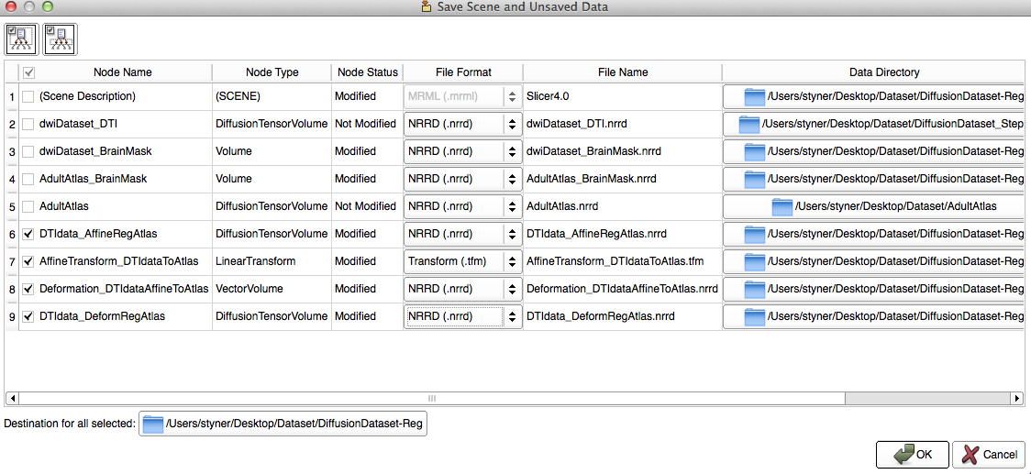
Save Outputs and Done
Save selected volumes and transforms
File → Save → (deselect/select checkboxes)
Choose common directory: “destination for all selected”

Slide 34
Conclusions
DTI registration is available in Slicer
2-step process currently, to be improved soon
Brainmasks are needed (unless data is skull stripped already)
This tutorial taught you how to register to an atlas
  How to get atlas?
Alternative: Build atlas from data

Slide 35
Acknowledgment
National Alliance for Medical Image Computing
NIH U54EB005149
UNC: Jean-Baptiste Berger, Clement Vachet, Aditya Gupta
Utah: Guido Gerig, Sylvain Gouttard
Iowa: Hans Johnson, Joy Matsui

