Slide 1
Utah II: NA-MIC HIGHLIGHTS
Guido Gerig, Marcel Prastawa, Sylvain Gouttard, Clement Vachet, Stanley Durrleman, Bo Wang, James Fishbaugh, Anuja Sharma
SCI Institute, University of Utah
Jack van Horn, Paul M. Vespa, Andrei Irimia, Micah Chambers
UCLA LONI, Neurosurgery, Neurology
Hans Johnson, University of Iowa
Martin Styner, Joseph Piven, Heather Hazlett, UNC Chapel Hill

Slide 2
Highlights

Slide 3
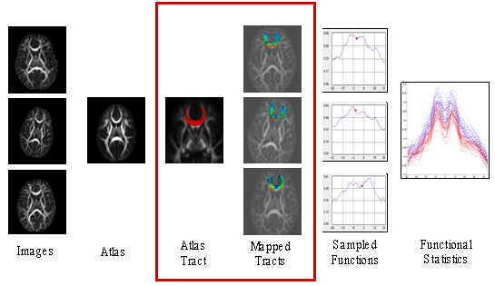
UNC-Utah DTI Processing Methods and Tools
2006-2009: Casey Goodlett “Tract-based analysis via atlas mapping and fiber parametrization”.
2009:

Slide 4
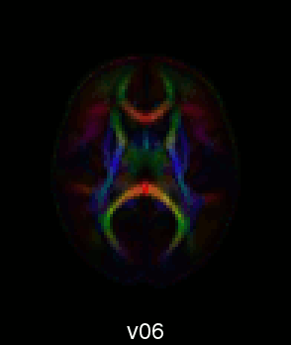
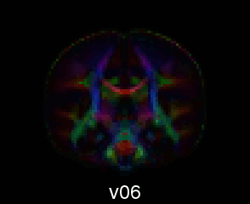
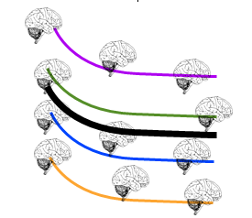
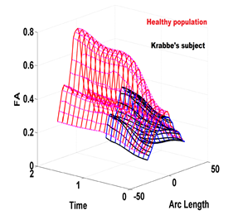
UNC-Utah DTI Processing Methods and Tools: ctd.
2008-2014: Applications to large clinical studies and animal imaging studies.
2010-2014: Extension to longitudinal diffusivity modeling (N. Sadeghi, A. Sharma)
2013-2014: M. Styner and group: 3D Slicer plug-ins: Integrated platform from raw data to full statistical analysis.
"DTIAtlasBuilder“, "DTIAtlasFiberAnalyzer“

Slide 5
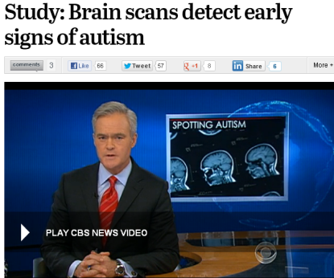
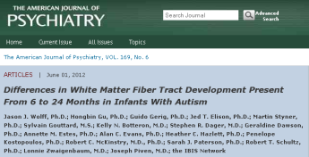
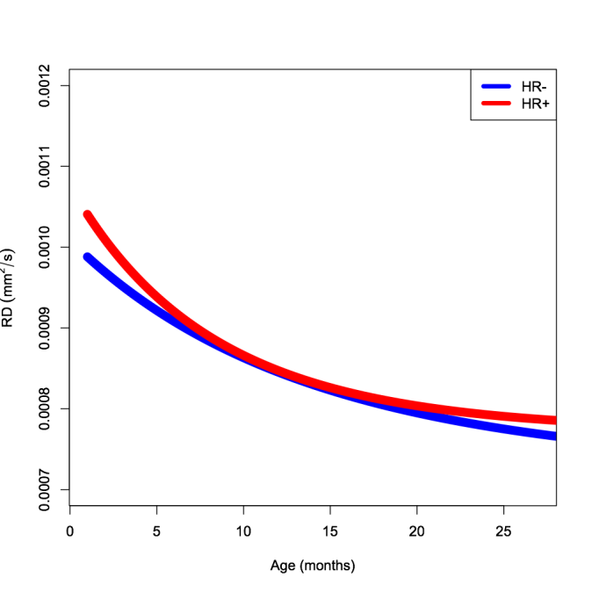
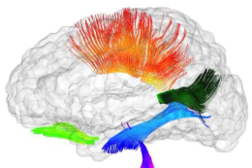
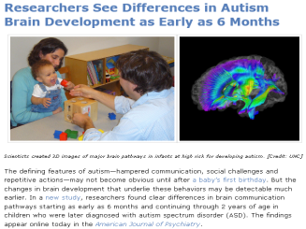
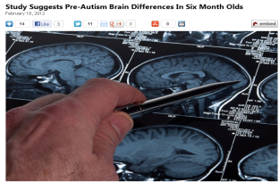

Slide 6
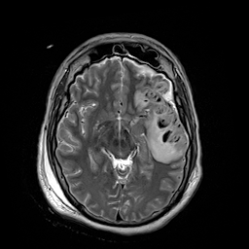
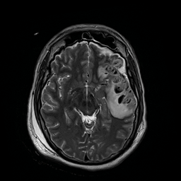
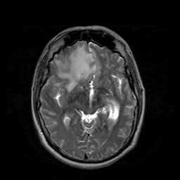
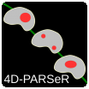
Modeling Brain Changes in longitudinal TBI (UCLA/USC/Utah)
Challenge:
4D-PARSeR (Pathological Anatomy Regression via Segmentation and Registration), M. Prastawa & B. Wang
Time 1
Time 2

Slide 7
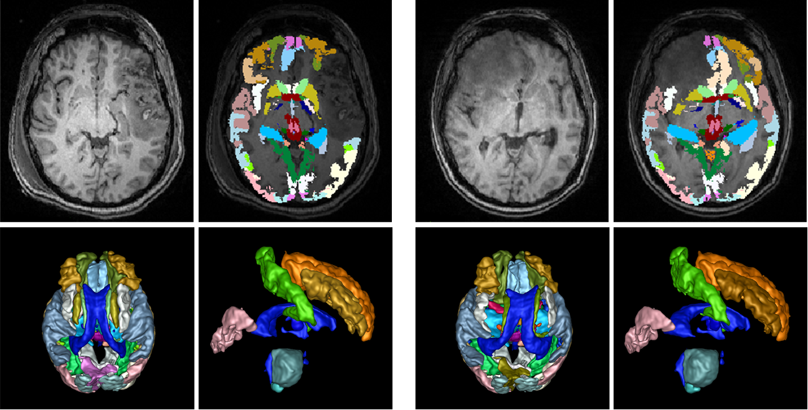
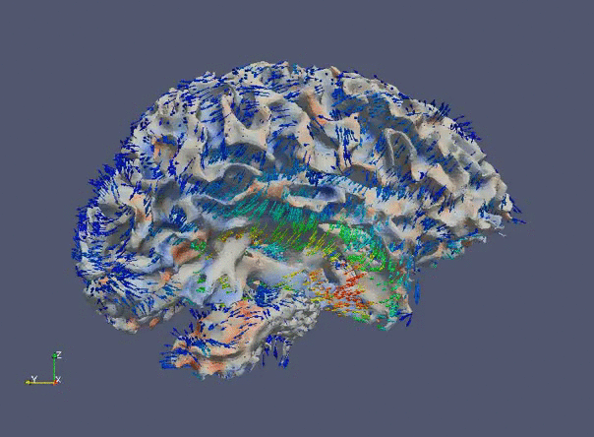
Modeling Brain Changes in longitudinal TBI (UCLA/USC/Utah)
Recipe for success (8 co-authored articles):
NA-MIC support (Core 1 & DBP)
Strong clinical/neuroscience/CS collaboration
Major math and numerical implementation

Slide 8
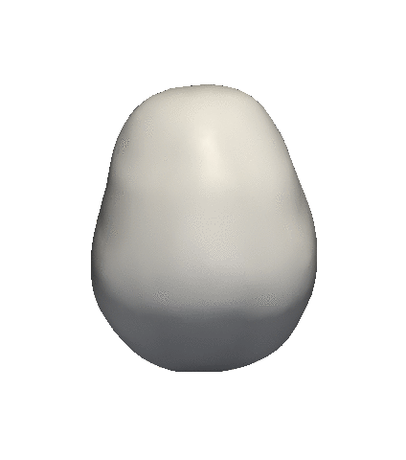
Longitudinal Shape Modeling
Correspondence-free shape statistics (“currents”): Fishbaugh, Durrleman, Prastawa
Complementary to particles (Whitaker/Cates/Styner et al.) – relaxing topology constraints
ExoshapeAccel: C/C++ NAMIC toolkit SW
Plug-in in progress this AHM’14

Slide 9
Longitudinal Shape Modeling
Example mandibular surgery case (L. Cevidanes, NA-MIC ancillary grant).
V2- 16 years of age before jaw surgery in the upper jaw maxilla
V6- 16 years of age 2 months post surgery
V10- 18 years of age, 2 years post-surgery
V12- 22 years of age, 6 years post- surgery

Slide 10
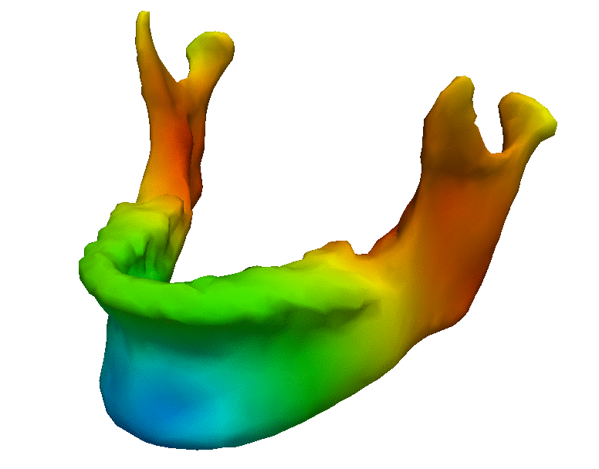
Longitudinal Shape Modeling
Example mandibular surgery case (L. Cevidanes, NA-MIC ancillary grant). Correspondence-free, controlled acceleration, 20’, no tuning.
Color: speed:
blue = slow and red = fast

Slide 11
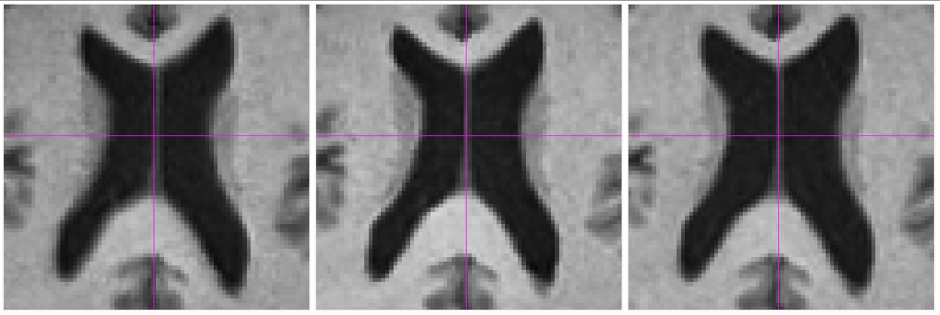
NA-MIC →
Neurodegeneration: Striatal atrophy & wm loss
NAMIC-II: Personalized, subject-specific modeling of longitudinal imaging.
Ancillary Predict HD grant: Utah & Iowa
Prodromal/prediagnostic biomarkers for disease progression and efficacy of therapeutic intervention.

Slide 12
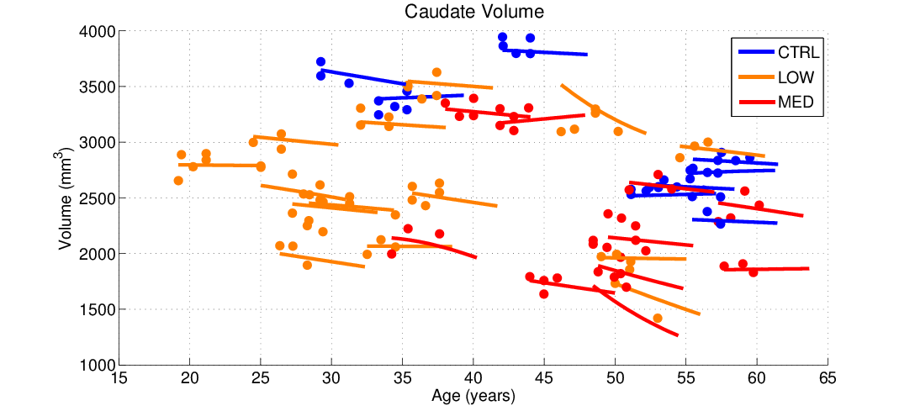
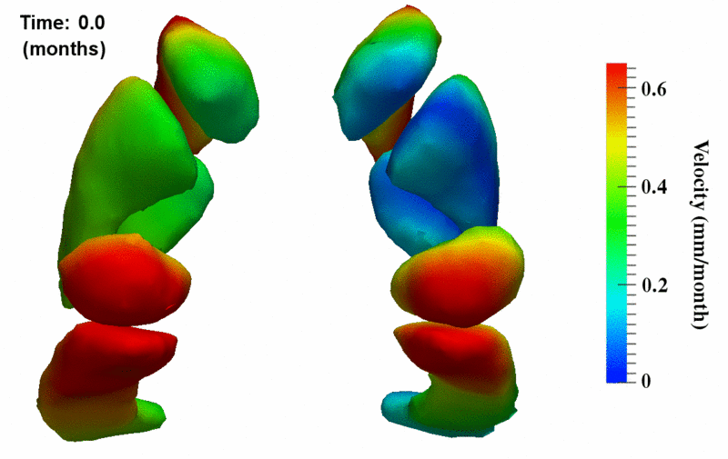
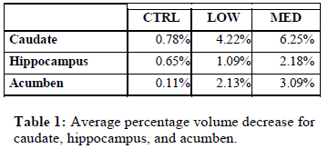
NA-MIC →
Caudate volume for 32 subjects (3 time pts) extracted after shape regression. Observed volumes are shown as circles, which highlight the noise in segmentation.
Notes:
We estimate consistent shape trajectories by considering all shapes simultaneously which respects the interplay between shape boundaries and locations.

Slide 13
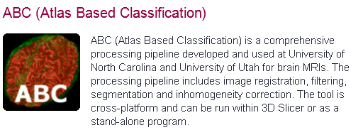
Technical Contributions
ABC Slicer 4 Extension Module
ExoshapeAccel: C/C++ NAMIC toolkit SW for estimating continuous evolution from a discrete collection of shapes.
Public download, tested by Iowa DBP.
MRIWatcher: ITK SW for quick viewing of large #3D datasets, with coupled zoom/scroll, overlays, info: Quick QC, reviewing, comparison.
MRIWatcher

Slide 14
U54 gone, long live NAMIC
NA-MIC funding was excellent opportunity to use research as a vehicle to make new technology available to the community.
NA-MIC became a brandname (e.g. CARS TBI session M. Vannier).
Collaborative spirit and activities will continue.
Ron, a thousand thanks!

