Slide 1
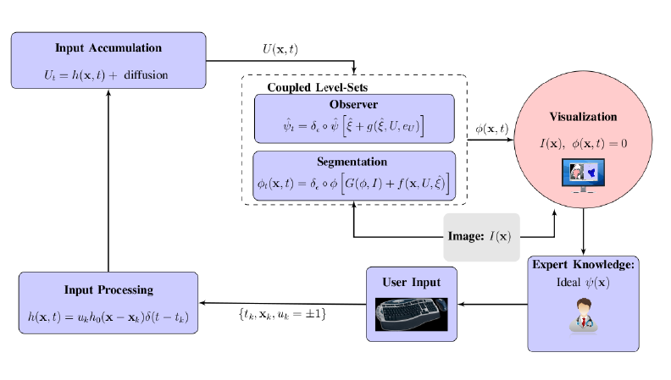
Algorithms (UAB/BU): Interactive segmentation feedback model

Slide 2
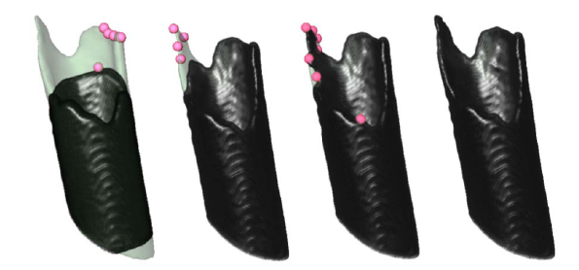
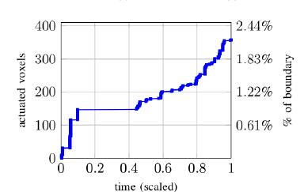
Slicer visualization and fiducials enable effective expert input
Figure: Progressive interactive
segmentation of bone fracture.
Figure: Percentage of voxels in which
there was user input compared to the total
number of voxels making up boundary of
ground-truth segmentation.

Slide 3
Bhattacharyya Distance (BD) vs. Mutual Information (MI) for TBI

Slide 4
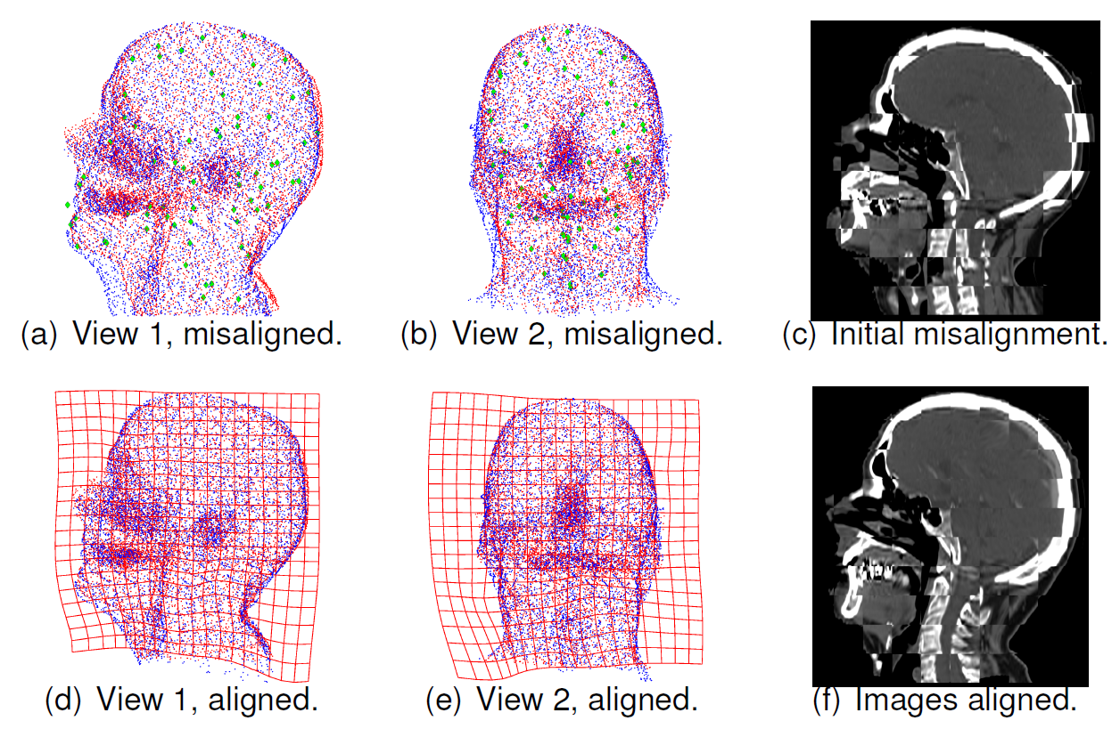
Stochastic point set registration for Adaptive Radiotherapy

Slide 5
Left atrium segmentation
Salient features + shape based evolution
Combine shape priors (Zernike moments) with RSSegmenter in Slicer
Working on Slicer module: Seed region and shape priors
Mult-atlas Kalman filter based approach
L. Zhu Y. Gao, A. Yezzi, R. MacLeod, J. Cates, A. Tannenbaum. Automatic Segmentation of the Left Atrium from MRI Images Using Salient Feature and Contour Evolution. EMBC, 2012.
L. Zhu, Y. Gao, A. Yezzi, A. Tannenbaum, Automatic Segmentation of the Left Atrium from MR Images Via Variational Region Growing with a Moments-based Shape Prior. TMI (submitted).
Notes:
5
5
Purpose:
The segmentation of the LA is the first step in detecting scar tissue for atrial fibrillation treatment.
Method:
In segmentation, a shape prior represented by Zernike moments is integrated with RSSegmenter so that the algorithm is specialized for the LA segmentation. The overall process is automatic and robust.
The first row shows how to detect a seed region for the LA. From left to right are: segmented heart region, edge map, distance map, and detected seed region.
The second row is a growing process starting from a seed region.
Slicer:
The RSSegmenter is available as a module in Slicer. The implementation of the shape prior is C++, which is easy to be integrated into Slicer.

Slide 6
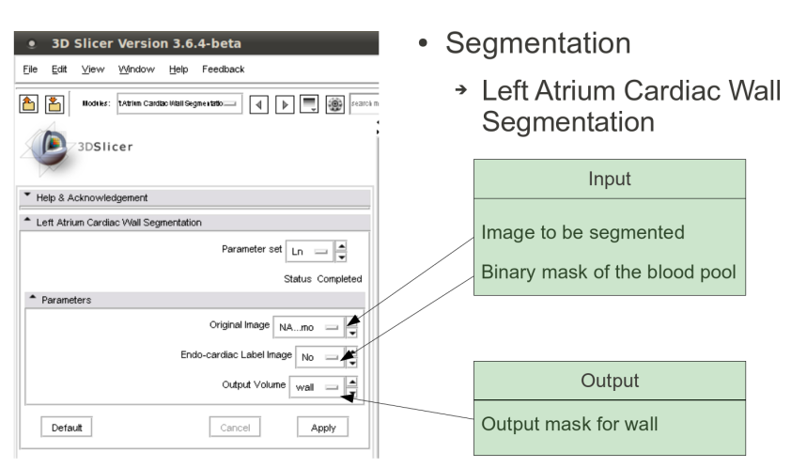
Scar segmentation
Segment myocardium wall
start from endo-cardium
distance modulated contour evolution
local/global evolution method
Sobolev active contours
Scar segmentation in wall
Mixture of Gaussians models intensity
Parameters estimated via EM
Slicer module
LA wall seg
Scar seg in C++
Wall segmenter Slicer3 module
Y. Gao, L. Zhu, A. Yezzi, S. Bouix , A. Tannenbaum. Scar Segmentation in DE-MRI, cDEMRs challenge. ISBI 2012.
Notes:
6
Slicer:
The LA wall segmentation has been integrated into Slicer as an extended module. The second step is implemented in C++ and is easy to be integrated into Slicer.
6
Method:
The scar segmentation is based on the LA segmentation. It consists of two steps:
Left atrial wall segmentation: It expands the LA chamber to a given distance (3mm), which is refined by utilizing the local-global active contour model.
Scar intensity modeling: the intensity inside the wall is represented by a Mixture of Gaussian, and the component with a higher value is classified as the scar intensity.
Slicer:
The LA wall segmentation has been integrated into Slicer as an extended module. The second step is implemented in C++ and is easy to be integrated into Slicer.

Slide 7
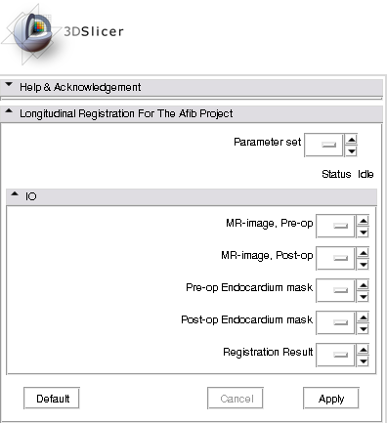
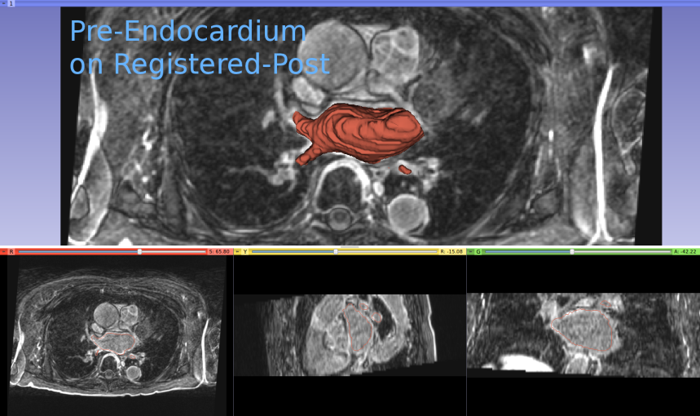
Longitudinal registration
Post-to-pre ablation MR registration
Accurate around left atrium
Registration couples MR images and LA masks
Delivered as Slicer module
Slicer module UI
Pre-endocardium overlay on registered post-MRI
Notes:
7
7

Slide 8
Longitudinal shape analysis
Two groups of LA shapes
AFib cured/recurred after ablation
Each subject has two time points
Shape differences along time?
Shape interpolation using optimal mass transport
Shape analysis at continuous time points
Statistical differences in the distribution of the contrast agent (related with fibrosis) between cured/recurred groups?
Notes:
8
8
8

