Slide 1
NAMIC Activities at UNC
Image Analysis
  DTI QC via Monte Carlo Simulation
  Longitudinal atlases with intensity changes
  DTI Registration with pathology
  Fiber tract analysis framework
Shape Analysis
  Longitudinal shape correspondence
  Groupwise cortical correspondence
  SPHARM-Particle shape analysis framework
TBI
HD
Methods
Engineering

Slide 2
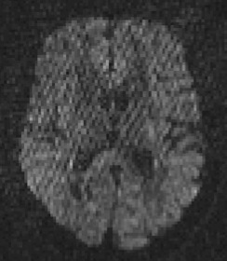
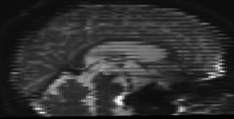
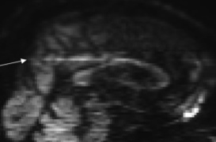
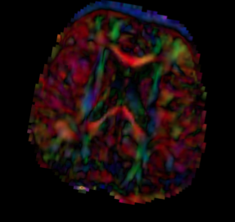
DTI QC – Error distribution
  DTI/DWI noisy, artifact rich => QC needed
  Rejection of bad gradients
    How much rejection is still okay?
    Simple threshold on numbers of rejected DWI?
  Goal: Estimate error distribution via Monte Carlo
  Reject dataset based on error requirements
    Error in FA or principal direction

Slide 3
DTI Error Distribution
1% FA error for HD
10° error for tractography/tumor

Slide 4
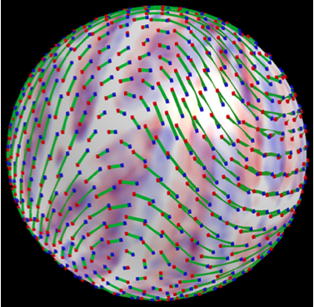
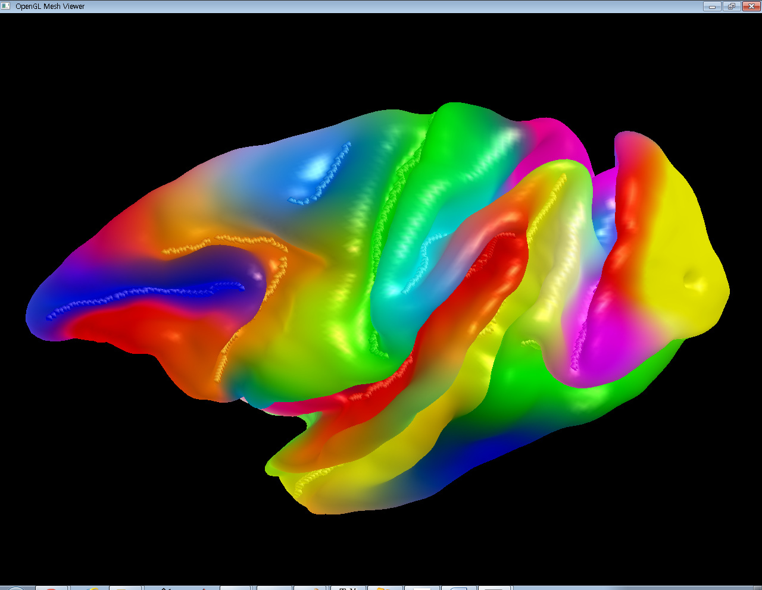
Cortical Correspondence
Goal: Flexible, group-wise correspondence on human cortex
  Allow for point and sulcal landmarks, longitudinal info
Existing NA-MIC particle based correspondence
    No guarantee on surface mesh topology
      Spherical parametrization
    No explicit registration/deformation
      Spherical harmonics encoding
      Local angular deformation
      Optimal pole choice

Slide 5
Group-wise Correspondence
Entropy on sulcal depth & landmarks
  Exponential spherical mapping
Color based correspondence QC

Slide 6
Cortical Correspondence

Slide 7
Brain Shape Regression
Utah NA-MIC shape regression applied to pediatric brain shape
Craniosynostosis pathologic brain development

Slide 8
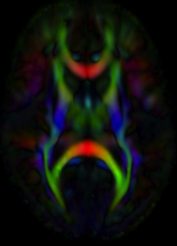
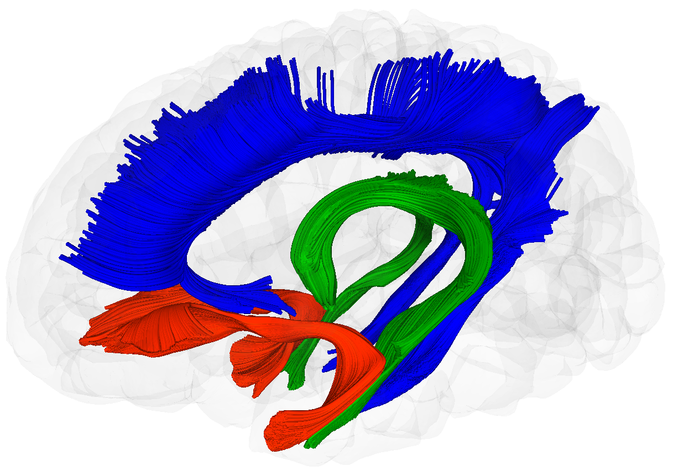
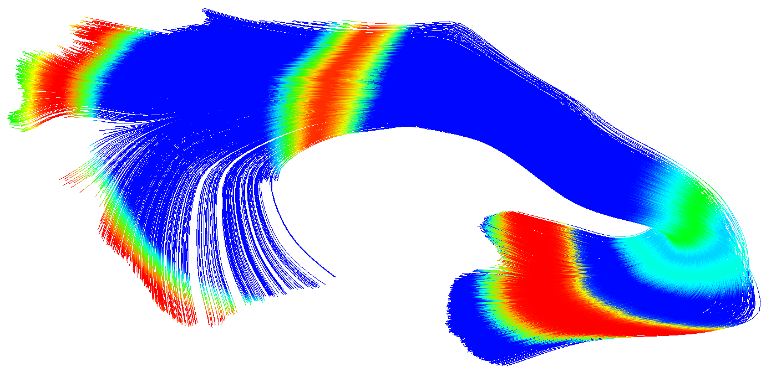
UNC-Utah DTI Framework
NA-MIC Algorithms from UNC, MIT, Utah, Iowa
Comprehensive tools
  DWI/DTI QC
  DWI/DTI-Atlas building
  Tractography
  Fiber metrics
  Profile analysis
Slicer compatible

