Slide 1
MIT Algorithms
Polina Golland

Slide 2
Project overview
Non-parametric segmentation
  Exemplar-based priors
Brain connectivity modeling
  Joint models of anatomical and functional connectivity
  Huntington’s disease
Models of pathology evolution
  Segmentation and time series modeling
  Traumatic brain injury

Slide 3
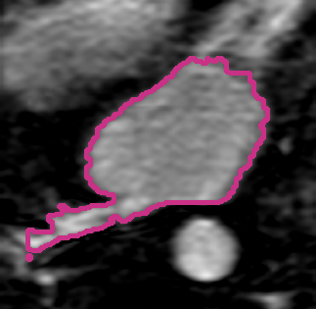
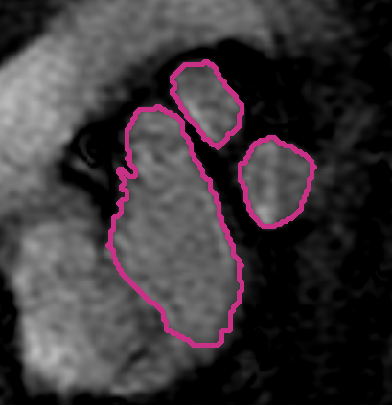
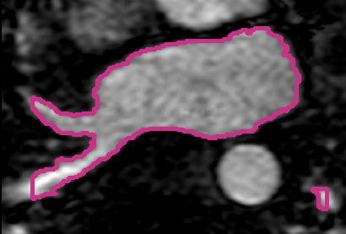
Non-Parametric Segmentation
Generative model for label fusion
  Segmentation algorithms
Applications: brain, left atrium of the heart
Volume Overlap
Sabuncu ‘09, ‘10; Depa ‘10

Slide 4
Efficient Label Fusion
Pre-align all training images
Use one registration to align new image
Perform label fusion
Depa ‘11

Slide 5
Going Forward
Common coordinate frame
  Understand reduction in accuracy
  Registration uncertainty
  Interesting theoretical connections
Application to radiotherapy planning
  Main challenge: accurate registration
  Registration in the presence of pathology and artifacts

Slide 6
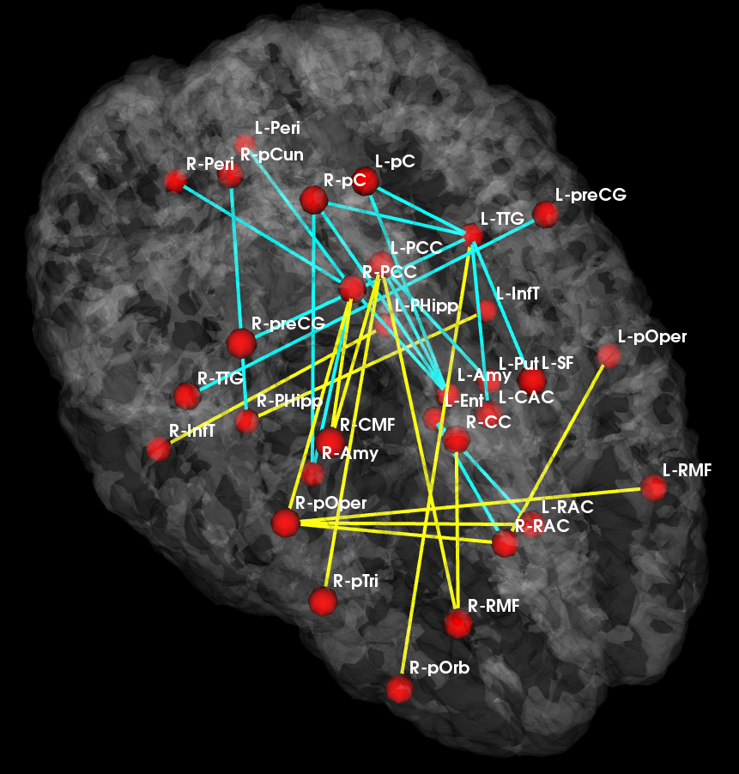
Brain Connectivity Modeling
Joint model for anatomical and functional connectivity
  Latent group connectivity template
  Signal likelihood shared across subjects
Application to population studies
  Changes in the connectivity template
Reduced
Increased
_{Control Template}
_{Disease Template}
Venkataraman ‘10, ‘12

Slide 7
Recent Results and Future Plans
A model of disease foci
  Region-based model of connectivity changes
  From connection-based to region-based
Going forward
  Application to a broad range of diseases, including HD

Slide 8
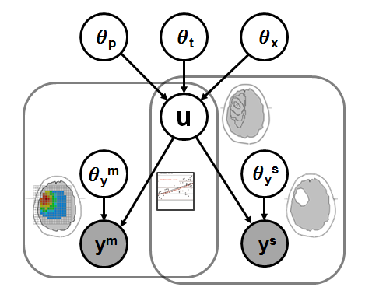




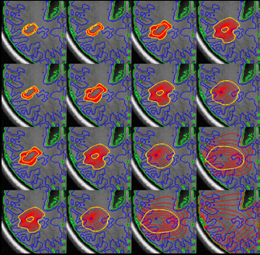
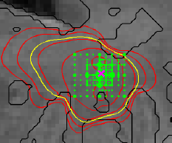
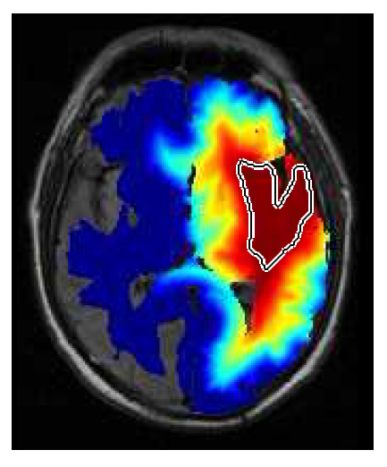
Evolution of Pathology
Physical model of evolution
  Diffusion reaction, proliferation
Statistical model of imaging
  Segmentations and spectroscopy
Output: model parameters and prediction
Menze ‘10, ‘11

Slide 9
Conclusions
Methodological developments
  Exemplar-based segmentation
  Connectivity analysis
  Segmentation and evolution of pathology
DBP challenges
  Registration in the presence of pathology
  Connection between physiological models and image analysis
Going forward
  Joint work with the DBPs on application

