Slide 1
CARMA Inhomogeneity Correction Filter Tutorial
CARMA Center
The University of Utah

Slide 2
Overview
Implementation of a local intensity correction for inhomogeneity due to coil placement in cardiac LGE-MRI images
Intensity correction is specific to LGE-MRI cardiac images
Inputs are a segmented region on which to base the intensity gradient model and a segmentation of the region of interest to apply the correction

Slide 3
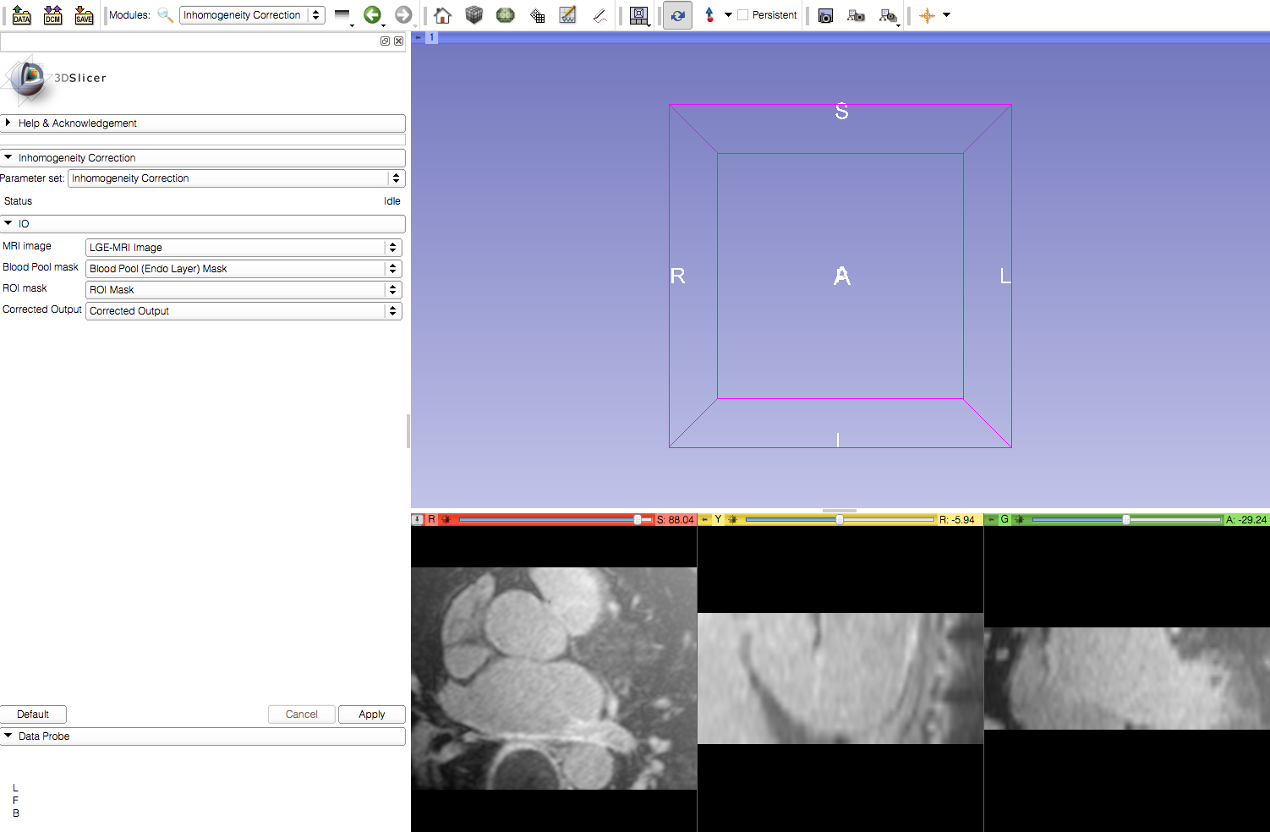
Step 1: Load Input Images
In this tutorial a blank image was used as an ROI mask

Slide 4
Step 2: Create Output Image File

Slide 5
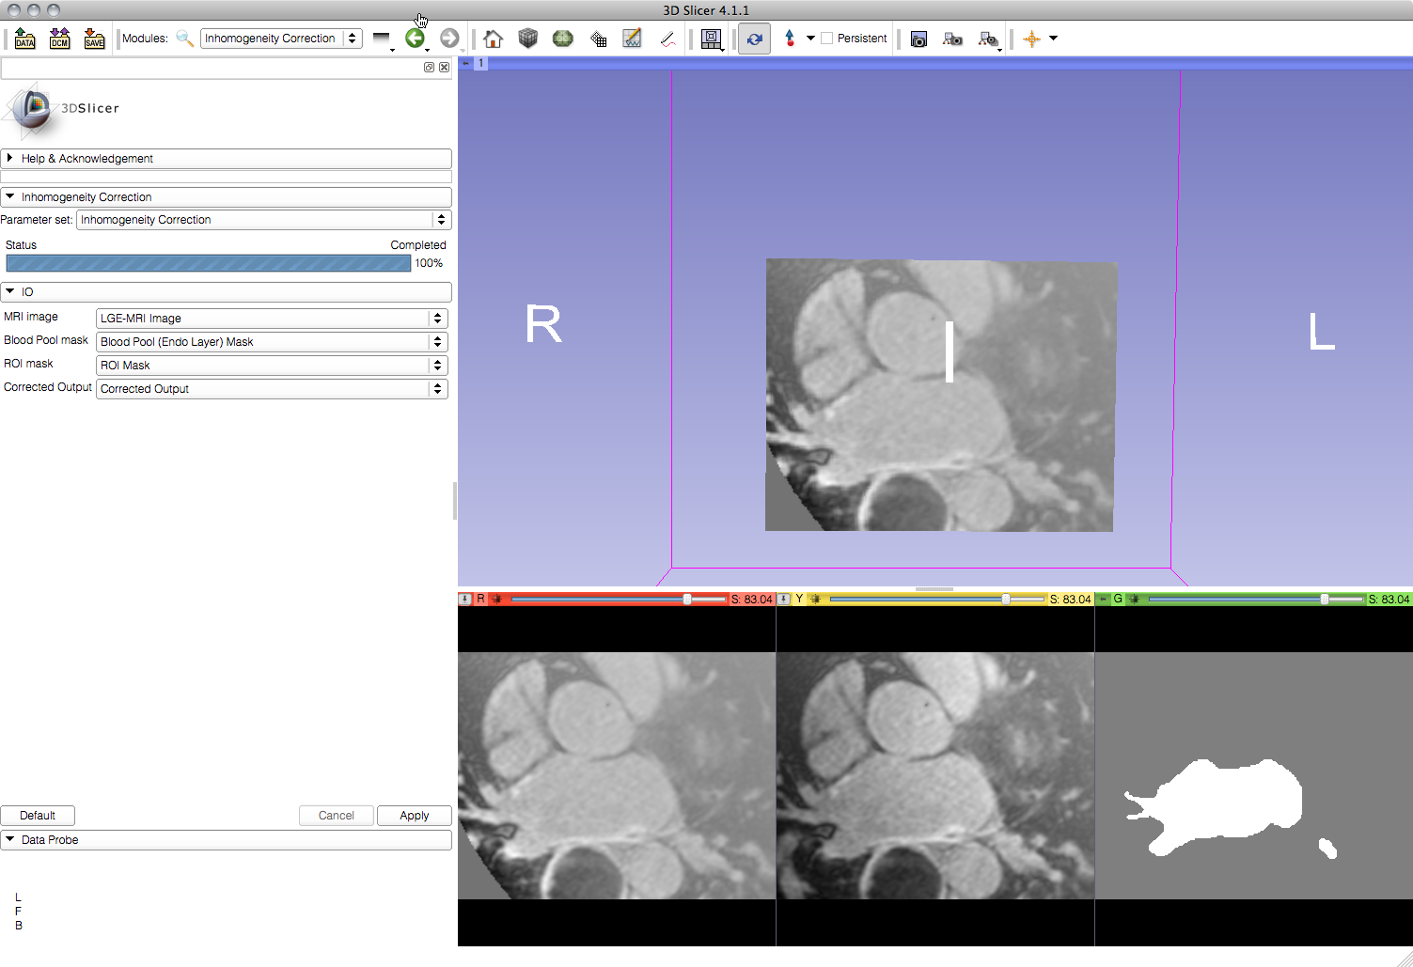
Step 3: Apply Filter
Corrected Image
Original Image
Blood Pool Mask

