Slide 1
Improvements in SlicerRT, the radiation therapy research toolkit for 3D Slicer
Csaba Pinter¹, Andras Lasso¹, An Wang², David Jaffray², and Gabor Fichtinger¹
¹Laboratory for Percutaneous Surgery, Queen’s University, Canada ²University Health Network, Toronto, ON, Canada

Slide 2
Motivation behind SlicerRT
Commercial treatment planning systems (TPS)
Existing research tools CERR, PLUNC, dicompyler, etc.
Inconvenient
Limited feature set
Expensive
Closed
Insufficient user and developer support
Cover only routine clinical procedures
Open-source?
Well documented
Free
Poor documentation
Not extensible
User-friendly
Extensible
Large, non-modular code base
Not flexible
Flexible
Stable
Unstable
Open-source
Platform-independent
SlicerRT
Notes:
Lack of a comprehensive and open radiation therapy toolkit
RT researchers use commercial TPSs along with existing research tools. Both categories have serious shortcomings when being used for research purposes.
.. aspires to overcome these limitations, and also congregate their strong properties, such as …

Slide 3
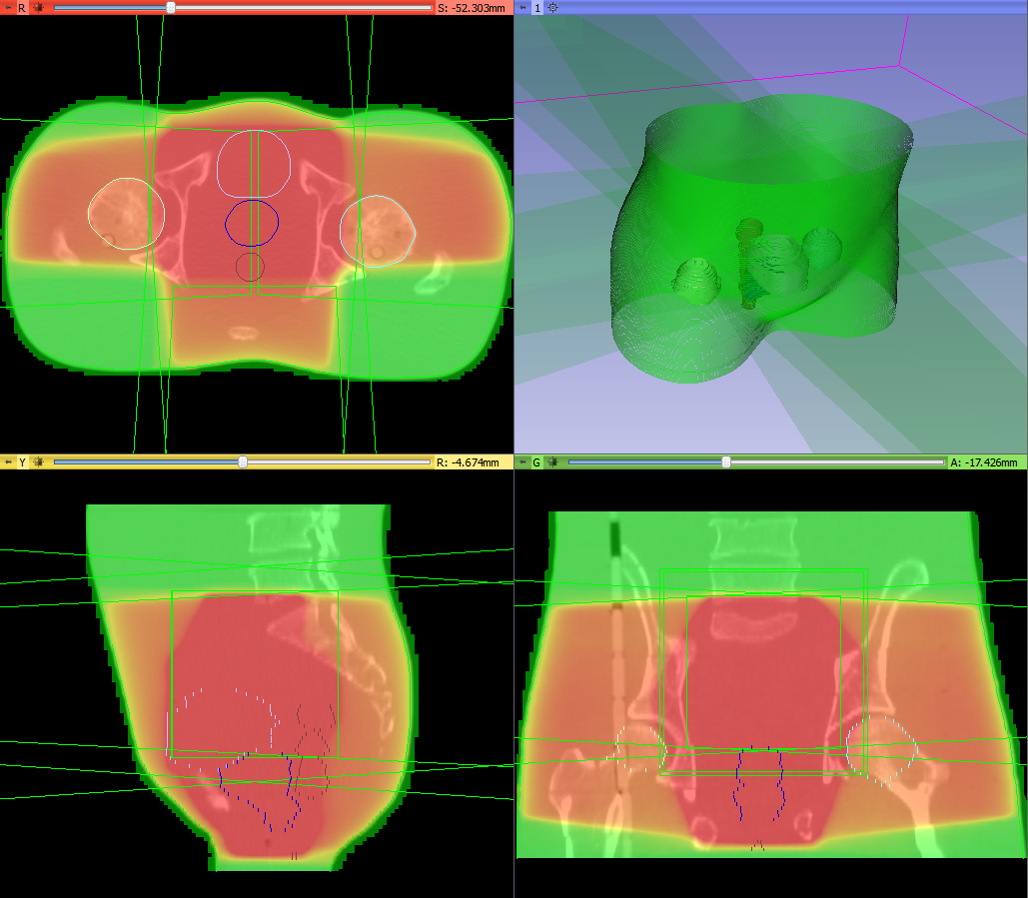
DICOM-RT import/export
Import integrated into core DICOM import plugin mechanism
Supported data types:
RT structure sets → Contours → Fiducial point
RT dose map
RT image
RT plan isocenter, beams
Planning CT, MR, etc.
Basic DICOM-RT export is implemented
Standard layout after loading phantom dataset
Notes:
- … main feature groups of SlicerRT
- The first step of every RT research workflow … broad spectrum of data … seamless handling and loading of the data using only the DICOM browser in 3D Slicer.
- export

Slide 4
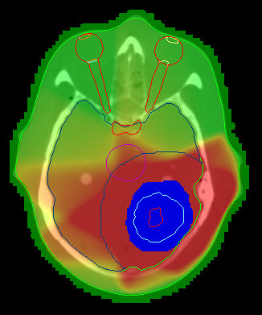
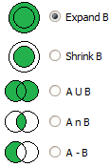
Contour analysis
Multiple representations (automatic conversion)
Ribbon model
Rasterized volume
Closed surface model
Contour comparison
Dice coefficient
Hausdorff distance
Contour morphology
Expand, shrink
Combine using logical operators
Ribbon model
Rasterized volume
Closed surface
Notes:
easy handling of the imported structure set contours, by offering multiple representations and automatic conversions between those. The supported representations are…
Improving this feature is one of our main focus: rasterize, closed surface

Slide 5
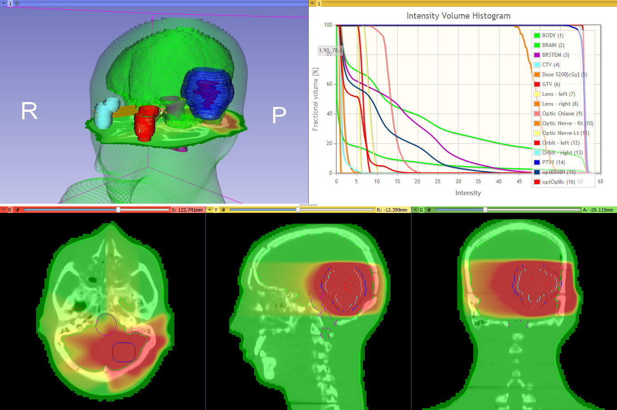
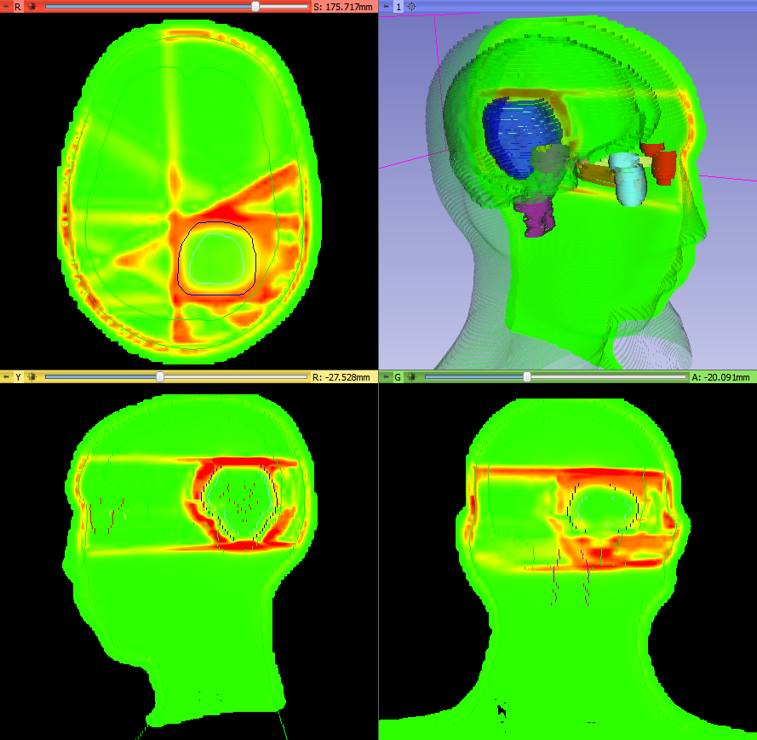
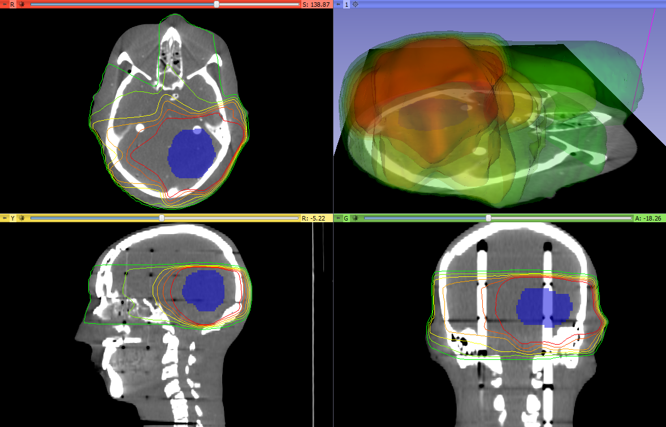
Dose analysis
Dose volume histogram (plot visualization + metrics)
Dose accumulation
Dose comparison (gamma)
Isodose contours / surfaces
External beam planning (photon, proton)
Registration
BSpline registration
Landwarp registration
Dose volume histogram
Gamma dose comparison
Isodose contours and surfaces

Slide 6
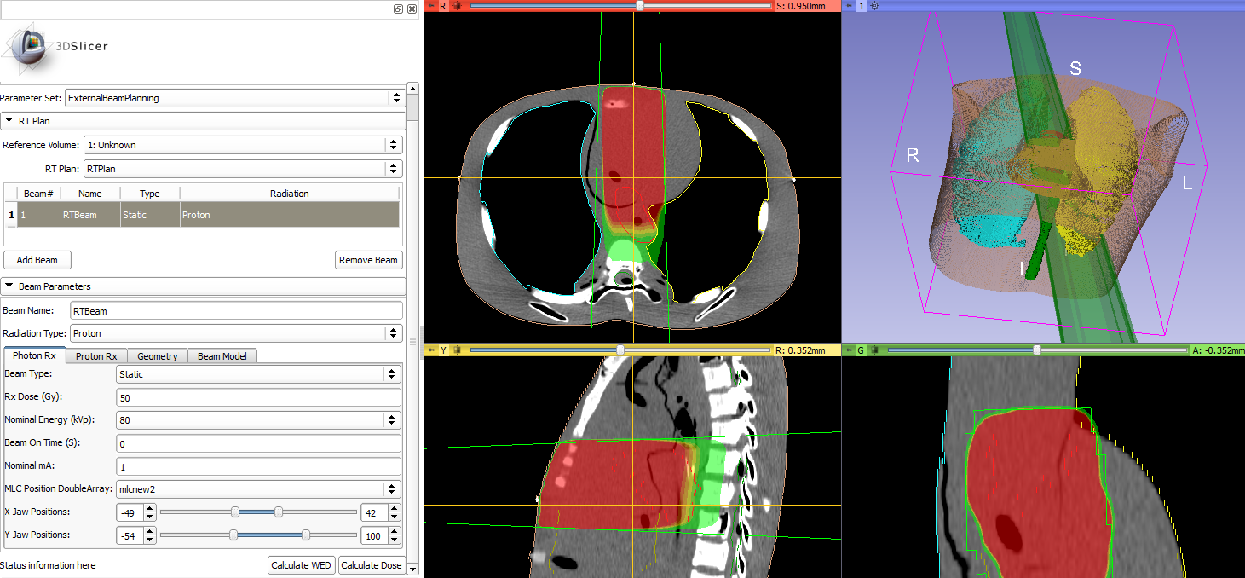
External beam planning
This module provide basic framework for RT planning and dose calculation for photon and proton
Photon MLC beam created in external beam planning module
Notes:
This module provide basic framework for RT planning and dose calculation.
1. Visualize RT plan, loaded or created. 1A. QA purposes 1B. IMRT optimization (once they have a nice dose matrix, they want to show the beams overlaid with the dose)
2. Dose calculation

Slide 7
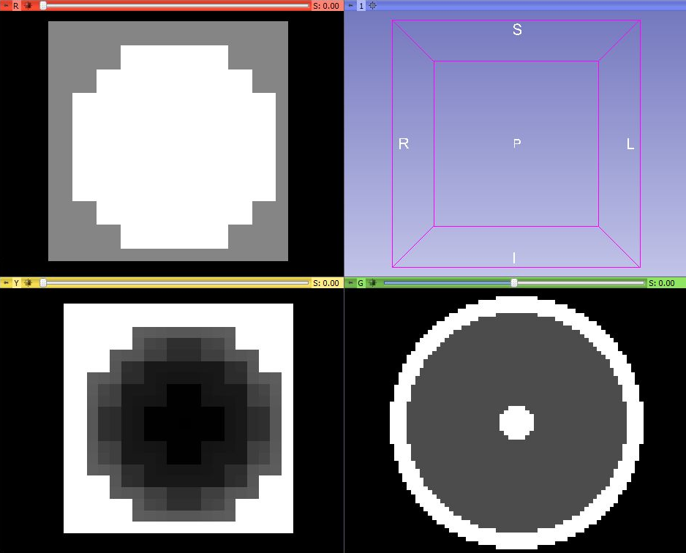
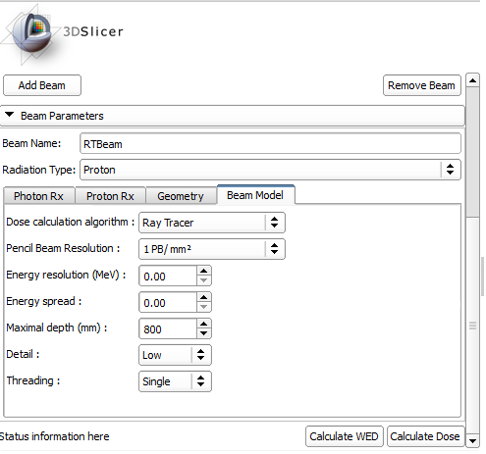
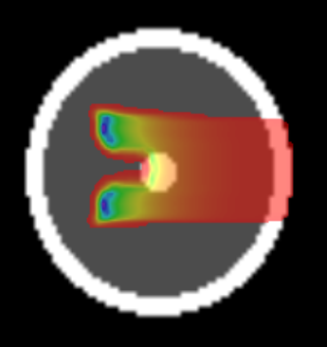
External beam planning - proton
Aperture
Range compensator
Target
External beam planning module UI
Beam dose distribution
Notes:
Spherical target at the center of a cylinder.
Choose target in UI -> Aperture, conform to the target
Range compensator: black=thin, gray=thicker

Slide 8
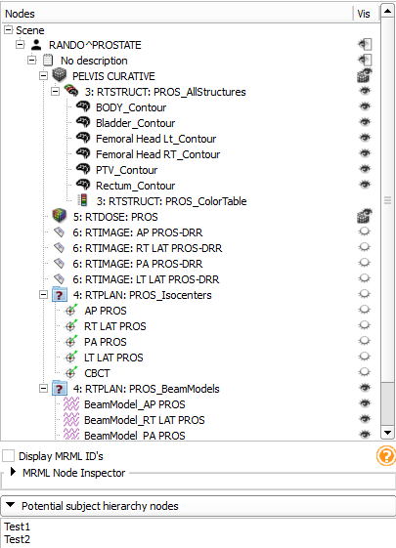
Subject hierarchy
New concept for organizing data
Nice and intuitive way of organizing and handling data Bring basic features in a data-centered tree view, such as
Show/hide
Transform branch
Extendable through plugins Broad API allowing many customizations, such as
DICOM export
Registration
Subject hierarchy module widget
Notes:
Our other current focus of research and development is data management …
many nice RT-related features, overviewing the loaded data inconvenient … familiar to TPS and eval. ws.

Slide 9
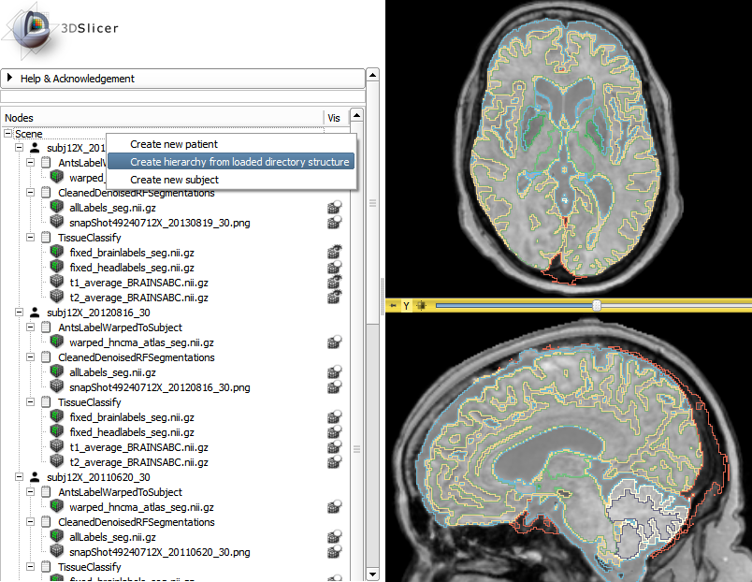
Subject hierarchy - plugins
Default
DICOM
Volumes
Registration
Parse local data
Contours
RT objects
Many more to come …
ParseLocalData plugin in action
Notes:
- Wide range of problems to solve here
- Most plugins provide a role that the data nodes can assume, for example … other plugins provide only context menu actions (PLD)
- Generally, these plugins provide the tree processing functionality to allow a more data-centric usage of Slicer instead of the operation and module centric approach … please keep this in mind when you use this module, and need only one or two small features to make your workflow more easy to perform

Slide 10
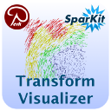
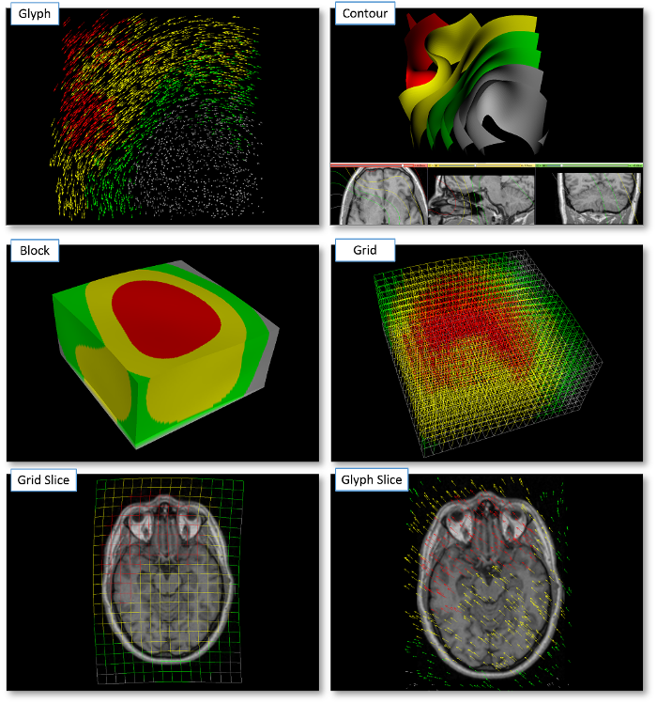
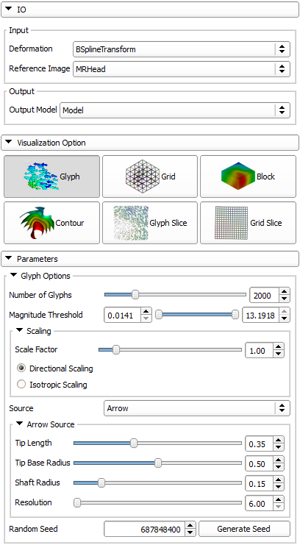
Transform visualizer

Slide 11
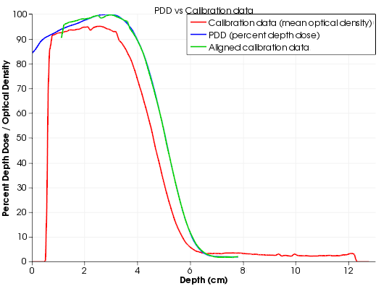
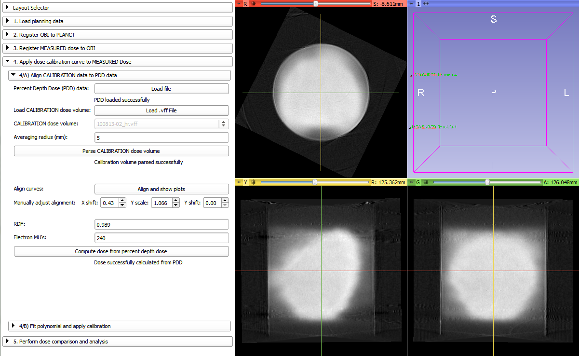
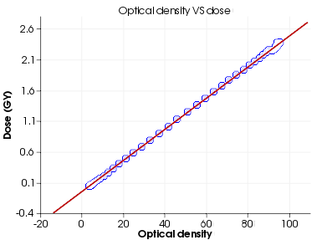
Gel dosimetry analysis
“Slicelet” for gel dosimetry analysis workflow
Wizard-like simplified user interface
Notes:
- basically a Slicer module that includes a full layout, and can be run separately from the main Slicer window, thus allowing a simplified, workflow-based interface, so that the user can focus on the task at hand.
- Gel dosimetry … used in commissioning new radiation techniques and comparison of planned and delivered dosage, among other things
- wizard-like

Slide 12
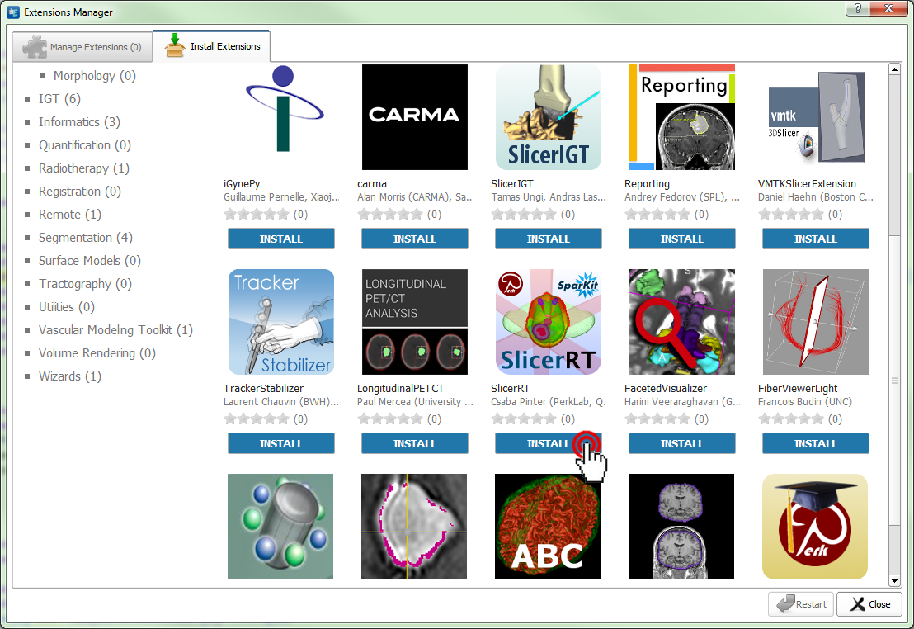
SlicerRT extension for 3D Slicer
Collection of RT-specific modules, includes
Distributed as a 3D Slicer extension: can be downloaded, installed, upgraded using the extension manager in Slicer
SlicerRT extension in the 3D Slicer app store (free)
Notes:
SlicerRT is distributed as a 3D Slicer extension. It can be easily found and installed from the Slicer Extension Manager.

Slide 13
Next steps
Planned for the next 6 months:
DICOM-RT export
External beam planning
Contour mechanism – integration to 3D Slicer core
Digitally reconstructed radiograph (DRR)
Rasterization evaluation and improvements
Scripting examples
More testing and validation
More information: http://SlicerRT.org
Notes:
Suggestions, comments and feature requests are warmly welcome! Our weekly meetings every Wednesday are also open to anybody to discuss any matter related to the toolkit.

Slide 14
Thank you for your attention!

