Slide 1
Core 1b – Engineering Retrospective “You may ask yourself, well, how did I get here?” – Talking Heads
Jim Miller
GE Research

Slide 2
October 22, 2003. First contact
Dear friends,
as you know, we have been talking about the creation of a software application center for BIRN. NIH just released an RFA which is well suited in size and scope for this endeavour and will require only minor modifications to our intended approach. I would like to invite you all to particpate in the development of an application. Please take a few minutes to review the RFA. Specifically, please review the requirements about the software dissemination in the supplementary instructions in the lower third of the RFA. I will contact you within the next few days to follow up.
Ron
January 24, 2004. Grant submitted
May 26, 2004. Study section review

Slide 3
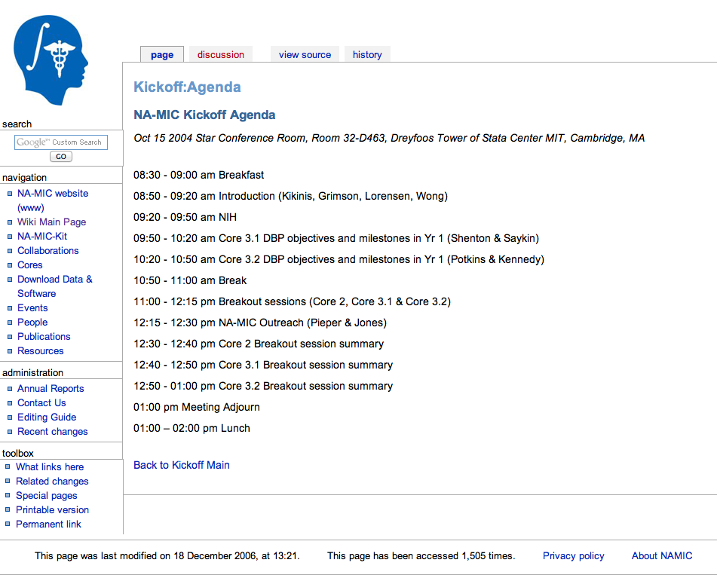
October 15, 2004. Kickoff

Slide 4
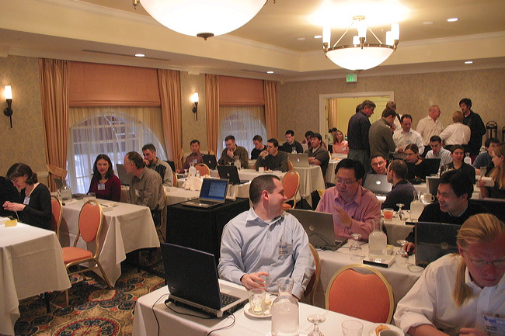
AHM 2005. An architecture defined

Slide 5
April 11, 2005. Coordinate frames
RASToRAS Transforms
SliceToRAS Matrix
XYToSlice Matrix
RASToIJK Matrix
RAS to RAS Coordinates
Slice Coordinates
XY Image Space Coordinates
IJK Volume Coordinates
Original ITK design – image orientation should be managed at the application level
Under NA-MIC - we recognized this was a limitation, particularly when handing data between Slicer and CLI’s
Added direction cosines to ITK Image and propagated through the toolkit
March 28, 2005. Generalize ITK transform IO
March 15, 2008. Optimized ITK B-spline registration
April 1, 2008. Slicer transform IO
January 8, 2014. Slicer slice visualization with non-linear transforms

Slide 6
June 27, 2005. Introducing Programming Week

Slide 7
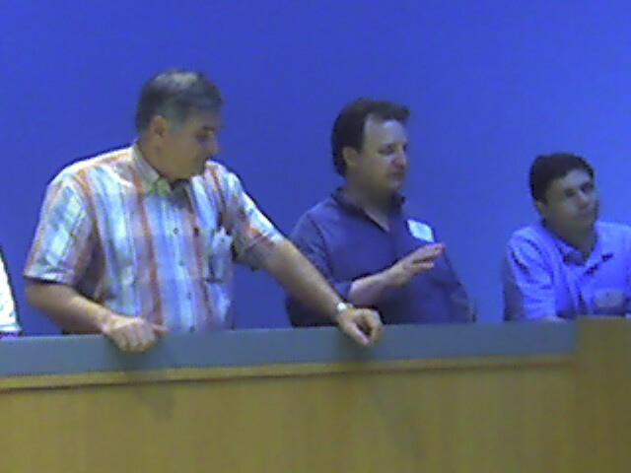
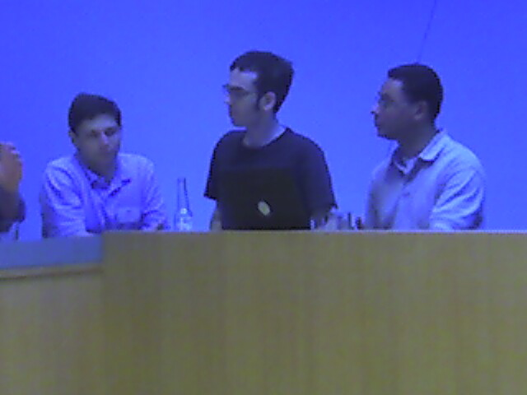
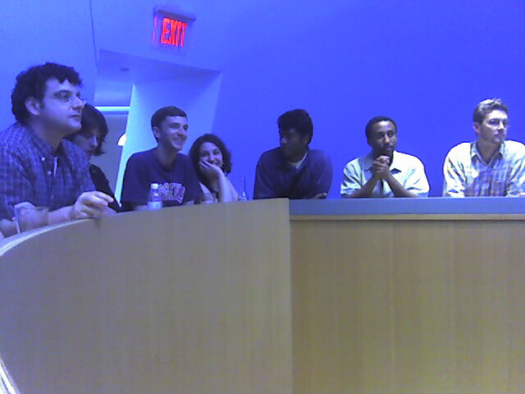
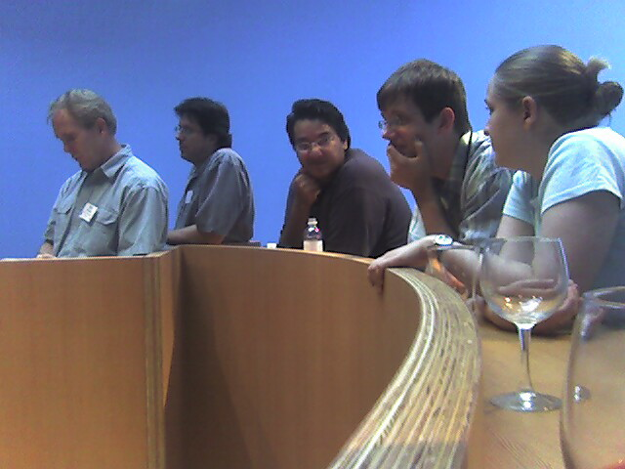
June 21, 2005. Debating licenses

Slide 8
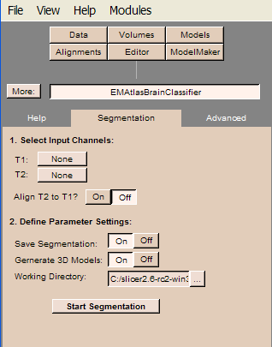
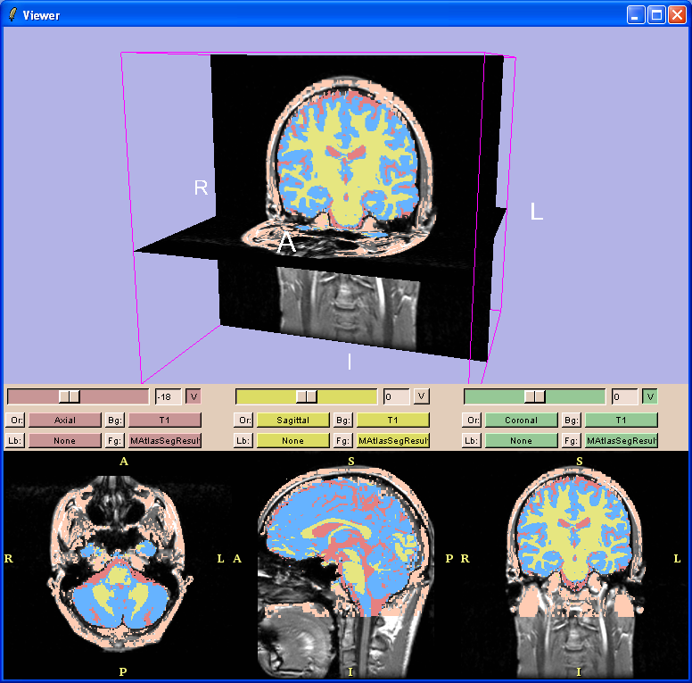
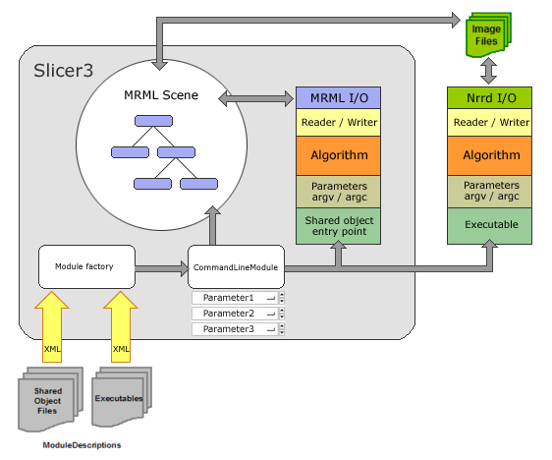
May 23, 2006. Core 1 Meeting at UNC
Steve Pieper and Jim Miller take a beating from Core 1 on Slicer 2.x
Calmer heads prevail. Steve and Jim present the Slicer3 plugin modules
“There must be something wrong with this…” – Polina Golland

Slide 9
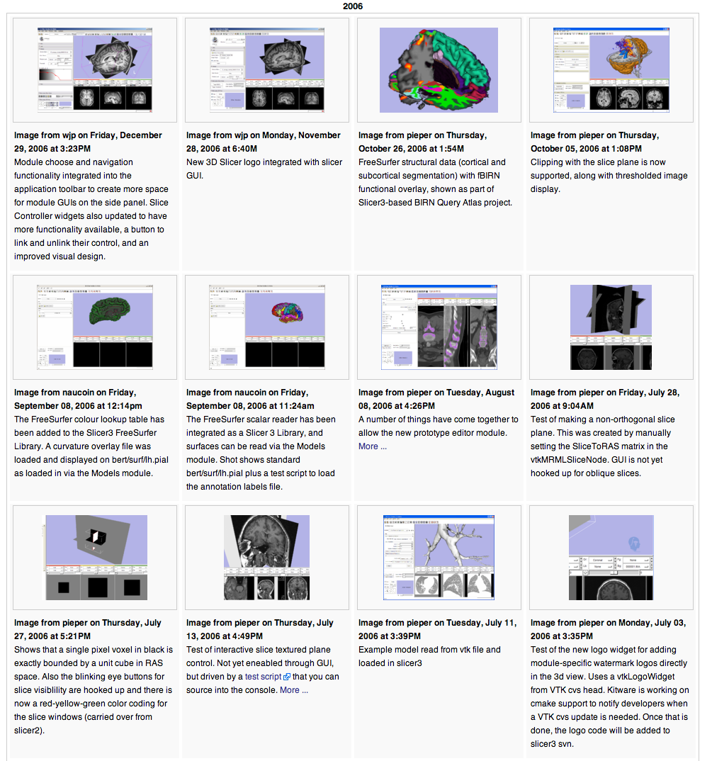
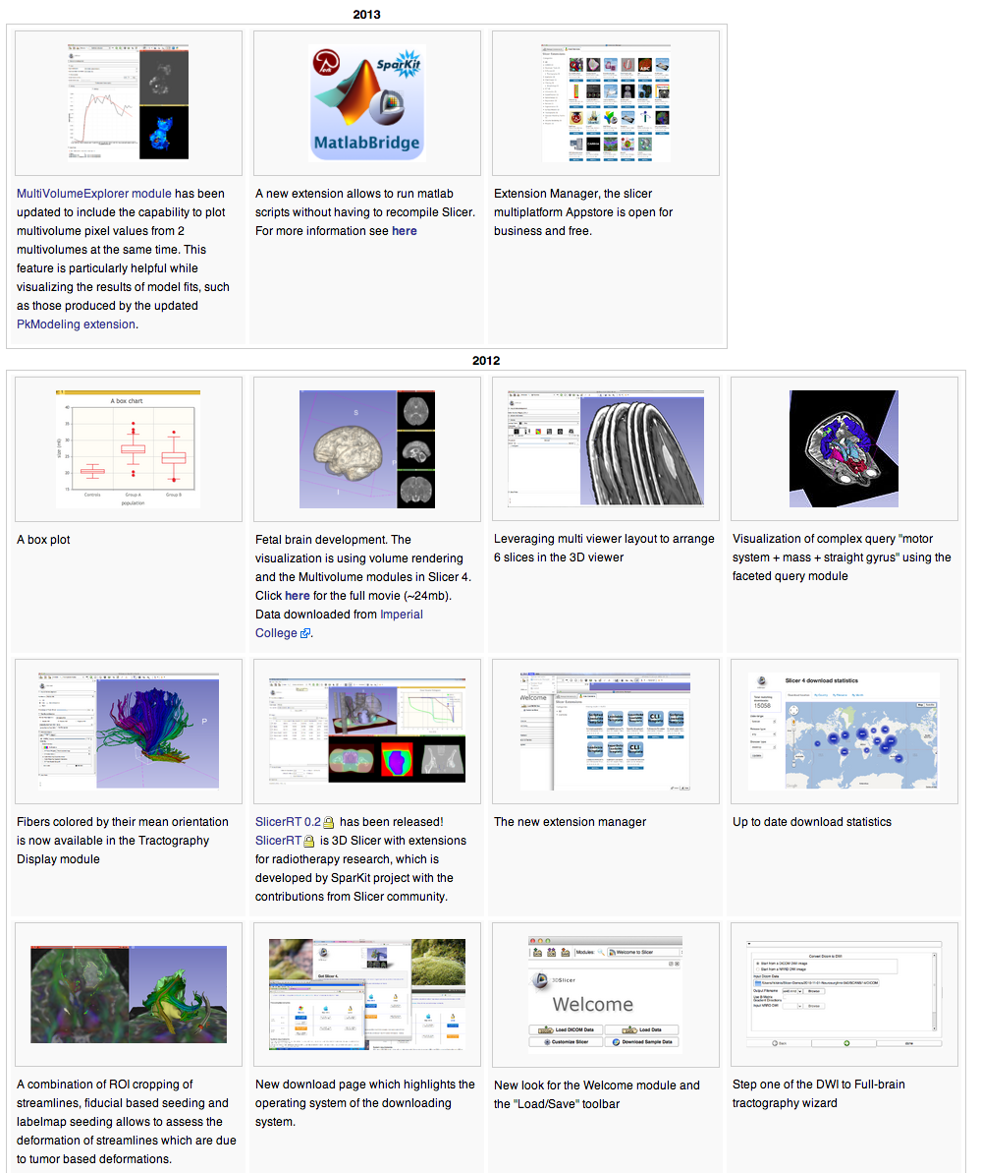
June 13, 2006. Visual Blog

Slide 10
June 26, 2006. Shared object CLIs
/** \class MRMLIDImageIO
* \brief ImageIO object for reading and writing images from a MRML scene
*
* MRMLIDImageIO is an ImageIO object that allows you to
* retrieve/store an image in a MRML node using a standard ITK
* ImageFileReader or ImageFileWriter. This allows a plugin to be
* written once and compiled into a shared object module that Slicer
* can communicate with directly or compiled into a command line
* program that can be executed outside of Slicer. …
*
* The "filename" specified will look like a URI:
* slicer:<scene id>#<node id> - local slicer
* slicer://<hostname>/<scene id>#<node id> - remote slicer
*
* This code was written on the Massachusetts Turnpike with extreme
* glare on the LCD.
*/

Slide 11
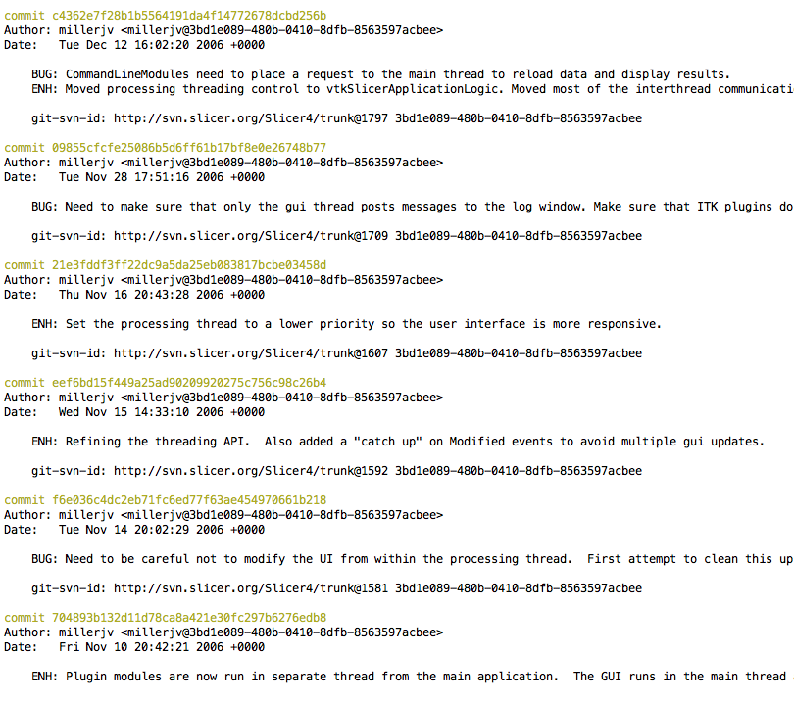
Fall 2006. GUI and Processing Threads
GUI Thread
Processing
Thread

Slide 12
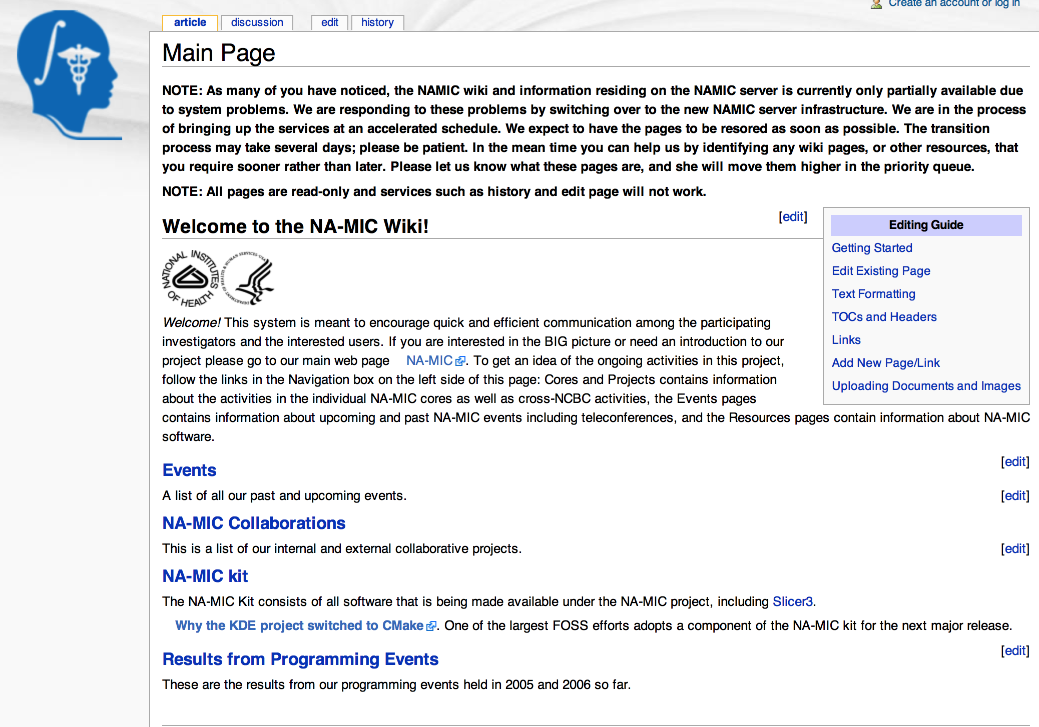
December 7, 2006. The day the wiki died
Disk failure
3 of the 5 disks in the RAID 5 died
Missing backups
Sometime in 2006 a change in file system permissions caused the backups to fail
Heroic efforts by Andy Cedilnik to reconstruct the wiki
Google cache
Personal browser caches

Slide 13
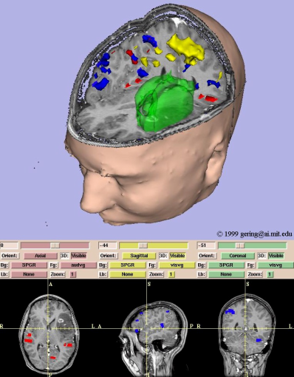
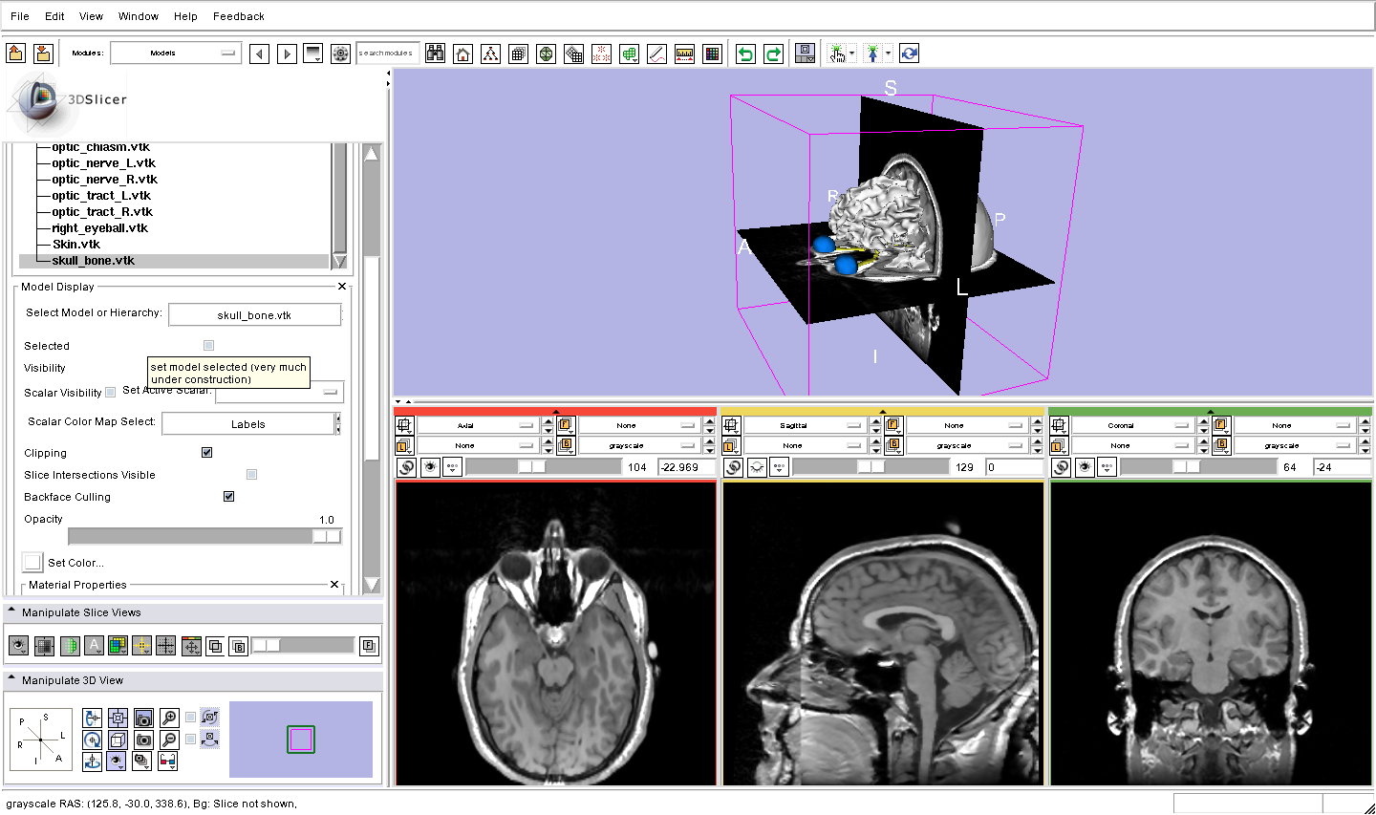
January 2007. Slicer 3 Beta
3D Slicer Version 2
3D Slicer Version 3

Slide 14
January 25, 2007. Python
To date, Tcl was the scripting language for Slicer (Slicer, Slicer 2, Slicer 3)
Dan Blezek magic to catch calls to unknown methods in python and delegate to Tcl
Luca Antiga from Mario Negri Institute extended plugin infrastructure to support Python modules
Python is now the primary scripting language in Slicer 4

Slide 15
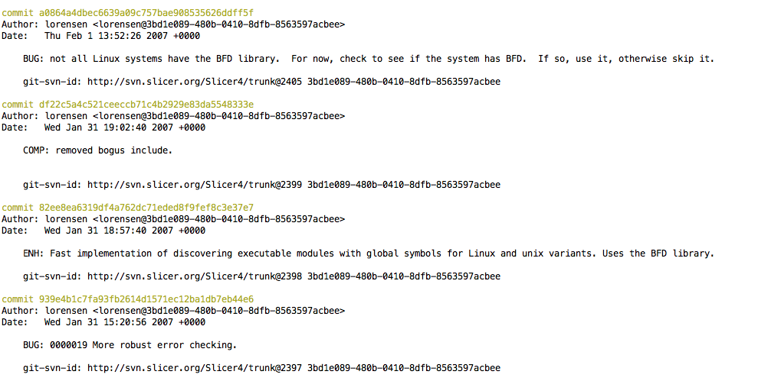
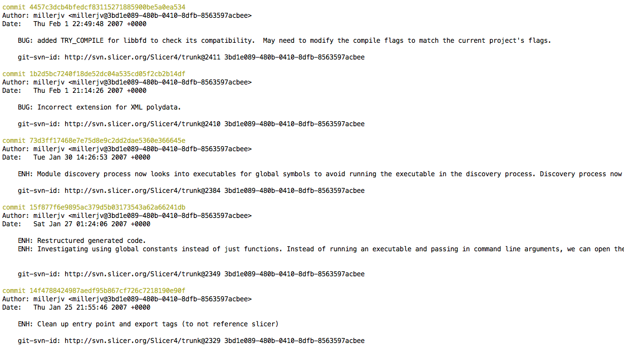
January 31, 2007. Bill Lorensen retires
But Jim made Bill work a full day
Integrating LibBFD into the Slicer Execution Model to speed up CLI discovery and Slicer3 launch

Slide 16
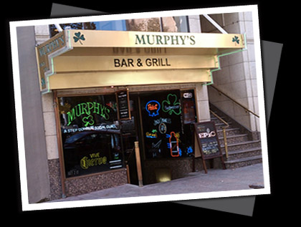
Bill’s Retirement Party

Slide 17
Bill’s 2nd Annual Retirement Party

Slide 18
Bill’s 8th Annual Retirement Party

Slide 19
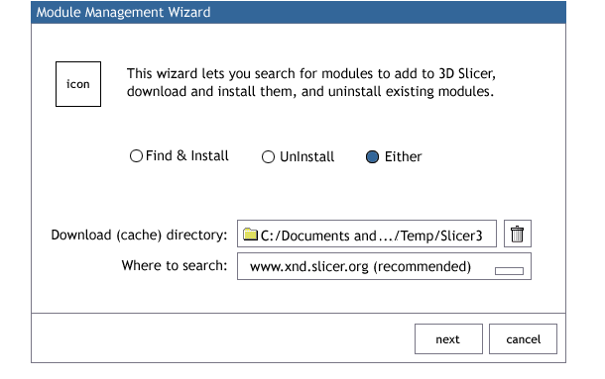
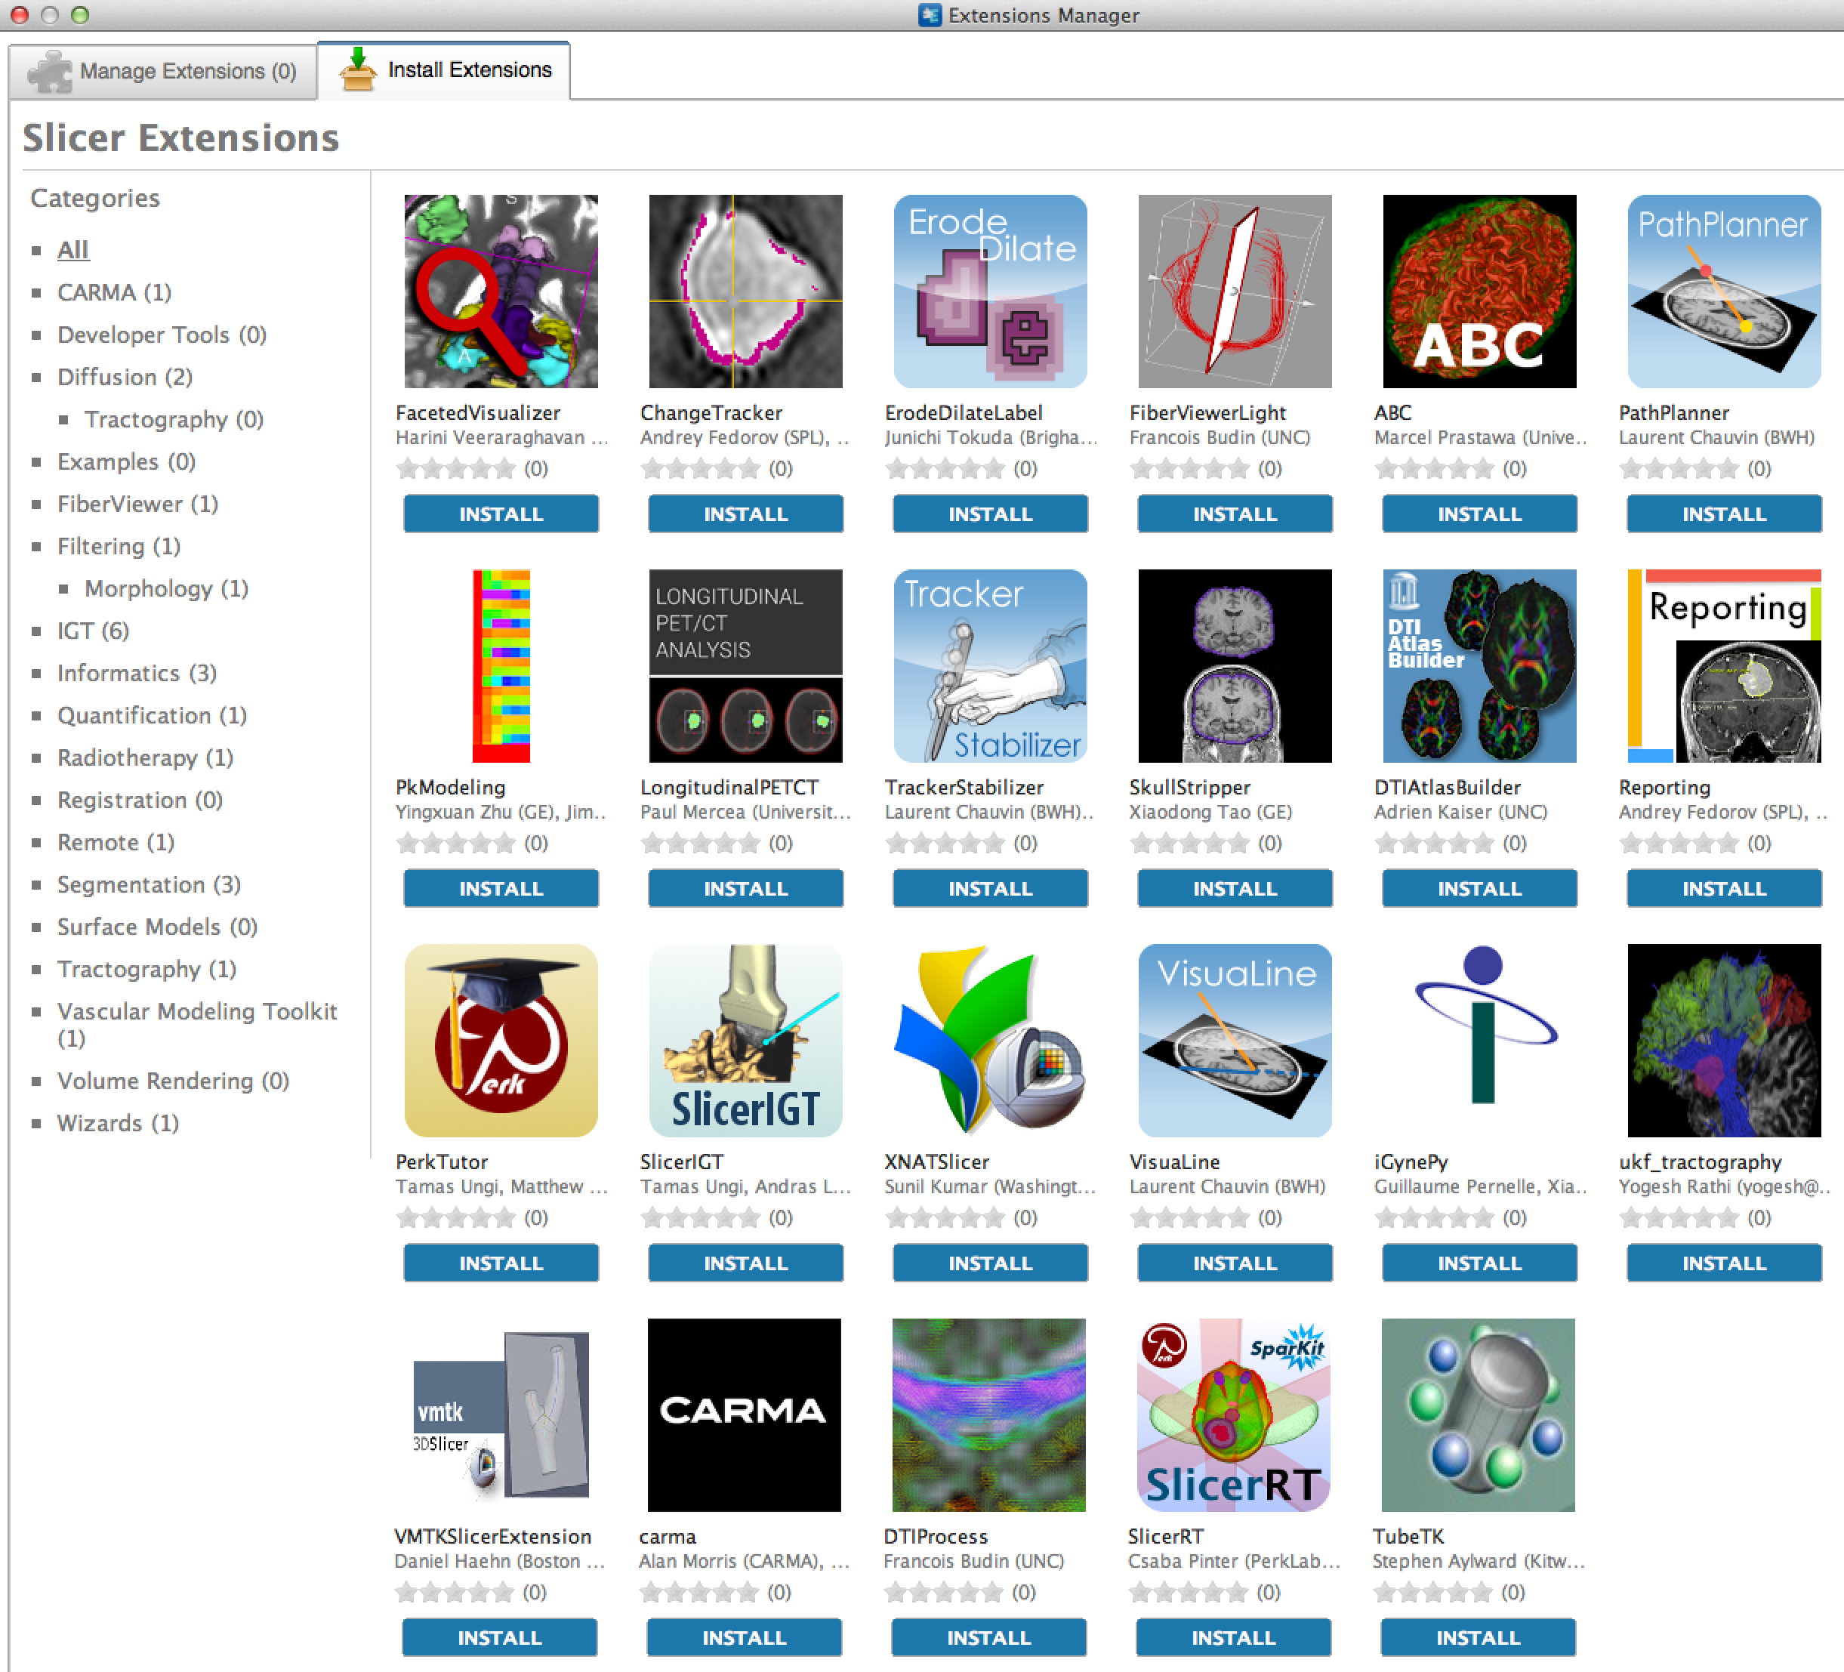
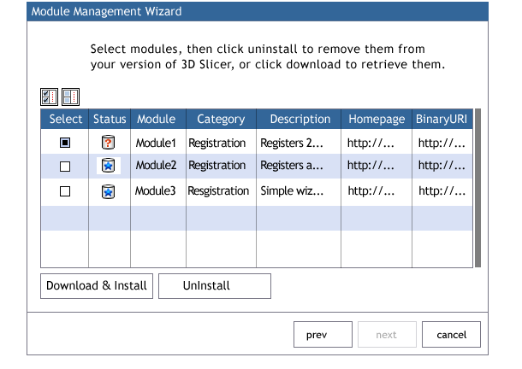
December 30, 2008. Extensions
2008
2013

Slide 20
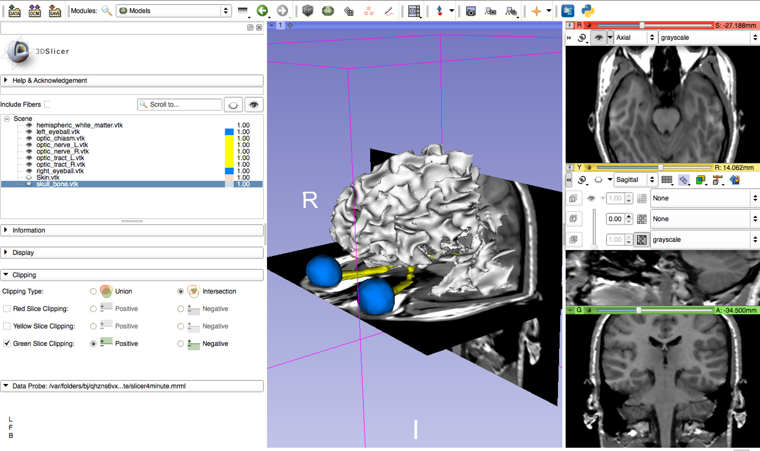
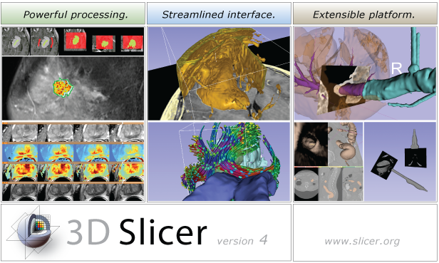
August 18, 2009. Introducing Qt
3D Slicer Version 3
3D Slicer Version 4

Slide 21
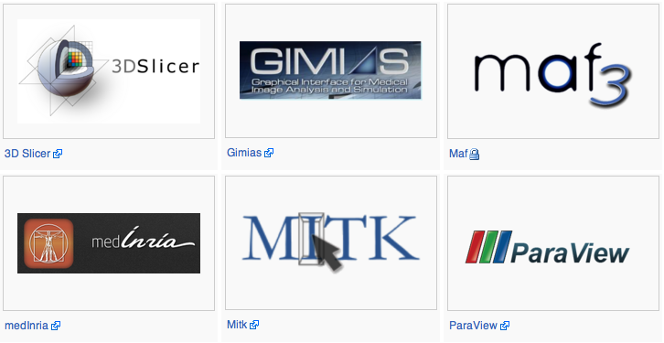
September 25, 2009. Introducing CTK

Slide 22
October 28, 2009. SuperBuild
Building the 3D Slicer requires building several external packages
Automate checkout, patch, configure, build
Slicer3 Tcl scripted build
$ getbuildtest.tcl
Difficult to identify and recover from errors
Slicer4 CMake scripted build
$ ccmake ../Slicer
$ make

Slide 23
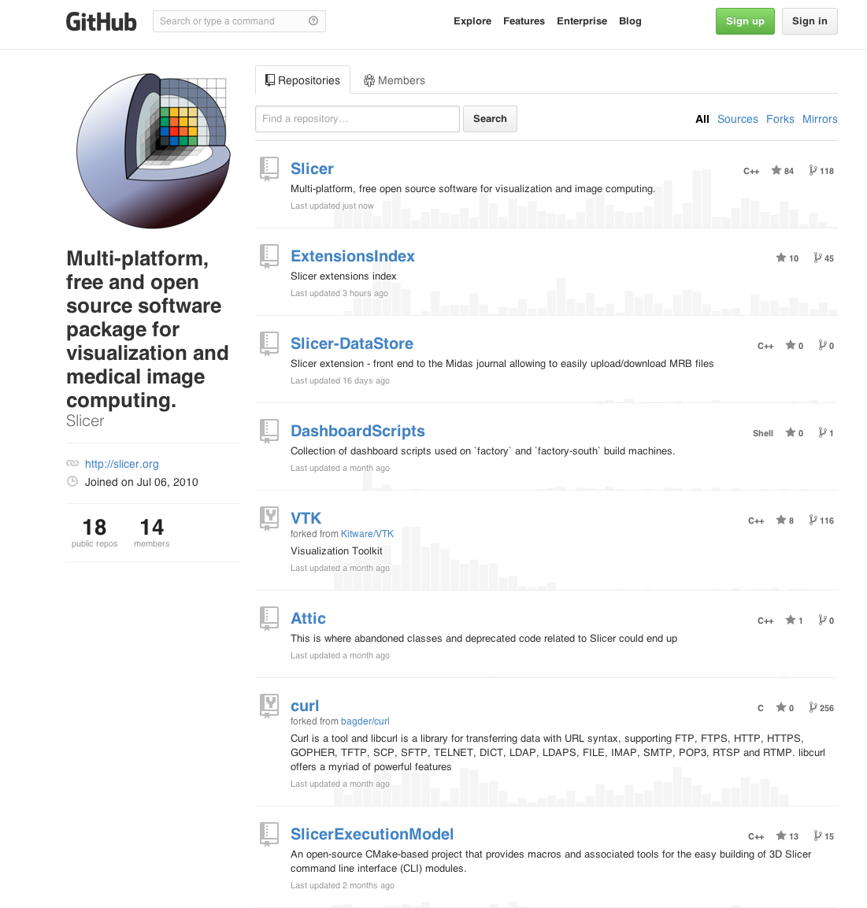
July 6, 2010. GitHub
Increased collaboration
forks, branches, pull requests
Sharing components with other systems
CTK
SlicerExecutionModel
Manage 3rd Party versioning and patches
Extension management

Slide 24
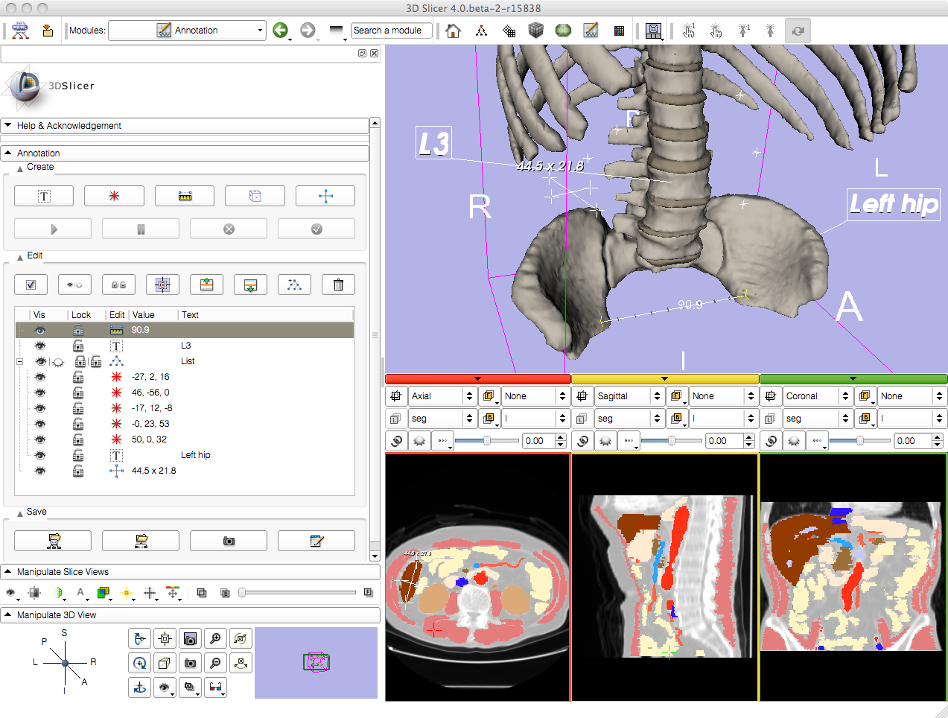
July 28, 2010. Annotations

Slide 25
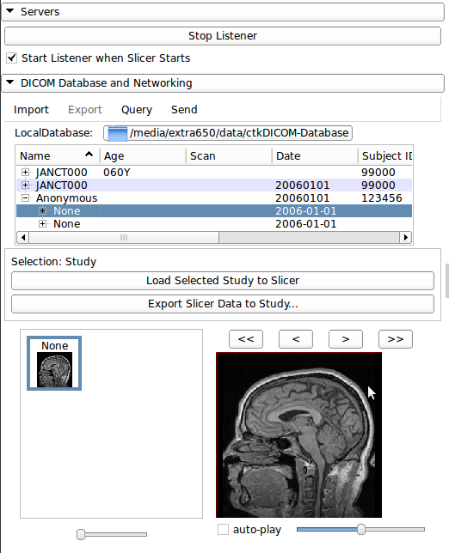
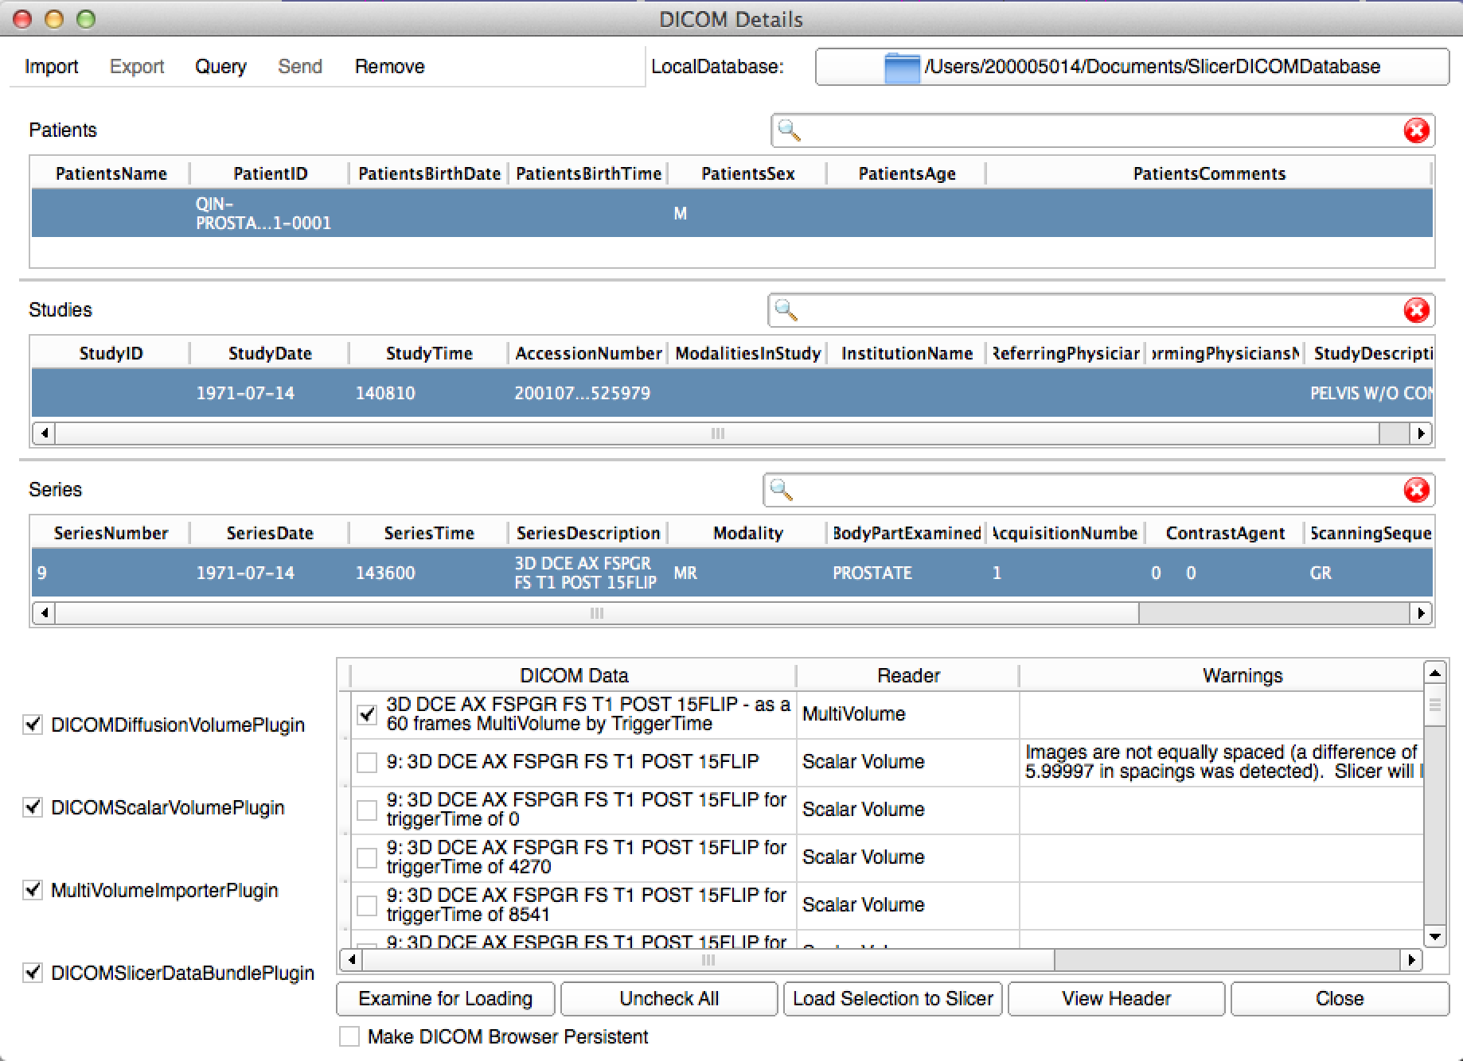
October 20, 2011. DICOM
2011
2014

Slide 26
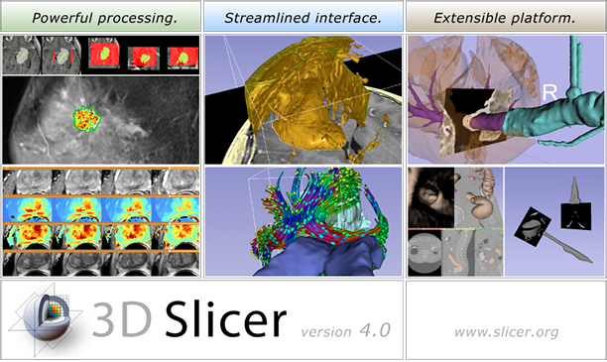
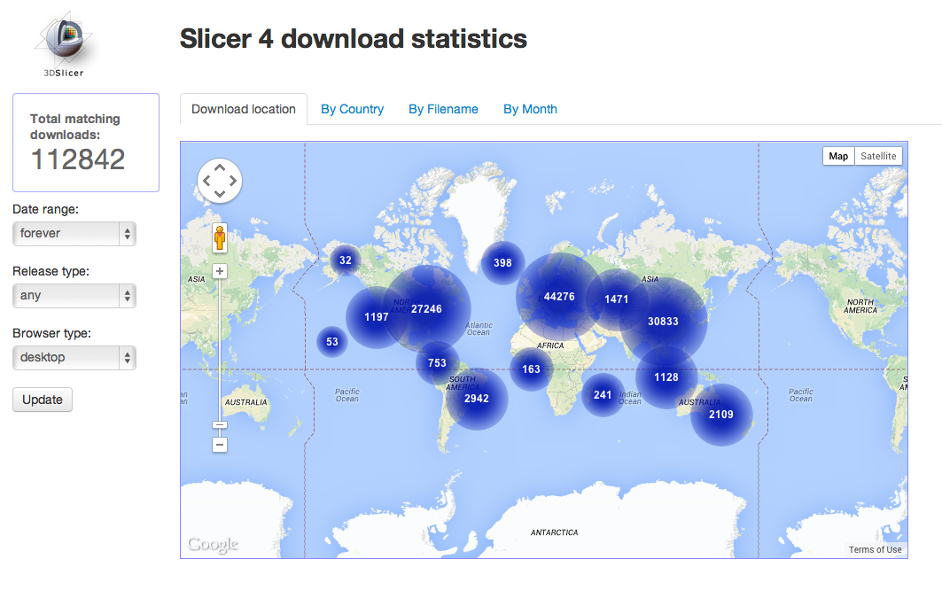
November 28, 2011. 3D Slicer Version 4

Slide 27
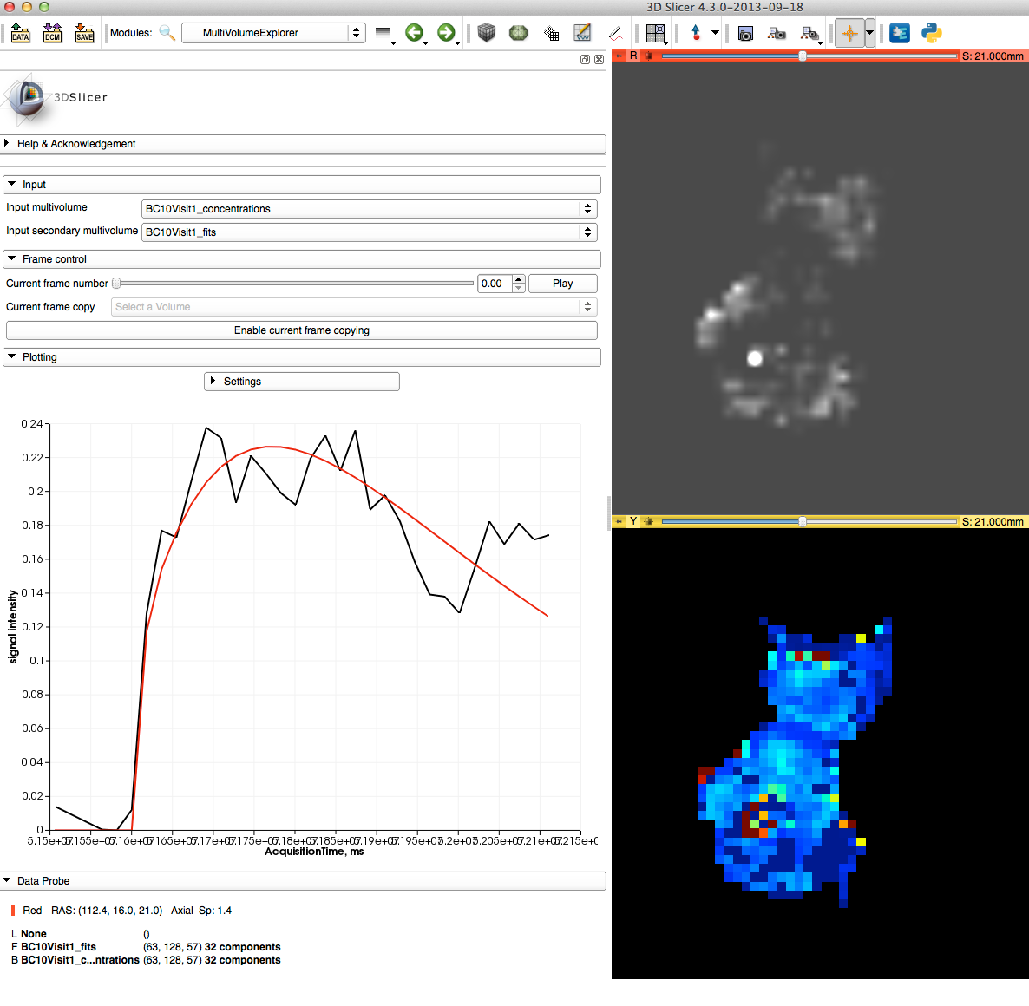
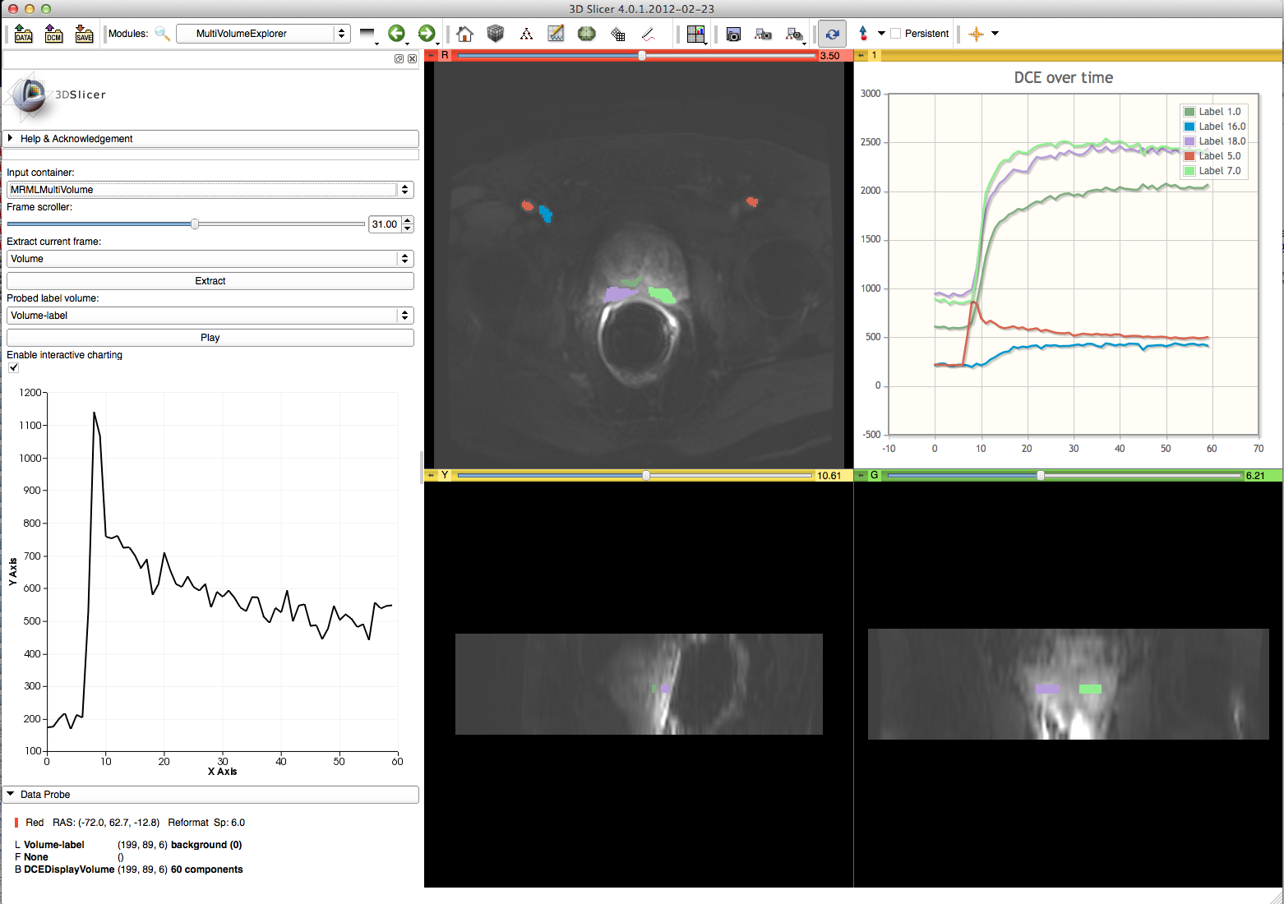
February 22, 2012. MultiVolumes

Slide 28
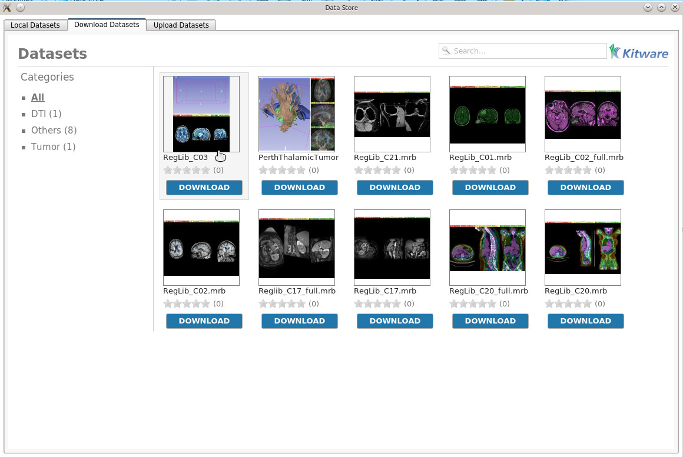
December 17, 2013. DataStore

Slide 29
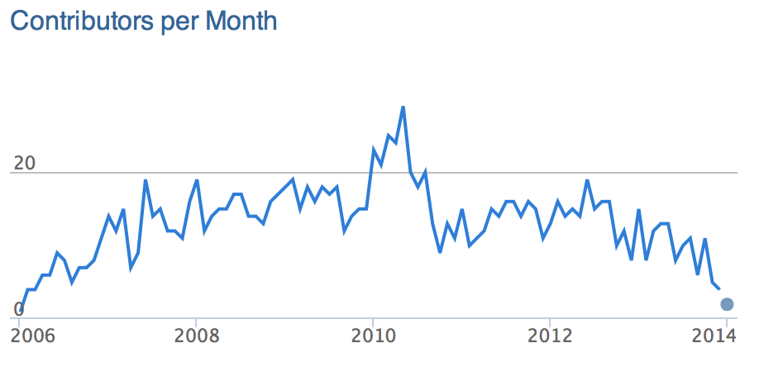
3D Slicer code retrospective
Code moved to Extensions, CTK.
Removed Slicer3 KWWidgets code.

Slide 30
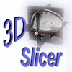
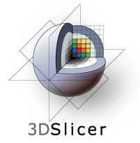
NA-MIC Kit, then and now
2005
2014

Slide 32
July 18, 2007. Multithreaded registration
Multithreaded ITK metrics
B-spline optimizations

Slide 33
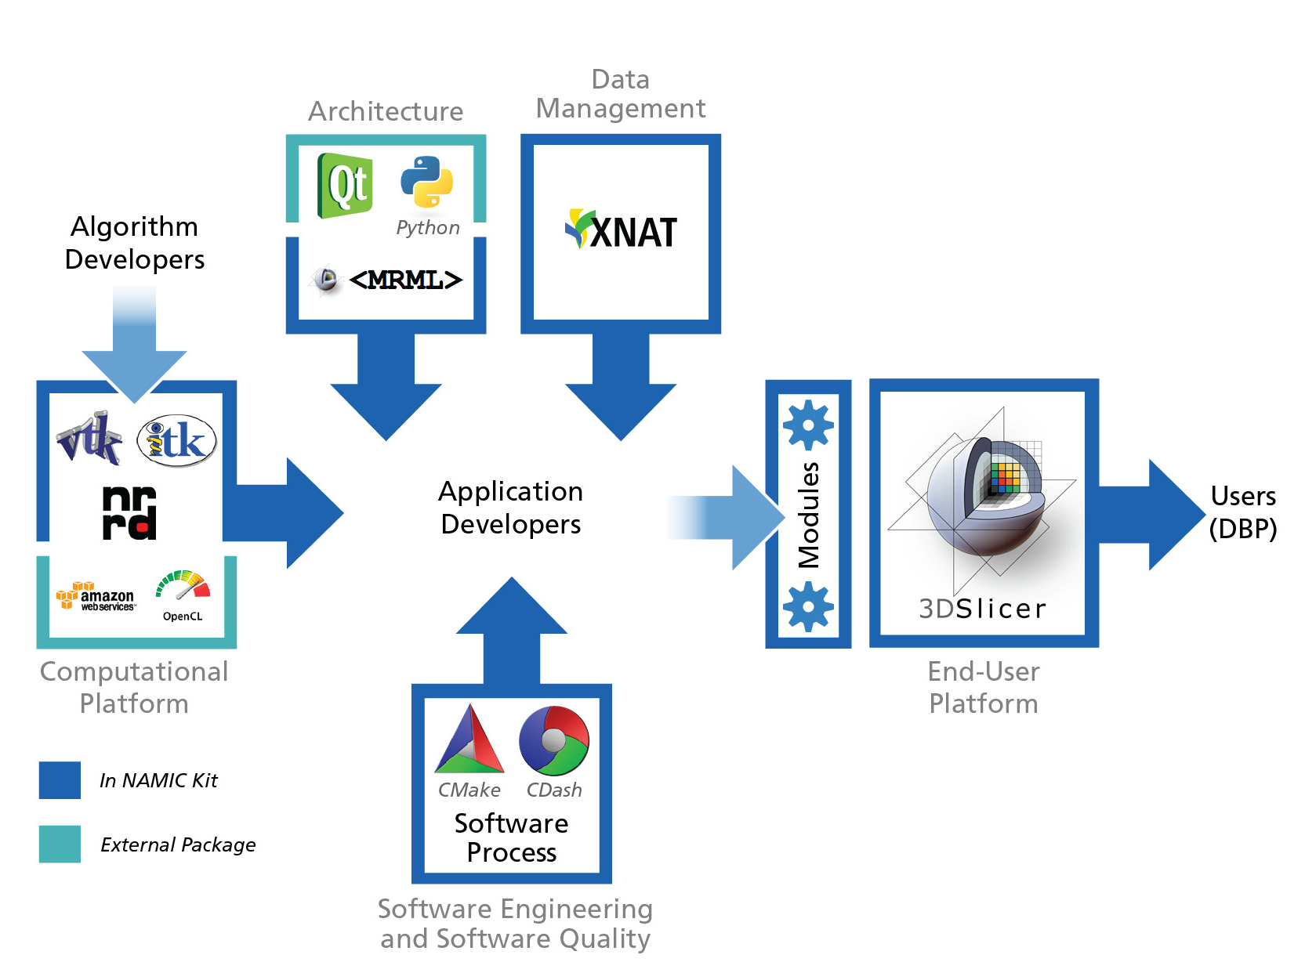
Core 1b – Engineering 5 Aims / 5 Platforms
Architecture – tools, operating paradigms, reporting mechanisms, integration points
End-user platform – interactive methods and information visualization for longitudinal analysis, exploratory data analysis, and translational research
Computational platform – stream processing, cloud computing, statistical analysis, informatics, machine learning
Data management – non-imaging and derived data, DICOM and cloud services
Software engineering and software quality – navigable timeline for revision control, build, test, documentation and release
1
4
3
2
5

