Slide 1


3D Slicer Tutorial:
Prototyping Surgical Robot System
Using ROS and 3D Slicer
Junichi Tokuda¹, Tobias Frank²,
Axel Krieger³, Simon Leonard⁴, Niravkumar Patel⁵
¹ Brigham and Women’s Hospital
² Gottfried Wilhelm Leibniz Universität Hannover
³ Children’s National Health System
⁴ Johns Hopkins University
⁵ Worcester Polytechnic Institute

Slide 2
Background
Growing Interest in Robot Assisted Interventions
  Robot-assisted laparoscopy
  Robotic catheter systems
  Robotic radiosurgery, etc.
R&D of Surgical Robot System
  Image processing and visualization for surgical planning
  Kinematics and motion planning for robot control
  Device management and control
➔ Requires a wide range of tools and methods developed in robotics and medical image computing fields

Slide 3
Background (2)
Common research platforms
  Medical Image Computing
    3D Slicer
    MITK
    NifTK
    OsiriX…
  Medical Robotics
    da Vinci Toolkit (dVRK)
    Raven II
    KUKA Lightweight Robot
➔ Need for a bridge between ROS and OpenIGTLink
Data sharing interface based on OpenIGTLink
Integrated with
Robot Operating System (ROS)

Slide 4
Objective of This Tutorial
Prototype surgical robot system using widely-available software and hardware
  3D Slicer as planning interface
  Lego Mindstorms as robot hardware
  Robot Operating System (ROS) as robot control software
Through this tutorial, you can:
  Learn software architecture of surgical robot systems
  Acquire hands-on experience of software-hardware integration for medical robotics

Slide 5
Prerequisite
3D Slicer Version 4.6 or later
Lego Mindstorms EV3 with WiFi dongle
ev3dev – Debian Linux for Mindstorms EV3
  http://www.ev3dev.org
ROS-IGTL-Bridge
  https://github.com/openigtlink/ROS-IGTL-Bridge

Slide 6
Architecture
Planning Workstation
EV3 Brick with ev3dev
OpenIGTLink
over TCP/IP
3D Slicer
ROS-IGTL-Bridge
Robot control node
ROS
network

Slide 7
Tasks in Each Compenent
3D Slicer
  Medical Image Display
  Segmentation
  Procedure Planning
  Pre/Intra Image Registration
  Tracker support
OpenIGTLink
  Communication Protocol
  Transformation manager
ROS
  Robot Control
  Path Planning
  Image Libraries
  Sensor Integration
  Simulation
ROS-IGTL-Bridge
  Convert ROS topics to OpenIGTLink
  Transformation manager
Controller Node
  Control actuators

Slide 8
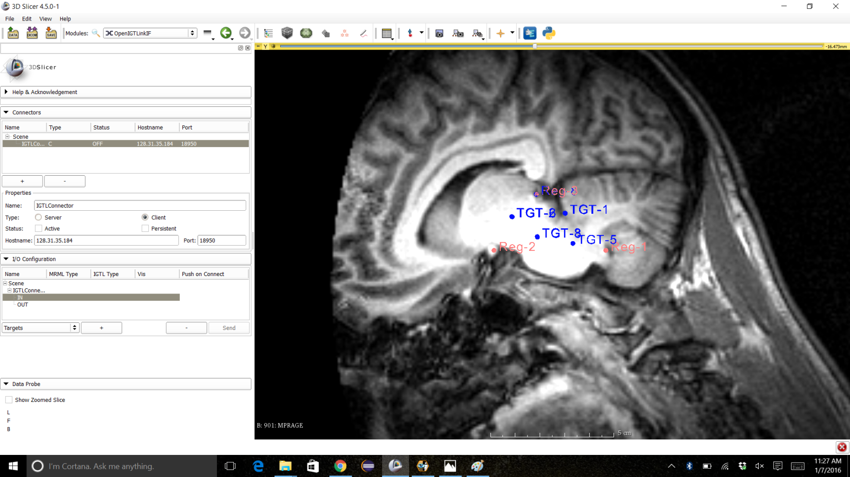
Step 1: Preoperative Planning
Pre-operative MRI Brain Scan
Mark three distinct points on brain for registration in Slicer
Plan cut in Brain Stem for tumor removal in Slicer

Slide 9
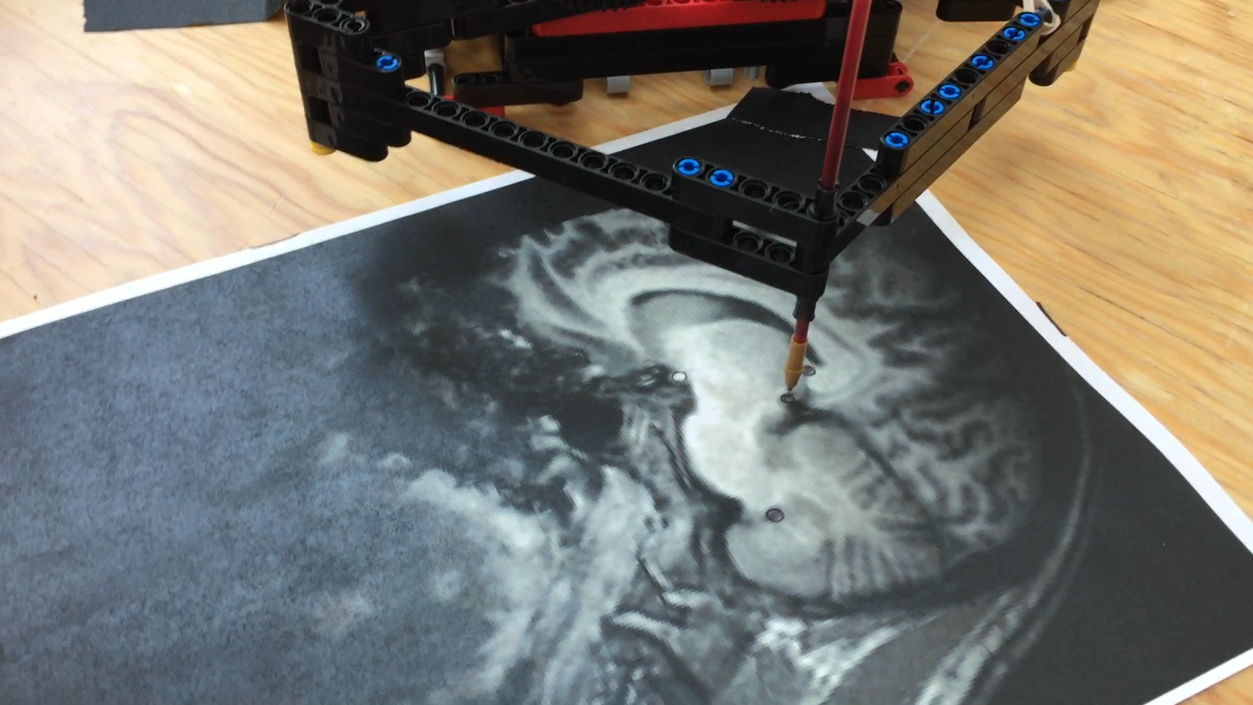
Step 2: Pre/Intraoperative Registration
Place scalpel over three distinct points for registration
Send registration points through ROS to Slicer

Slide 10
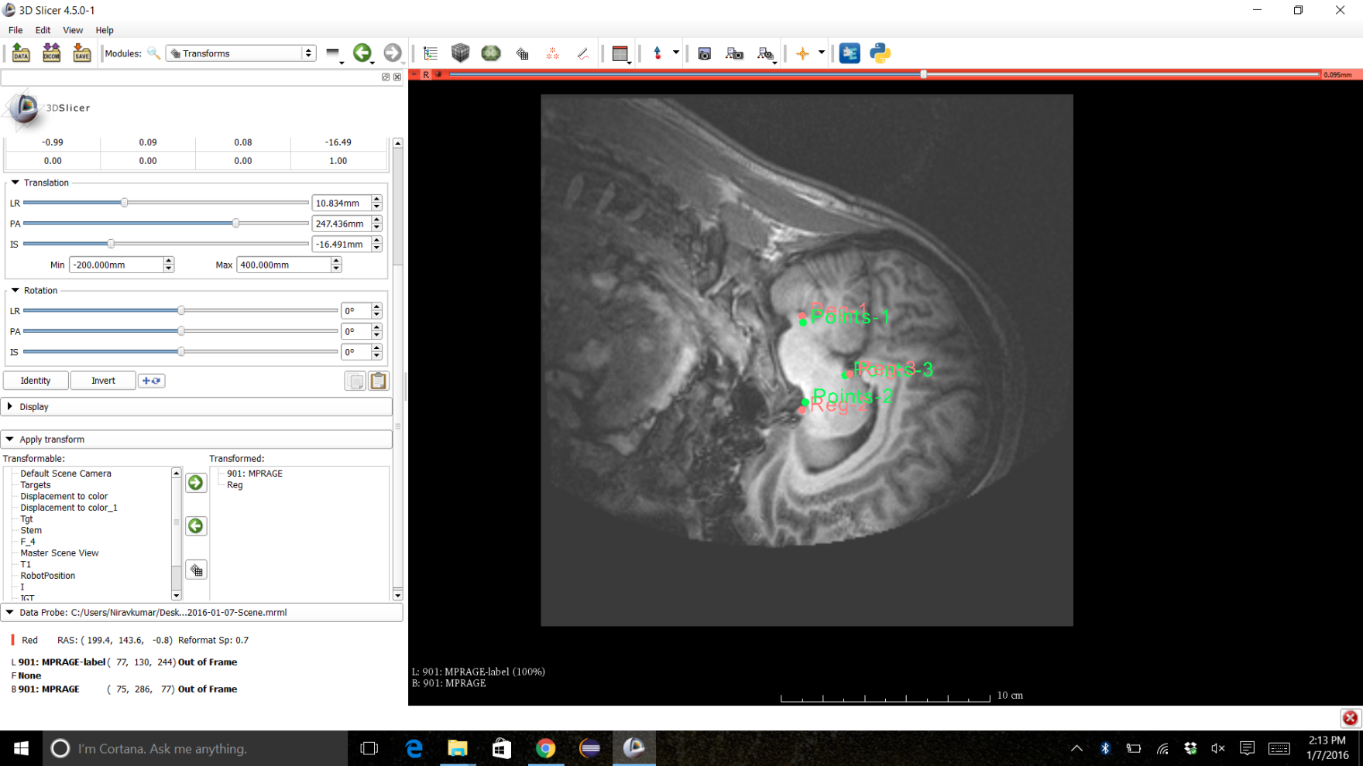
Step 2: Pre/Intraoperative Registration (2)
Perform registration in Slicer
Send target points for cut to ROS

Slide 11
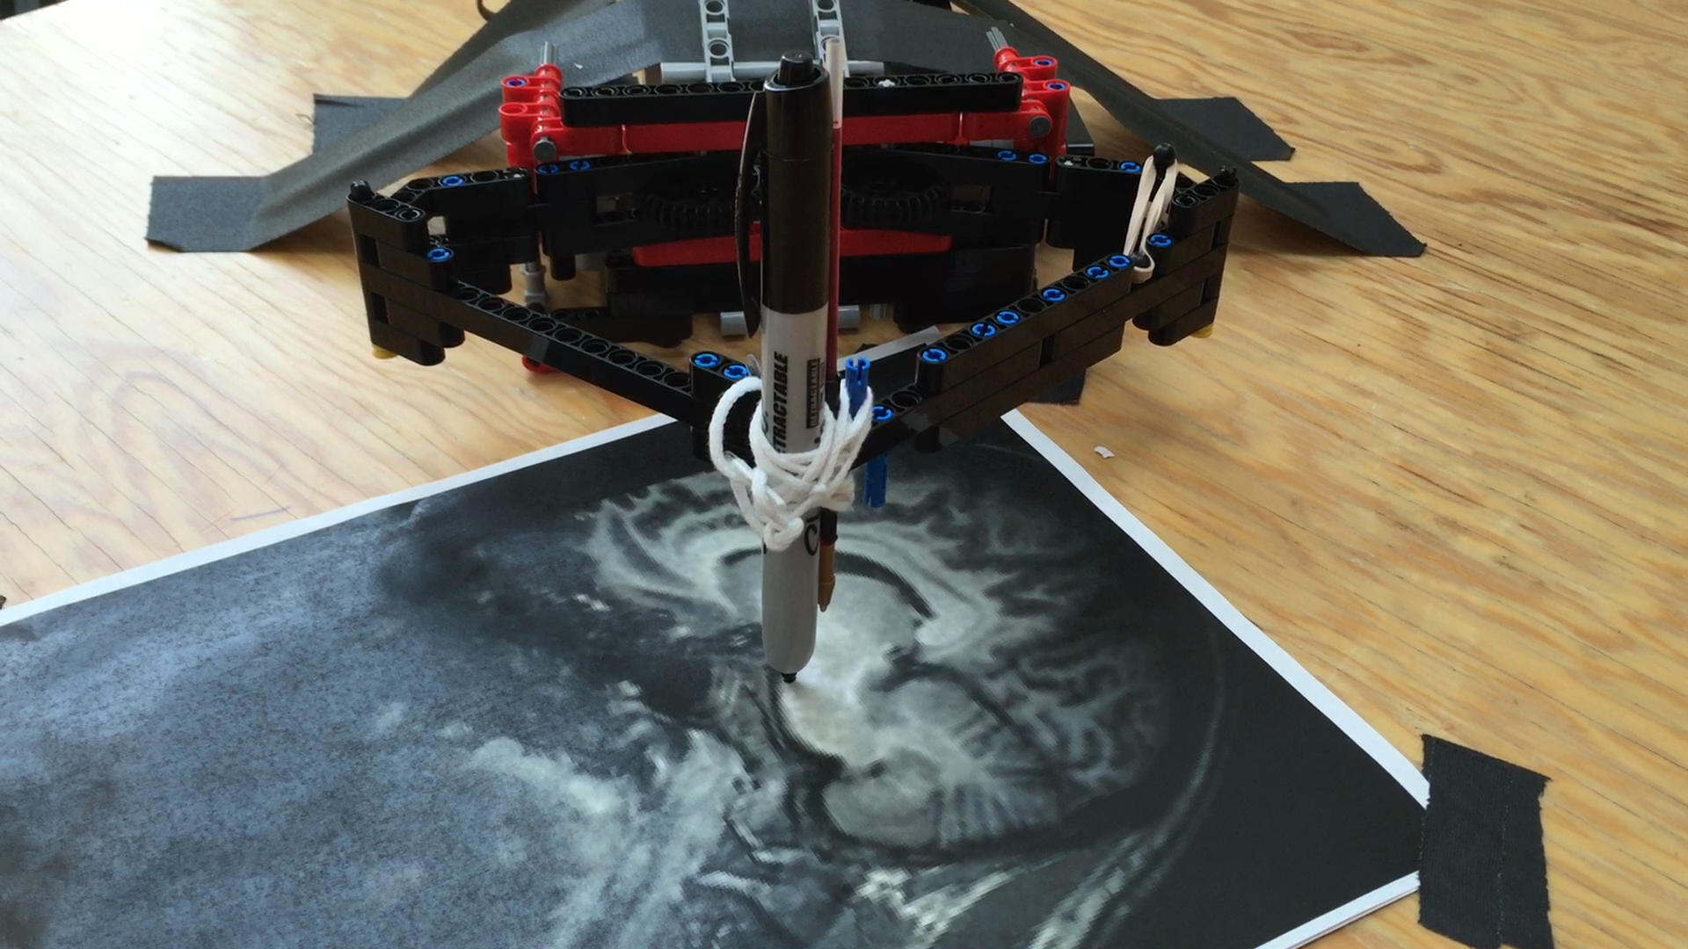
Step 3: Robotic Procedure
Robot path is planned and sent to robot
Robotic traces the planned trajectory

Slide 12
Conclusion
Integration of 3D Slicer and ROS
  Provide access to resources developed in two communities
  Allows quick prototyping of surgical robot systems
  Thanks to a wide variety of hardware supported by ROS, the system can be scaled up easily without changing the system architecture

