Slide 1
SLICER-ROS Integration
Junichi Tokuda (Brigham and Women's Hospital)
Axel Krieger (Children's National Medical Center)
Simon Leonard (Johns Hopkins University)
Tobias Frank (University Hannover, Germany)
Niravkumar Patel(Worcester Polytechnic Institute)

Slide 2
Architecture Outline
3D Slicer
Medical Image Display
Segmentation
Procedure Planning
Pre/Intra Image Registration
Tracker support
OpenIGTLink
Communication Protocol
Transformation manager
ROS Node
Convert ROS topics to OpenIGTLink
Transformation manager
ROS
Robot Control
Path Planning
Image Libraries
Sensor Integration
Access to other open source libraries
Simulation
ROBOT
Lego Mindstorm
Linux with ROS

Slide 3
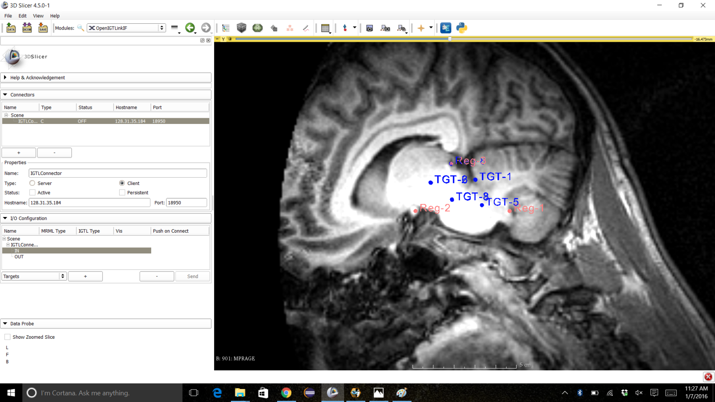
Step 1: Pre-operative Planning
Pre-operative MRI Brain Scan
Mark three distinct points on brain for registration in SLICER
Plan cut in Brain Stem for tumor removal in SLICER

Slide 4
Step 2: Pre/Intra-operative Registration
Place scalpel over three distinct points for registration
Send registration points through ROS to SLICER

Slide 5
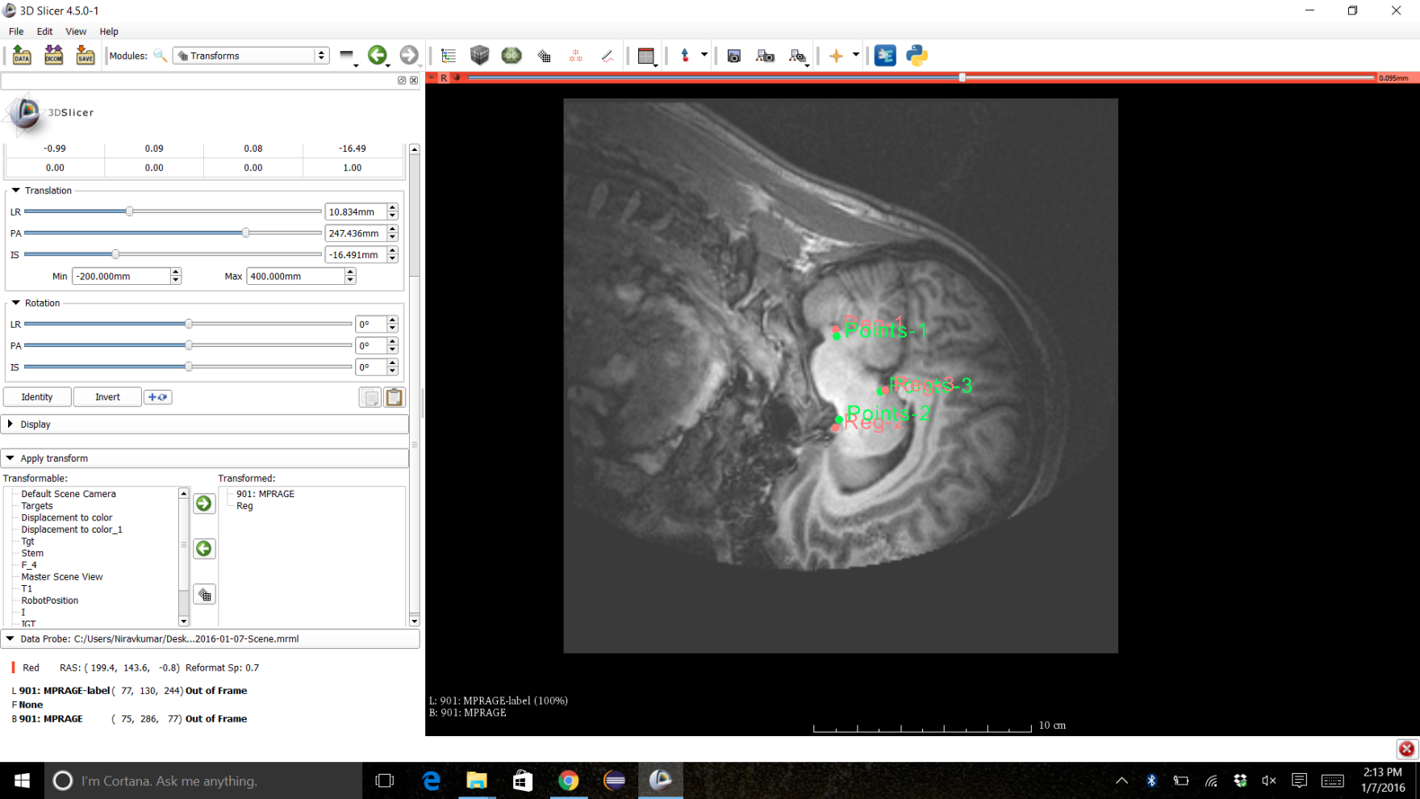
Step 2: Pre/Intra-operative Registration
Perform registration in SLICER
Send target points for cut to ROS

Slide 6
Step 3: Robotic Procedure
Robot path is planned and sent to robot
Robotic scalpel performs cut

