Slide 1
3D Slicer Workshop – University of Iowa DICOM Support for Quantitative Imaging
David Clunie (dclunie@dclunie.com)
PixelMed Publishing

Slide 2
Learning Objectives
A few definitions
A brief history
Some justification
Why doing more than the least is better
What to encode
How to encode it
What is new and useful
How to package it all together

Slide 3
What is Quantitative Imaging?
“Quantitative imaging is the extraction of quantifiable features from medical images for the assessment of normal or the severity, degree of change, or status of a disease, injury, or chronic condition relative to normal … includes the development, standardization, and optimization of anatomical, functional, and molecular imaging acquisition protocols, data analyses, display methods, and reporting structures … permit the validation of accurately and precisely obtained image-derived metrics with anatomically and physiologically relevant parameters, including treatment response and outcome, and the use of such metrics in research and patient care.”
RSNA QIBA
“https://www.rsna.org/QIBA.aspx”

Slide 4
What is Quantitative Imaging?
“Quantitative imaging is the extraction of quantifiable features from medical images for the assessment of normal or the severity, degree of change, or status of a disease, injury, or chronic condition relative to normal … includes the development, standardization, and optimization of anatomical, functional, and molecular imaging acquisition protocols, data analyses, display methods, and reporting structures … permit the validation of accurately and precisely obtained image-derived metrics with anatomically and physiologically relevant parameters, including treatment response and outcome, and the use of such metrics in research and patient care.”
RSNA QIBA
“https://www.rsna.org/QIBA.aspx”

Slide 5
What is DICOM?
Digital Imaging and Communications in Medicine
“Facilitates interoperability of devices claiming conformance
Addresses semantics of commands & associated data
Addresses semantics of file services, file formats & information directories for off-line communication
Explicit in defining conformance requirements …
Facilitates operation in a networked environment.
Structured to accommodate the introduction of new services … facilitating support for future medical imaging applications.”
DICOM PS3.1 Introduction & Overview
“http://dicom.nema.org/medical/dicom/current/”

Slide 6
DICOM – Brief History
1982 – 1st PACS Conference – session on standards
1982 – AAPM Report 10 – Standard Format for Image Interchange
1983 – ad hoc meeting between FDA, ACR & NEMA
1983 – 1st meeting of ACR-NEMA “Digital Imaging and Communications Standards” Committee
1985 – ACR-NEMA 300-1985 (“version 1.0”) issued
1988 – ACR-NEMA 300-1988 (“version 2.0”) issued
1990 – Inter-vendor testing of version 2.0 at Georgetown
1992 – Trial of DICOM (“version 3.0) at RSNA
1993 – DICOM 3.0 issued

Slide 7
DICOM – Brief History
1982 – 1st PACS Conference – session on standards
1982 – AAPM Report 10 – Standard Format for Image Interchange
1983 – ad hoc meeting between FDA, ACR & NEMA
1983 – 1st meeting of ACR-NEMA “Digital Imaging and Communications Standards” Committee
1985 – ACR-NEMA 300-1985 (“version 1.0”) issued
1985 – IEEE 802.3 Ethernet (based on 1976 Metcalfe)
1986 – Aldus TIFF (version 3; prior versions drafts only)
1987 – CompuServe GIF
1988 – ACR-NEMA 300-1988 (“version 2.0”) issued
1990 – Inter-vendor testing of version 2.0 at Georgetown
1992 – Trial of DICOM (“version 3.0) at RSNA
1992 – JPEG (ITU T.81; ISO 10918-1 1994)
1993 – DICOM 3.0 issued

Slide 8
DICOM – Brief History
ACR-NEMA versions 1 and 2
50-pin 16 bit parallel interface
no network (assumed “network interface unit”)
layered
messages with commands and data
tag-value pairs
described patients, studies, images
described modality, acquisition, 3D position, etc.

Slide 9
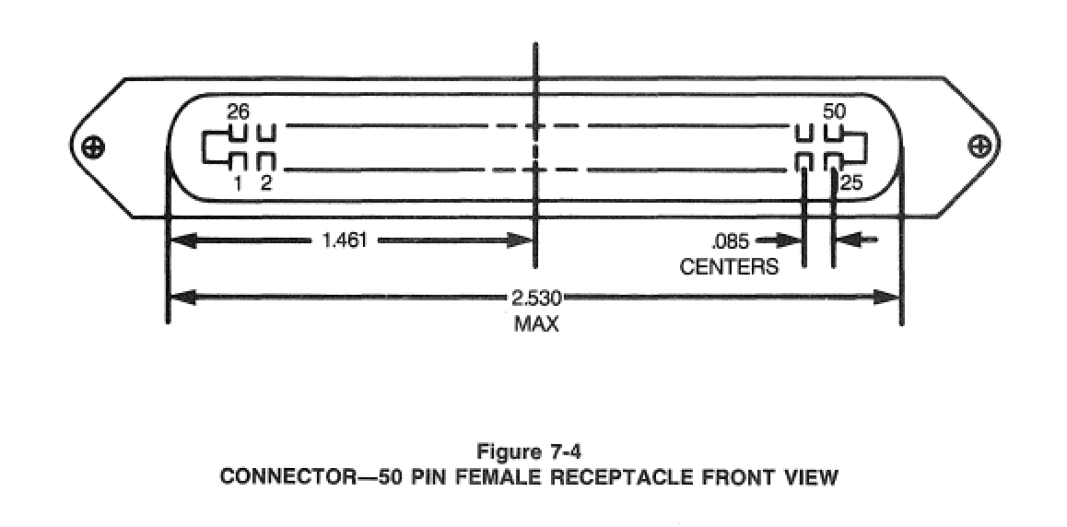
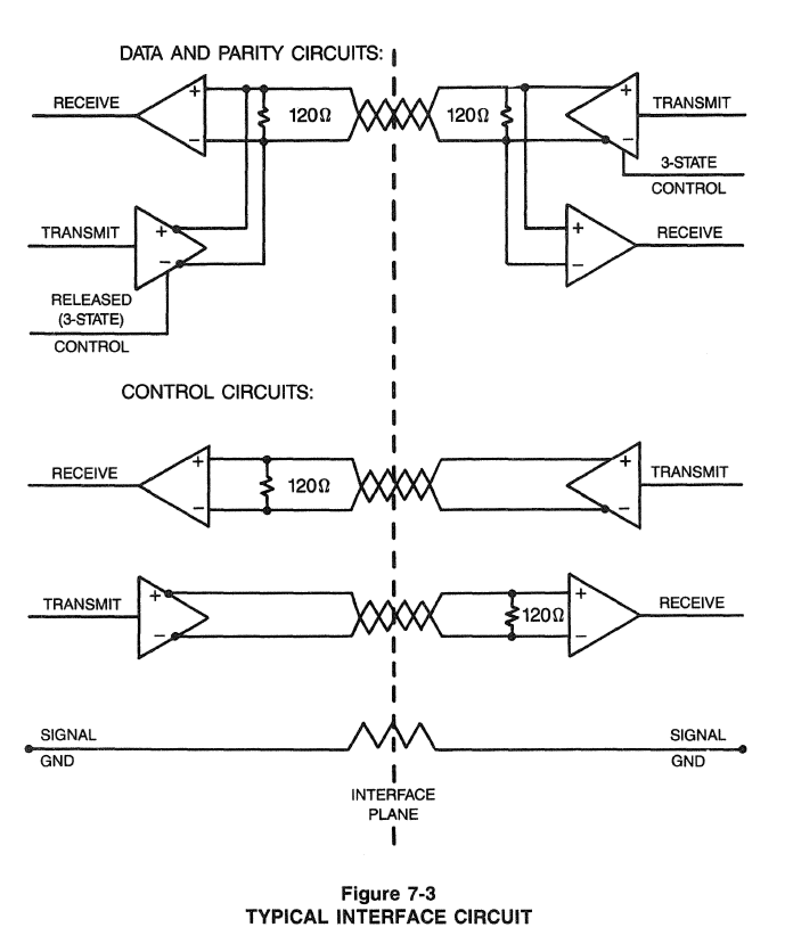
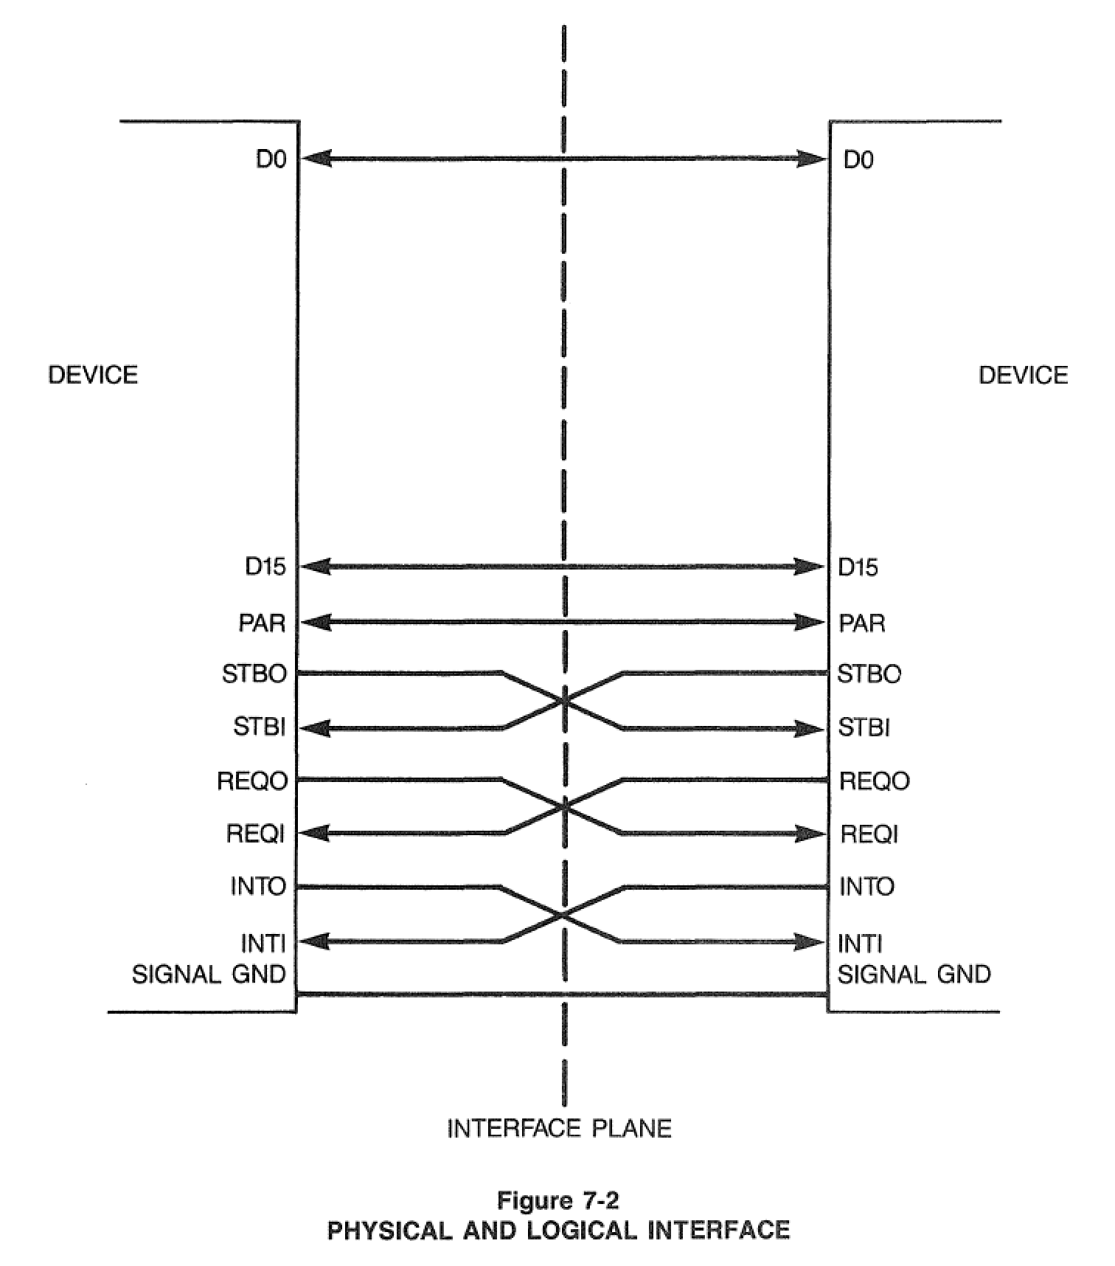

Slide 11
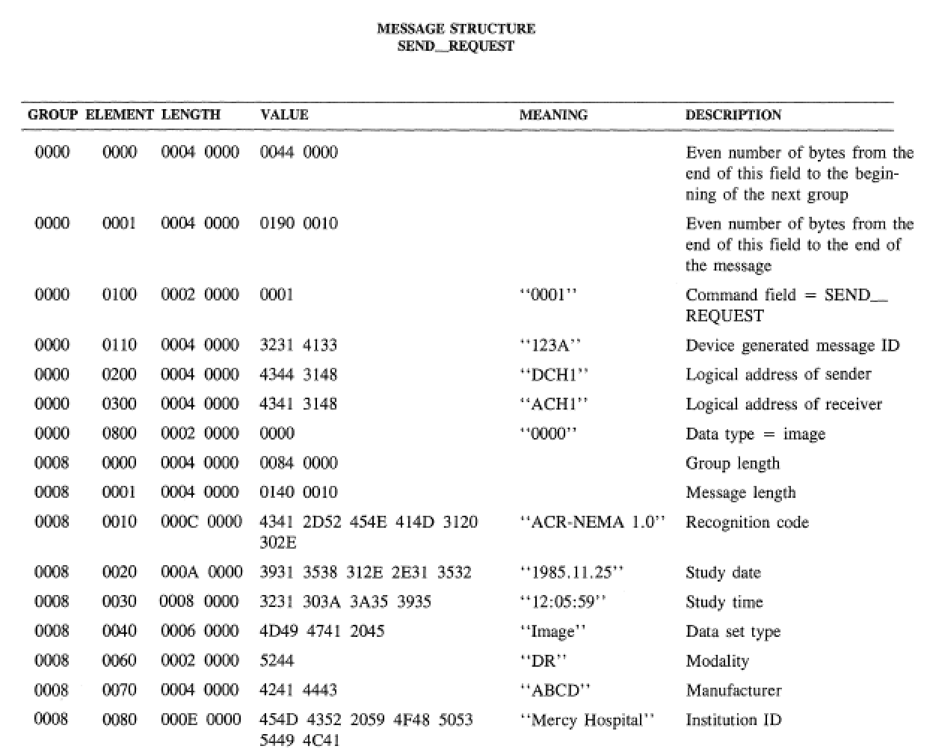

Slide 13
DICOM – Brief History
ACR-NEMA versions 1 and 2
50-pin 16 bit parallel interface
no network (assumed “network interface unit”)
layered
messages with commands and data
tag-value pairs
described patients, studies, images
described modality, acquisition, 3D position, etc.
DICOM “3.0”
TCP/IP network protocol (and OSI semantics)
“object-oriented” description & conformance

Slide 14
DICOM – Scope
Implicit in the standard’s name: “Digital Image and Communications in Medicine”
Images and image-related information
All acquisition modalities (all “’ologies”)
1993: CR, CT, MR, US, NM, SC (DF and DV)
2014: XA, XRF, DX, MG (+DBT), IO, PT, VL (Photo, Endo, Slide), WSI, OCT (OP,IV)
RT, SR (+CAD), waveforms, OP measurements and maps, surface scans, implants, segmentations
Storage + other services

Slide 15
Why does DICOM exist ?
Previous solutions closed (proprietary)
Real world requires open standards
heterogeneous modalities
heterogeneous workstations
heterogeneous archives, PACS, etc.
Consortium of
industry (NEMA)
users (ACR, ACC, CAP ...)

Slide 16
Why (open) standards at all ?
Too many permutations of ...
Acquisition device vendors
general
GE, Siemens, Philips, Toshiba, Shimadzu, Hitachi, ...
special
Bruker, iTheraMedical, Mediso, PerkinElmer ...
Processing and archive device vendors
general
GE, Siemens, Philips, ... (+ open source)
special
NeuroQuant, InViCRO, ...

Slide 17
Why not “existing” standards ?
Didn’t “exist” when ACR-NEMA formed
Pure imaging standards (TIFF, etc.)
limited support for medical image types
don’t encode domain specific information
Other domains not a good fit
military, remote sensing, astronomical, etc.
ISO standards (e.g., IPI) never adopted
Medical standards that didn’t do images
HL7, MIB (IEEE 1073), etc.
Needed more services than just storage
query/retrieve, printing, workflow, etc.

Slide 18
DICOM – Why?
Domain-specific fields
patient identification & characteristics
device identification & characteristics
acquisition protocol parameters
study management identifiers, dates and times
Need to handle binary bulk pixel data
e.g., HL7 text based and no image support
Need to be extensible
evolving technology, private extensions
variable rather than “fixed” length headers

Slide 19
Key goals of DICOM
Support interoperability
NOT (necessarily) interfunctionality
WITHOUT defining (restricting) architecture
Define conformance
specific services and objects
documentation (Conformance Statement)
negotiation
Consensus standard
Voluntary compliance
Open (license fee free)

Slide 20
DICOM – Modality Interface
Standard Boundary
PACS +/- RIS
Modality
Archive
Modality
Modality
Workstations
Manager
Modality

Slide 21
DICOM - Workstation Interface
Standard Boundary
Standard Boundary
PACS +/- RIS
Modality
Archive
Modality
Modality
Workstations
Manager
Modality

Slide 22
DICOM - Workstation Interface
Standard Boundary
Standard Boundary
PACS +/- RIS
Modality
Archive
Modality
Modality
Workstations
Manager
Bidirectional !
Modality

Slide 23
DICOM & Quantitative Imaging
Encoding of images & results
Terminology & codes
DICOM standards in clinical practice
images from modalities
derived images – e.g., CBF
ROIs – e.g., CT Hounsfield units, PET SUV
size measurements – distance, area, volume
“Quantitative” imaging is nothing new
different emphasis than narrative reporting

Slide 24
Clinical v Research Use Cases
Narrative reporting
see it, compare it, dictate it
Quantitative reporting +/- research
see it, analyze it, measure it, code it, re-use it
Same standards
greater need for numbers & codes
more structure

Slide 25
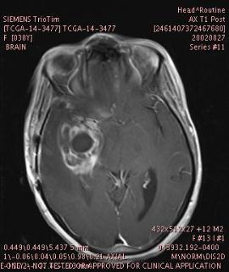
See It, Compare It, Dictate It
“Hairy mass, rt. temporal lobe, bigger”

Slide 26
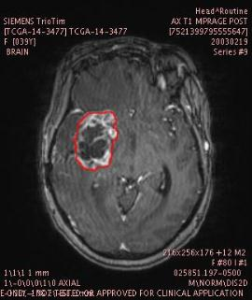
See It, Analyze It, Measure It
Segmented Lesion Volume 31,524 mm³

Slide 27
Code It
Why, how, what, where …
(R-F8106,SRT, “Grand mal seizure”)
(24587-8,LN,“MR brain w/wo IVC”)
(F-04E4E,SRT,“Brain mass lesion”)
(RID6061,RADLEX, “Circumferential enhancement”)
(T-A250D,SRT,“Right Temporal Lobe)

Slide 28
Tabulate It
Lesion # | TimePoint # | Volume | Auto LD | Auto SD | % From Baseline Volume
1 | 20020501 | 24120 | 57 | 27 | 0
1 | 20020827 | 43990 | 58 | 31 | 82
1 | 20020919 | 31524 | 46 | 37 | 31
1 | 20021026 | 31554 | 59 | 35 | 31
1 | 20021207 | 27081 | 49 | 27 | 12
1 | 20030219 | 39748 | 55 | 37 | 65

Slide 29
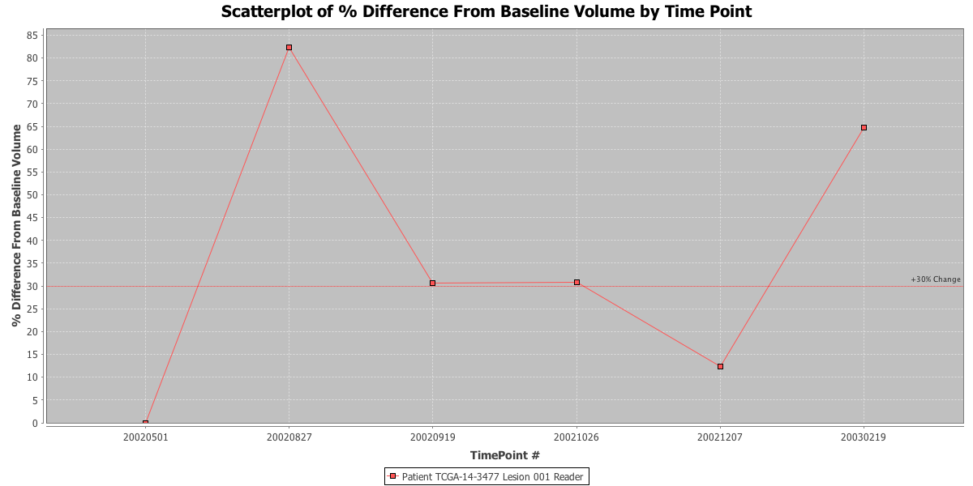
Graph It

Slide 30
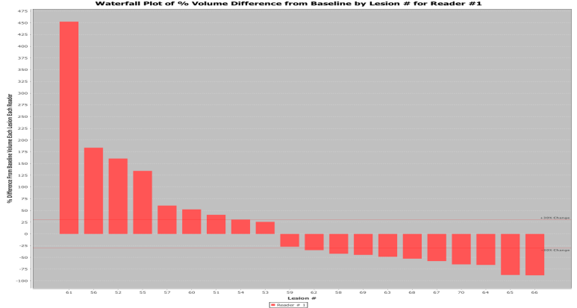
Aggregate It and Visualize It

Slide 31
Re-Use It
Quantitative analysis need not be a “dead end”
can just transcribe or cut-and-paste numbers into a dictated or plain text report
pre-populated “merge” fields created from structured input provide a productivity and quality gain
can indeed save pretty tables & graphics as a screen shot or PDF
but … much better to be able to re-use structure, numbers, codes next time, for comparison, searching, mining and basis for quality improvement metrics

Slide 32
Preaching to the Converted
Researchers know this
But …
don’t always use standards, or the same “standards” as their clinical colleagues
Why not?
contempt for “outdated” format
“not invented here” syndrome
lack of convenience
lack of familiarity
lack of availability (in tools)
missing features

Slide 33
Preaching to the Converted
Researchers know this
But …
don’t always use standards, or the same “standards” as their clinical colleagues
Why not?
contempt for “outdated” format
“not invented here” syndrome
lack of convenience
lack of familiarity
lack of availability (in tools)***
missing features***

Slide 34
Changing the Paradigm
“Translational” research
“bench to bedside” – compatibility with PACS
co-clinical trials – animals + patients at same time
Improving the tools
export capability in clinical formats from 3D Slicer
Improving the standard
multi-frame images (one file for entire volume)
quantitative images – real world values
label maps, segmentations, parametric maps
floating point pixels
structured reports with numeric measurements

Slide 35
Self-Serving Reasons
Data management problem
Missing metadata for identification/management
project, acquisition (what)
subject (who)
history (when/where)
Manual approach
files, folders, portable drives, sticks, spreadsheets
Managed non-standard approach
metadata tags in proprietary database
Standard approach
metadata preserved in file header, not detached,

Slide 36
Composite Context
DICOM objects contain “composite context”
Patient … same for all instances for patient
Study … same for all instances for procedure
Series … new for each acquisition/derivation
Equipment
Frame of Reference
Needs to be de-identified
use research IDs to replace patient IDs, etc.
Research tools must preserve & propagate
into derived objects (images, SEG, REG, SR, etc.)
via intermediate objects (e.g., floating point parametric map, raw data instances)

Slide 37
Quantitation – Images In
Modalities make DICOM images
often do not populate critical attributes for quantitative imaging in a standard way
anatomy, protocol, technique, contrast, timing
workflow challenge – copy from modality work list
user entry – need a place on screen, need to do it
copy to header – sometimes standard lags behind
evolving technology – need for private data elements
inertia once implemented – delays standard elements
quantitative pixel values – physical units & quantities
“Can lead a horse (vendor) to water (standard), but can’t make it drink”

Slide 38
Enhanced Multi-frame Images
Shared attributes
Per-frame attributes
Pixel data

Slide 39
A s s o c i a t i o n
DB
DB
DB
DB
UIDs
Store, parse, check
C-Store request
Dataset (attributes+pixels)
C-Store response (acknowledgement)

Slide 41
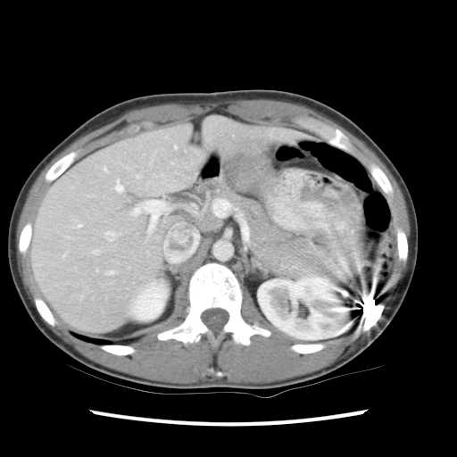
PATIENT TABLE
IMAGE TABLE
0125678
Smith^James
1 mm
1
0125735
Jones^Alan
1 mm
2
………..
…………
………..
……
STUDY TABLE
………..
……
20051109
2267
………..
……
20060301
3920
………..
……
Potentially thousands of individual per slice database insertion operations
………..
……
………..
……
………..
……
SERIES TABLE
………..
……
1
Localizer
………..
……
2
Axial C/A/P
………..
……
DB
…
……
………..
……
………..
……
………..
……
1 mm
1897

Slide 42
PATIENT TABLE
IMAGE TABLE
0125678
Smith^James
1 mm
1
0125735
Jones^Alan
1 mm
2
………..
…………
………..
……
STUDY TABLE
………..
……
20051109
2267
………..
……
20060301
3920
………..
……
Potentially thousands of individual per slice database insertion operations
………..
……
………..
……
………..
……
SERIES TABLE
………..
……
1
Localizer
………..
……
2
Axial C/A/P
………..
……
DB
…
……
………..
……
………..
……
………..
……
1 mm
1897

Slide 43
PATIENT TABLE
IMAGE TABLE
0125678
Smith^James
1 mm
1
0125735
Jones^Alan
………..
…………
STUDY TABLE
20051109
2267
20060301
3920
Single database insertion - just don’t need per-slice detail in database
………..
……
SERIES TABLE
1
Localizer
2
Axial C/A/P
DB
…
……

Slide 44
Not (just) about performance
Greater “inter-functionality”
browsing
routing
hanging
rendering
Achieved through
better description of organization of data
more mandatory attributes
more standard values (& codes)
reduced dependence on private attributes

Slide 45
MR Acquisition Contrast
Original SOP Classes
guess from echo and repetition time, etc.
recognize proprietary Protocol Name
Enhanced SOP Classes
new mandatory frame level attribute
Acquisition Contrast
DIFFUSION, FLOW_ENCODED, FLUID_ATTENUATED, PERFUSION, PROTON_DENSITY, STIR, TAGGING, T1, T2, T2_STAR, TOF

Slide 46
Technique Attributes & Terms
 | CT |  | MR
SOP Class | Original | Enhanced | Original | Enhanced
Attributes (Mandatory) | 18 (0) | 41 (39) | 44 (2) | 103 (94)
Terms (Enumerated) | 4 (2) | 86 (18) | 38 (9) | 228 (47)

Slide 47
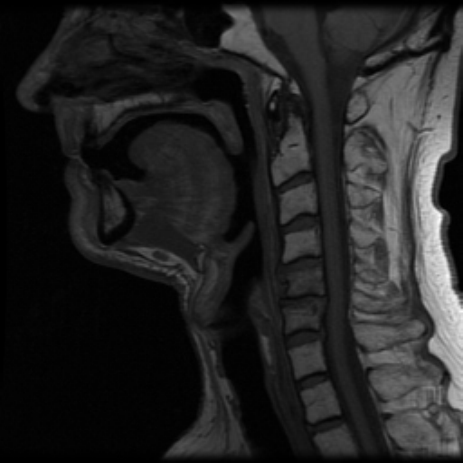
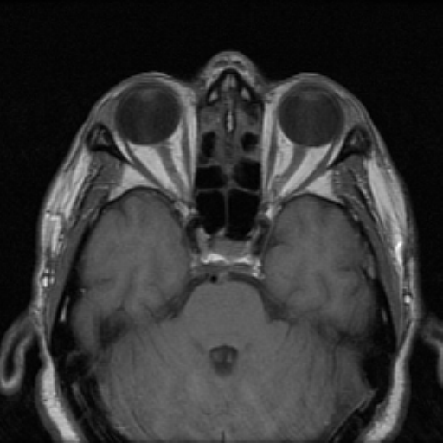
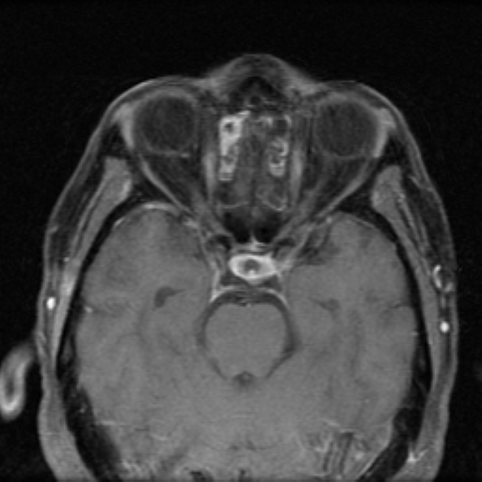
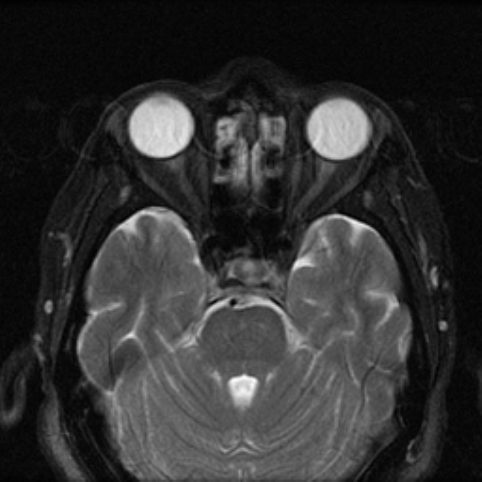
Hanging protocol rule impact
T1 SAG PRE GD
T1 AXIAL PRE GD
T2 AXIAL
T1 AXIAL POST GD
Acquisition Contrast = T1
Image Orientation ≈ 1\0\0\0\1\0
Contrast Agent #1
Administered = YES
Route = (G-D101,SNM3, “IV”)
Ingredient = (C-17800,SRT, “Gd”)

Slide 48
Acquisition Timing Information
Original SOP Classes
inconsistent use of
Content (Image) Time
Acquisition Time
Frame Time (+/- Frame Time Vector)
contrast timing information never used
Enhanced SOP Classes
unambiguous definition of acquisition timing
explicit relationships with contrast & cardiac timing

Slide 49
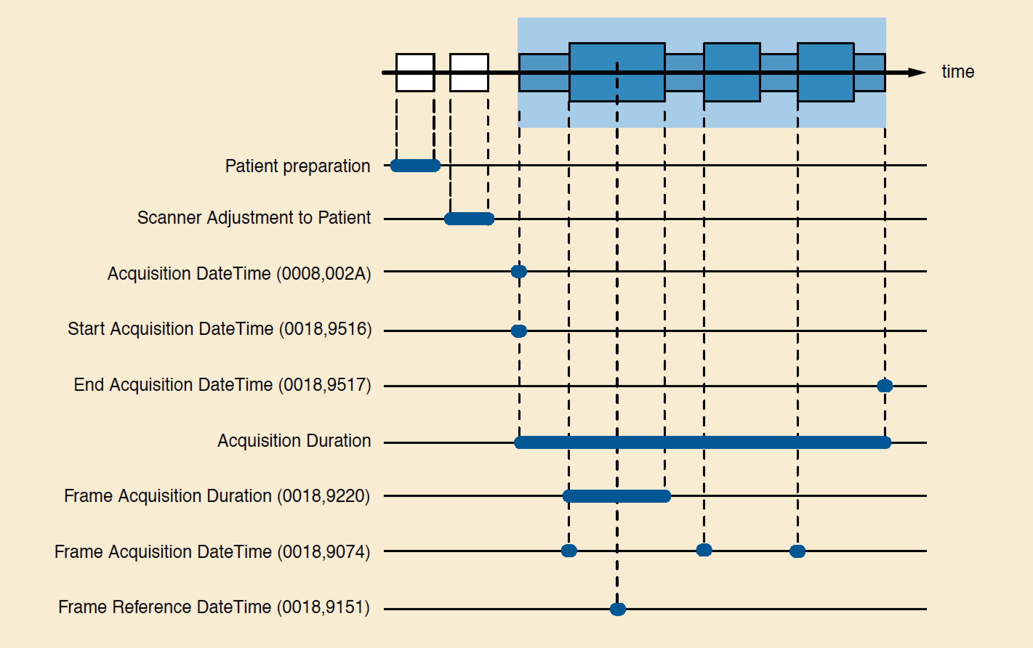
Timing Information

Slide 50
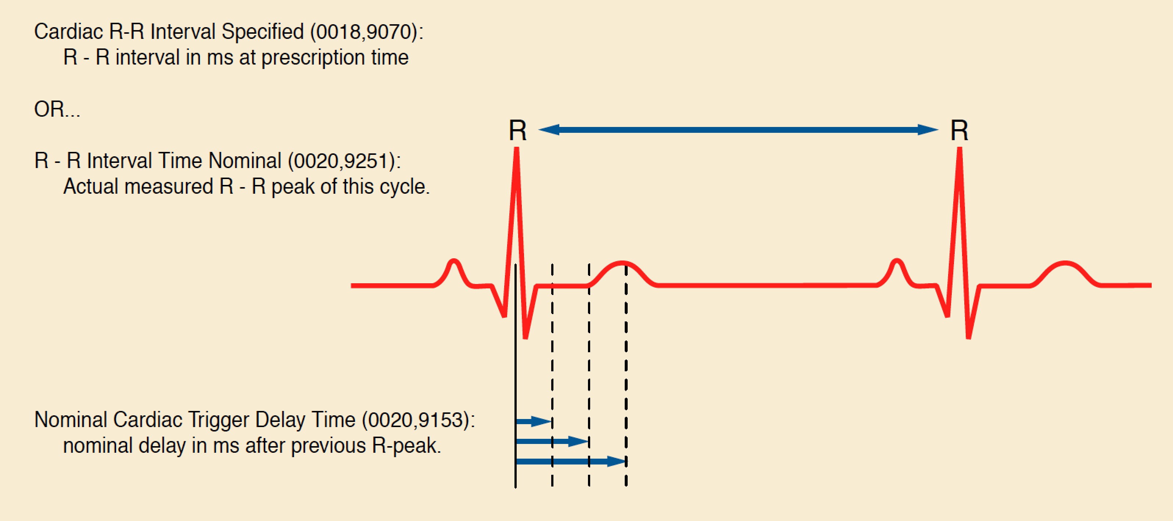
Cardiac Timing Information

Slide 51
Organizational Features
Shared and Per-frame Functional Groups
a Functional Group has Attributes that vary as a group
e.g., Pixel Measures, Plane Orientation
compact & makes explicit what doesn’t change
Dimensions
a priori hints as to how the frames are organized
specify intended order of traversal, such as space, then time (e.g., for cardiac cine loops)
Stacks
groups of spatially-related slices, repeatable
Temporal positions
“time slots” or “bins”

Slide 52
Organizational Features
Goal is to reduce the work that the receiving application has to do to “figure out”
how the data is organized
why it is organized that way
Without preventing use of the data in unanticipated ways
e.g. 3D on a dataset not intended as a volume
Two “levels”
detailed: shared & per-frame attributes
overall: dimensions, stacks and temporal positions

Slide 53
Multi-frame Functional Groups
Shared attributes
Per-frame attributes
Pixel data

Slide 54
What is a Functional Group?
“A set of logically related Attributes that are likely to vary together”
Examples:
position related
orientation related
spacing related
timing related
May be “shared” (all same) or “per-frame”
Shared Functional Group Sequence – one item
Per-Frame FGS – one item per frame (vector)

Slide 55
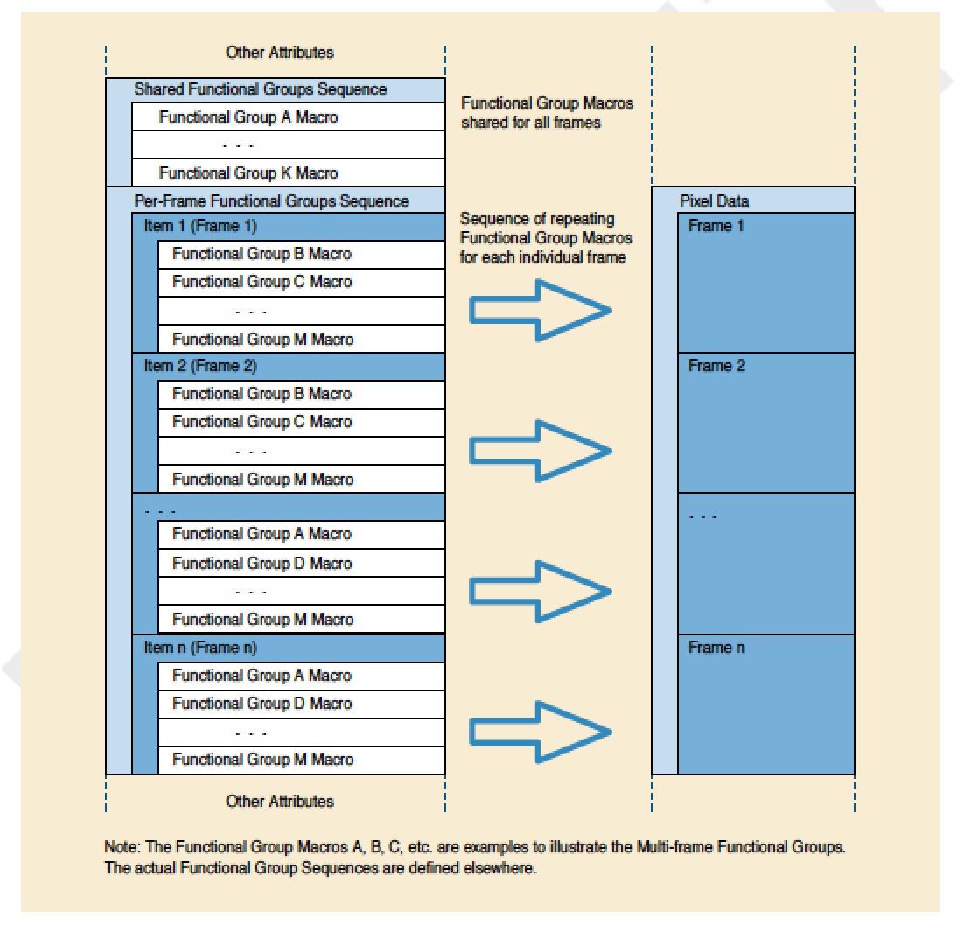
Functional Group Encoding

Slide 56
Functional Groups – Varieties
Common to many IODs, e.g.,
Pixel Measures
Frame Anatomy
Frame VOI LUT
Real World Value Mapping
Specific to particular IODs, e.g.,
MR Spatial Saturation
CT Table Dynamics
X-Ray Field of View
PET Frame Correction Factors
US Image Description

Slide 57
Modules vs. Functional Groups
Still have traditional “Modules” at top level
Modules
Attributes describing entire acquisition
e.g., cumulative stuff
Shared functional groups
Attributes about frames that happen to have the same values for all frames
Per-frame functional groups
Attributes about frames that have different values for any frame

Slide 58
Stacks
H\

Slide 59
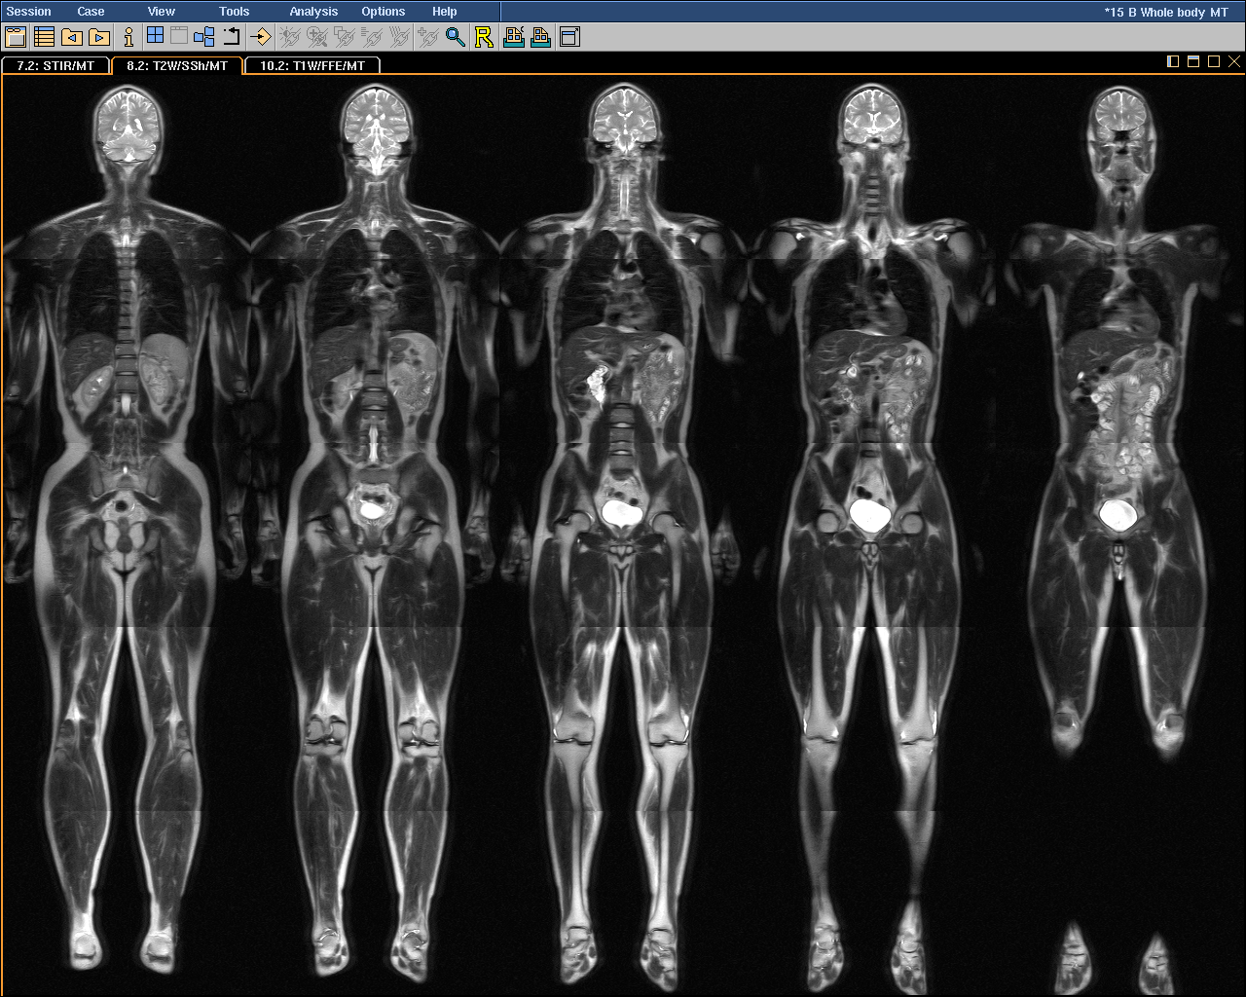
5
4
Stack ID
3
2
1
1
2
3
4
5
In-Stack Position

Slide 60
Multi-frame Dimensions
Real world (Wikipedia):
“In physics and mathematics, the dimension of a space or object is informally defined as
the minimum number of coordinates needed to specify any point within it”
DICOM:
“A dimension is a set of attributes
that change on a per-frame basis in a manner that is known before the image is acquired,
are defined by the generating application and
are especially intended for presentation”

Slide 61
Multi-frame Dimensions
Multi-frame Dimensions Module
in top level dataset
defines an “organization” (set of dimensions)
with an optional organization “type”
e.g., “3D” or “3D_TEMPORAL” in Volume US
defines each dimension
by reference to a per-frame varying Attribute
by referenced to Functional Group containing Attribute
For each frame, encode
numeric “index” of position within each dimension
starts from 1, increases by 1
an index, not the value of the referenced Attribute

Slide 62
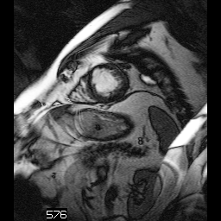
Trigger Delay Time
Temporal Position Index
Stack ID = 1
Dimension Index Values
2
\
1
\
5
48 ms
2
5
2\1\5
4
2\1\4
3
2\1\3
2
2\1\2
1
2\1\1
In-Stack Position
Dimension Index Pointers:
Temporal Position Index
Stack ID
In-Stack Position
Stack ID = 1
Time (1)
0 ms
1
5
1\1\5
4
1\1\4
3
1\1\3
2
1\1\2
1
1\1\1
Space (2)
In-Stack Position

Slide 63
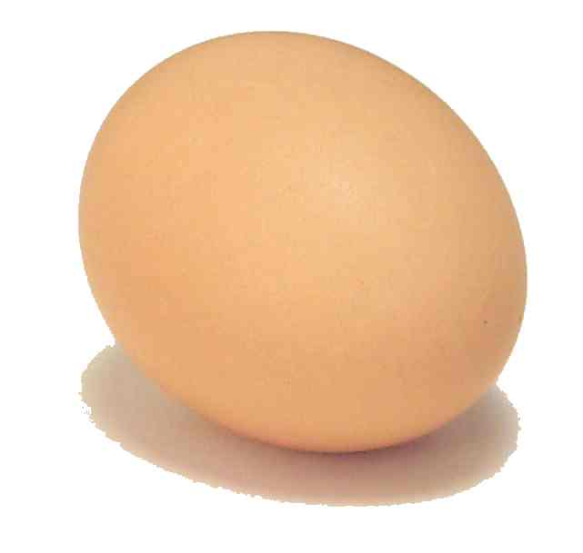
But when ?
Modality
PACS

Slide 64
Enhanced MF for Research
Few modalities create enhanced MF yet
notable exceptions: Philips MR, Bruker MR
No reason not to “convert” legacy images
Benefits
don’t have to manage hundreds of slice files
don’t lose metadata converting to research-specific volume-oriented format (e.g., NRRD, NIfTI, Analyze, MNI, etc.)
How?
convert generic stuff that all vendors do
+/- retain/convert (relevant) private attributes
specific supplement (157) to DICOM to describe it

Slide 65
Legacy Converted Enhanced
“True” Enhanced MF objects in DICOM
many mandatory required attributes/values
one of their benefits, if information is known
hard to populate during conversion
Legacy Converted Enhanced MF objects
mandatory conversion of geometry (position, orientation, spacing)
optional conversion of other generic stuff, if known
sequences to store all other original attributes, separated into shared and per-frame sets
specific variants for CT, MR and PET
Enhanced Secondary Capture MF family
grayscale or color
may include geometry and other functional groups

Slide 66
PACS to PACS (or VNA) with Legacy DICOM Object Conversion
PACS
PACS
Modality
Convert SF -> MF
Convert SF -> MF
Modality
Convert MF -> SF
Convert MF -> SF
Classic SF
Legacy Converted MF
Workstations
True Enhanced MF

Slide 67
Measurements Out
Regions of Interest (ROI)
contours and other image-related references
measurements, categorical assessments
Per-voxel values
parametric maps (e.g., SUV, ktrans)
label maps and segmentations
Intermediate re-usable work products
spatial registration (rigid & deformable)
fiducials
real-world values (quantities & physical units)

Slide 68
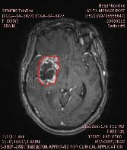
DICOM encoding of ROIs
Private elements
evil & must be stopped
Curves in image
weak semantics, old, retired
Overlays in image
weak semantics
Presentation States
weak semantics, PACS favorite
Structured Reports
best choice, but more work
RT Structure Sets
coordinates only
Segmentations
per-voxel ROIs; use with SR
Date | Volume | Auto LD | Auto SD
20021207 | 27080 | 49 | 27
… | … | … | …

Slide 69
DICOM Structured Reports
Hierarchical structure
codes, numbers, coordinates, image references, etc.
Flexibility is constrained by templates
just as XML is constrained by DTD or Schema
Standard DICOM binary representation
easily stored in PACS though general purpose visualization remains challenging
easily transcoded to XML or JSON for processing
Widely used in existing quantitative modalities
echo-cardiography, obstetric ultrasound
received and understood by voice reporting systems
Easier to implement if good toolkit support
e.g., dcmtk provides abstractions in an SR API

Slide 70
SR – Questions and Answers
Tree of nodes
Most nodes are name-value pairs
name is the “question” (code)
value is the “answer” (text, code, numeric, etc.)
Different style choices possible, e.g.
(M-54000,SRT,“Necrosis”) = (G-A203,SRT,“Present”)
(F-00005,SRT,“Finding”) = (M-54000,SRT,“Necrosis”)
Template of questions & value sets
populated by human (pick lists from value sets)
encode image processing results (e.g., detect signal)
rule based (e.g., too small to measure)

Slide 71
SR Templates for Quantitation
Described in DICOM PS3.16
many existing templates for clinical quantitative applications, e.g., cardiovascular, OB/GYN
good basis for research design, but insufficient
QIICR project proposed new templates
accepted into DICOM as final text 2014/11
root template for generic “imaging measurements” (CP 1386)
reused recently added planar/volumetric ROIs as well as simple measurements
re-used improved “image library” to describe relevant image characteristics acquisition parameters (CP 1389)
added code sets for perfusion (CP 1391) and PET (CP 1392) methods and measurements
shared definition of “quantities” with separate real world value map improvements

Slide 72
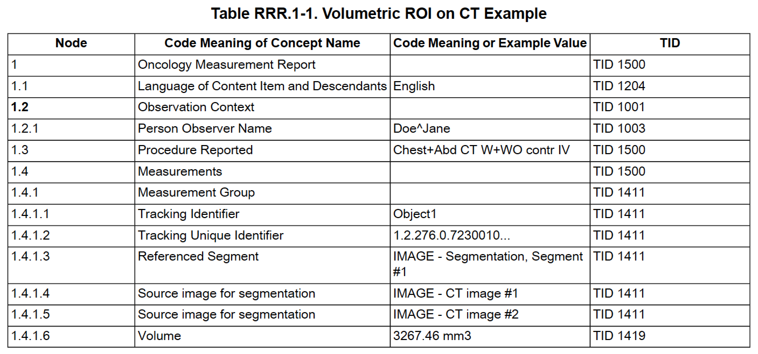
Example of Measurement Report

Slide 73
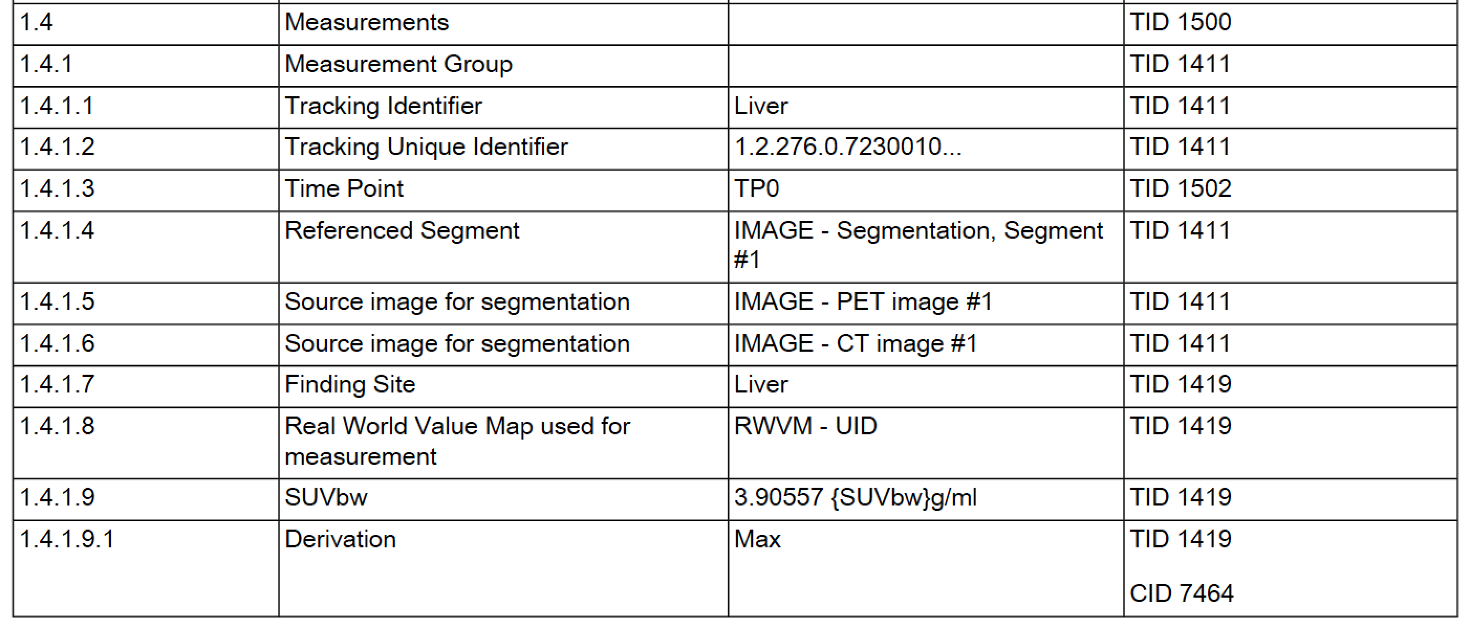
Example of PET Measurement - I

Slide 74
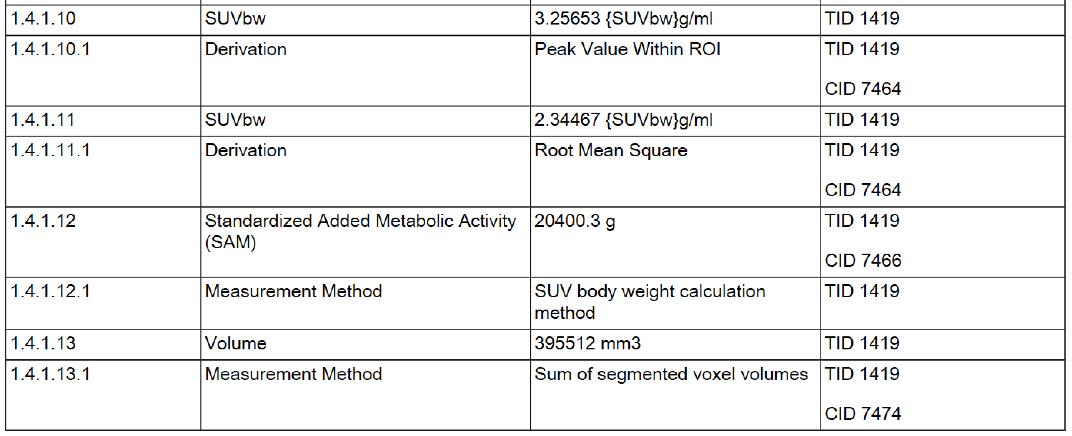
Example of PET Measurement - II

Slide 75
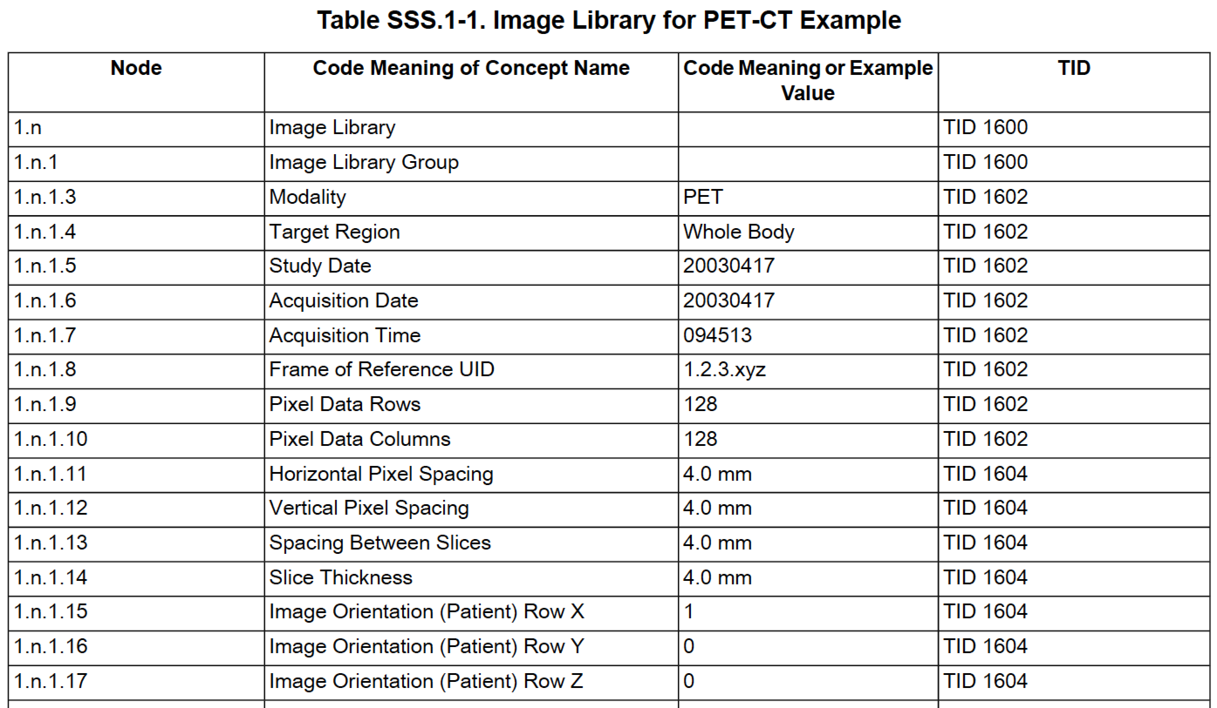
Example of Image Library

Slide 76
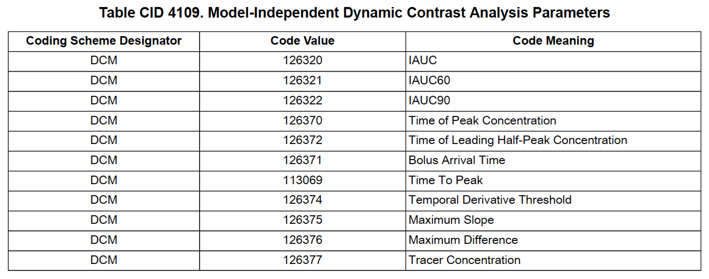
Example of New Codes & Definitions

Slide 77
DICOM RT Structure Sets
Simple structure
focus is iso-contour 3D coordinates of regions to treat
very limited semantics
no standard/extensible measurements beyond volume
Standard DICOM binary representation
easily transcoded to other DICOM objects like SR or PS if 3D (patient-relative) to 2D (image-relative) coordinate mapping is available (e.g., via source images or an SR image library)
Widely used in existing RT & non-RT systems
also understood by many academic software tools

Slide 78
DICOM Presentation States
Intended to preserve appearance
grayscale pipeline (window)
spatial transformation (pan/zoom)
annotation (text, overlays, vector graphics)
Lack semantics
what does the text “mean”? (NLP)
which graphic is it associated with?
Overall, a poor choice for quantitative results
may be all that is available in many PACS (to create & view)

Slide 79
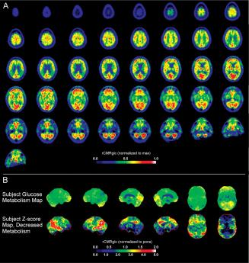
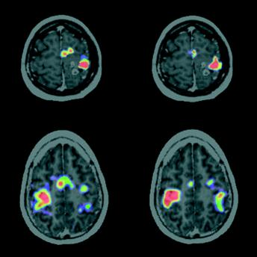
Parametric Maps
Foster N L et al. Brain 2007;130:2616-2635
Meyer P T et al. J Neurol Neurosurg Psychiatry 2003;74:471-478

Slide 80
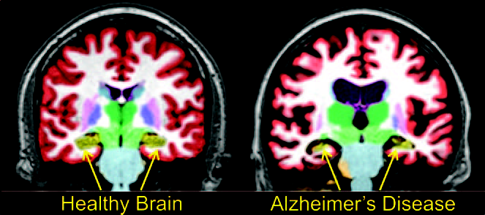
Label Maps
Brewer J et al. AJNR 2009; 30:578-580

Slide 81
Parametric & Label Maps
Per-voxel encoding of numeric or label values
“Images”, but not just “pretty pictures”
modality-specific or secondary capture; single or multi-frame
Segmentations (alternative to label maps)
binary, probability, fractional occupancy
multiple segments (multiple labels)
Parametric maps
pixel value “means something” – real world value map (RWVM)
integers +/- (linear) rescaling to floats (usable by any viewer)
“derived” images of modality-specific SOP Class
recently added floating point voxels and SOP Class (Sup 172)
Leave “fusion” (superimposition) to application
e.g., PET SUV on top of CT
can use Blending Presentation State to specify what to fuse

Slide 82
Segmentations
Can be used to encode tissue segmentation, functional segmentation, and artifact identification for quantification or visualization
Can encode segmentation of entire volumes, single slices, smaller sub-regions, or 2D frames
An alternative mechanisms to encode ROI: voxel based, rather than contours (outlines)
Useful for encoding “atlases”
Coded description of segment category can be anatomical or property based or both
Encoded as a multi-frame image
Each frame represents a 2D plane or a slice of a single segmentation category

Slide 83
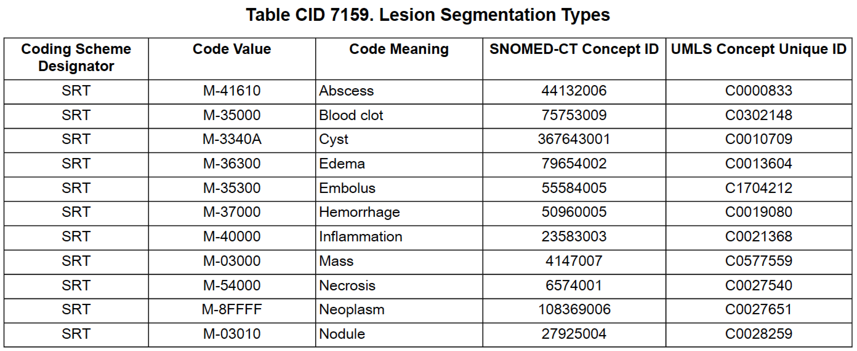
Segmentation Codes

Slide 84
Segmentations
More than one segment category is supported per instance – if more than one segment category is defined, each is encoded in a separate set of frames (i.e., multiple segment categories are not packed into pixels or indexed – not a numerical “label map”)
Segmentations are either binary or fractional (probability or occupancy percentages)
Spatial sampling and the extent do not need to be identical to the referenced images – need encode only region within “bounding box” of voxels in segments (subset of frames, subset of image matrix)
For 3D segmentations, related to patient coordinate system via Frame of Reference +/- explicit reference to images on which segmentation was performed

Slide 85
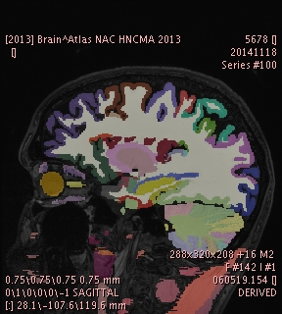
DICOM Segmentation Example
Harvard Brain Atlas converted from NRRD Label Map with numerical voxel indices to DICOM Segmentation with one bitmap per anatomical segment, superimposed on differently sampled “original” MR image

Slide 86
Parametric Maps
Each pixel value has "meaning" in real world
“Parametric" alludes to the meaning being the parameter of something, e.g.:
parameters of pharmacokinetic models, such as Ktrans of the Tofts model used in DCE-MRI
regional cerebral blood volume (RCBV) or flow (RCBF) used in perfusion CT
normalized values based on body size, such as SUVbw used in PET
diffusion parameters such as Apparent Diffusion Coefficient (ADC) used in MR DWI

Slide 87
Parametric Maps
Can be encoded as:
“traditional” IOD-specific images of “derived” type
new Parametric Map Storage SOP Class
Parametric Map Storage SOP Class
integer or floating point (32 or 64 bit) pixels
single “sample” per frame (i.e., monochrome)
pseudo-coloring for rendering defined separately
leverages functional groups, dimensions, 3D positioning of enhanced MF family objects
for intermediate files (to propagate composite context)
uses Real World Value Map mechanism to define “meaning” of parameter values

Slide 88
Real World Value Mapping
Modality
VOI
P
LUT
LUT
Display
LUT
Stored
Values
Real world
Real
value
Value
Value
Unit
LUT
Real World
Real World
Measurement
Value LUT
or
Value Intercept
Units Code
Data
and Slope
Sequence
(0040,9212)
attributes
(0040,08EA)

Slide 89
Real World Value Mapping
Separate pipelines based on pixels
what to show on the display
what the pixel (voxel) “means”
e.g., MR pixel values
signal intensity windowed for display
mapped to physical unit (e.g. phase contrast velocity)
recently added code for “quantity” as well (CP 1387)
Encoding options:
within image or separate object (e.g., derived later)
linear equation or LUT, applied to all/sub-set of range
point operation (applies to all voxels in slice/frame)
referenced from SR for ROI measurement (CP 1388)

Slide 90
Real World Value Mapping
Units:
Unified Code for Units of Measure (UCUM)
Quantity defined (extensibly) as:
(G-C1C6, SRT, "Quantity”)
(121401, DCM, “Derivation”)
(G-C036, SRT, “Measurement Method”)
E.g., Cerebral Blood Flow (CBF)
Measurement Units Code Sequence
(ml/[100]g/min, UCUM, "milliliter per 100 gram per minute")
Quantity Definition Sequence
(G-C1C6, SRT, "Quantity") = (113055, DCM, "Regional Cerebral Blood Flow")

Slide 91
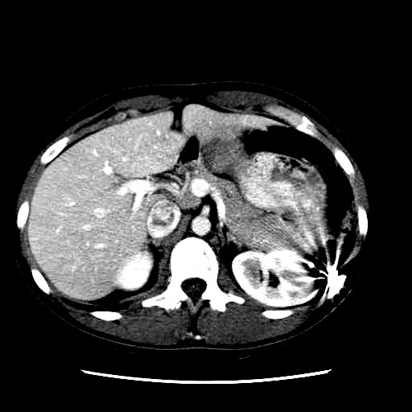
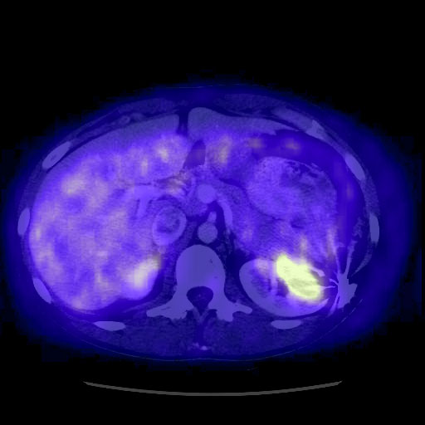
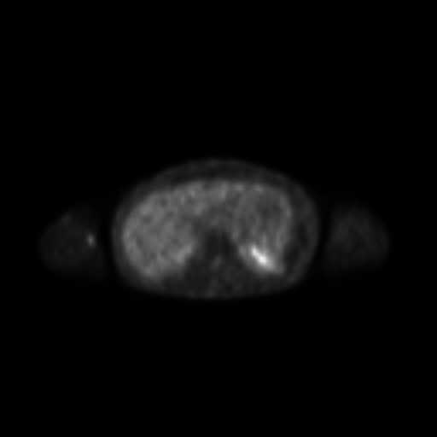
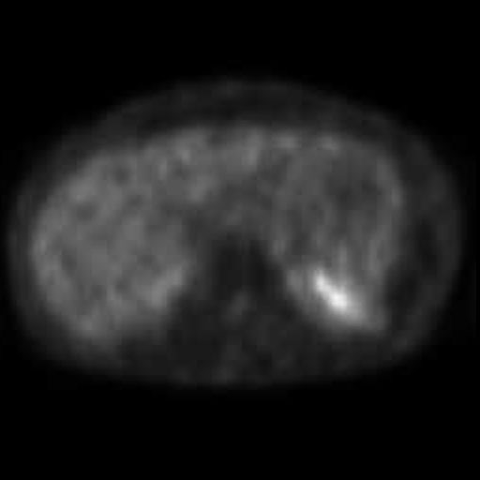
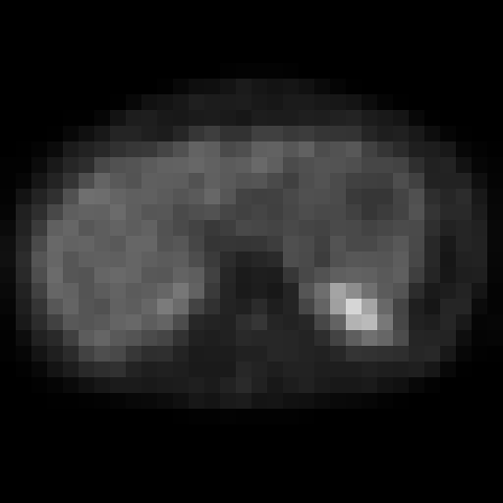
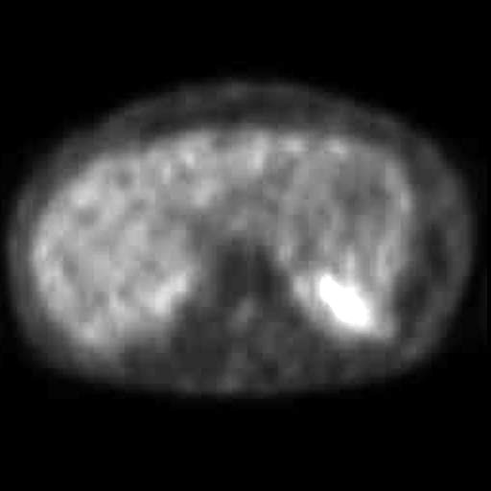
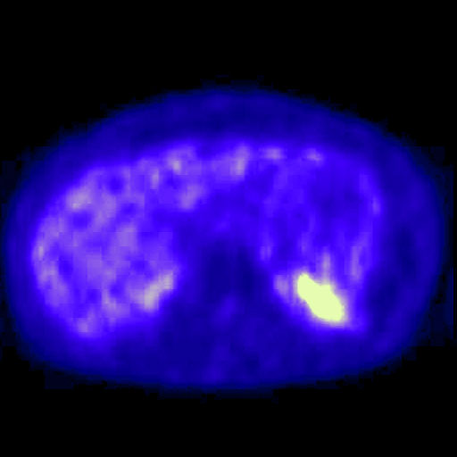
Blending Presentation State
select underlying
[register]
rescale and window
blend
select superimposed
within slices
resample
pseudo-color
between slices

Slide 92
Registration & Fiducials
Mapping between 3D coordinates
DICOM Registration – rigid matrix
DICOM Deformable Registration
Location of specific points
DICOM Fiducial
Used to save manual or automated results
save application state for further work later
re-use for other purposes (e.g., sync’d scrolling)

Slide 93
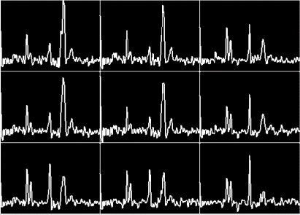
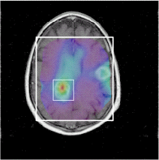
Other Bulk Data Storage
Time-based Waveforms
ECG
Hemodynamic
Audio
MR Spectroscopy
Single voxel
Multi-voxel
Multi-frame
Metabolite maps (CSI) as images
Raw Data IOD

Slide 94
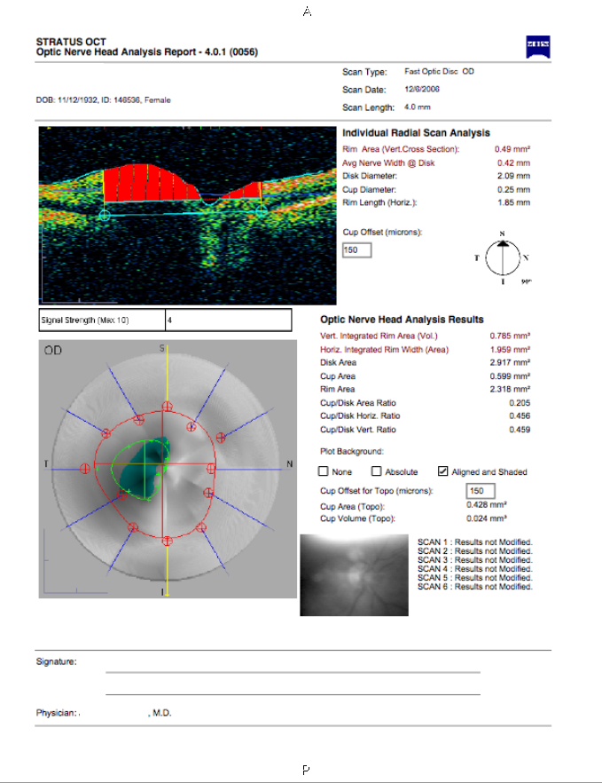
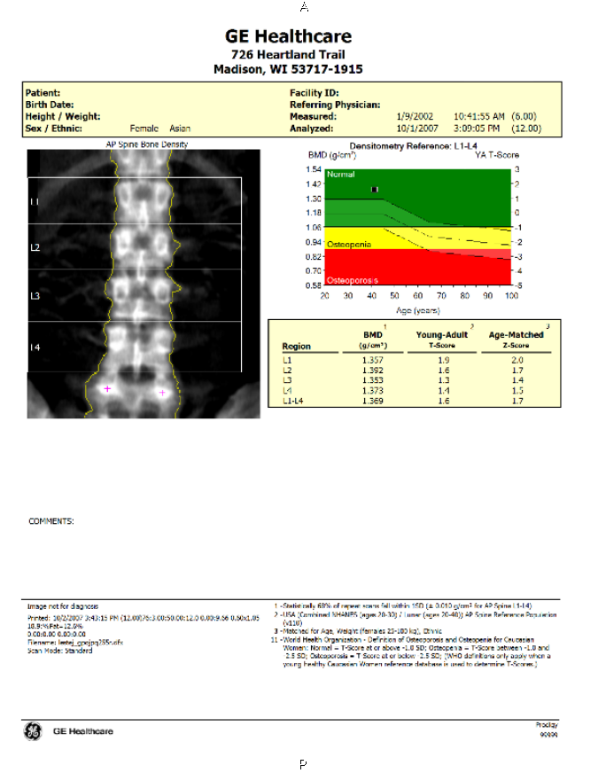
Encapsulated PDF Pretty Pictures
A “prettier” alternative to Secondary Capture Images

Slide 95
All Together Now …
DICOM Segmentation
Previous DICOM SR etc
DICOM Registration
Current DICOM Images from Modality
Analysis Workstation
DICOM SR
PACS Store, Distribute and Review
DICOM Real World Value
Previous DICOM Images from PACS
DICOM Parametric Map Images

Slide 96
SR as the Organizing Structure
DICOM Segmentation
Previous DICOM SR etc
DICOM Registration
Current DICOM Images from Modality
Analysis Workstation
DICOM SR
PACS Store, Distribute and Review
DICOM Real World Value
Previous DICOM Images from PACS
DICOM Parametric Map Images

Slide 97
Distributing the Results
DICOM Segmentation
Previous DICOM SR etc
DICOM Registration
Current DICOM Images from Modality
Analysis Workstation
DICOM SR
PACS Store, Distribute and Review
DICOM Real World Value
Previous DICOM Images from PACS
DICOM Parametric Map Images

Slide 98
Final thoughts …
DICOM is not just for modality vendors
Use of DICOM facilitates faster translation from research into clinical trial and/or clinical use with structured data, not just “pretty pictures”
Research applications can benefit from improved organization in enhanced family images, even if conversion required
Rich family of DICOM objects and mechanisms to support quantitative imaging result recording, derived images, and intermediate results
New parametric map object with floating point pixels
New SR templates and related infrastructure for measurement encoding with rich research-specific code sets and templates
DICOM is responsive to research requirements (e.g., QIICR project, WG18 Clinical Trials & Research) – 9 month cycle time if aggressive
Widely used toolkits can rapidly adopt new mechanisms (e.g., dcmtk in response to QIICR requirements) leading to broader generic support (e.g., in 3D Slicer, Osirix, ClearCanvas, etc.)

