Slide 1
3D Slicer in Image Guided Therapy
Nobuhiko Hata, PhD
Brigham and Women’s Hospital

Slide 2
National Center for Image-Guided Therapy
www.ncigt.org
Surgical Planning Lab, Harvard Medical School
Surgical Navigation and Robotics Laboratory
National Alliance for Medical Image Computing
Intelligent Surgical Instrument Project, Japan

Slide 3
Slicer in IGT
Extension of Slicer for IGT research
To enable and clinically validate the innovative treatment.
To foster collaboration and resource sharing across research centers
Historically, Slicer started as in-house research software for IGT research at Brigham and Women’s Hospital [Hata 98] [Gering 99]

Slide 4
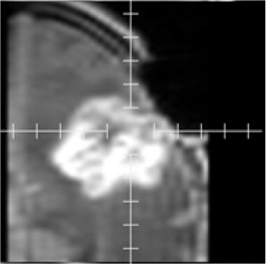
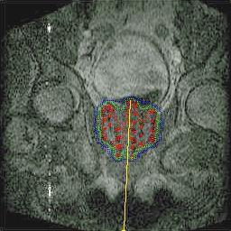
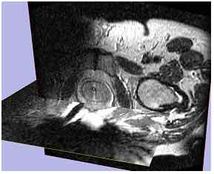
IGT applications by Slicer
Brain (biopsy, craniotomy, NdYAG laser ablation)
Prostate (brachytherapy, biopsy)
Liver and kidney (Microwave, Cryo, laser ablation)
Endoscopy (broncho-, neuro-, feto-scopy)

Slide 5
Role of Slicer in IGT research
Planning
Pre-operative imaging fusion
DCE MRI analysis
Monitoring/Control
Target definition
Intra-operative image feedback
Guidance
Tracker support
“Navigation”
Patient-to-Image registration
Neuro-fiber tracking

Slide 6
Role of Slicer in IGT research
Planning
Pre-operative imaging fusion
DCE MRI analysis
Monitoring/Control
Target definition
Intra-operative image feedback
Guidance
Tracker support
“Navigation”
Patient-to-Image registration
Neuro-fiber tracking

Slide 7
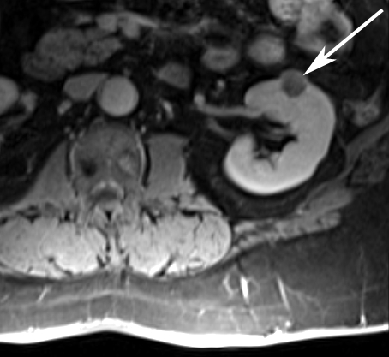
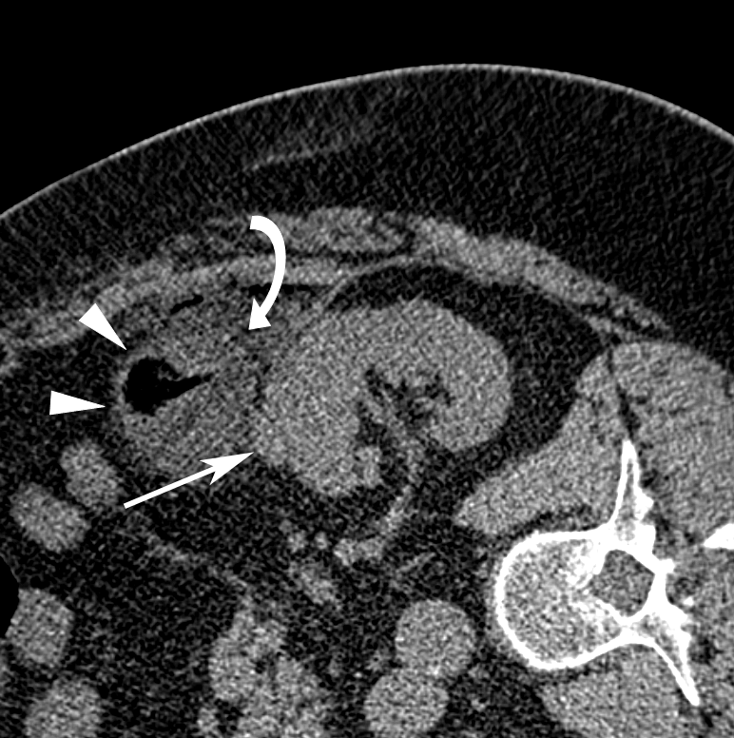
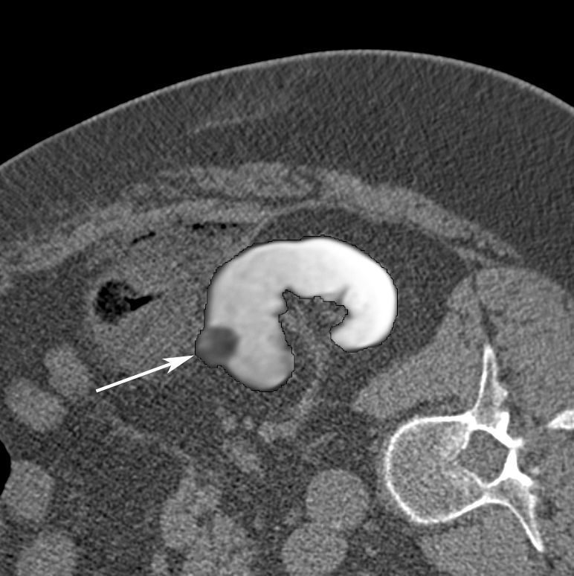
Planning Example: CT-guided renal cancer ablation
Pre-procedural MRI
Intra-procedural CT
Registered Image
Case: 61 y/o male, left RCC
DSC = 0.97
95% HD = 1.1 mm
Oguro et al, Int J Comput Assist Radiol Surg, 2011
Elhawary et al, Acad Rad, 2010

Slide 8
Role of Slicer in IGT research
Planning
Pre-operative imaging fusion
DCE MRI analysis
Monitoring/Control
Target definition
Intra-operative image feedback
Guidance
Tracker support
“Navigation”
Patient-to-Image registration
Neuro-fiber tracking

Slide 9
Monitoring/Control Example - CT-guided liver tumor ablation
Oguro et al, Int J Comput Assist Radiol Surg, 2011

Slide 10
How are we (NA-MIC, NCIGT) serving IGT community?
Slicer IGT programming event Dec 2007, at BWH
Unmet needs of IGT developer community identified
Inter-device communication mechanism to/from Slicer
Fast Volume rendering
Plug-in mechanism to add/remove module
Flexible GUI design

Slide 11
Role of Slicer in IGT research
Planning
Pre-operative imaging fusion
DCE MRI analysis
Monitoring/Control
Target definition
Intra-operative image Feedback
Guidance
Tracker support
“Navigation”
Patient-to-Image registration
Neuro-fiber tracking
Inter-device communication to/from Slicer: OpenIGT Link

Slide 12
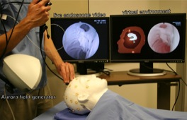
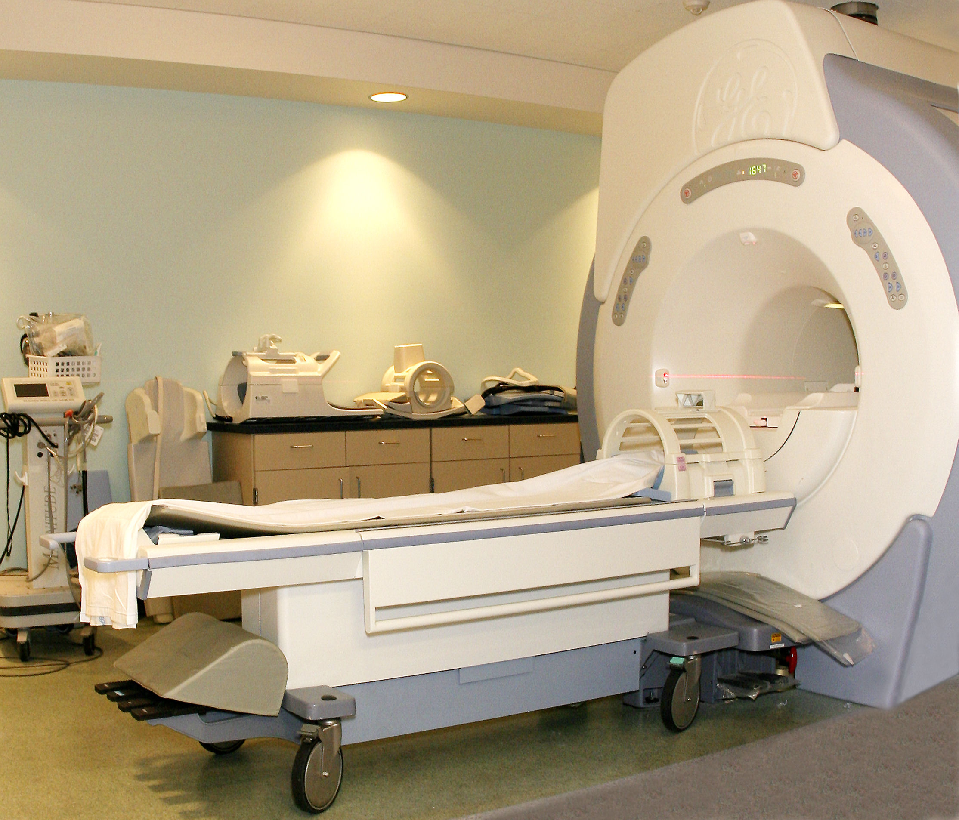
Open IGT Link
Inter-device communication mechanism
Enables exchange of coordinates, images, control commands
Open protocol
History
“Need” indentified during IGT Programming event in Dec, 2008
Design discussion during a NA-MIC programming event (Jan, 2008)
Initial implementation by NIH-funded IGT researchers in Spring 2008
[Tokuda et al 2010]

Slide 13
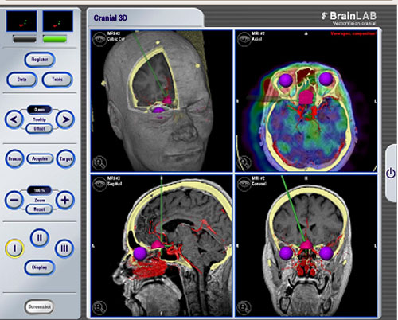
Guidance: BrainLab – Slicer Integration
BrainLab Vector Vision
FDA-approved product
Patient-to-image registration
Device tracking
3D Slicer
Research Platform
Interactive DTI fiber tracking
BrainLab
Slicer3
VVLink
BioImaging Suite
OpenIGTLink
Elhawary et al Neurosurgery 2011

Slide 14
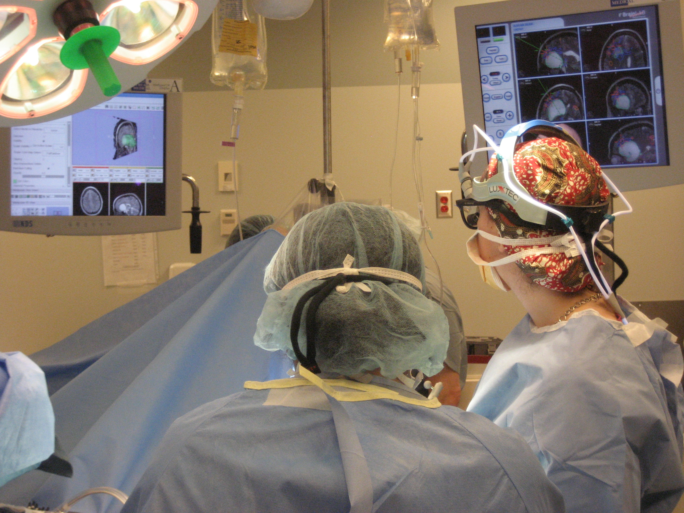
Slicer3

Slide 15
Realtime Fiducial Seeding

Slide 16
Unmet Needs
2007 -> 2011
First brainstorming session during current NA-MIC AHM
Support for streaming image data
Emerging IGT with 4D US
(More) Flexibility in GUI design
DICOM listener/query/retrieval/database
Motion compensation

Slide 17
Conclusion
3D Slicer
Useful tool for IGT software development
Facilitates collaboration and dissemination
Open IGT Link
Inter-device communication tool in IGT
Useful to integrate 3D Slicer with FDA-approved clinical devices and provide complementary functions
Plan for future
Continuing effort to extend Slicer 3 for new IGT applications
Unmet needs (motion, 4D,

