Slide 1
SlicerRT Patient Hierarchy introduction

Slide 2
Motivation
Represent loaded medical data in a more intuitive way
Easier handling of grouped data (e.g. show)
Special RT data: structure sets, beams, etc.
Maintain relationships between different data nodes
Purpose: automatic selection, data export
Example: registered image with input images
Notes:
3D Slicer from a more technical perspective

Slide 3
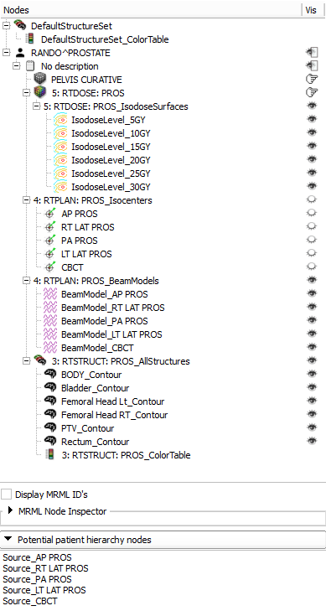
Current state
Building tree when loading from DICOM
Add every related node (e.g. color tables, generated beam models)
Reparenting, adding from potential nodes list
Finding related nodes automatically
Show/hide complete branches, show volumes
Notes:
3D Slicer from a more technical perspective

Slide 4
Implementation
vtkMRMLHierarchy nodes (Displayable for displayable leaves) with attributes:
HierarchyType : PatientHierarchy
DicomLevel : [Patient/Study/Series/Subseries]
DicomUid : [UID]
References: e.g. RoiReferencedSeriesUid
Sometimes additional info, e.g. modality
Widgets (Qt designer plugin available)
TreeView
SceneModel, SortFilterProxyModel
Potential nodes list (model, proxy model)
Notes:
3D Slicer from a more technical perspective

Slide 5
Implementation cont’d
PatientHierarchy plugin mechanism Outsources reparent operations for specific node types (e.g. contours have to deal with color tables and labelmap volume labels)
AddNodeToPatientHierarchy
ReparentNodeInsidePatientHierarchy
Logic: convenience utility functions (mostly static) for
Insertion
Queries (e.g. are nodes in same branch, check DICOM level)
Set/get whole branch visibility (e.g. studies, structure sets)
Find patient hierarchy nodes
Generate tooltips
etc.
Notes:
3D Slicer from a more technical perspective

Slide 6
Generalization and integration
Generalization
Isolate non-DICOM specific parts
Migrate infrastructure (plugin mechanism, widgets)
Rename to SubjectHierarchy? (StudyHierarchy?)
Extensive automatic testing
Integrate to Slicer core
Re-create patient hierarchy features as subclasses of the new hierarchy module
Use the same module (Subject Hierarchy)
Extend functionality for DICOM and DICOM-RT
Notes:
3D Slicer from a more technical perspective

