Slide 1
SlicerRT Image-guided radiation therapy research toolkit for 3D Slicer
Csaba Pinter¹, Andras Lasso¹, An Wang², David Jaffray², and Gabor Fichtinger¹
¹Laboratory for Percutaneous Surgery, Queen’s University, Canada ²University Health Network, Toronto, ON, Canada

Slide 2
SparKit project overview
Goal: provide open-source platform for translational clinical research, mainly cancer
Themes:
SlicerRT: radiotherapy toolkit for 3D Slicer
SlicerIGT: Image-guided therapy with 3D Slicer
Funding by Cancer Care Ontario till 2016
PI & co-PIs: Gabor Fichtinger (Queen’s), David Jaffray (Toronto UHN), Terry Peters (Robarts)
Notes:
Runs under the umbrella project SparKit: Software Platform and Adaptive Radiotherapy Kit
Originally funded by OCAIRO, didn’t cover platform development.

Slide 3
Motivation behind SlicerRT
Commercial treatment planning systems (TPS)
Existing research tools CERR, PLUNC, dicompyler, etc.
Inconvenient
Limited feature set
Expensive
Closed
Insufficient user and developer support
Cover only routine clinical procedures
Open-source?
Well documented
Free
Poor documentation
Not extensible
User-friendly
Extensible
Large, non-modular code base
Not flexible
Flexible
Stable
Unstable
Open-source
Platform-independent
SlicerRT
Notes:
Lack of a comprehensive and open radiation therapy research toolkit
RT researchers use commercial TPSs along with existing research tools. Both categories have serious shortcomings when being used for research purposes.
SlicerRT aspires to overcome these limitations, and also congregate their strong properties, such as ease of use, stability, flexibility, and so on.

Slide 4
Development principles
Leverage existing tools and parallel efforts: 3D Slicer¹, Plastimatch²
“Hub” for RT data analysis and comparison
Cover most common RT research workflows
Free, open-source license (BSD)
Open to integrate algorithms
Extensive documentation
XiO®
Pinnacle³
Eclipse™
DICOM-RT
DICOM-RT
DICOM-RT
SlicerRT
MATLAB
DICOM-RT
¹ S. Pieper, M. Halle, and R. Kikinis, 3D SLICER. Proceedings of the 1st IEEE International Symposium on Biomedical Imaging: From Nano to Macro (Brigham and Women’s Hospital, Boston, MA, 2004), pp. 632–635.
² G. C. Sharp, R. Li, J. Wolfgang, G. Chen, M. Peroni, M. F. Spadea, S. Mori, J. Zhang, J. Shackleford, and N. Kandasamy, “Plastimatch: An open source software suite for radiotherapy image processing,” in Proceedings of the XVIth International Conference on the Use of Computers in Radiotherapy (ICCR) (Amsterdam, the Netherlands, 2010).
Notes:
Approach to leverage… By doing so, we can minimize parallel developments of for example visualization or registration tools, that are otherwise crucial parts of an RT research toolkit.
We aim SlicerRT to be a hub for…The hub approach is illustrated on the right side. It shows that SlicerRT cooperates with multiple treatment planning systems and Matlab, using their native formats.

Slide 5
General workflow overview
3D Slicer
RT import (DICOM)
Visualization (volumes, models, 2D/3D, etc.)
Processing (registration, segmentation, etc.)
Analysis (error metrics, measurements, image fusion, etc.)
RT-specific analysis (dose comparison, DVH, …)
RT export (DICOM, Matlab, …)
SlicerRT components
3D Slicer components
Notes:
This diagram explains the general workflow that SlicerRT supports.
It starts with…Then follows by setting up the proper display using…Next, we process our input, which means contouring or registration…It is followed by the analysis of the data using both 3D Slicer and * SlicerRT tools and algorithms. Finally,…

Slide 6
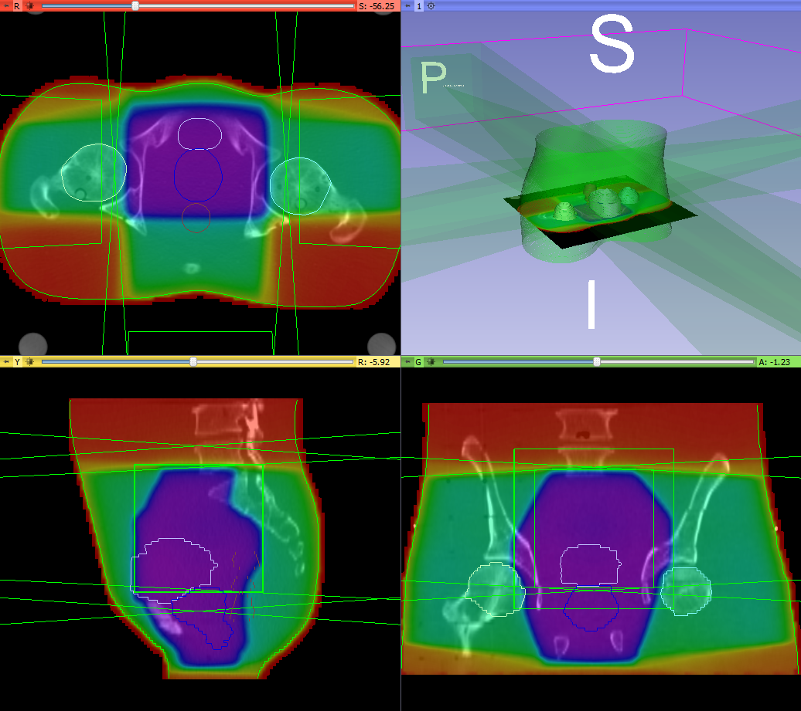
DICOM-RT import
Integrated into core DICOM import plugin mechanism
Data is organized in a smart hierarchy
Supported data types:
RT structure sets → Contours → Fiducial point
RT dose map
RT image
RT plan: isocenter, beams
Planning CT, MR, etc.
Standard layout after loading phantom dataset
Notes:
Now I'd like to introduce the main feature groups of SlicerRT.
The first step of every RT research workflow … … seamless handling and loading of the data using only the DICOM browser in 3D Slicer
Patient hierarchy

Slide 7
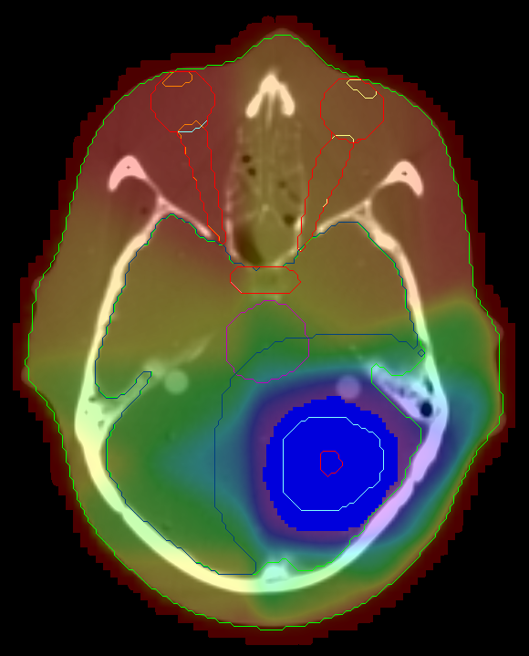
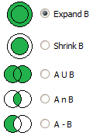
Contour analysis
Multiple representations (automatic conversion)
Ribbon model
Rasterized volume
Closed surface model
Contour comparison
Dice coefficient
Hausdorff distance
Contour morphology
Expand, shrink
Combine using logical operators
Ribbon model
Rasterized volume
Closed surface
Notes:
…that incorporates several modules in SlicerRT. Our Contours module allows easy handling of the imported structure set contours, by offering multiple representations and automatic conversions between those. The supported representations are…
…the desired input format for numerous processing and analysis techniques

Slide 8
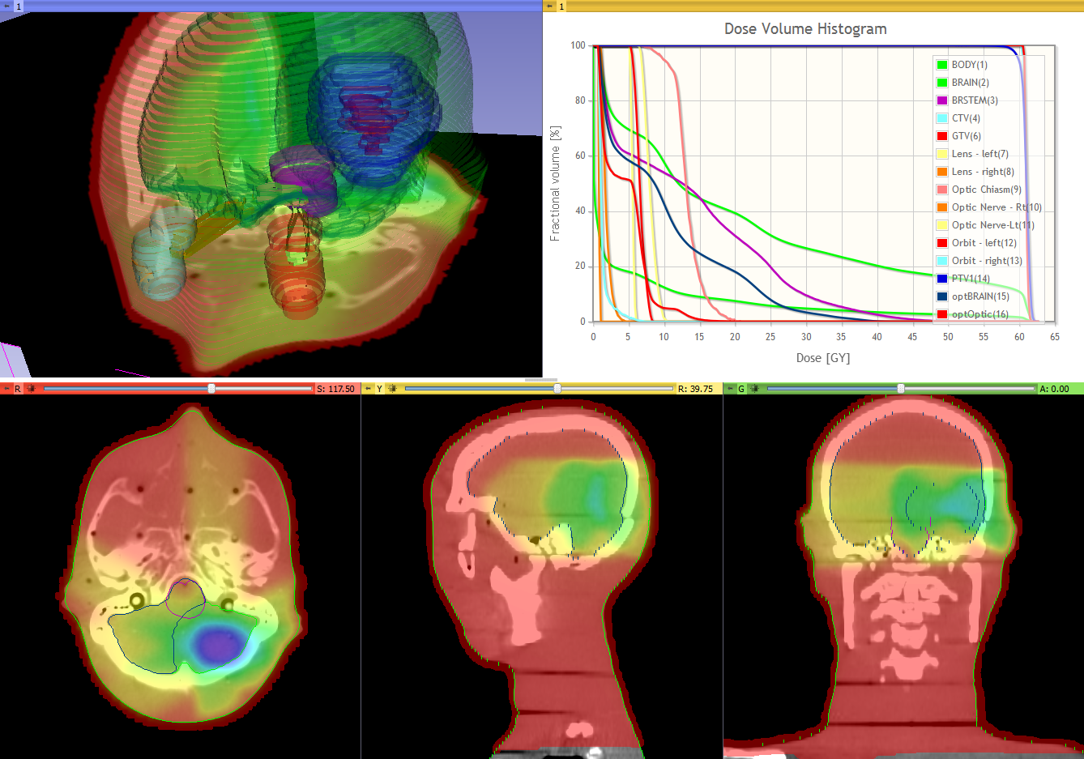
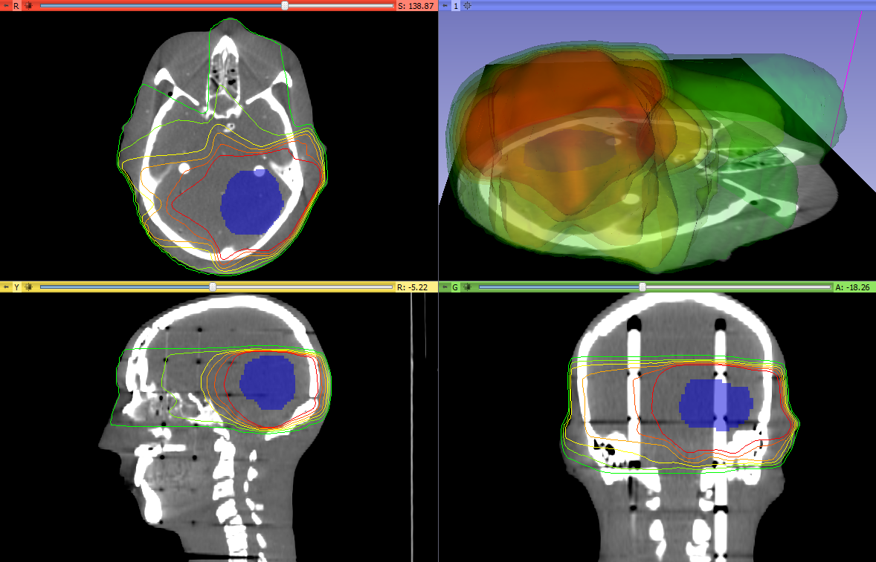
Dose analysis
Dose volume histogram
Dose volume histogram (plot visualization + metrics)
Dose accumulation
Dose comparison (gamma)
Isodose contours / surfaces
Visualize deformation fields
Proton dose computation
Registration
BSpline registration
Landwarp registration
Isodose contours and surfaces

Slide 9
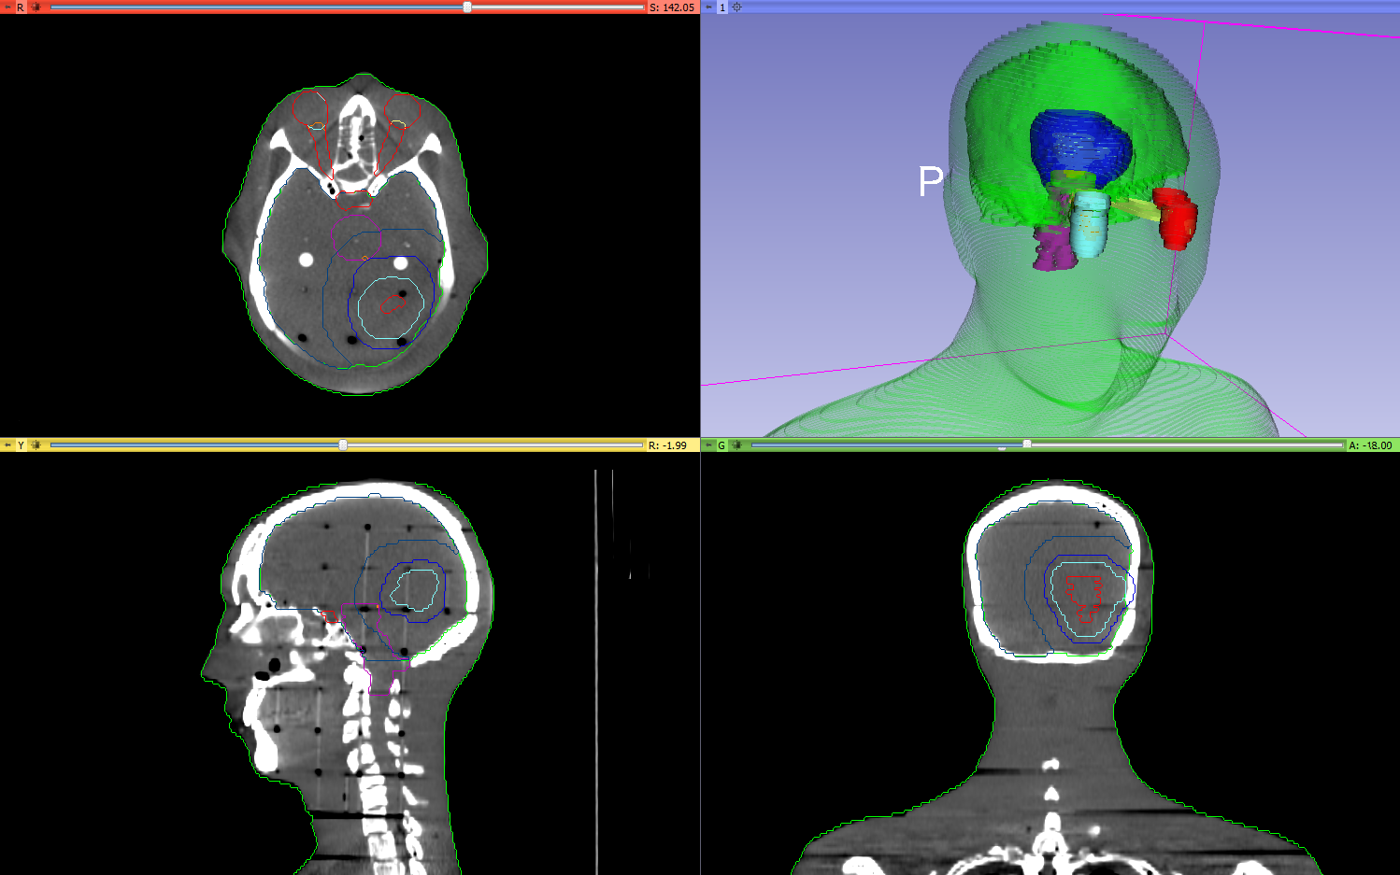
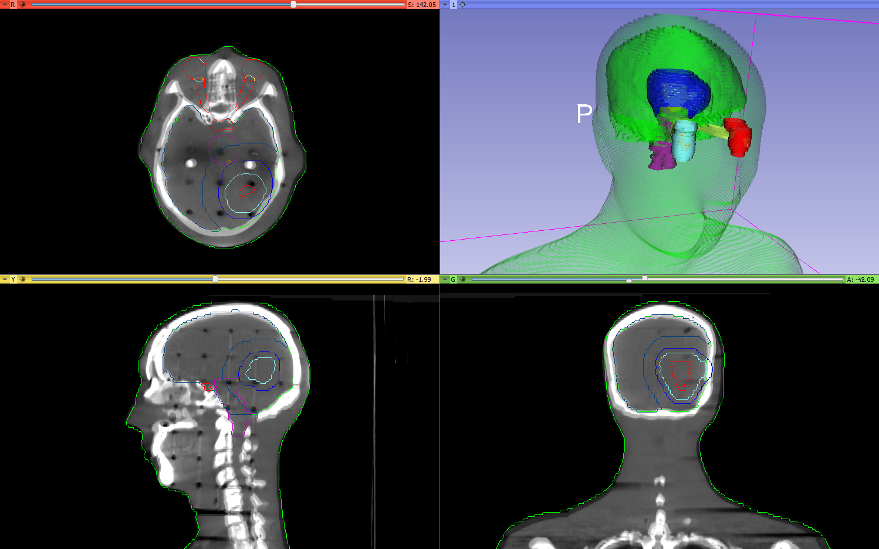
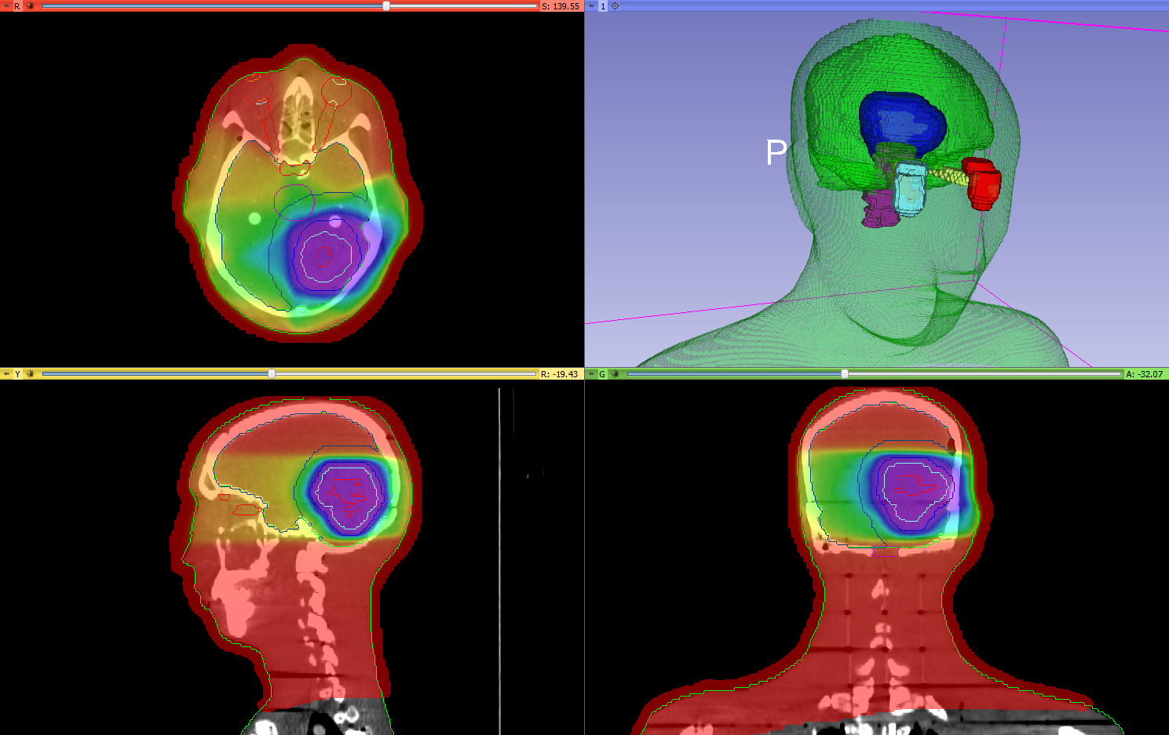
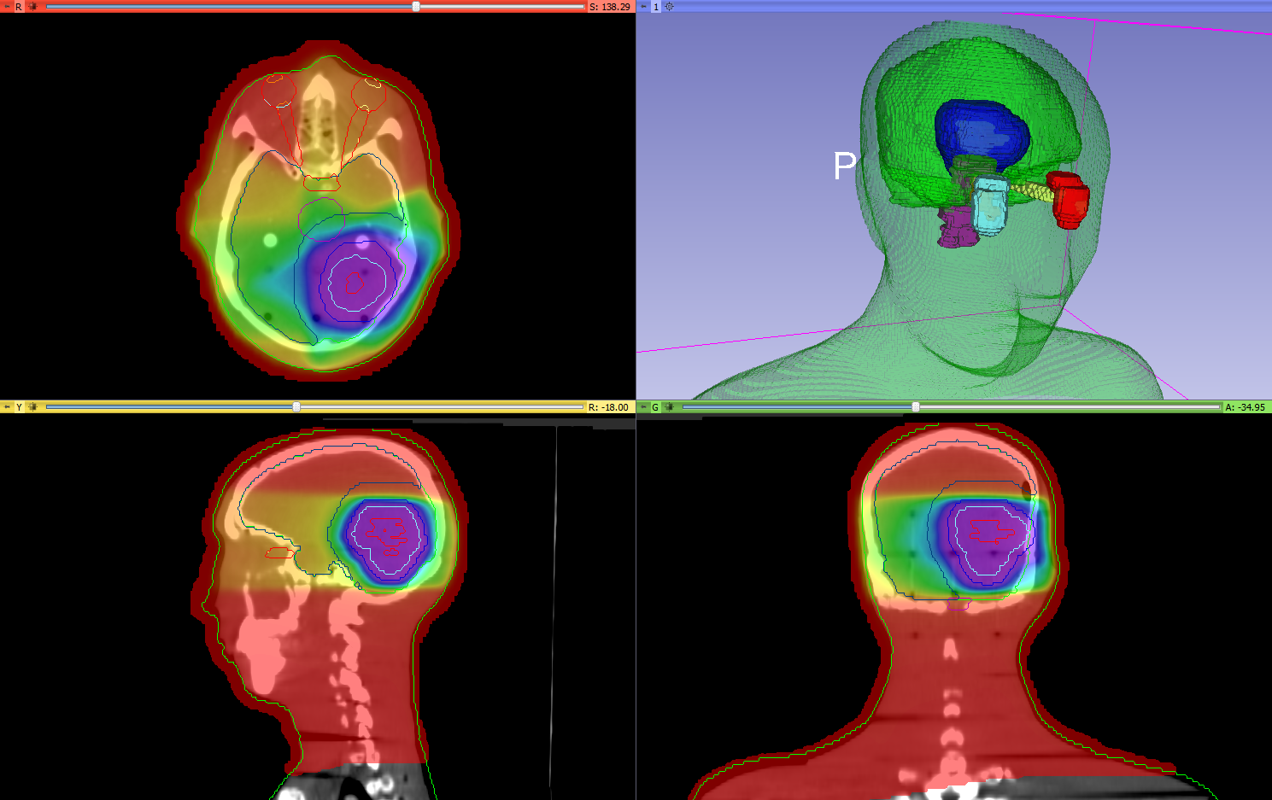
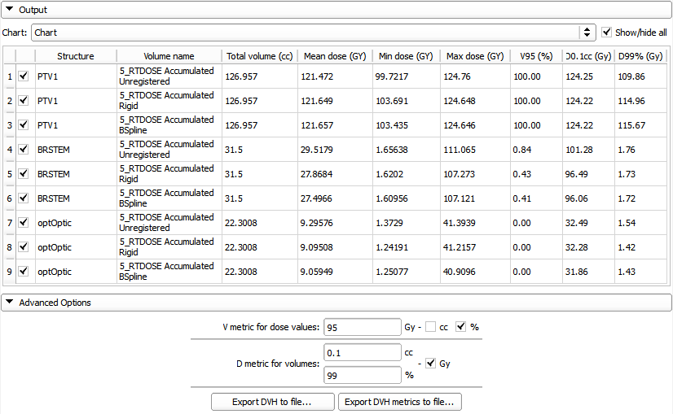
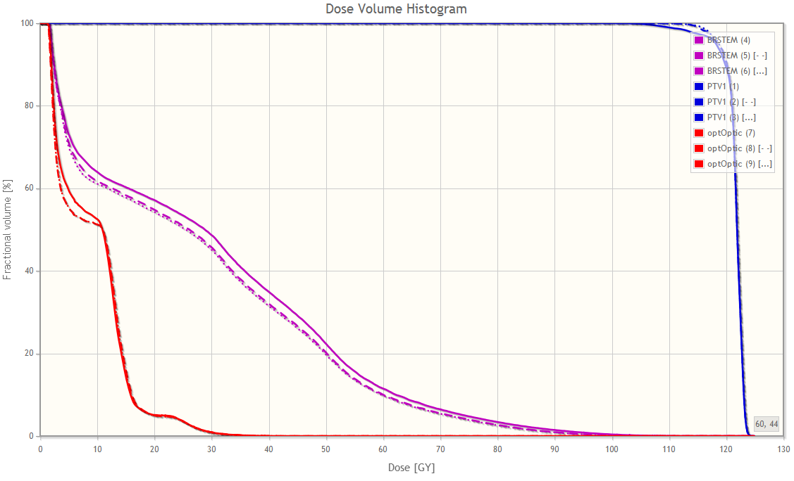
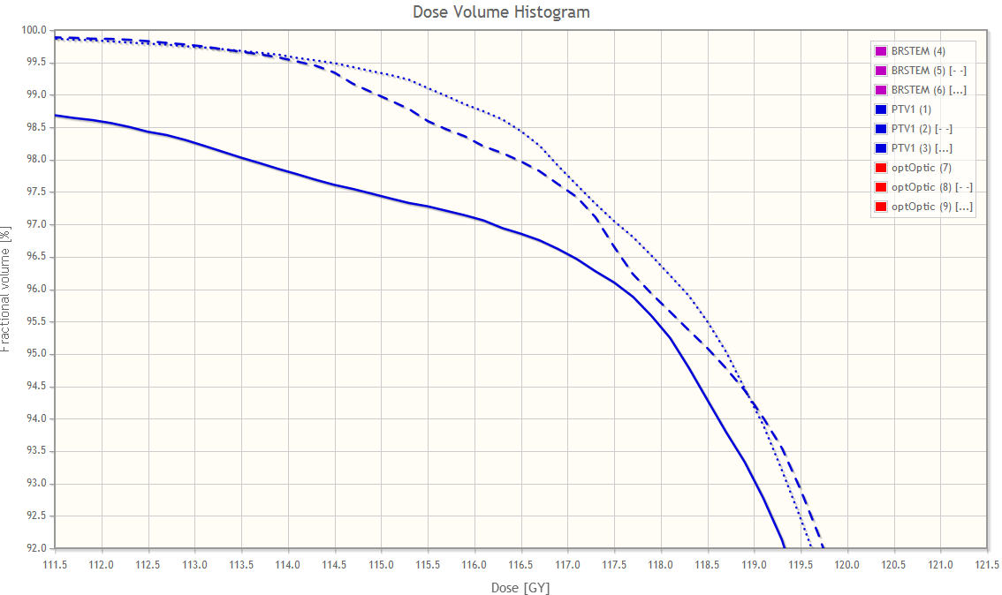
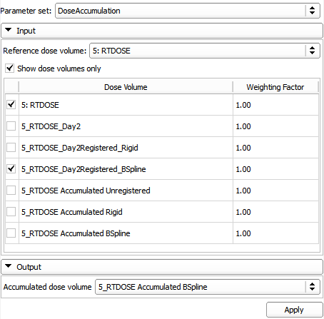
Example use case
Use case: Evaluate the effectiveness of RT plan adaptation
Import, load and visualize data
Register day 1 CT with day 2 CT
Rigid
Bspline
Resample day 2 dose using results
Accumulate doses
Compute and display DVH for all methods
Compare DVH curves and metrics for target volume and organs at risk
Notes:
Now I'd like to present an example use case, possibly the one that covers the most features available in SlicerRT at the moment. …
We compute the results without adaptation as a baseline. …
… between the two CT images. We need to register them and apply the registration result to the day two dose distribution, thus aligning the two datasets together for analysis.
Zooming in on the area the target dose starts to fall, we can compare the delivered dose better for each case.
We can also check the basic metrics and compute more complicated ones to quantify the differences.

Slide 10
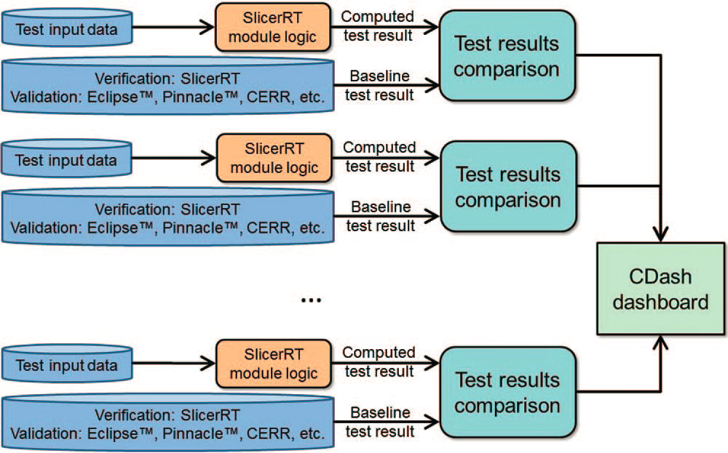
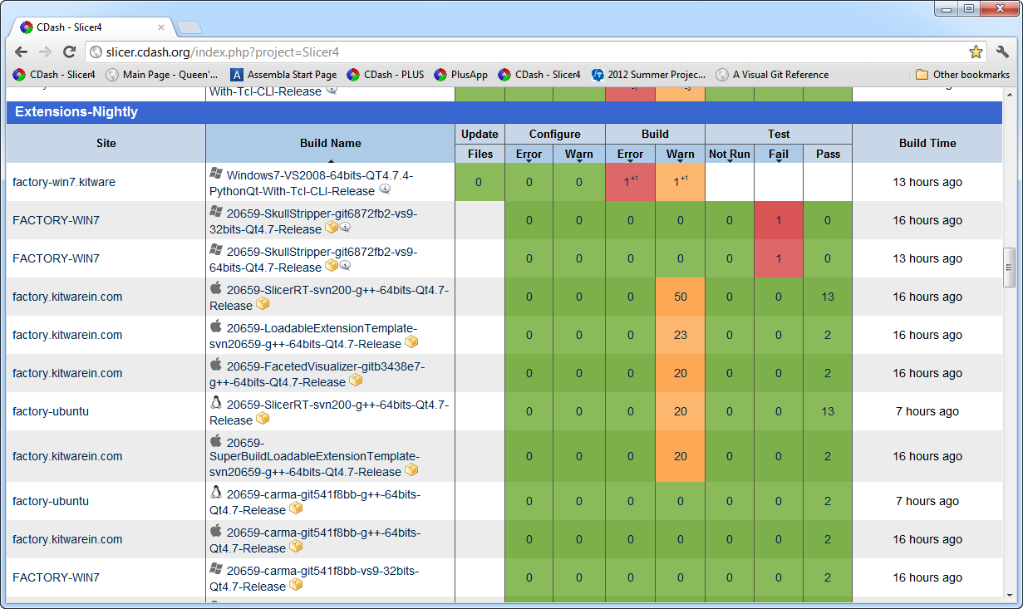
Software quality
Extensive automatic testing done on multiple platforms every night
Validated against other software packages (Pinnacle, CERR, …)
Automatic test infrastructure for automatic verification and validation
Test results reported to the web-based dashboard
http://slicer.cdash.org/index.php?project=Slicer4
Notes:
The quality of our software, which means stability, reliability, accuracy, flexibility, extensibility and maintainability is ensured by following the strict and proven development processes we adapted, and the verification and validation performed by the automated testing system. The automated unit and application tests run …
The reliability and accuracy of the SlicerRT algorithms are ensured through a series of validation tests, in course of which our results are compared to the results of other software packages, such as Pinnacle or CERR.

Slide 11
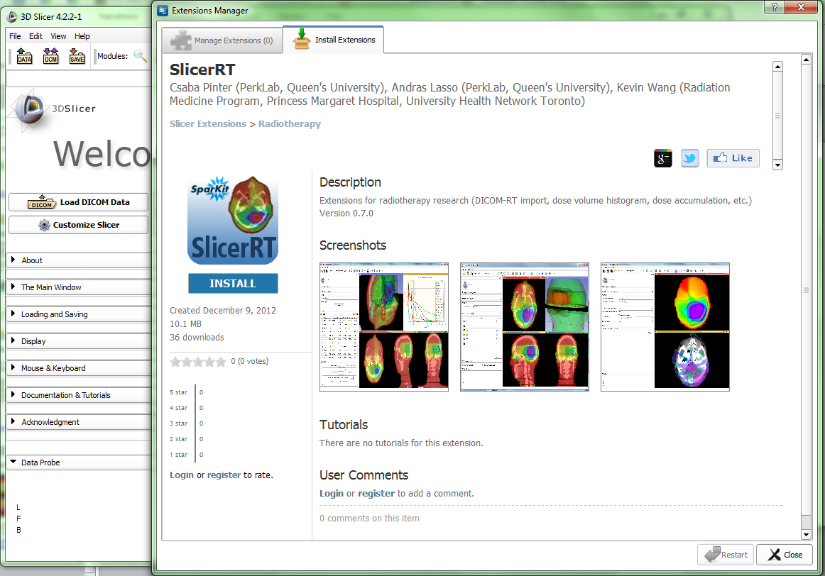
Extension for 3D Slicer
Collection of RT-specific modules, includes
Distributed as a 3D Slicer extension: can be downloaded, installed, upgraded using the extension manager in Slicer
SlicerRT extension in the 3D Slicer app store (free)
Notes:
SlicerRT is distributed as a 3D Slicer extension. It can be easily found and installed from the Slicer AppStore.

Slide 12
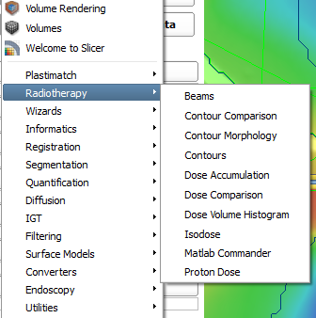
Next steps
Enhancements planned for the next 6 months:
DICOM-RT export
Matlab bridge interface: execute Matlab functions from 3D Slicer
Digitally reconstructed radiograph
Support CERR PlanC format
Scripting examples
More testing and validation
Current radiotherapy modules (including work-in-progress modules)
Detailed plan: https://www.assembla.com/spaces/slicerrt/tickets
Notes:
The major tasks we are planning to do in the near future are to implement the DICOM-RT export functionality and finalize the Matlab bridge interface. There are smaller features also coming up. … detailed plan … website.
Suggestions, comments and feature requests are warmly welcome! Our weekly meetings on every Wednesday are also open to anybody to discuss any matter related to the toolkit.

Slide 13
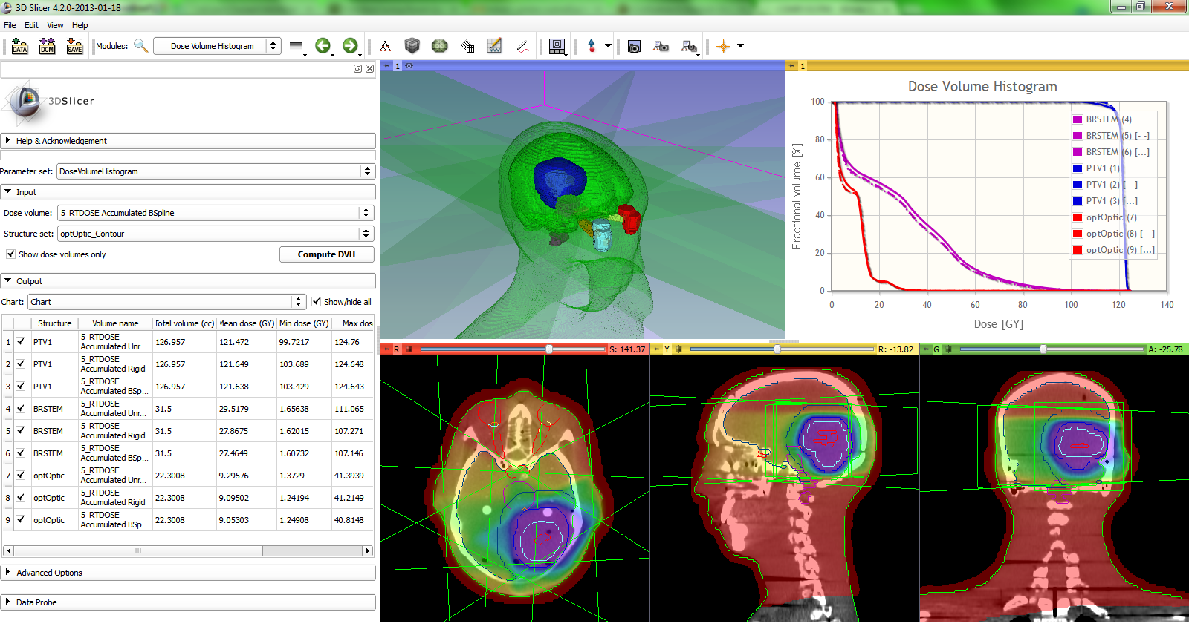
Thank you!
Overview paper: Csaba Pinter, Andras Lasso, An Wang, David Jaffray, and Gabor Fichtinger, “SlicerRT: Radiation therapy research toolkit for 3D Slicer”, Med. Phys. 39 (10), October 2012
Project homepage: http://www.SlicerRT.org/
Contact: Csaba Pinter (pinter@cs.queensu.ca)
Notes:
Thank you for your attention!
Are there any questions?

