Slide 1
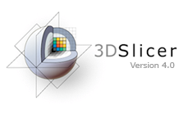
Diffusion MRI Analysis
Sonia Pujol, Ph.D.
Zora Kikinis, Ph.D.
Harvard University, Boston, USA

Slide 2
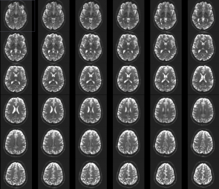
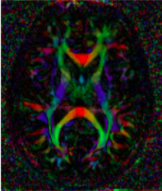
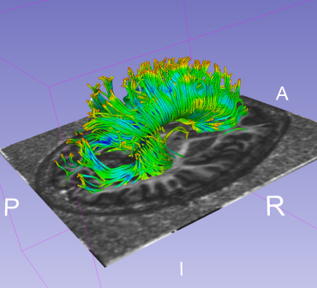
Tutorial Outline
This tutorial is an introduction to the fundamentals of Diffusion MRI analysis, from the estimation of diffusion tensors to the interactive 3D visualization of fiber tracts.
Diffusion MRI Analysis

Slide 3
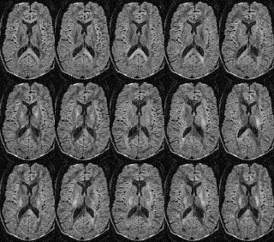
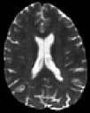
Tutorial Dataset
The tutorial dataset DiffusionMRI_tutorialData is a Diffusion Weighted MR scan of the brain acquired with 41 gradient directions and one baseline.
Diffusion Sensitizing Gradients
Diffusion Weighted Images (DWI)
Diffusion MRI Analysis

Slide 4
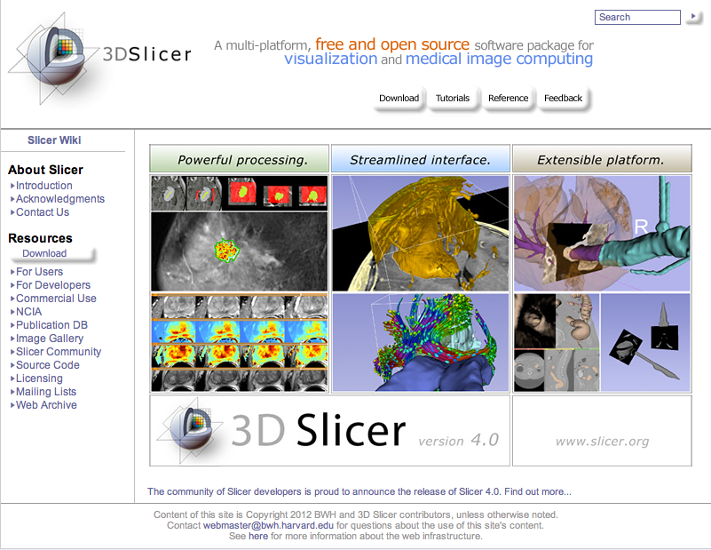
Tutorial Software
The tutorial uses the 3DSlicer version 4.3
software available at www.slicer.org
Disclaimer
It is the responsibility of the user of 3DSlicer to comply with both the terms of the license and with the applicable laws, regulations and rules. Slicer is a tool for research, and is not FDA approved.
Diffusion MRI Analysis

Slide 5
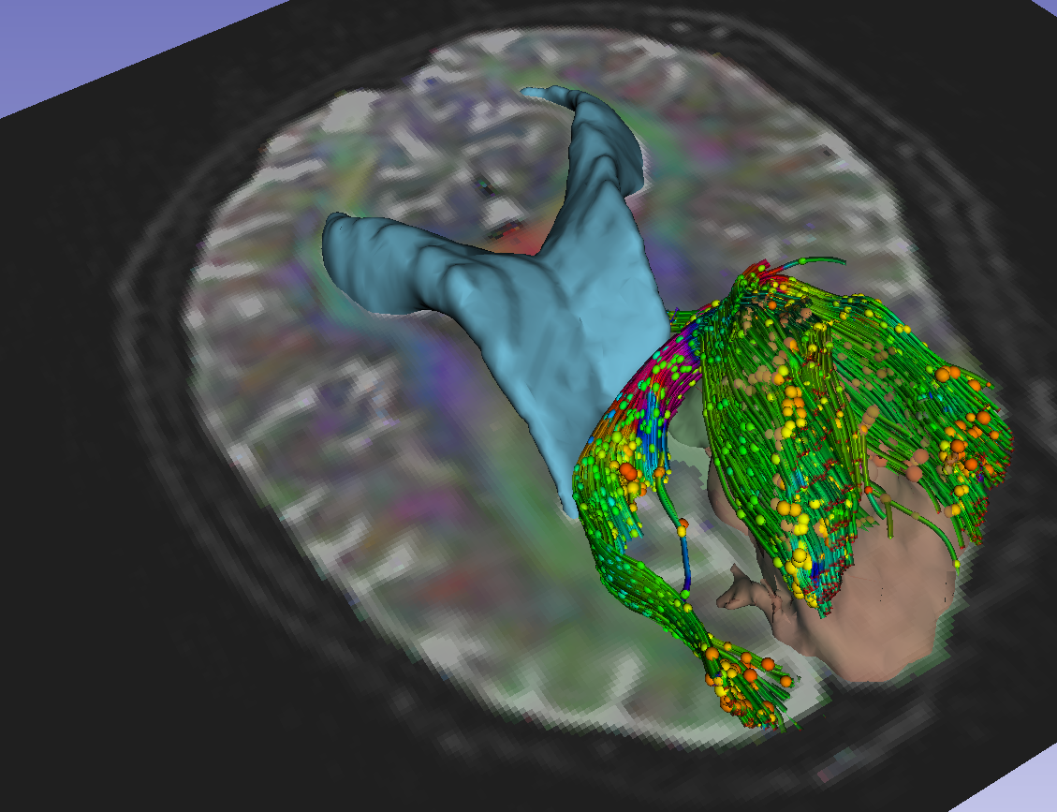
3DSlicer software
An end-user application for image analysis
An open-source environment for software development
A software platform that is both easy to use for clinical researchers and easy to extend for programmers
3D Slicer is a multi-institution effort supported by the National Institutes of Health.
Diffusion MRI Analysis

Slide 6
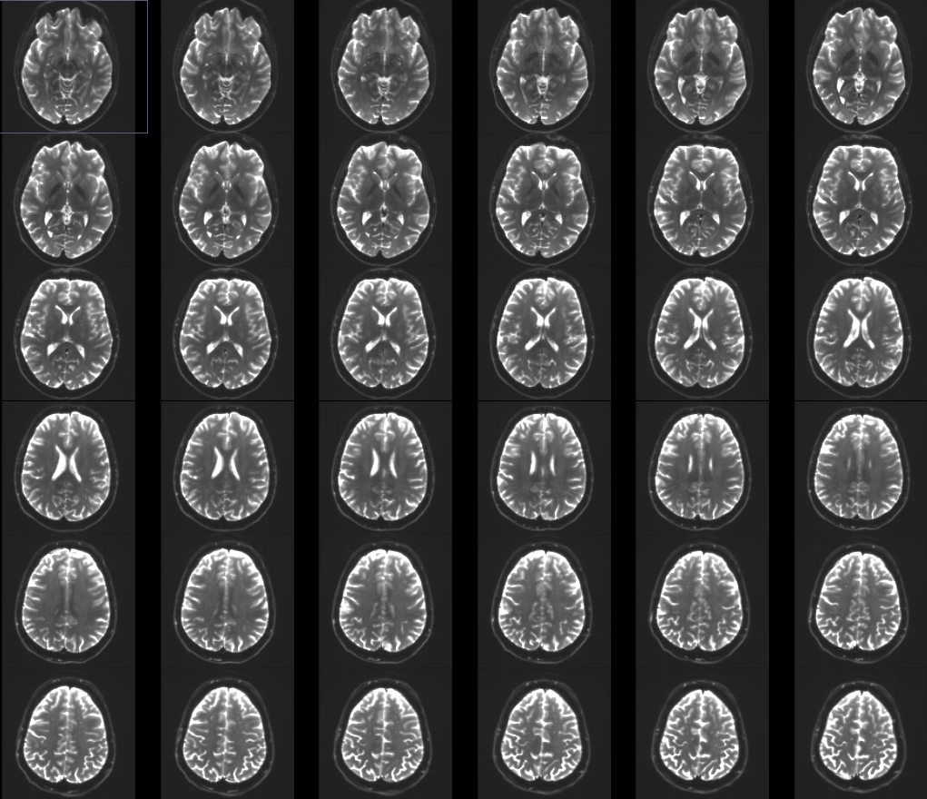
Part 1: From DWI images to Tensors
Diffusion MRI Analysis

Slide 7
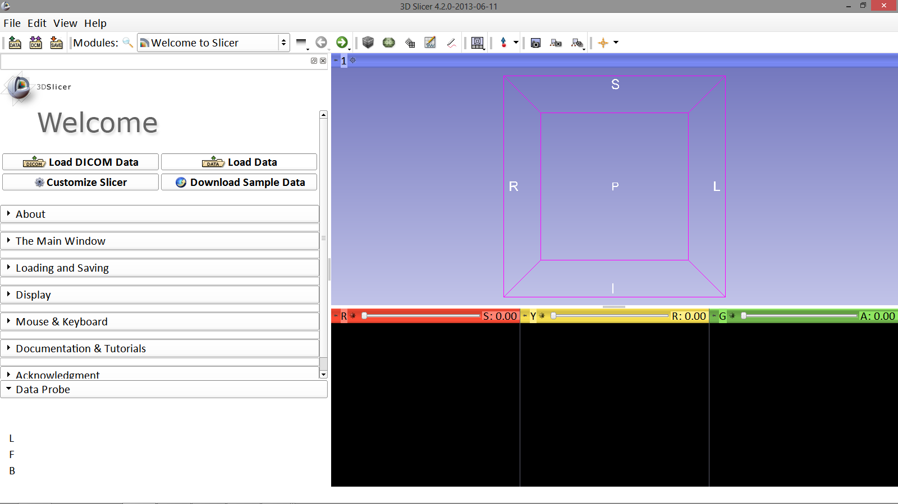
Loading the DWI Dataset
First, start Slicer4
Image Courtesy of Dr. Alexandra Golby, Brigham and Women’s Hospital, Boston, MA..
Diffusion MRI Analysis

Slide 8
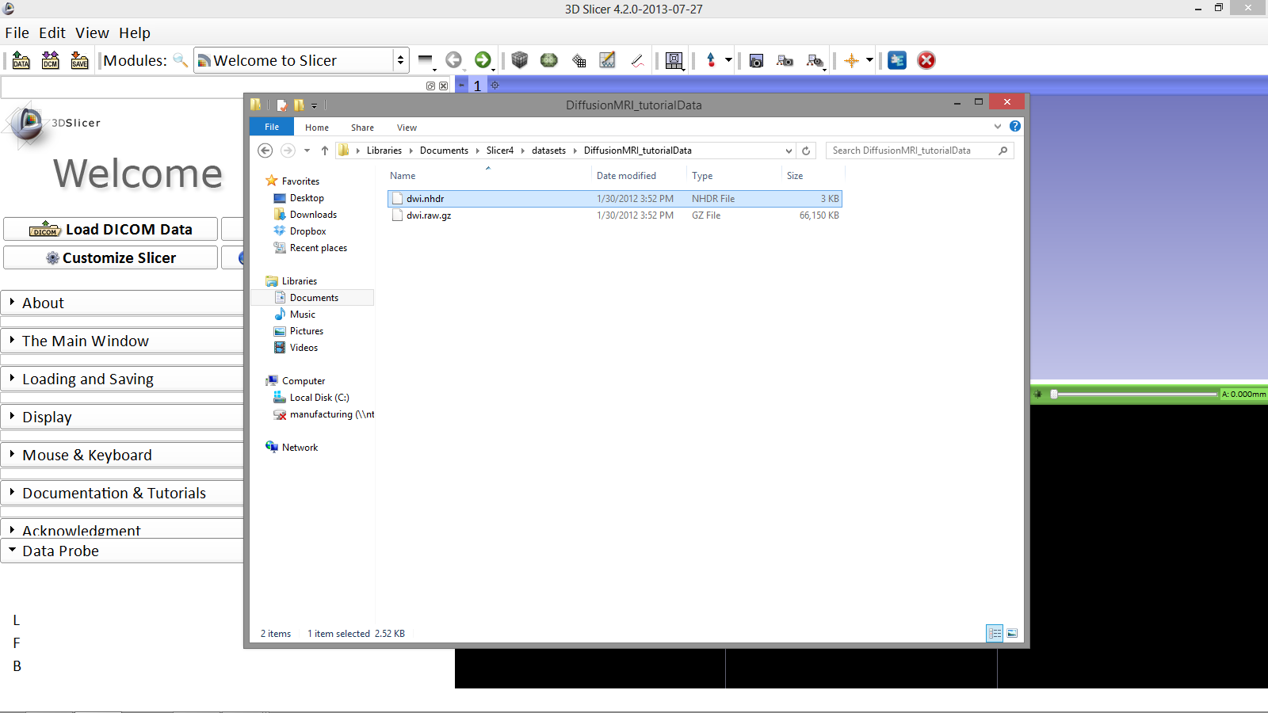
Loading the DWI Dataset
In your files archive, locate the file dwi.nhdr in the dataset folder for this tutorial
Image Courtesy of Dr. Alexandra Golby, Brigham and Women’s Hospital, Boston, MA..
Diffusion MRI Analysis

Slide 9
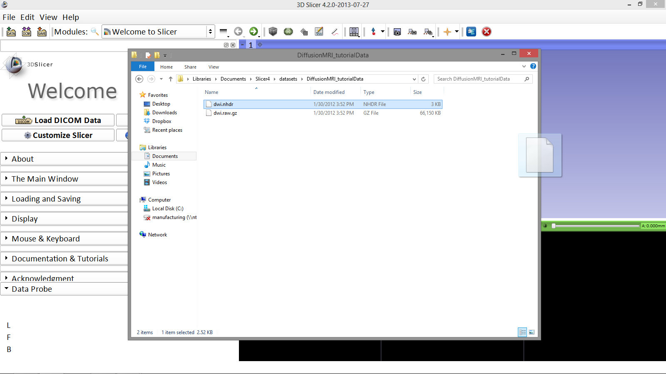
Loading the DWI Dataset
Drag and drop the file dwi.nhdr onto the viewer of the Slicer4 application
Image Courtesy of Dr. Alexandra Golby, Brigham and Women’s Hospital, Boston, MA..
Diffusion MRI Analysis

Slide 10
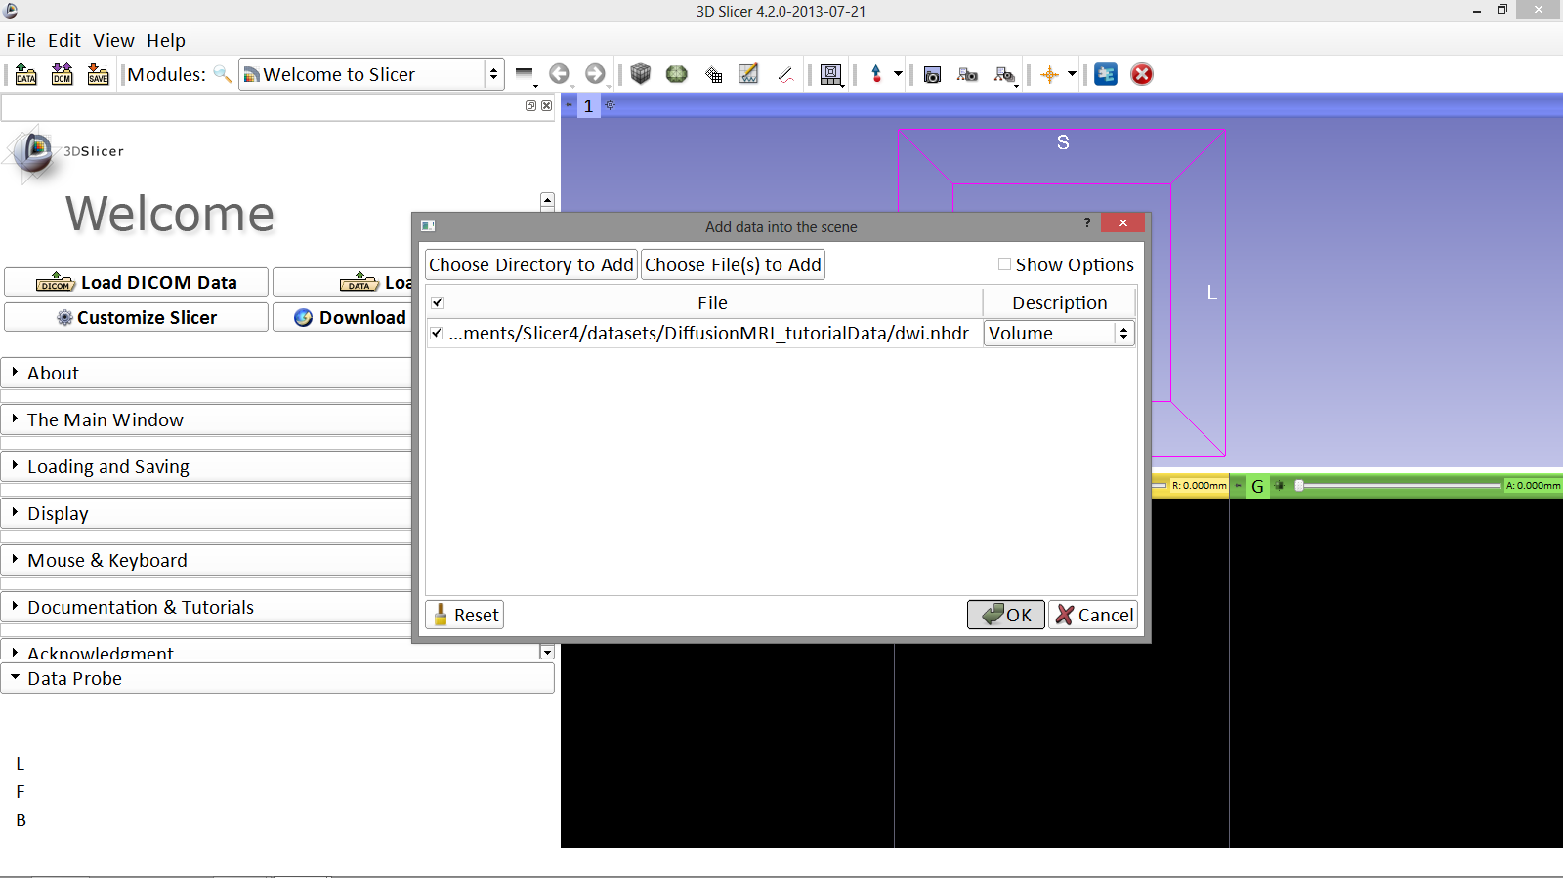
Loading the DWI Dataset
Image Courtesy of Dr. Alexandra Golby, Brigham and Women’s Hospital, Boston, MA..
Exit the archive folders window, and click OK to load the dataset to Slicer
Diffusion MRI Analysis

Slide 11
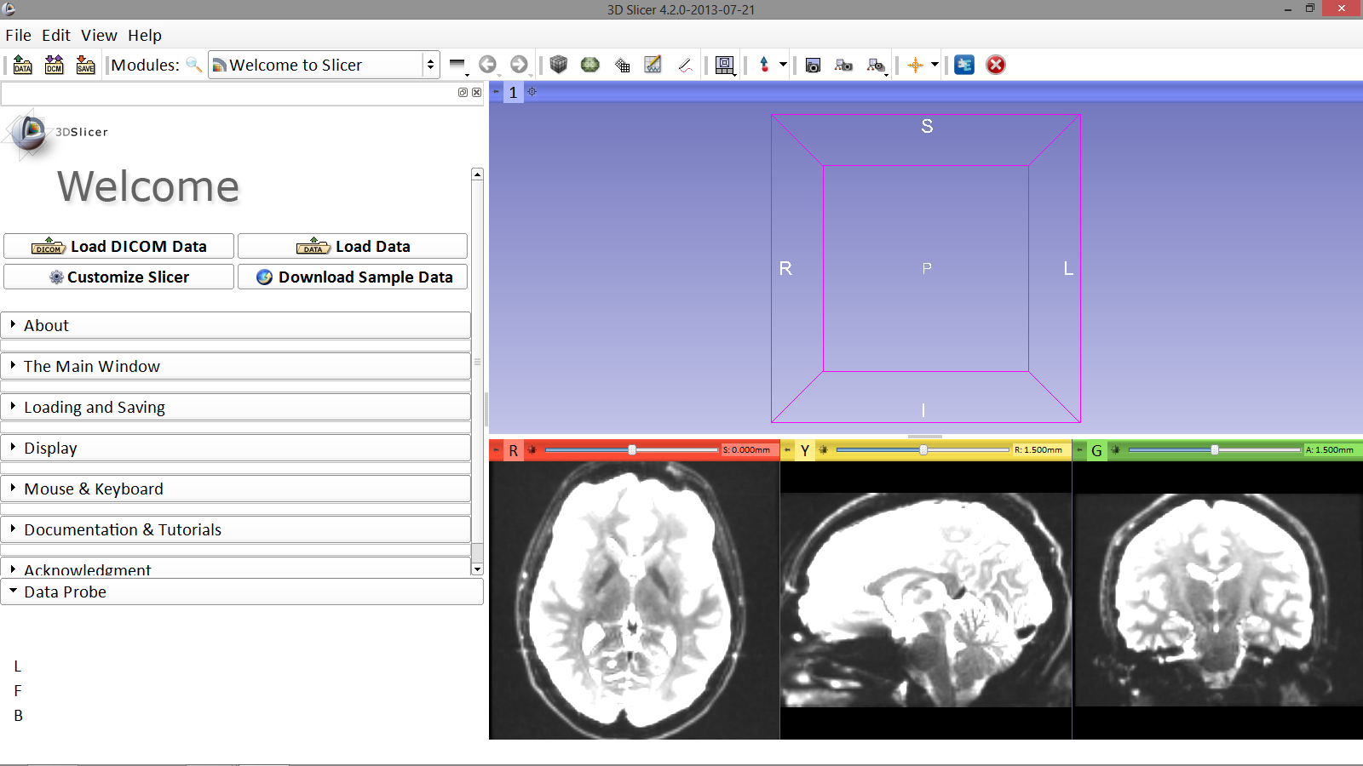
Loading the DWI Dataset
Slicer displays DWI volume of the brain
Image Courtesy of Dr. Alexandra Golby, Brigham and Women’s Hospital, Boston, MA..
Diffusion MRI Analysis

Slide 12
Main Application Graphic User Interface (GUI)

Slide 13
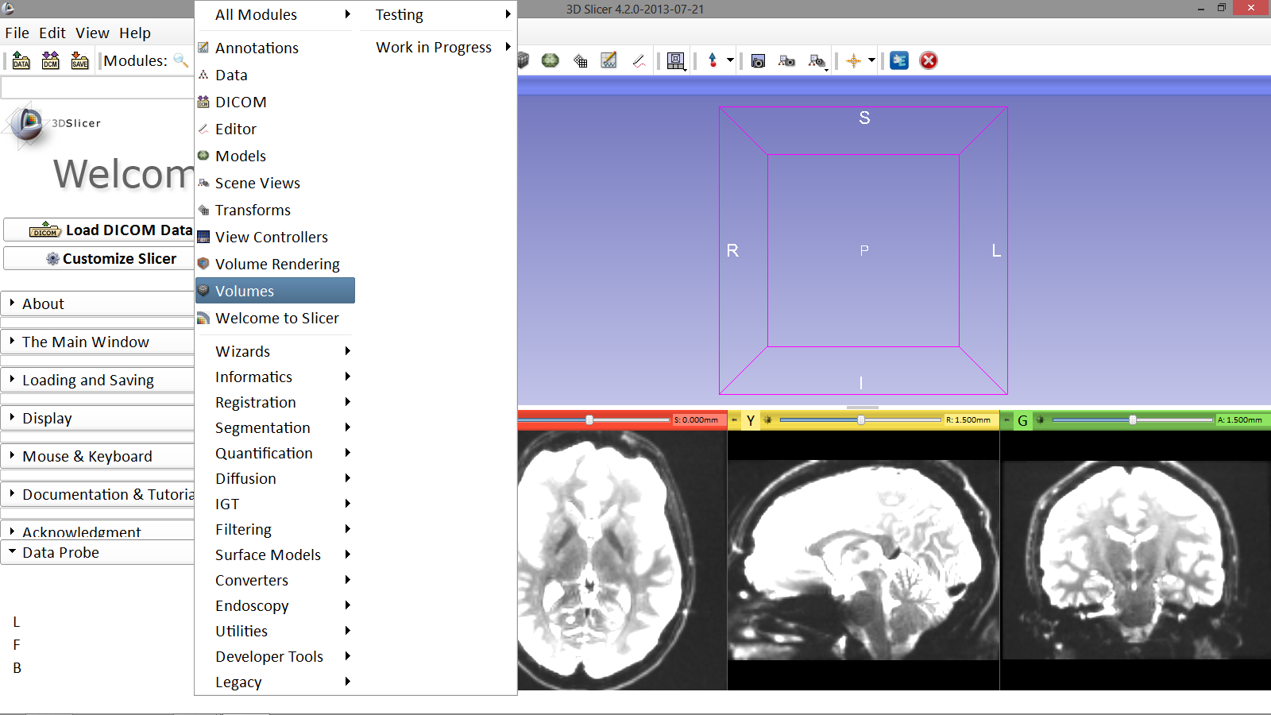
Loading the DWI Dataset
Click on the Modules menu and select the module Volumes
Image Courtesy of Dr. Alexandra Golby, Brigham and Women’s Hospital, Boston, MA..
Diffusion MRI Analysis

Slide 14
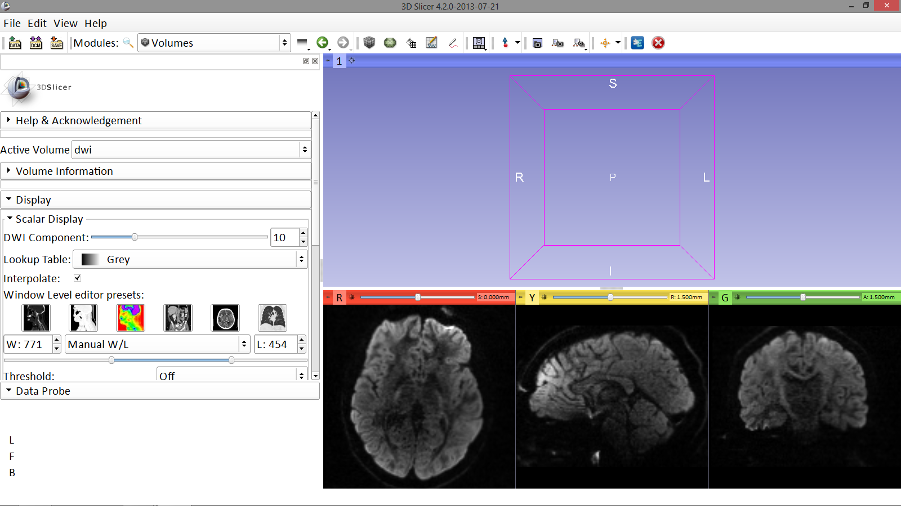
Loading the DWI Dataset
Adjust the Window Level editor presets with the Volume module menu
Image Courtesy of Dr. Alexandra Golby, Brigham and Women’s Hospital, Boston, MA..
Diffusion MRI Analysis

Slide 15
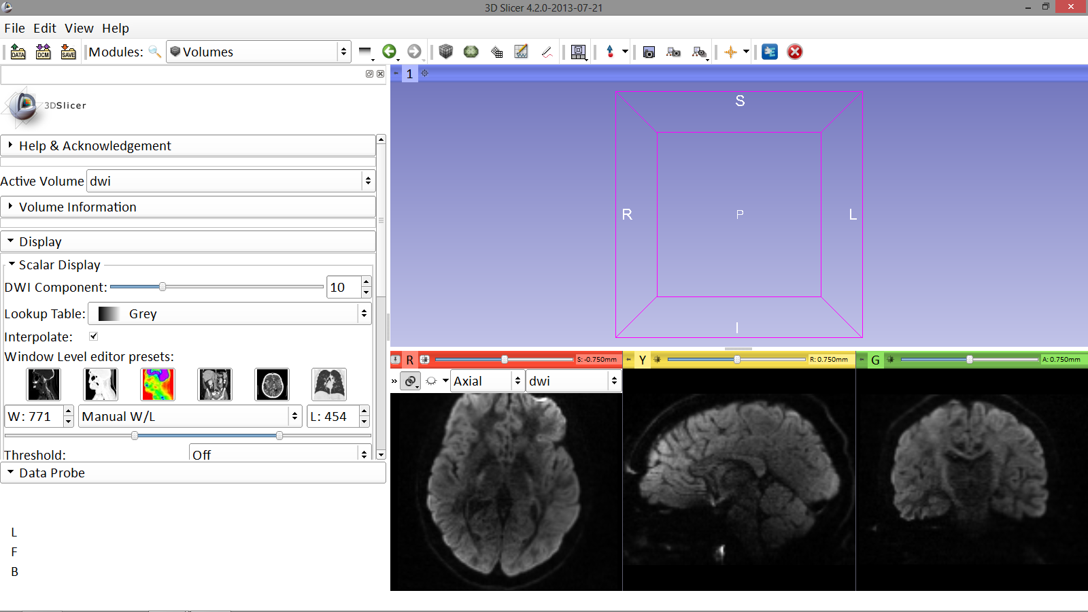
Loading the DWI Dataset
Position your mouse over the pin icon, then click on the link icon and the fit image to window icon
Image Courtesy of Dr. Alexandra Golby, Brigham and Women’s Hospital, Boston, MA..
Diffusion MRI Analysis

Slide 16
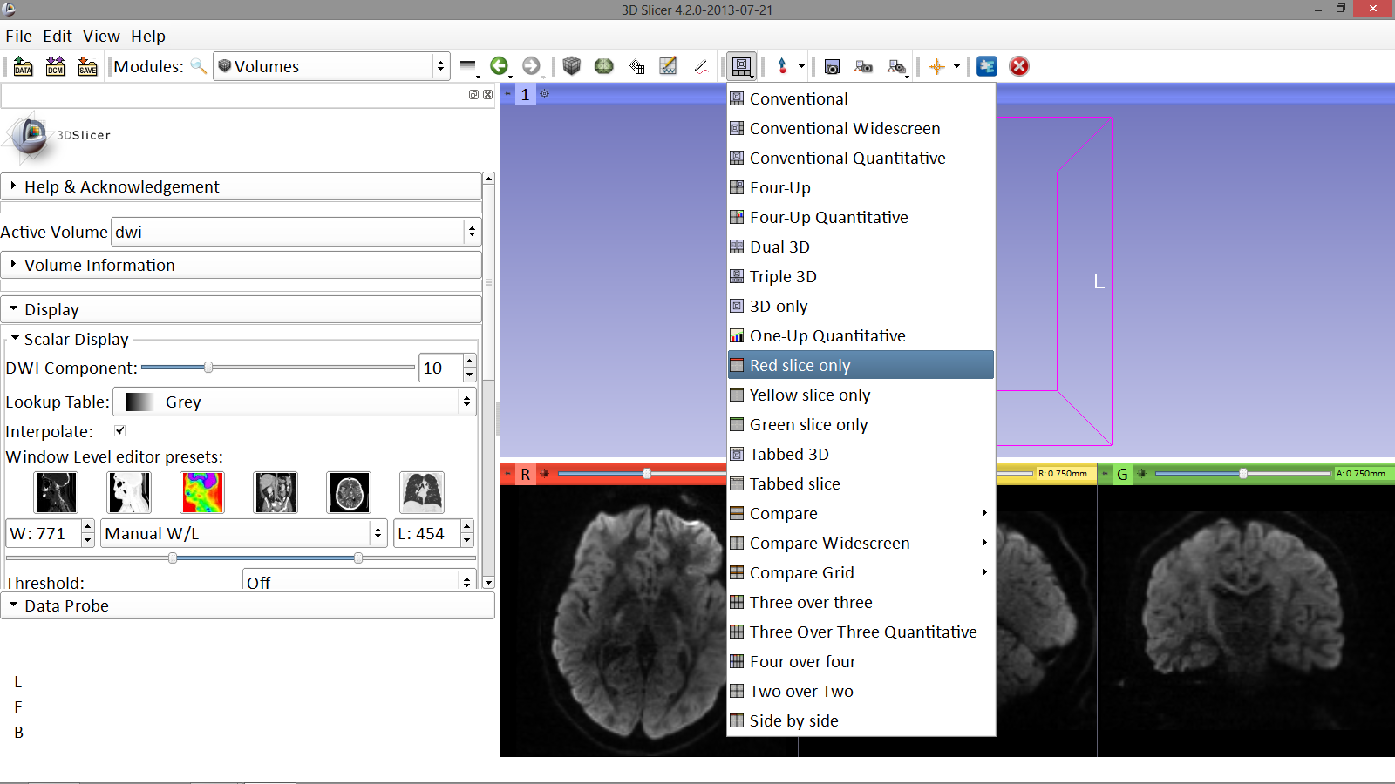
Loading the DWI Dataset
Click on the Slicer layout menu and select the Red slice only layout
Image Courtesy of Dr. Alexandra Golby, Brigham and Women’s Hospital, Boston, MA..
Diffusion MRI Analysis

Slide 17
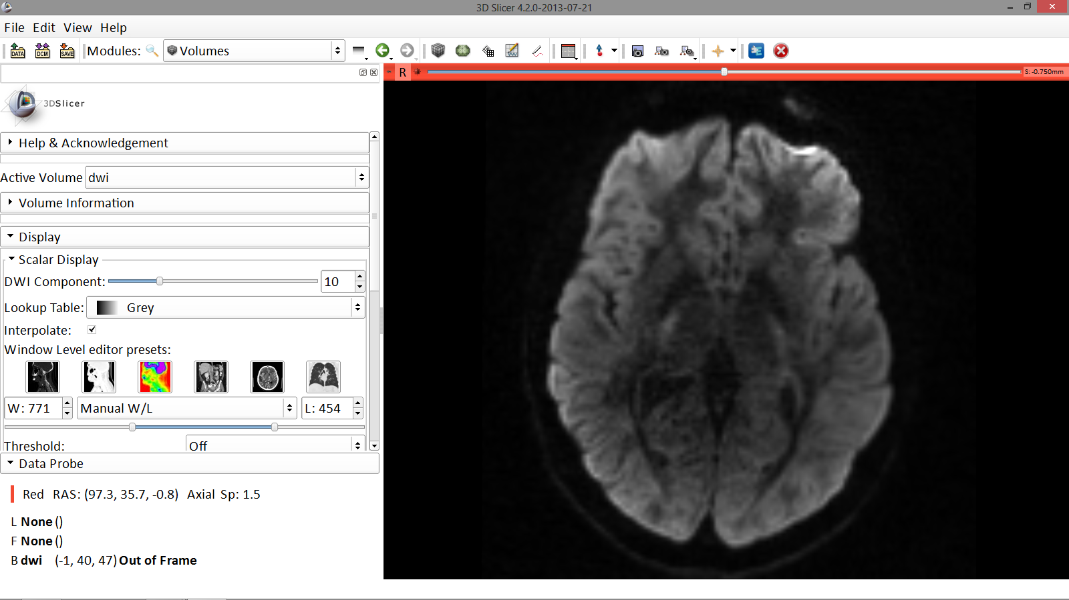
Loading the DWI Dataset
Slicer displays only the Axial anatomical slice in the Viewer
Image Courtesy of Dr. Alexandra Golby, Brigham and Women’s Hospital, Boston, MA..
Diffusion MRI Analysis

Slide 18
Estimation of the tensors from diffusion weighted image
Diffusion Weighted Image Diffusion Tensor Image
(DWI) (DTI)

Slide 19
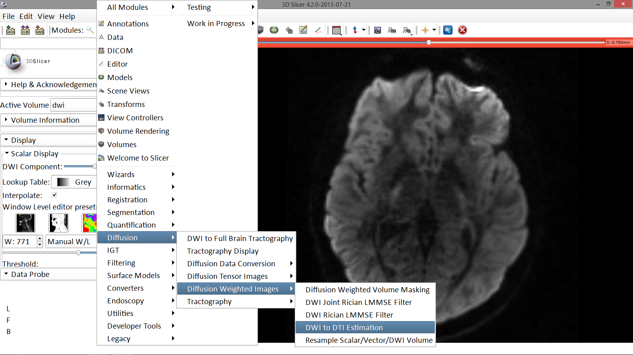
From DWI to DTI
Click on the Modules menu and select the module DWI to DTI Estimation
Image Courtesy of Dr. Alexandra Golby, Brigham and Women’s Hospital, Boston, MA..
Diffusion MRI Analysis

Slide 20
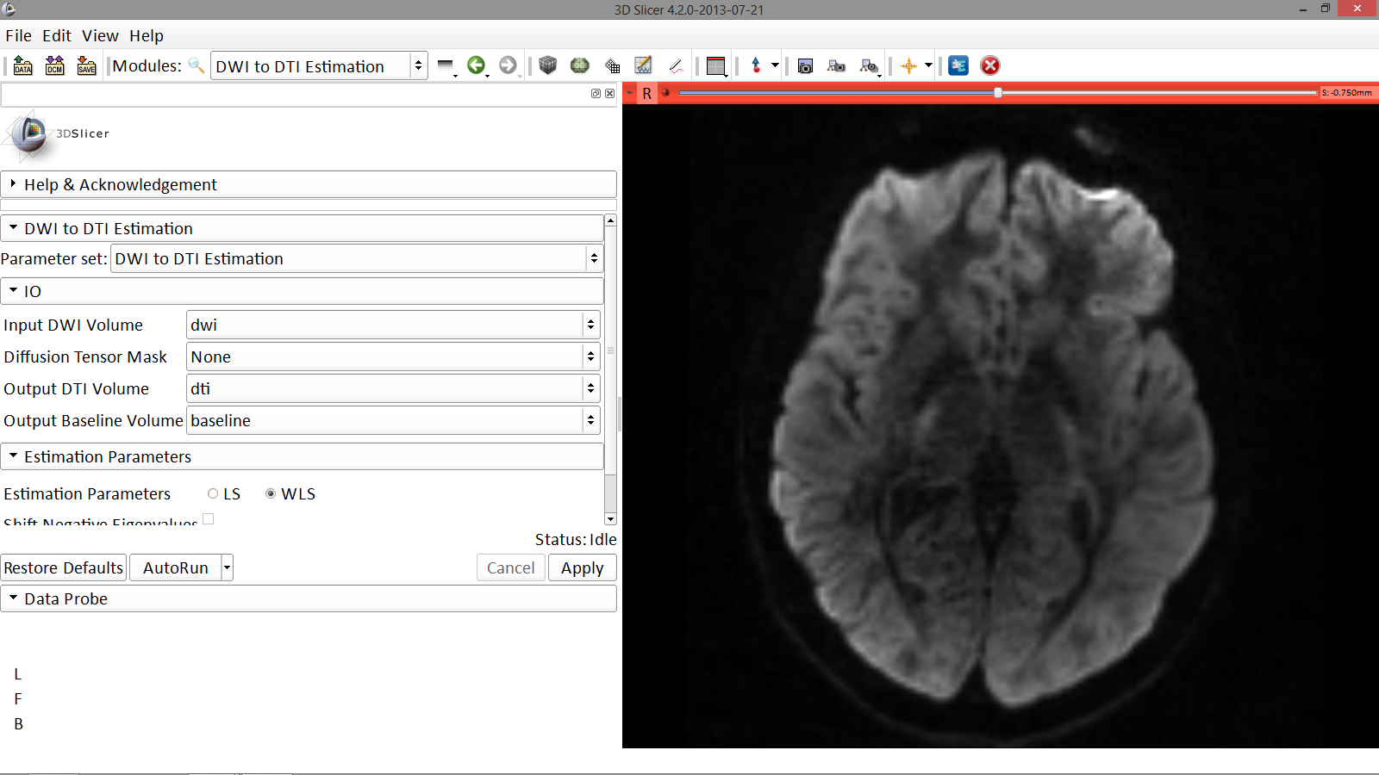
From DWI to DTI
Select the module DWI to DTI Estimation in the modules menu:
-select the Input DWI volume ‘dwi’
-select Output DTI Volume ‘Create and Rename New Volume’, and rename it ‘dti’
-select Output Baseline Volume ‘Create and Rename new Volume’, and rename it ‘baseline’
-select the Estimation Parameter ‘LS’ (Least Squares) and click on Apply.
Image Courtesy of Dr. Alexandra Golby, Brigham and Women’s Hospital, Boston, MA..
Diffusion MRI Analysis

Slide 21
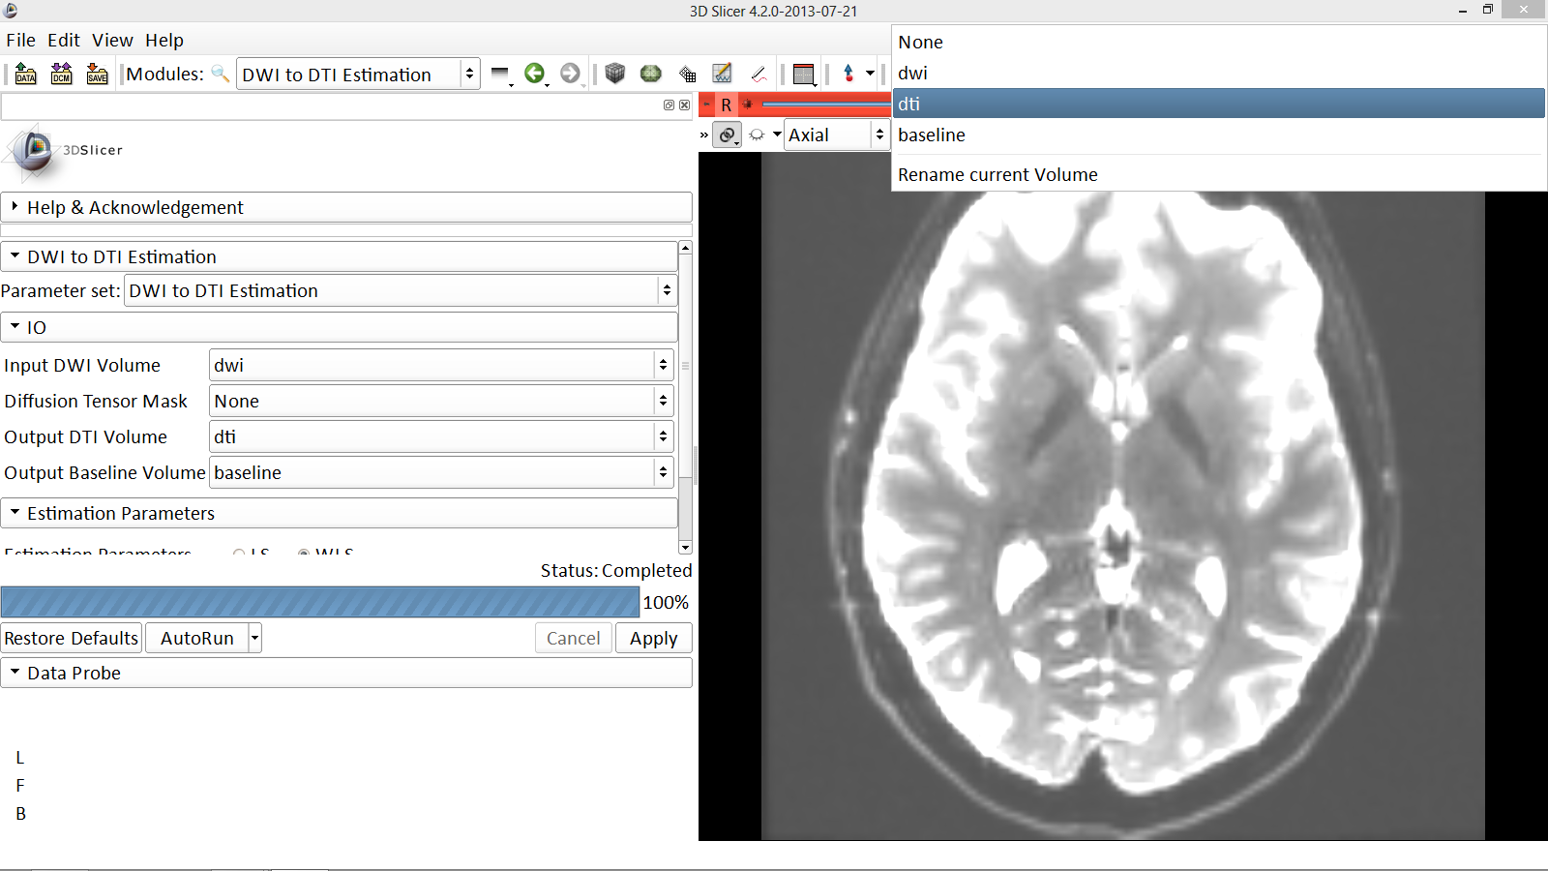
From DWI to DTI
Position your mouse over the pin icon and select the volume dti
Image Courtesy of Dr. Alexandra Golby, Brigham and Women’s Hospital, Boston, MA..
Diffusion MRI Analysis

Slide 22
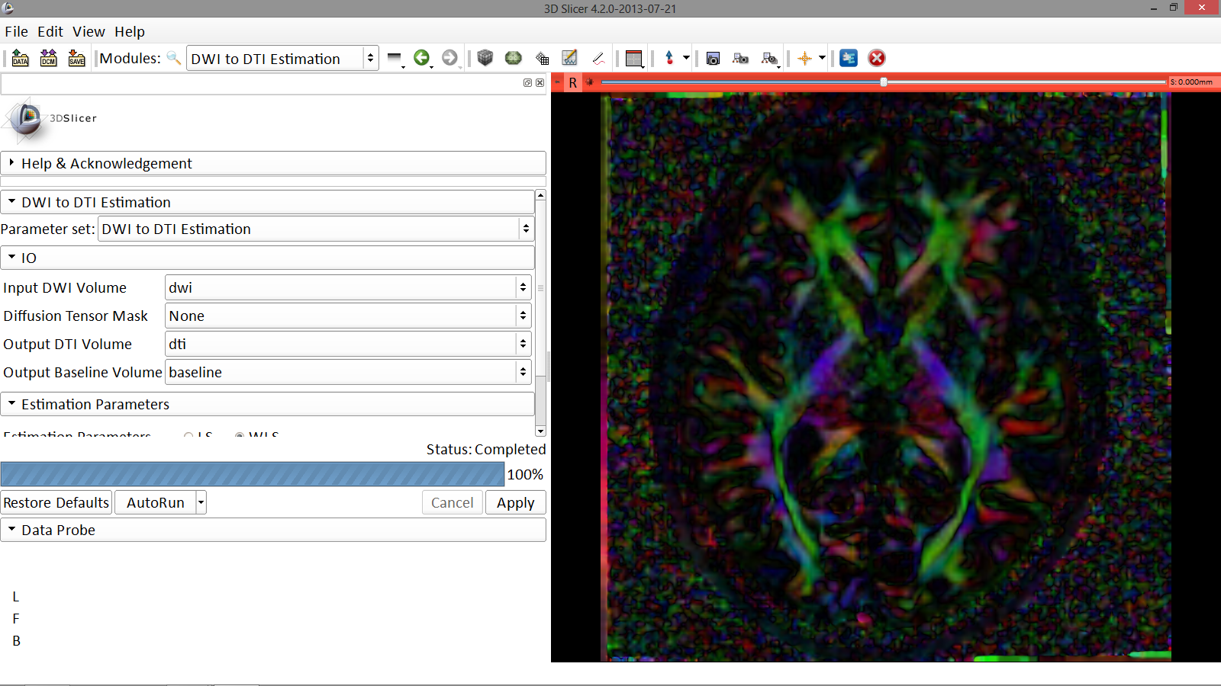
From DWI to DTI
Slicer displays the DTI volume in color by orientation mode:
Red: right-left
Green: anterior-posterior
Blue: inferior-superior
Image Courtesy of Dr. Alexandra Golby, Brigham and Women’s Hospital, Boston, MA..
Diffusion MRI Analysis

Slide 23
Exploring the DTI Dataset
Use the slider to browse through the dti volume, and try to locate the Corpus Callosum
Image Courtesy of Dr. Alexandra Golby, Brigham and Women’s Hospital, Boston, MA..
Diffusion MRI Analysis

Slide 24
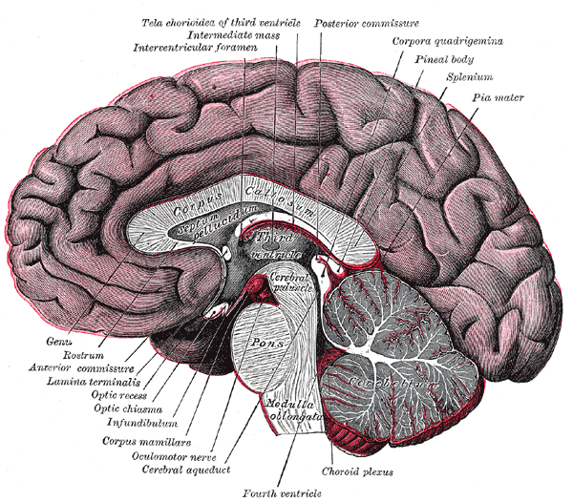
Corpus Callosum
The corpus callosum is a broad thick bundle of dense myelinated fibers that connect the left and right hemisphere. It is the largest white matter structure in the brain
Image from Gray’s Anatomy
Diffusion MRI Analysis

Slide 25
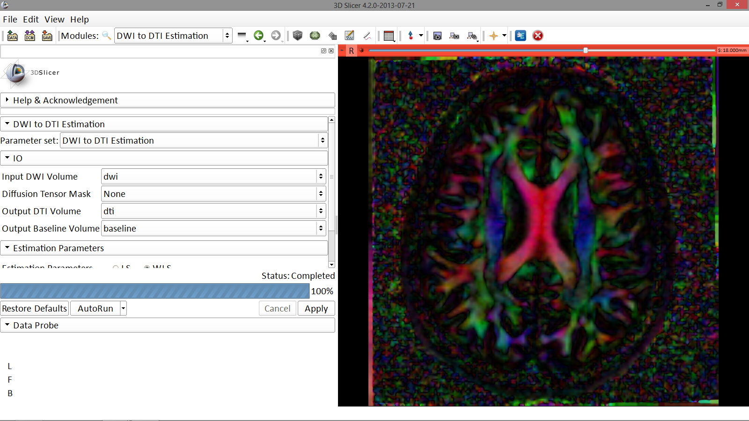
Corpus Callosum
Corpus Callosum
Image Courtesy of Dr. Alexandra Golby, Brigham and Women’s Hospital, Boston, MA..
Diffusion MRI Analysis

Slide 26
Scalar measurements of diffusion tensor
from DTI to FA

Slide 27
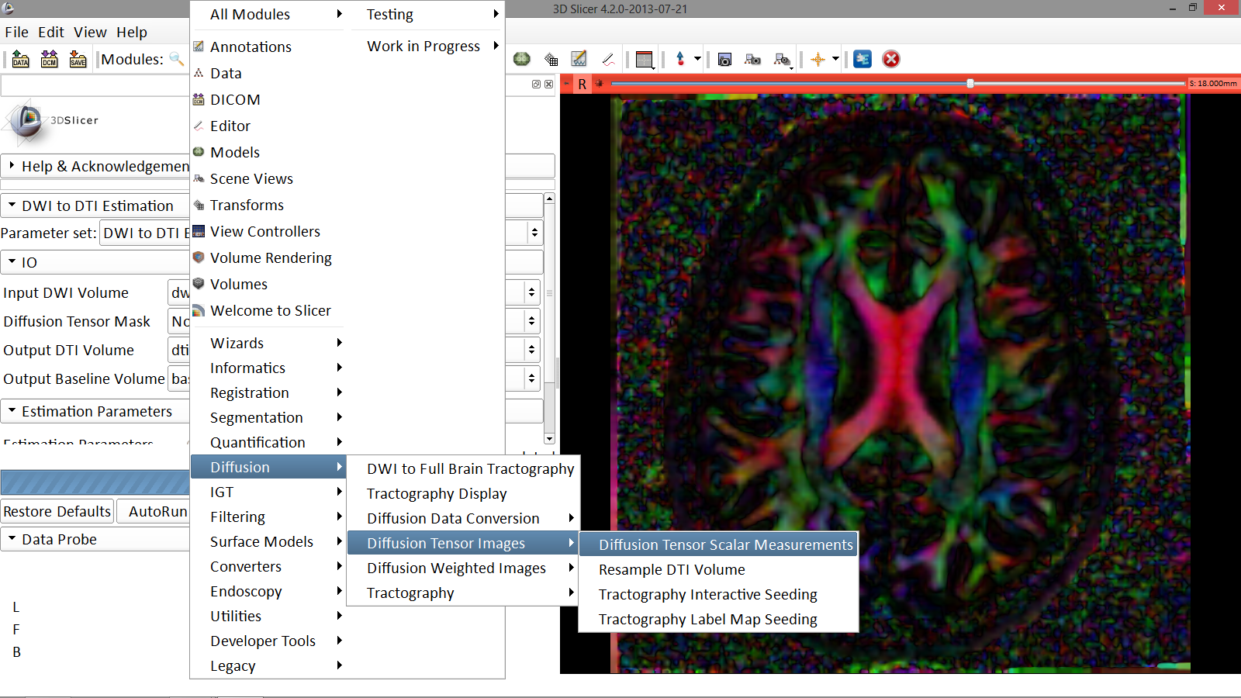
Fractional Anisotropy
Click on the Modules menu and select the module Diffusion Tensor Scalar Measurements
Image Courtesy of Dr. Alexandra Golby, Brigham and Women’s Hospital, Boston, MA..
Diffusion MRI Analysis

Slide 28
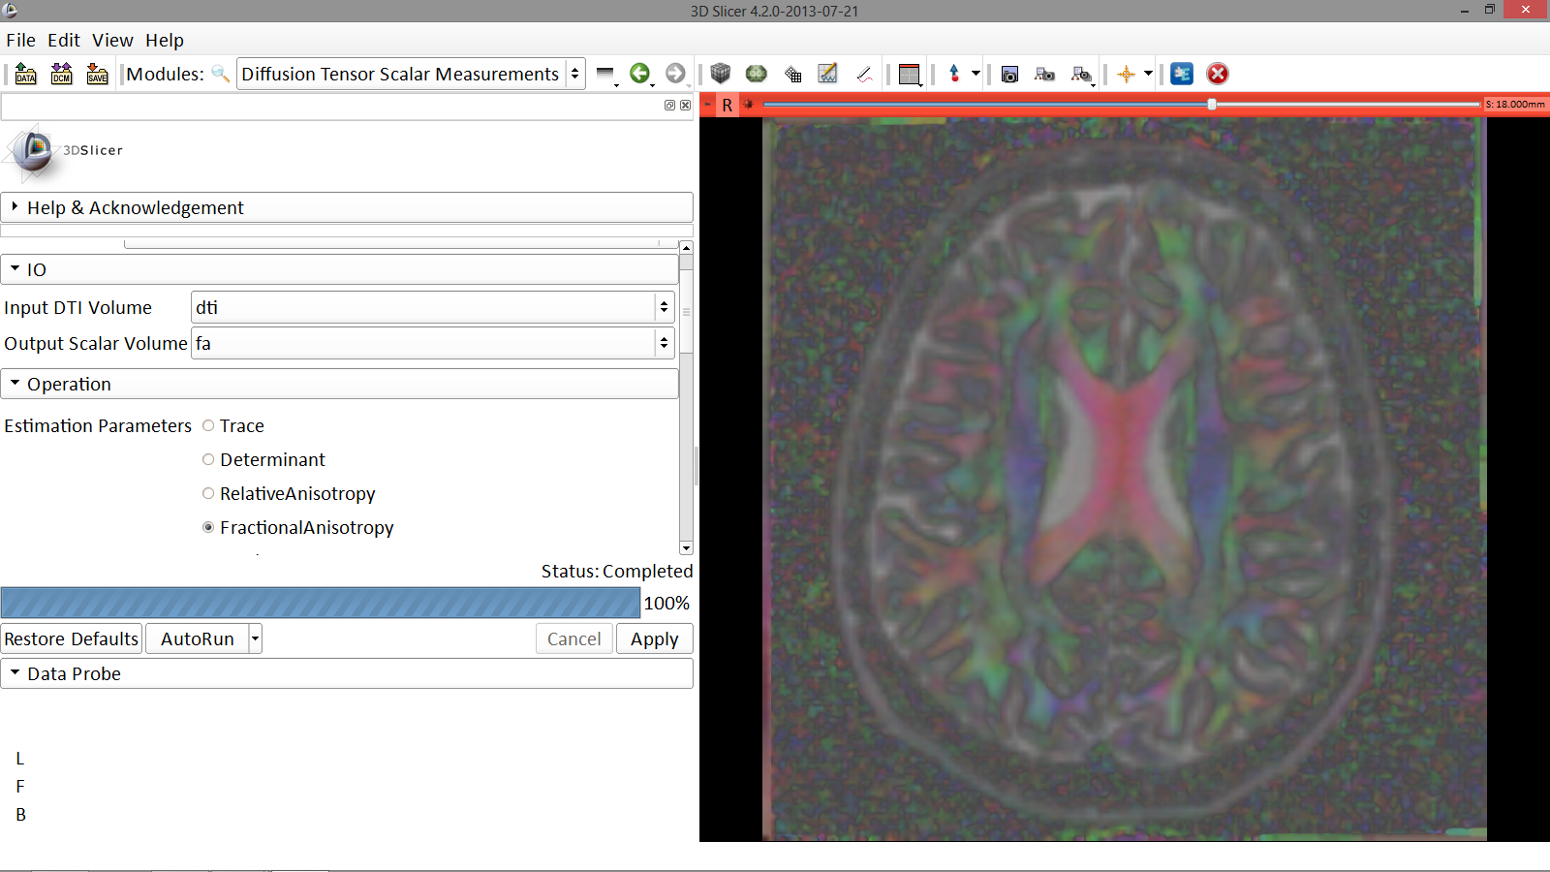
Fractional Anisotropy
Fill in the following information:
-Set Input DTI Volume to ‘dti’
-Select Output Scalar Volume ‘Create new Volume’ and rename it ‘fa’
-Select the Operation ‘Fractional Anisotropy’
-Click on Apply to calculate the Fractional Anisotropy map of the tensor volume
Image Courtesy of Dr. Alexandra Golby, Brigham and Women’s Hospital, Boston, MA..
Diffusion MRI Analysis

Slide 29
Fractional Anisotropy
The FA image appears in the red viewer
Image Courtesy of Dr. Alexandra Golby, Brigham and Women’s Hospital, Boston, MA..
Diffusion MRI Analysis

Slide 30
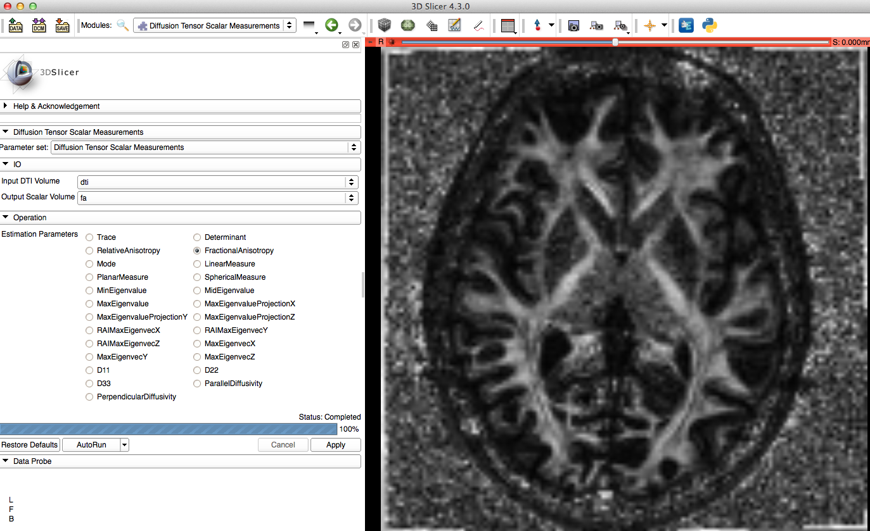
Fractional Anisotropy
Click on the Slicer layout menu and select Conventional layout
Image Courtesy of Dr. Alexandra Golby, Brigham and Women’s Hospital, Boston, MA..
Diffusion MRI Analysis

Slide 31
Part 2: Tractography
Diffusion MRI Analysis

Slide 32
Tractography seeded from
a region of interest (ROI)

Slide 33
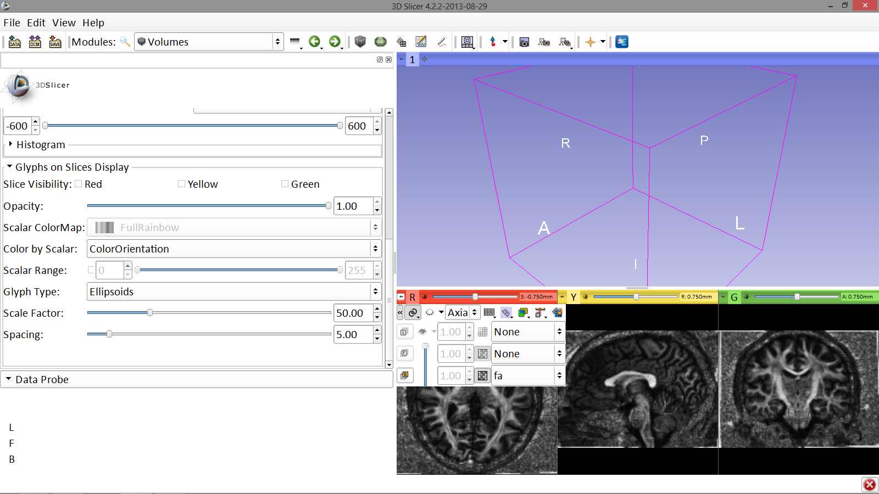
Diffusion MRI tractography
Position your mouse over the pin icon, click on << icon and change the Foreground to ‘None’ and the background to ‘fa’
Image Courtesy of Dr. Alexandra Golby, Brigham and Women’s Hospital, Boston, MA..
Diffusion MRI Analysis

Slide 34
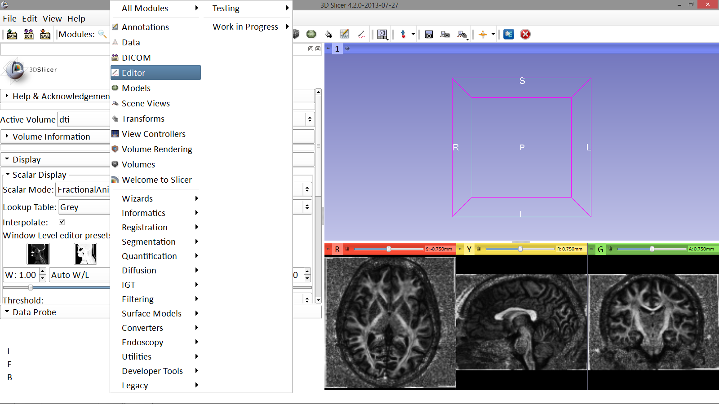
Diffusion MRI tractography
Select the module Editor
Image Courtesy of Dr. Alexandra Golby, Brigham and Women’s Hospital, Boston, MA..
Diffusion MRI Analysis

Slide 35
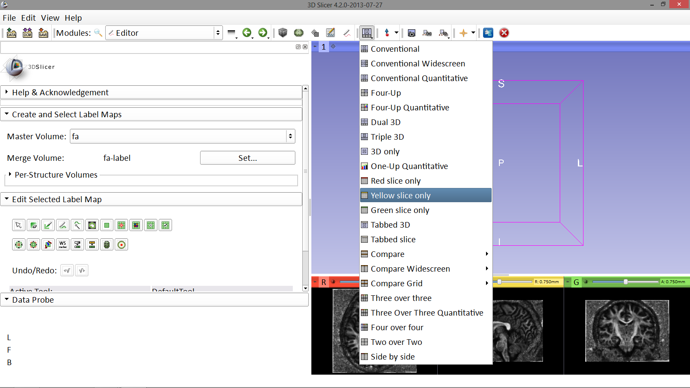
Diffusion MRI tractography
Select Apply when the ‘label-map window’ appears,
then switch to the Yellow slice only layout
Image Courtesy of Dr. Alexandra Golby, Brigham and Women’s Hospital, Boston, MA..
Diffusion MRI Analysis

Slide 36
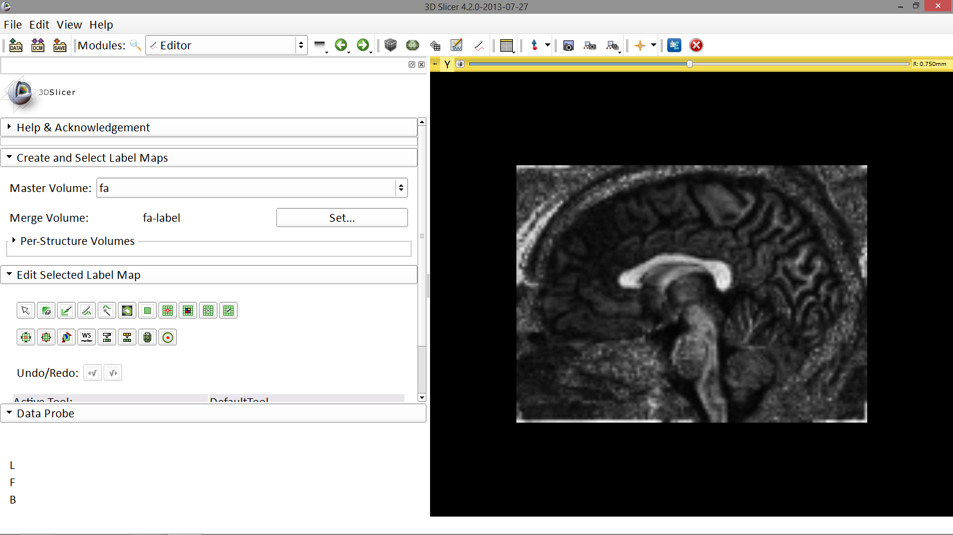
Diffusion MRI tractography
Click on the fit to screen icon to adjust the dimensions of the yellow slice viewer to fit the screen
Image Courtesy of Dr. Alexandra Golby, Brigham and Women’s Hospital, Boston, MA..
Diffusion MRI Analysis

Slide 37
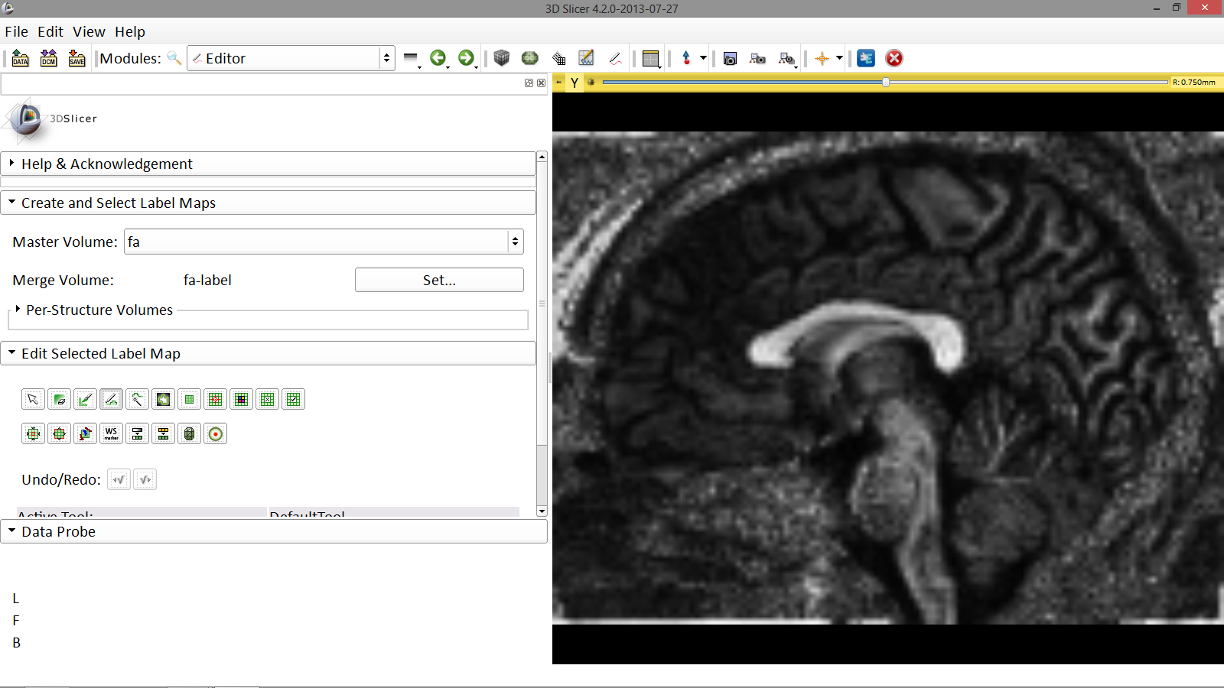
Diffusion MRI tractography
Select the DrawEffect tool
Image Courtesy of Dr. Alexandra Golby, Brigham and Women’s Hospital, Boston, MA..
Diffusion MRI Analysis

Slide 38
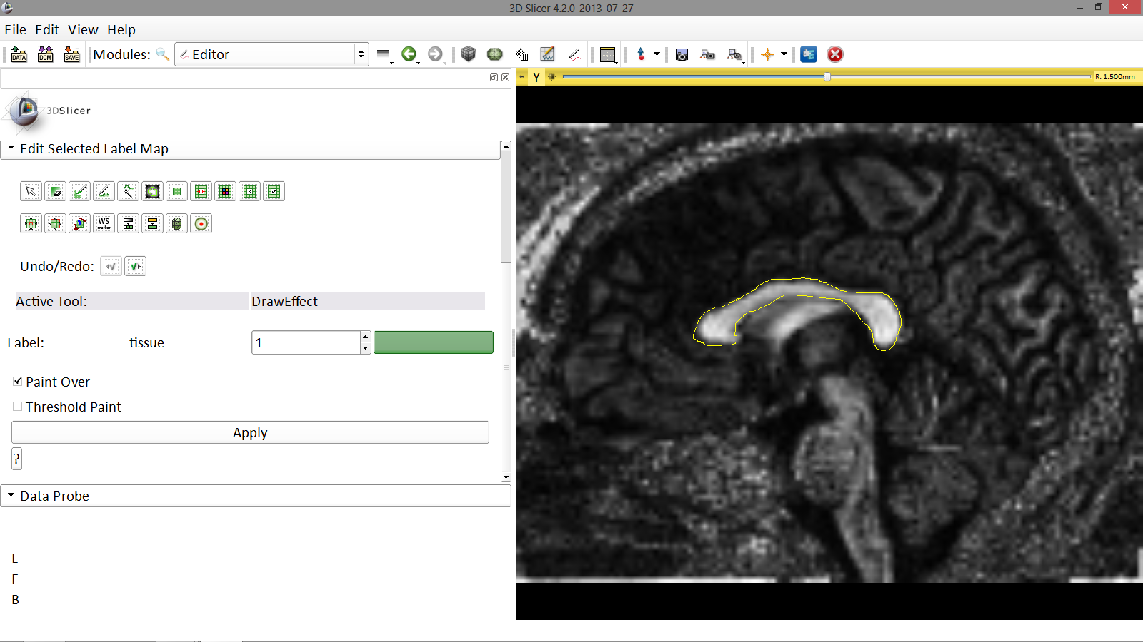
Diffusion MRI tractography
Outline the contour of the Corpus Callosum with the DrawEffect tool equipped and press enter. Repeat this step with 3 adjacent sagittal slices
Image Courtesy of Dr. Alexandra Golby, Brigham and Women’s Hospital, Boston, MA..
Diffusion MRI Analysis

Slide 39
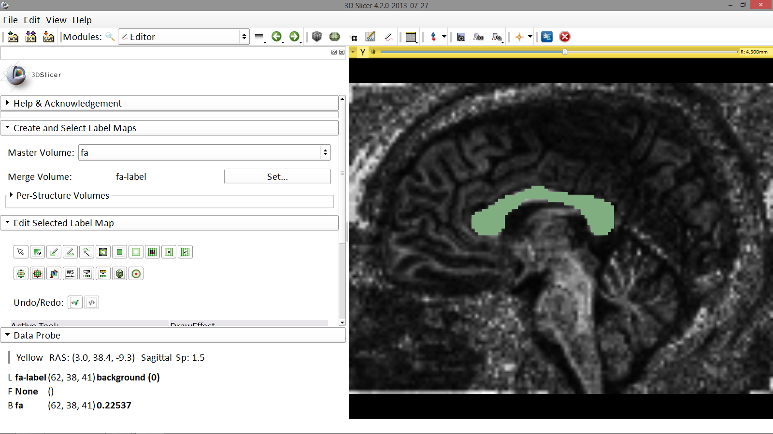
Diffusion MRI tractography
The tracts will be seeded from the region of interest (ROI) defined in the Corpus Callosum area.
Image Courtesy of Dr. Alexandra Golby, Brigham and Women’s Hospital, Boston, MA..
Diffusion MRI Analysis

Slide 40
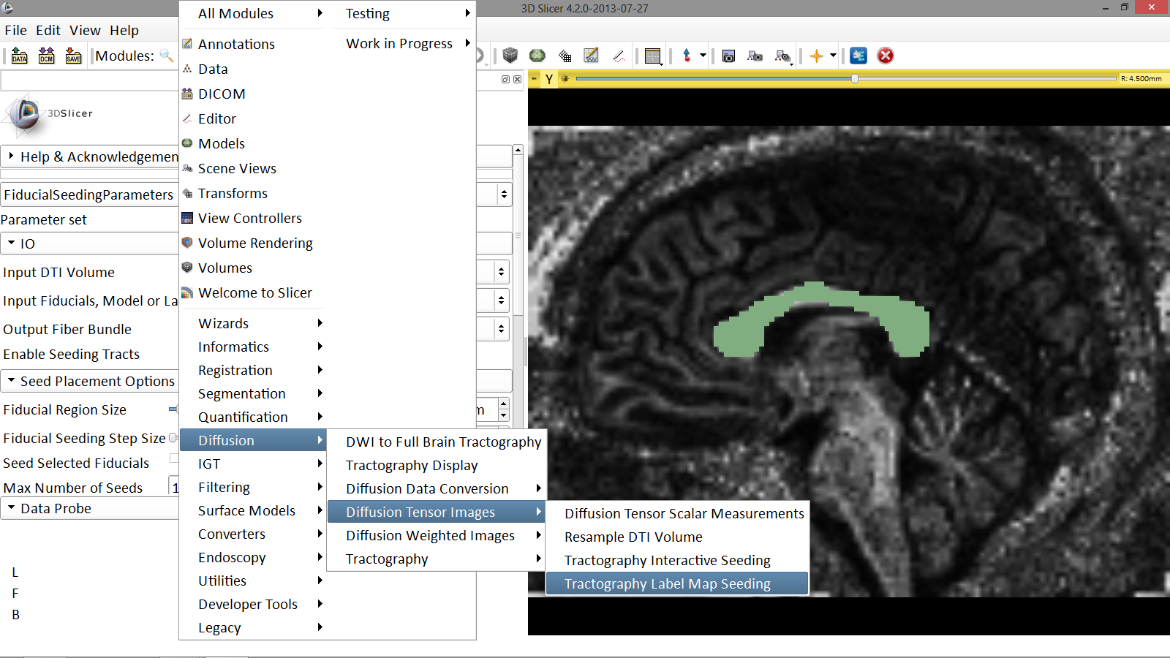
Diffusion MRI tractography
Select the module Tractography Label Map Seeding
Image Courtesy of Dr. Alexandra Golby, Brigham and Women’s Hospital, Boston, MA..
Diffusion MRI Analysis

Slide 41
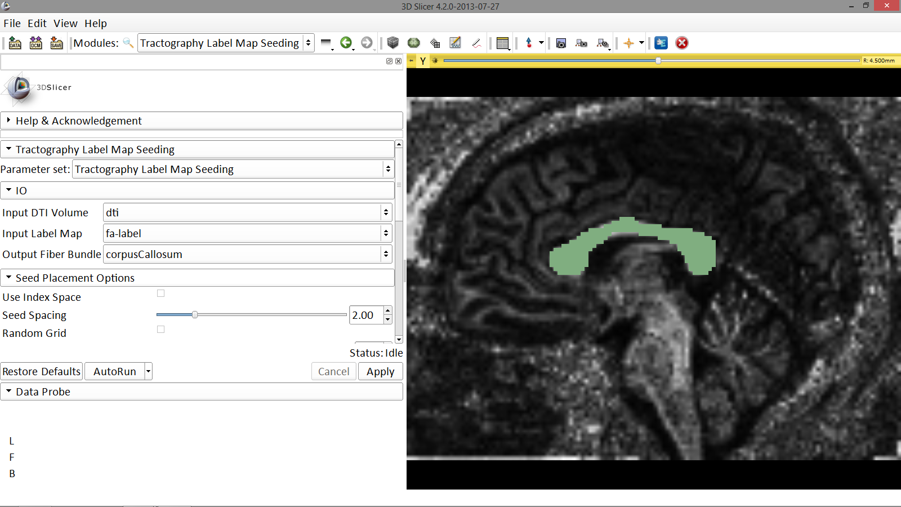
Labelmap Seeding: I/O
-Set the Input DTI Volume to ‘dti’
-Set the Input Label Map to ‘fa-label’
-Set Output Fiber Bundle to ‘Create and Rename New Fiber Bundle’ and rename it ‘corpusCallosum’
Image Courtesy of Dr. Alexandra Golby, Brigham and Women’s Hospital, Boston, MA..
Diffusion MRI Analysis

Slide 42
ROI Drawing
Under Seed Placement Options, check off the option for ‘Use Index Space’
Image Courtesy of Dr. Alexandra Golby, Brigham and Women’s Hospital, Boston, MA..
Diffusion MRI Analysis

Slide 43
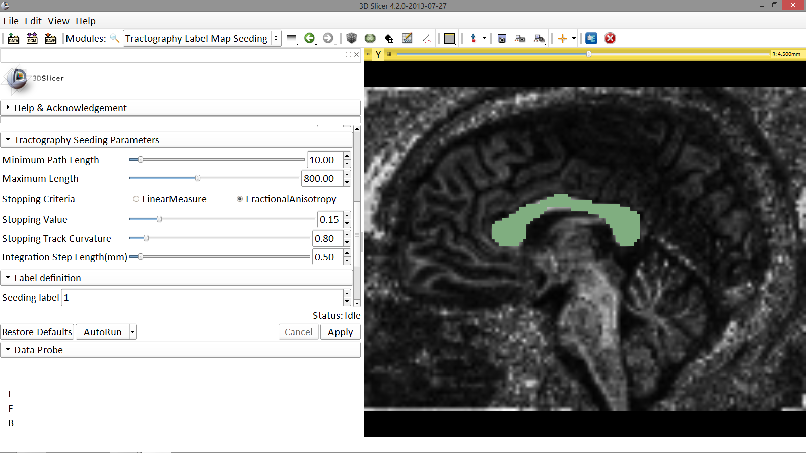
Labelmap Seeding: parameters
Select the default Tractography Seeding parameters:
-Minimum Path Length: 10 mm
-Maximum Length: 800 mm
-Stopping Criteria: FractionalAnistropy
-Stopping Value: 0.15
-Stopping Track Curvature: 0.8
-Integration Step Length: 0.5 mm
Click on Apply
Image Courtesy of Dr. Alexandra Golby, Brigham and Women’s Hospital, Boston, MA..
Diffusion MRI Analysis

Slide 44
Labelmap Seeding: parameters
Click on the Slicer layout menu and select Conventional layout

Slide 45
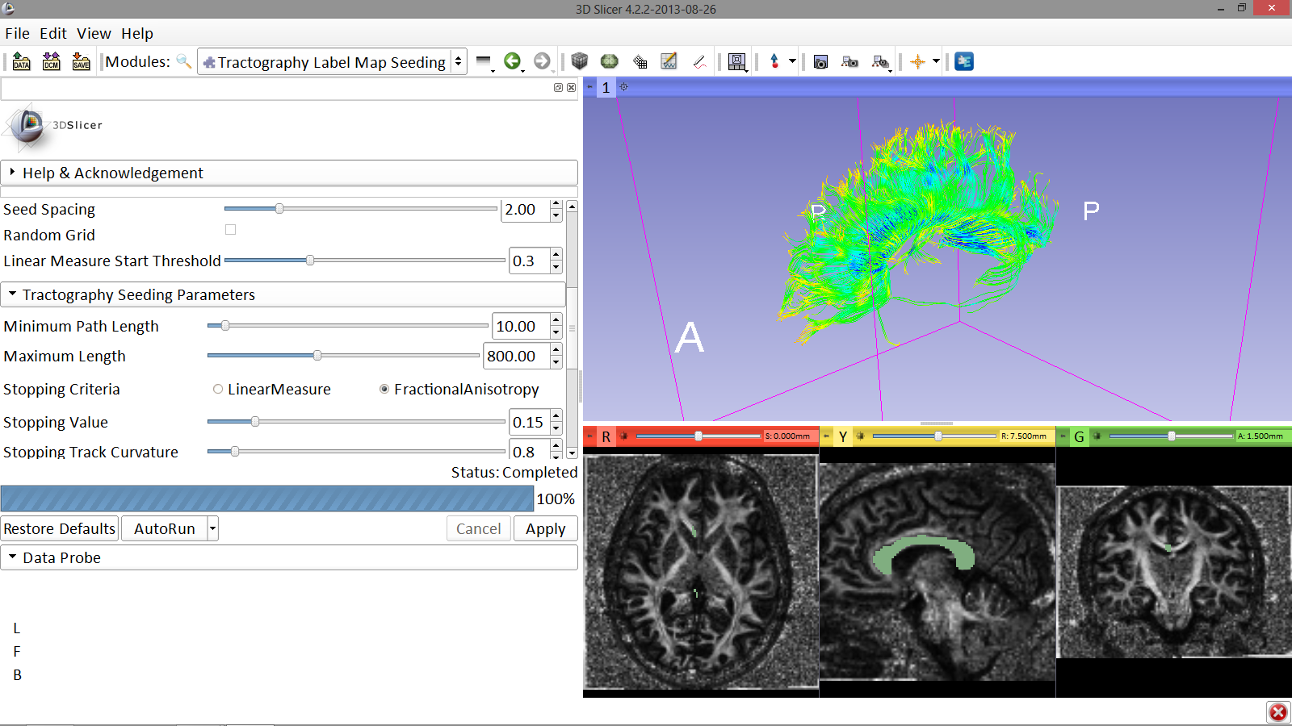
Labelmap Seeding: Tracts
The tracts generated in the corpus callosum area appear in the 3D viewer.
Image Courtesy of Dr. Alexandra Golby, Brigham and Women’s Hospital, Boston, MA..
Diffusion MRI Analysis

Slide 46
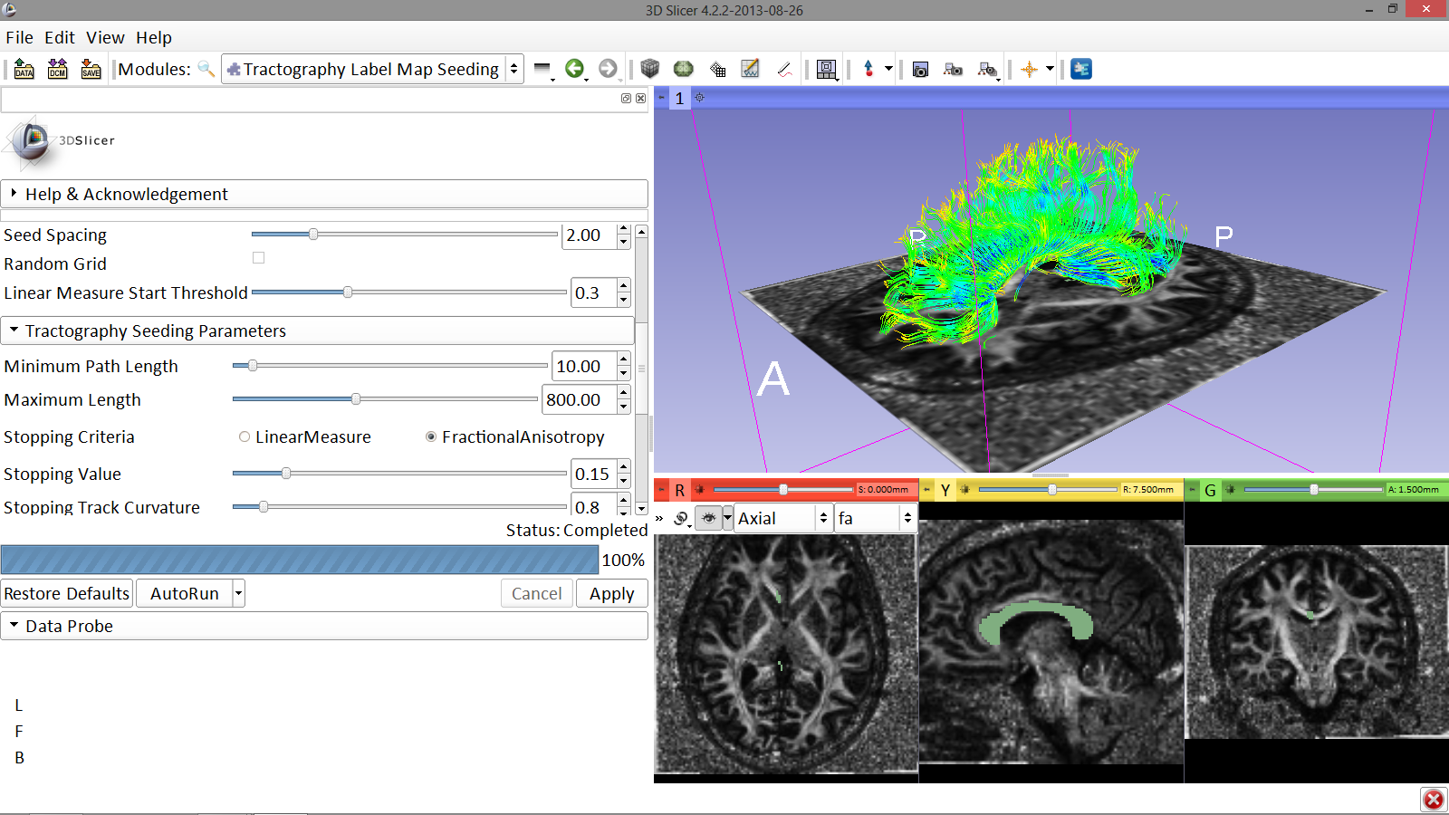
Tractography Results
Position the mouse over the pin icon and click on the eye icon to display the axial slice in the 3D viewer
Image Courtesy of Dr. Alexandra Golby, Brigham and Women’s Hospital, Boston, MA..
Diffusion MRI Analysis

Slide 47
Tractography seeded from a fiducial

Slide 48
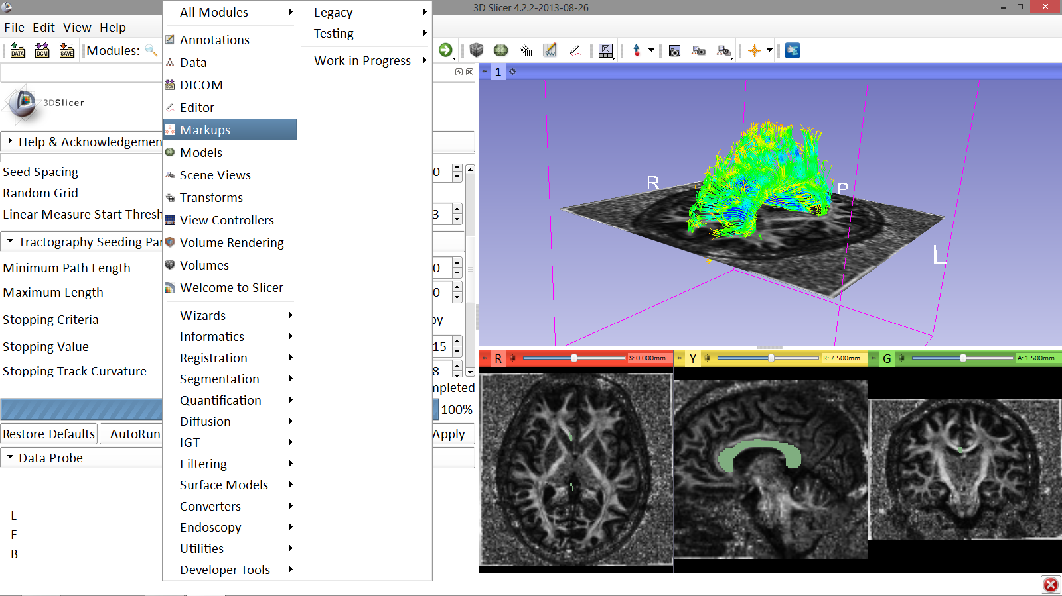
Fiducial Seeding
Select the module Mark Ups
Image Courtesy of Dr. Alexandra Golby, Brigham and Women’s Hospital, Boston, MA..
Diffusion MRI Analysis

Slide 49
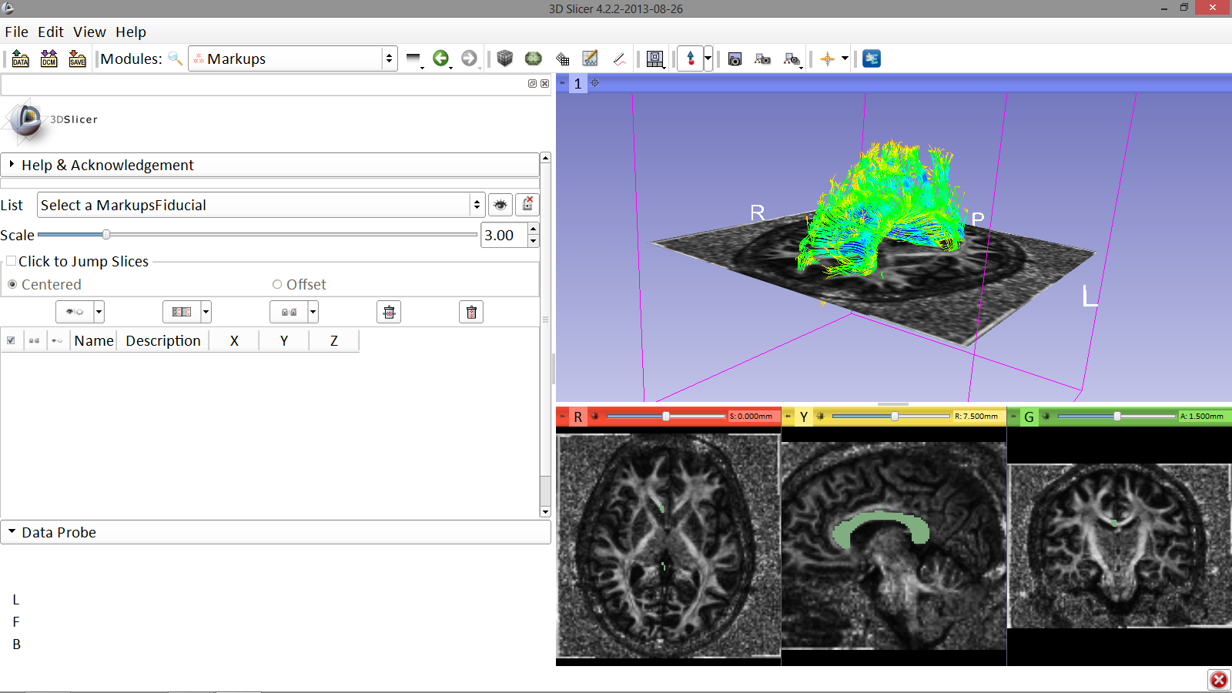
Fiducial Seeding
Click on the arrow icon to create a fiducial
Image Courtesy of Dr. Alexandra Golby, Brigham and Women’s Hospital, Boston, MA..
Diffusion MRI Analysis

Slide 50
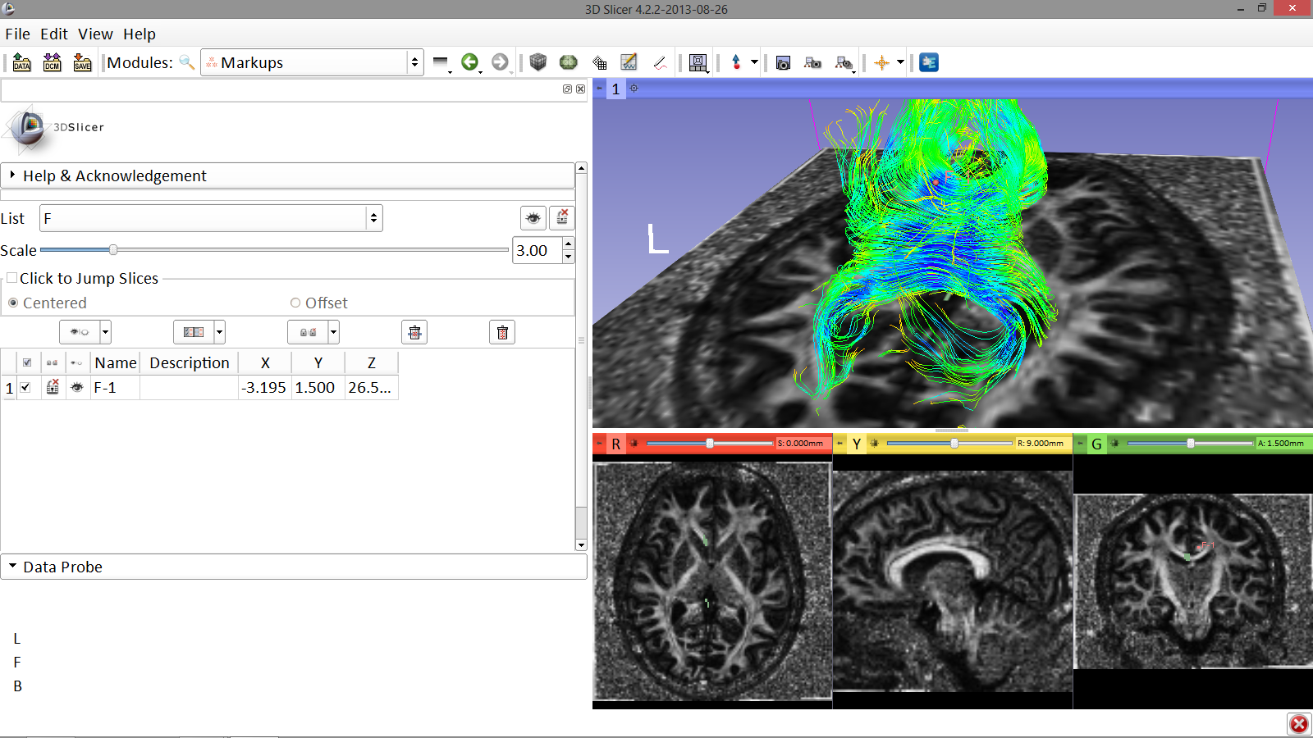
Fiducial Seeding
Position the fiducial in the left cingulum of the coronal slice
Image Courtesy of Dr. Alexandra Golby, Brigham and Women’s Hospital, Boston, MA..
Diffusion MRI Analysis

Slide 51
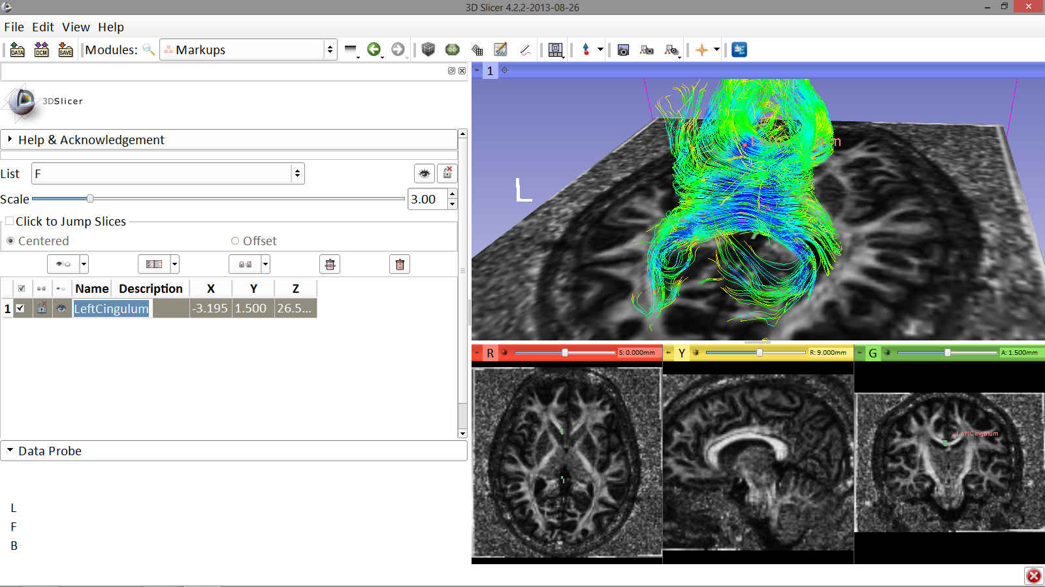
Fiducial Seeding
Set fiducial scale to 5.00
Double click on the fiducial and change the name to LeftCingulum
Image Courtesy of Dr. Alexandra Golby, Brigham and Women’s Hospital, Boston, MA..
Diffusion MRI Analysis

Slide 52
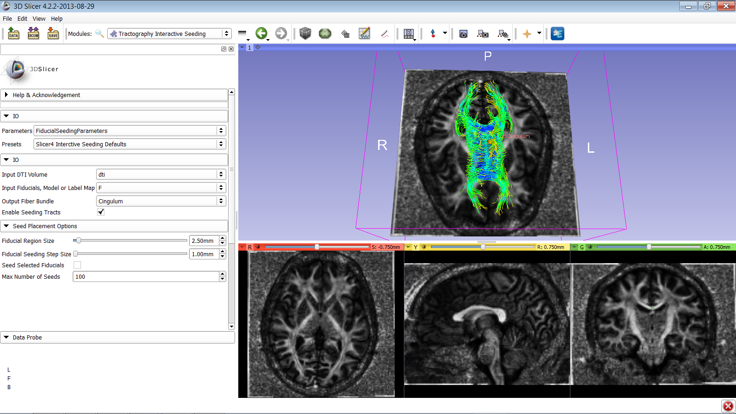
Fiducial Seeding
Select the module Tractography Interactive Seeding
Select the Input DTI volume ‘dti’
Select the Input Fiducials, Model or Label Map ‘F’
Select the Output Fiber Bundle ‘Create New Fiber Bundle’ and rename it ‘Cingulum’
Diffusion MRI Analysis

Slide 53
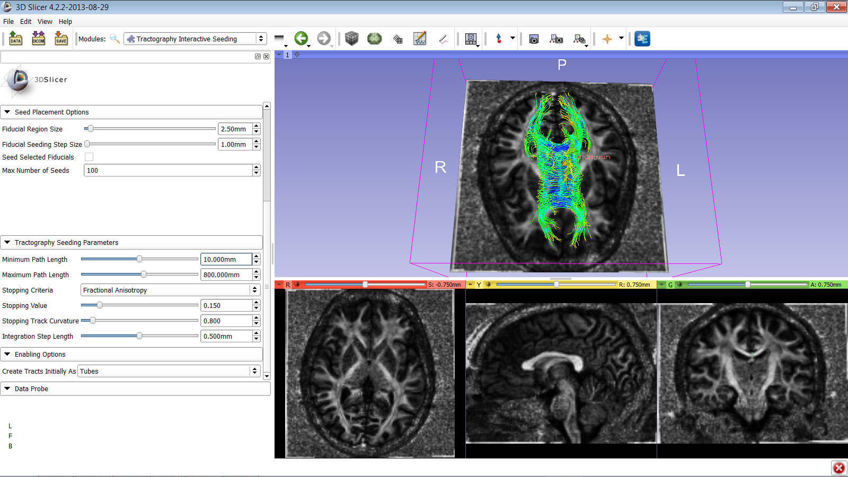
Fiducial Seeding
Set the tractography parameters as follows:
-Fiducial region size: 2.5 mm
-Fiducial Seeding Step Size: 1.0 mm
-Maximum number of seeds: 100
-Minimum Path Length: 10 mm
-Maximum Path Length: 800 mm
-Stopping Criteria: Fractional Anisotropy
-Stopping Value: 0.15
-Stopping Track Curvature: 0.8
-Integration step length: 0.5 mm
-Create Tracts Initially as Tubes
Diffusion MRI Analysis

Slide 54
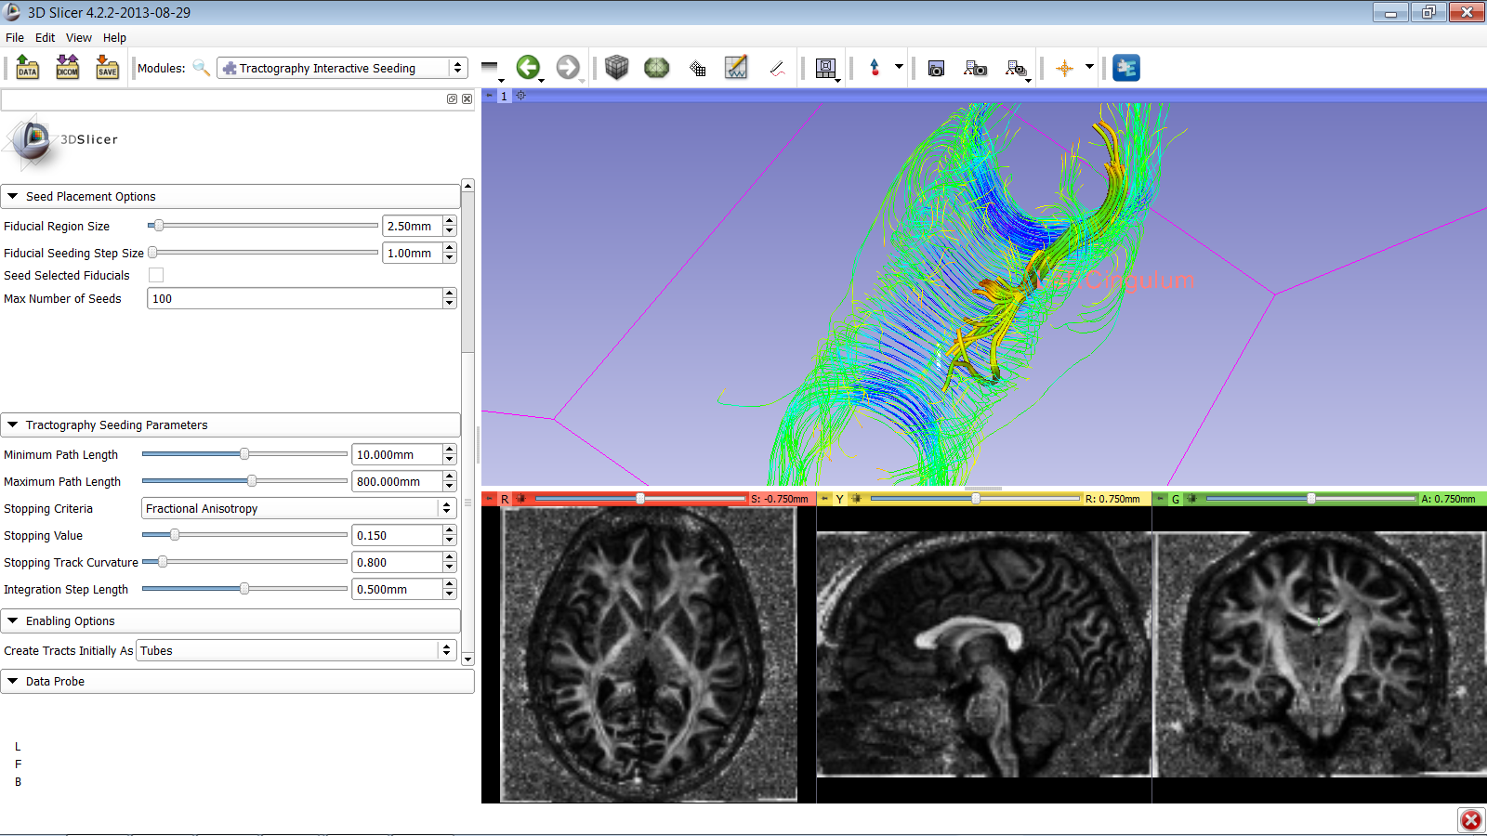
Fiducial Seeding
Part of the left cingulum appears in the 3D viewer.
Move the Left Cingulum fiducial to explore the spatial relationship between the left cingulum and the corpus callosum
Diffusion MRI Analysis

Slide 55
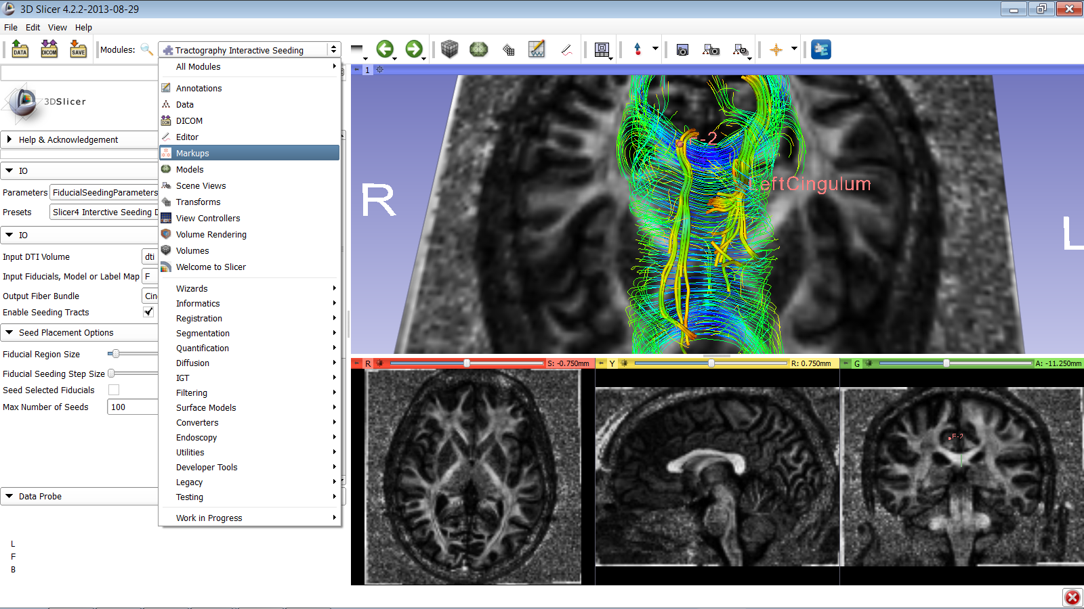
Fiducial Seeding
Go to the Markups module
Diffusion MRI Analysis

Slide 56
Fiducial Seeding
Click on the arrow icon to create a second fiducial
Image Courtesy of Dr. Alexandra Golby, Brigham and Women’s Hospital, Boston, MA..
Diffusion MRI Analysis

Slide 57
Fiducial Seeding
Position the fiducial in the right cingulum of the coronal slice
Image Courtesy of Dr. Alexandra Golby, Brigham and Women’s Hospital, Boston, MA..
Diffusion MRI Analysis

Slide 58
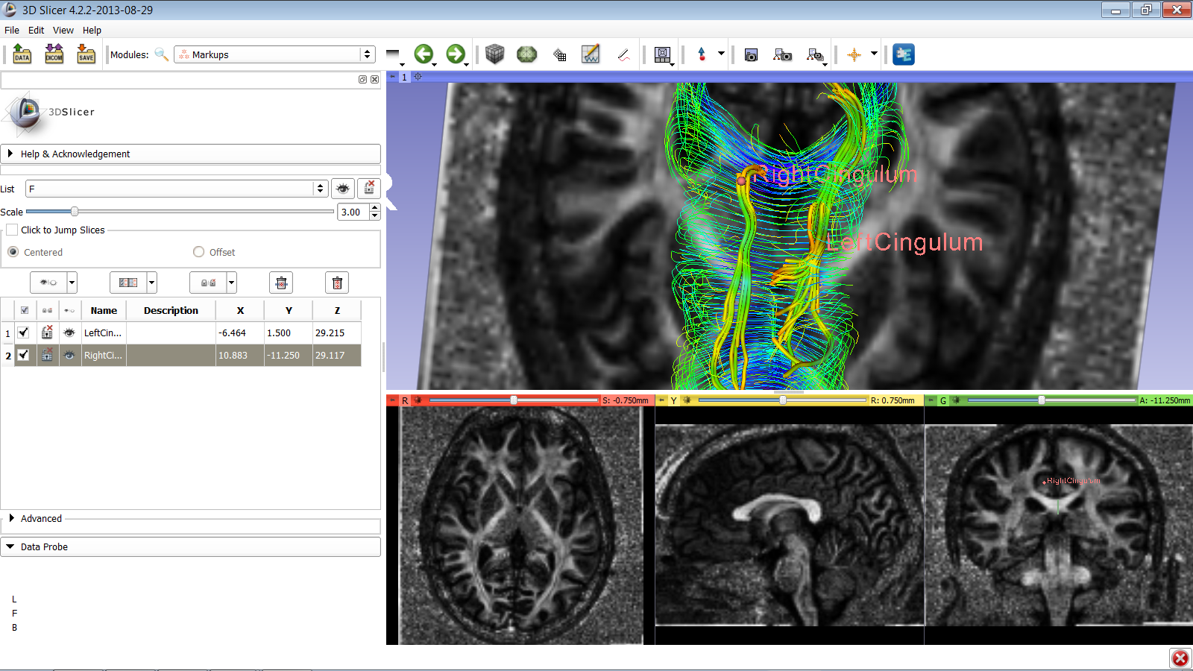
Fiducial Seeding
Part of the left and right cingulum appear in the 3D viewer.
Move the fiducials to explore the spatial relationship between the left and right cingulum, and the corpus callosum
Diffusion MRI Analysis

Slide 59
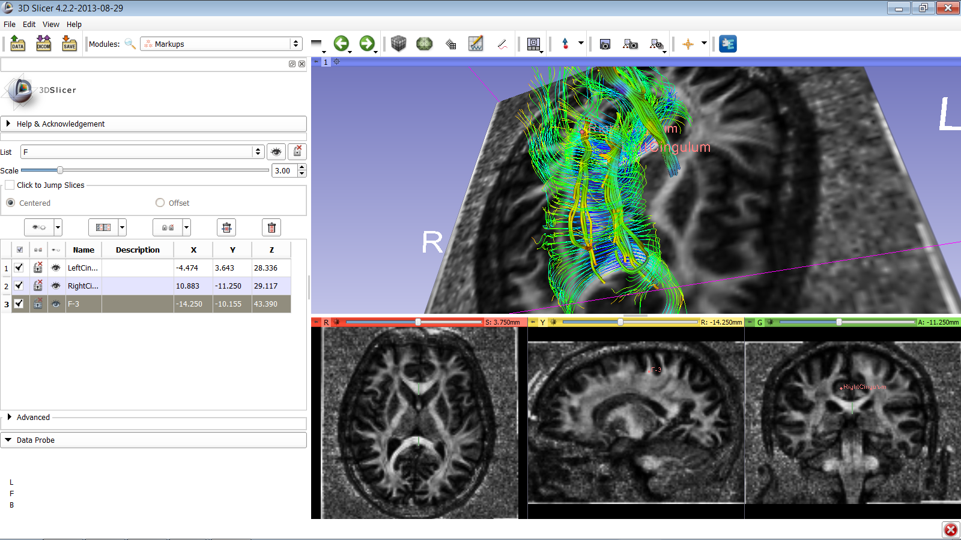
Tractography ‘on-the-fly’
The Fiducial Seeding functionality allows you to do tractography ‘on-the-fly’ to explore white matter structures interactively
Diffusion MRI Analysis

Slide 60
DTI Analysis
Select the module Data to display the list of elements that have been generated in this tutorial
Diffusion MRI Analysis

Slide 61
Conclusion
This tutorial guided you through the different steps of a Diffusion MR Analysis pipeline, from tensor estimation to 3D tracts visualization. This can be applied to explore and to study the fiber tracts of brain white matter .
Diffusion MRI Analysis – Sonia Pujol, Ph.D.
NA-MIC ARR 2012

Slide 62
Contact: spujol@bwh.harvard.edu
zora@bwh.harvard.edu
Diffusion MRI Analysis – Sonia Pujol, Ph.D.
NA-MIC ARR 2012

Slide 63
Slicer Community
www.slicer.org
Mailing lists:
slicer-user@bwh.harvard.edu
slicer-devel@bwh.harvard.edu
Diffusion MRI Analysis – Sonia Pujol, Ph.D.
NA-MIC ARR 2012
Notes:
Download / update software
Find tutorials,
Give feedbaack, get help,
Find documentation

Slide 64
Acknowledgments
National Alliance for Medical Image Computing (NA-MIC)
NIH U54EB005149
Neuroimage Analysis Center (NAC)
NIH P41RR013218
Parth Amin, WIT ’16
Matthew Flynn, WIT ‘16
Diffusion MRI Analysis

