Slide 1
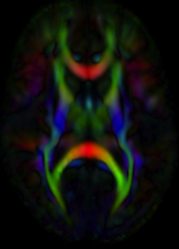
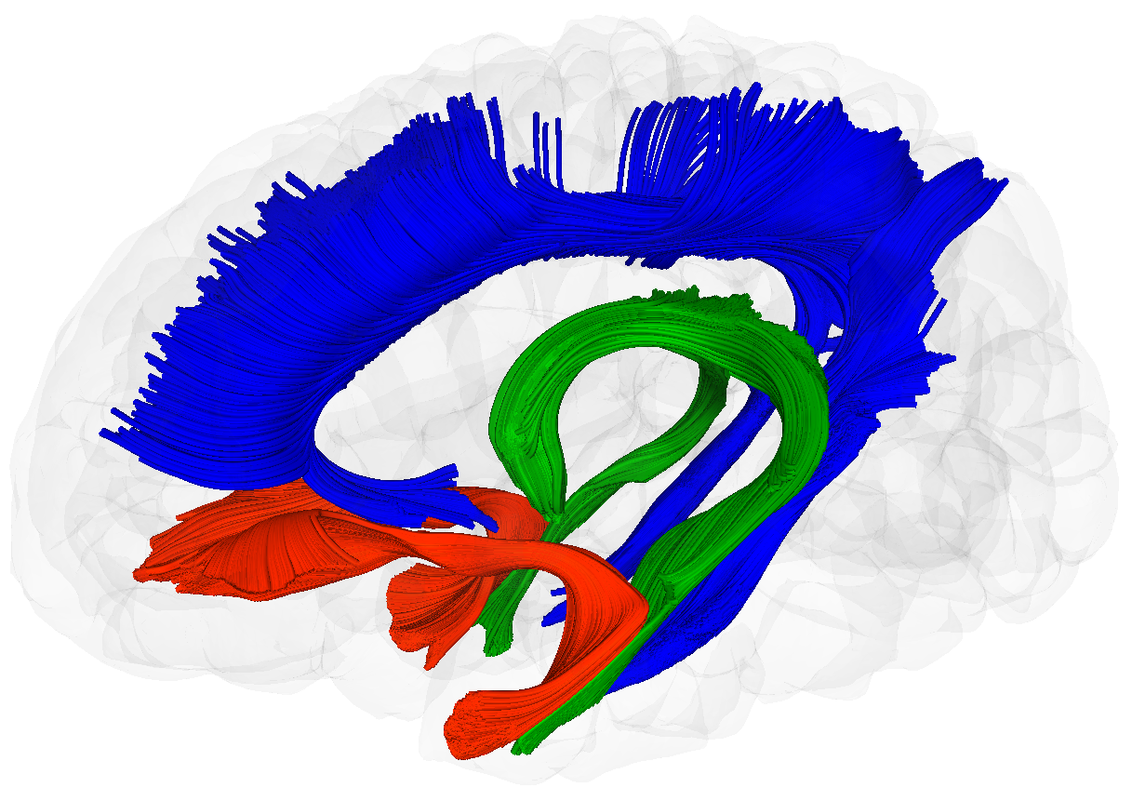
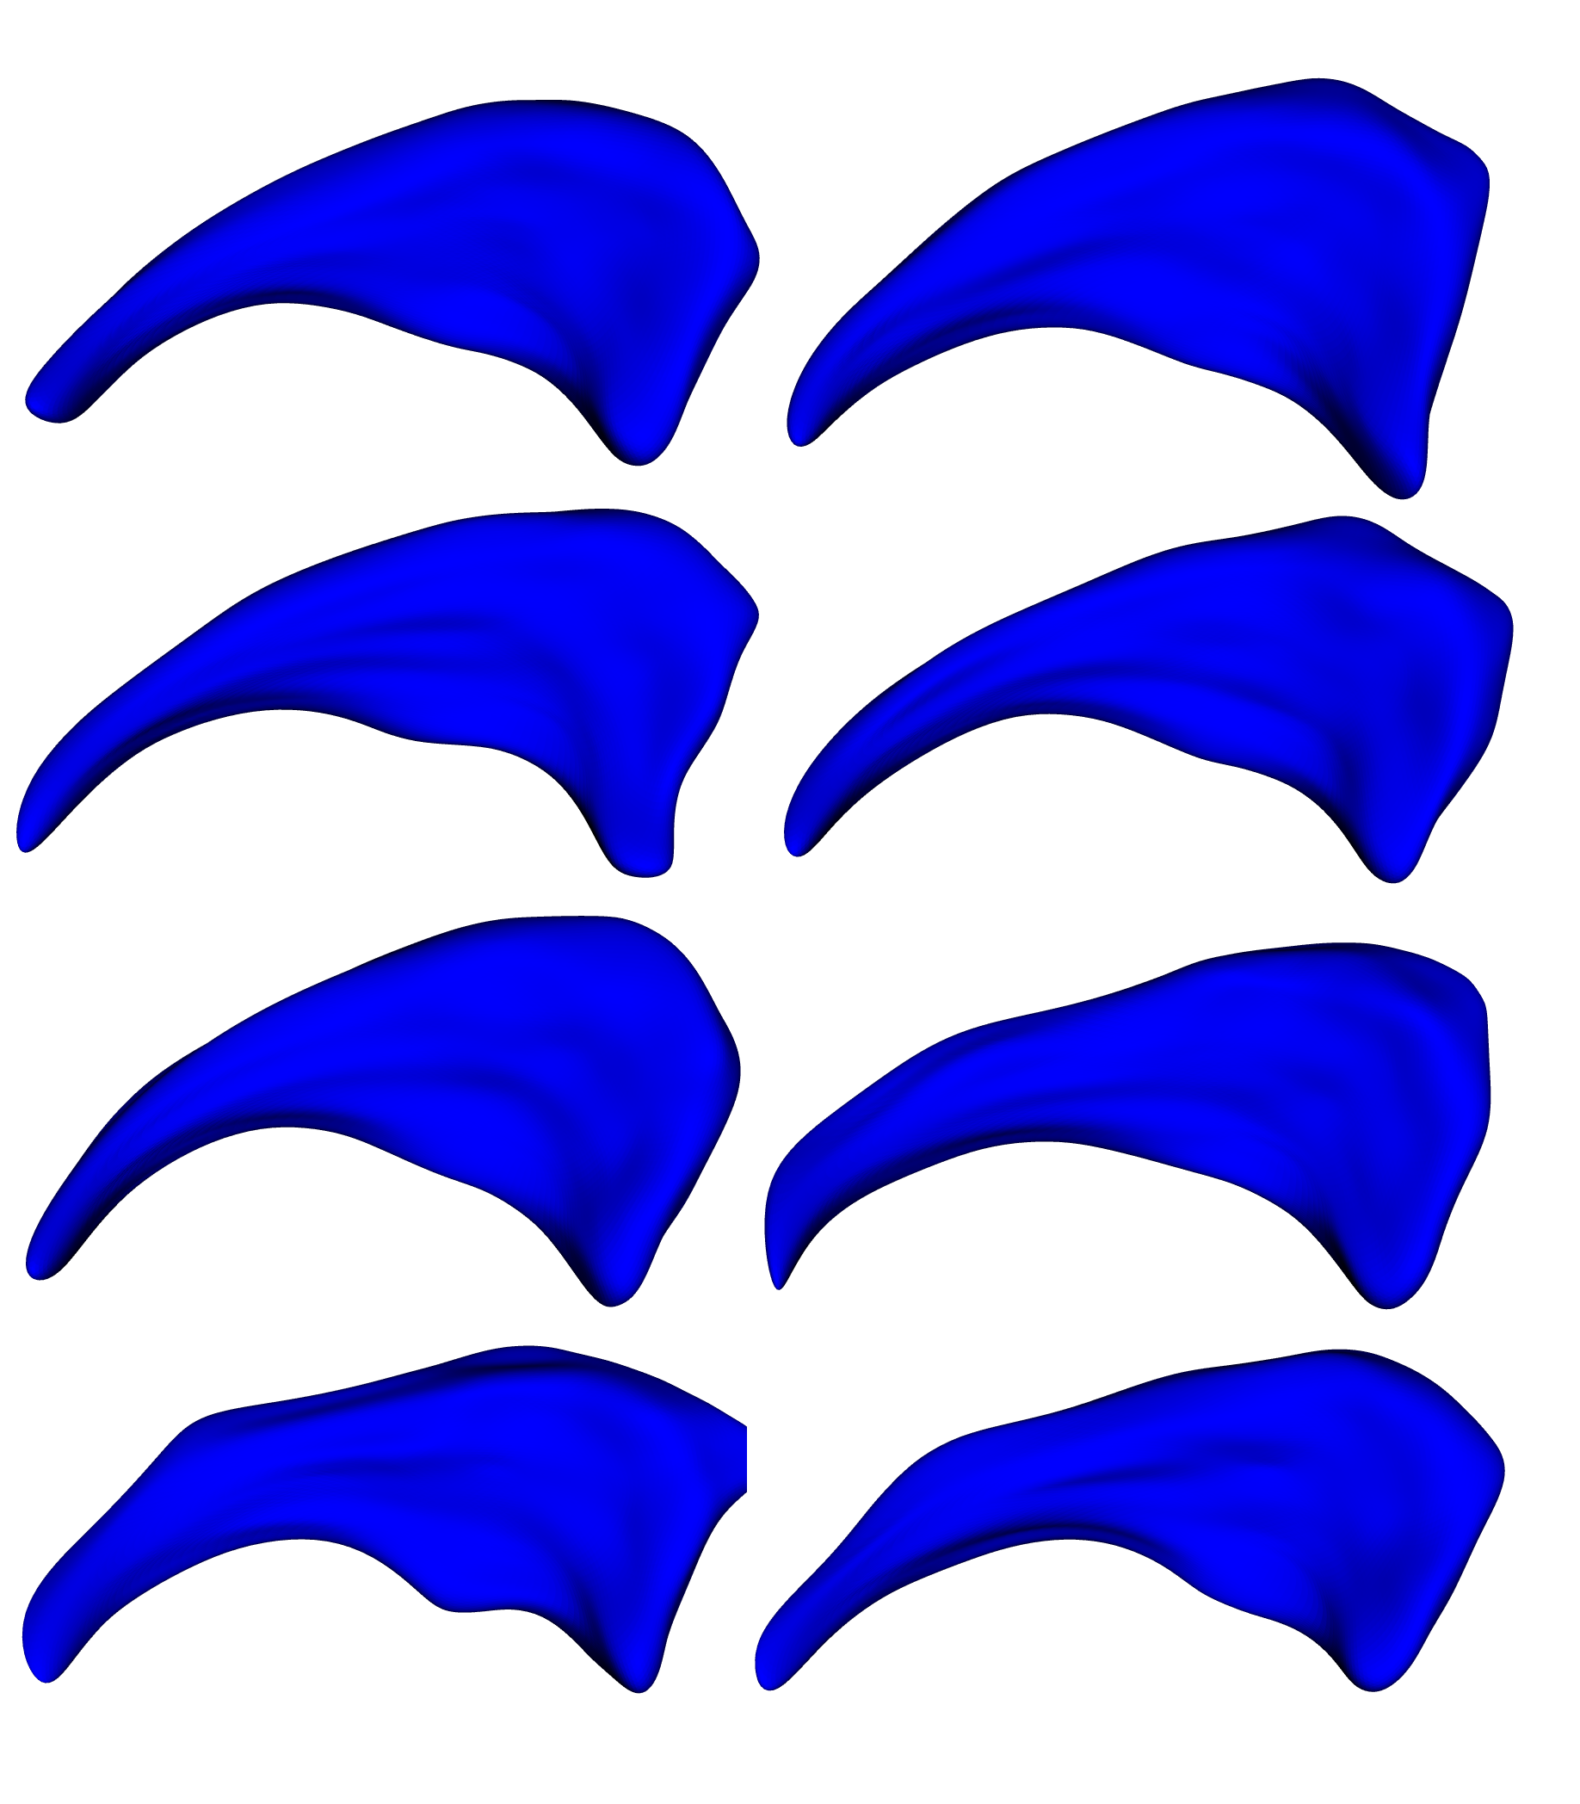
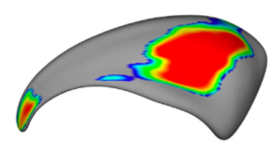
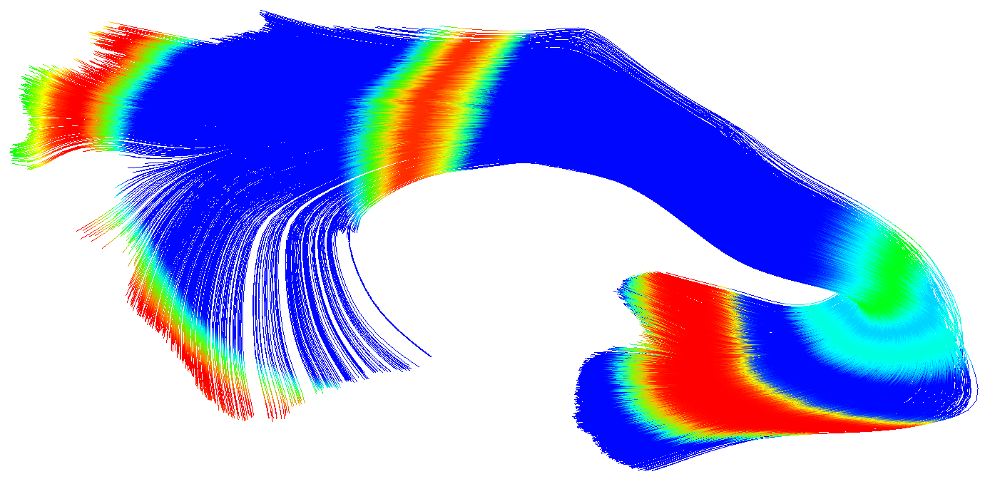
NAMIC at UNC
DTI, Shape and Longitudinal registration
Closely linked with Utah 1 (Ross) and 2 (Guido)

Slide 2
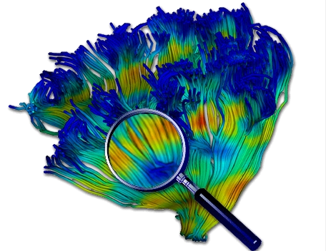
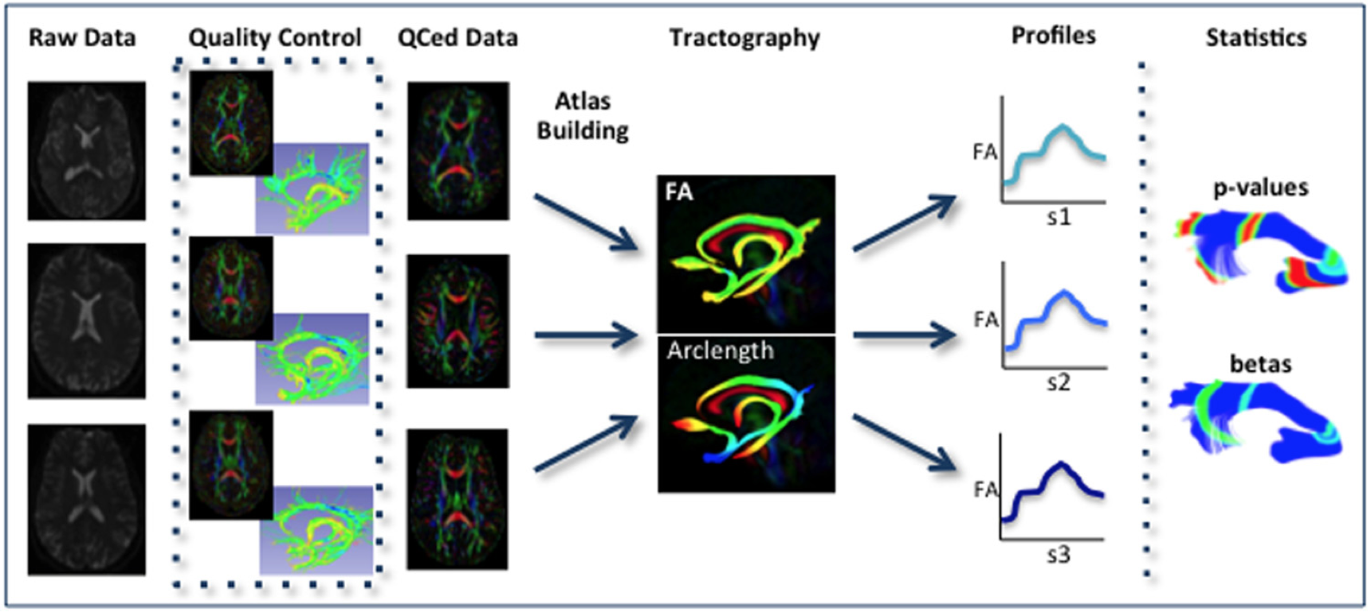
UNC-Utah DTI Fiber Analysis
Analysis of DTI properties along the fiber
Many years of methods & tool development
Allows for localized analysis with high sensitivity

Slide 3
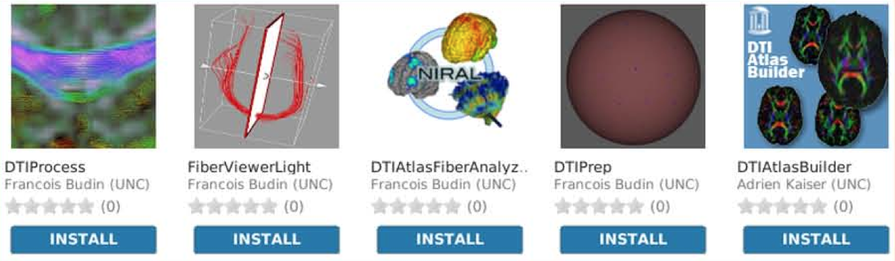
UNC DTI Activities
DTI QC: Vibration artifacts, Error estimation
Fibers: Post-processing, clustering
Statistical analysis methods
Main tool development, Slicer extensions, batch and grid processing

Slide 4
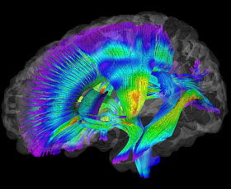


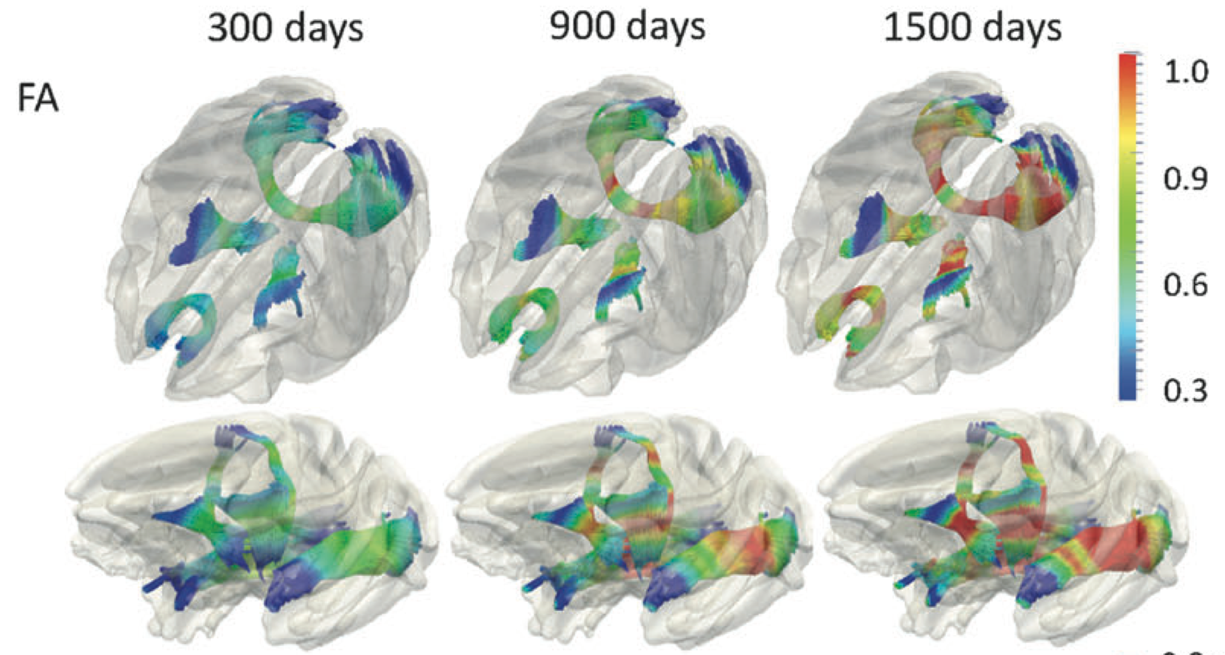
DTI Achievements
First “true” fiber based analysis
>25 clinical papers
  Designed for human data, used for primate and rodent MRI’s
>25 methodological papers
Slicer extensions for investigators
  SPIE tutorials
  Training @ UNC
Framework only available within last year => expect many more papers from the community
AJP, 12
Cerebral Cortex, 12

Slide 5
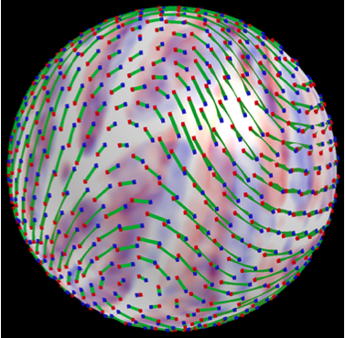
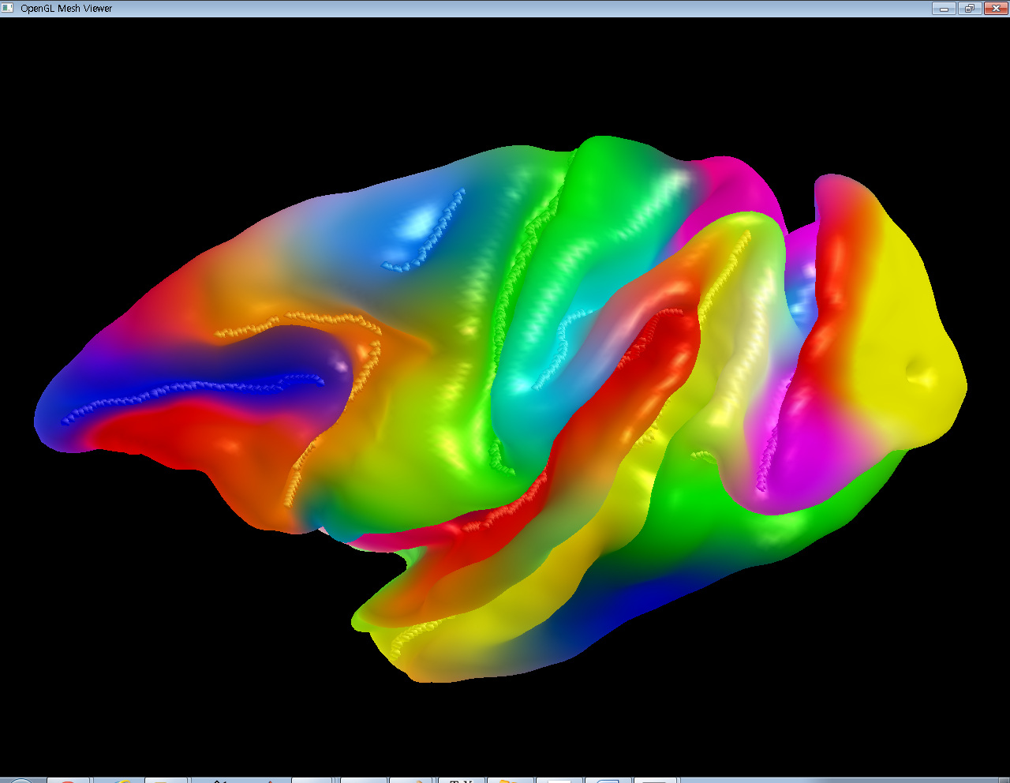
Cortical Correspondence
Goal: Flexible, group-wise cortex correspondence
  Cortical thickness analysis in HD DBP
  Allow for point and sulcal landmarks, longitudinal info
Existing NA-MIC particle based correspondence
    No guarantee on surface mesh topology
      Spherical parametrization
    No explicit registration/deformation
      Spherical harmonics encoding
      Local angular deformation
      Optimal pole choice

Slide 6
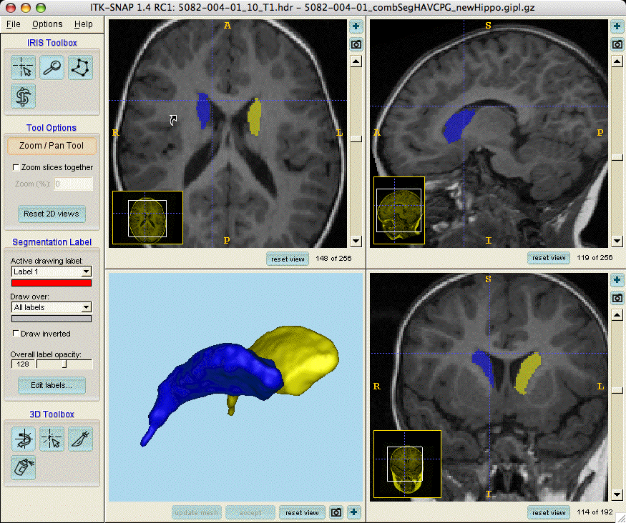
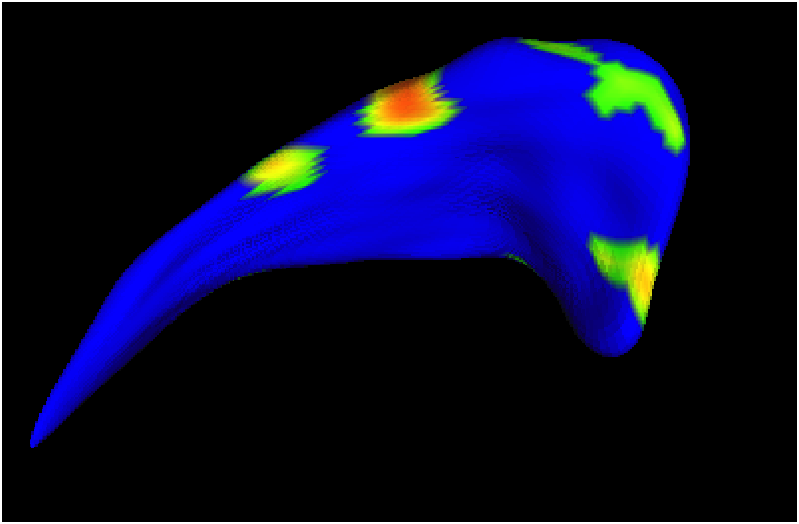
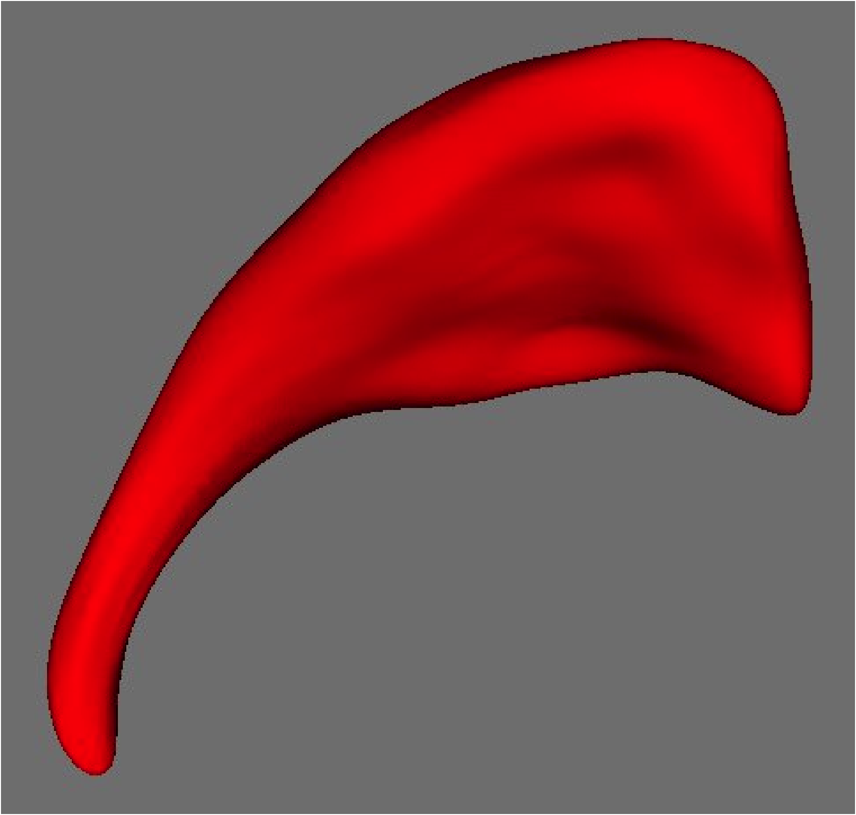
UNC-Utah Shape Tools
Analysis of shape differences or changes
  Pathology in brain structures, Segmentation QC studies, bone structures in Paleontology, Botany & Anthropology
  Localization of pathology, classification via shape
  Comprehensive toolset: classical SPHARM-PDM, implied medial description, group-wise particle description
Volumetric analysis: Size, Growth
Shape Representation
Statistical analysis
Binary Segmentation

Slide 7
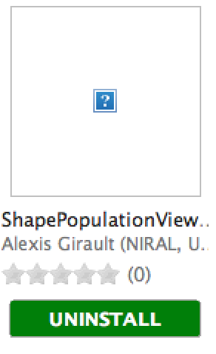
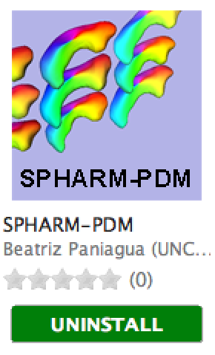
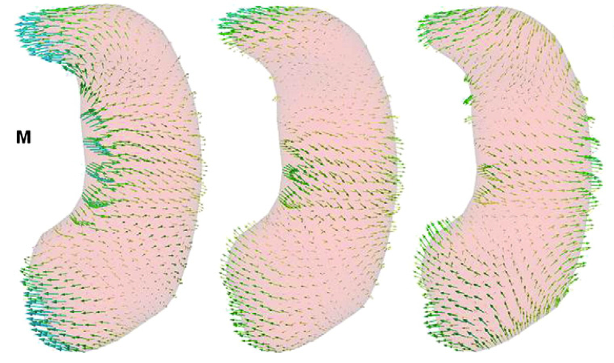
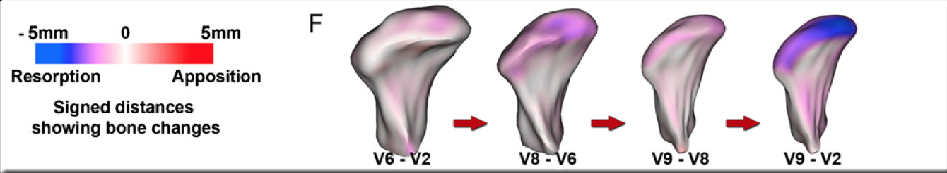
UNC Shape Activities
Particle based correspondence for complex and non-spherical topology cases
  Convoluted (cortex) and narrow (mandible)surfaces
  Incorporating longitudinal modeling
Implied medial description
Statistical analysis methods
Main tool development
  Slicer extensions, batch and grid processing, visualization tools

Slide 8
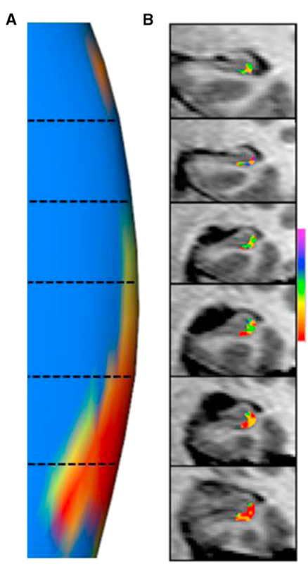
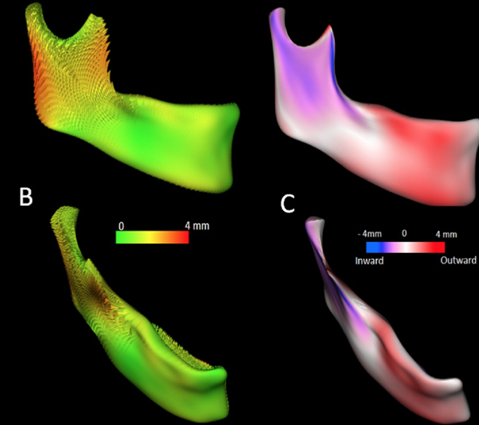
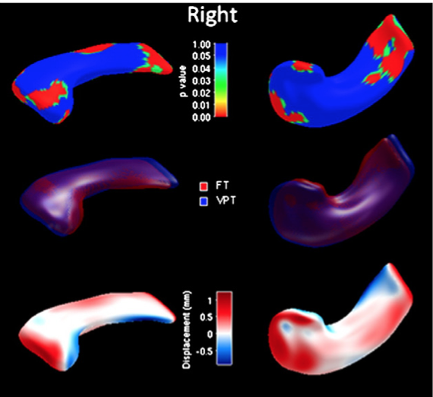
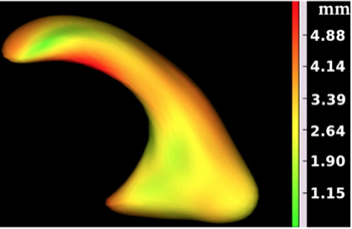
Shape Achievements
>25 clinical papers with NA-MIC co-authors
>20 clinical papers without NA-MIC co-authors
>25 methodological papers
Slicer extensions for investigators
  Training @ UNC
  No other (non-technical) shape analysis toolset around
  SPHARM considered standard, new methods compare to it
Neuron, 13
OSOMOPORE, 11
NeuroImage, 13
NeuroImage, 12

Slide 9
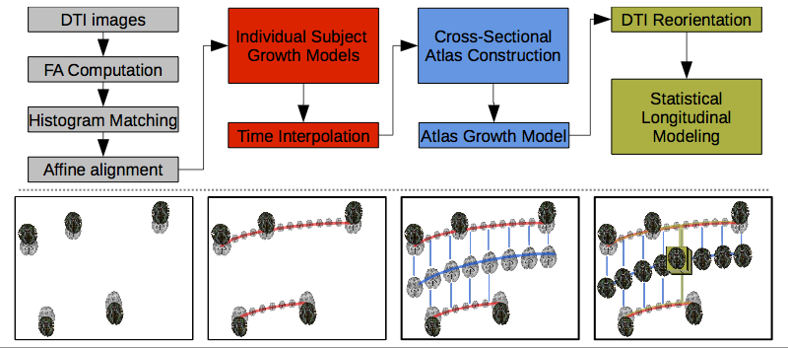
Longitudinal Atlas Building
4D atlas with individual growth/change trajectories
For DTI and structural MRI
Splenium
3D atlas
4D atlas

Slide 10
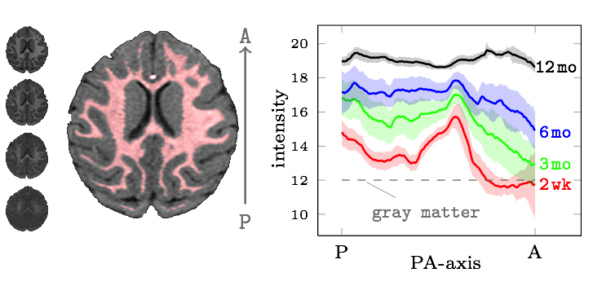
4D Intensity Changes
  Models intensity changes across time
    logistic function, model is incorporated into intensity match
  Handles non-balanced & missing samples
  Allows for joint processing of longitudinal intra-subject data
    Structural Segmentation & tissue classification
    Enhances stability => sensitivity to detect longitudinal changes
Average A-P intensity change in WM
Notes:
A novel method to create DTI atlases incorporating a model of change in intensity. The left image nicely shows the contrast inversion and the radical change in intensity in the white matter that happens in the first few months of life. The intensity change is modeled as a logistic function (more in the next slide). It is noteworthy that the longitudinal registration handles if data is missing or the time sampling is non-balanced (e.g. we can include subjects that are missing a timepoint, and do not need discrete time points, but rather handle time in a continuum. The right image shows the average WM intensity profile from Anterior to Posterior in a selected slice at different ages. Even from 6-12 mo there is significant intensity change happening.

Slide 11

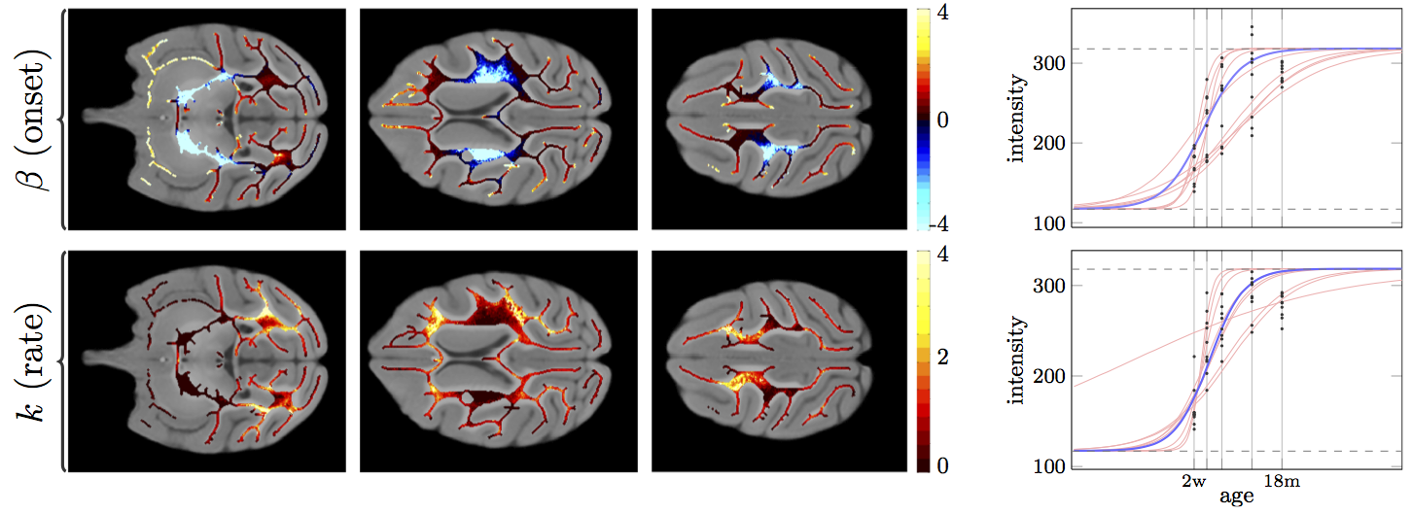
Intensity Change Images
Intensity change “atlas image” as byproduct
  Estimated onset (in months) and rate of maturation
Individual (red), median (blue) logistic curves, image intensity (dots) for 2 voxels
^{Thinned white matter mask}
Notes:
As a byproduct of the longtiudinal registration, we compute an intensity change model. This can be also studied (and compared across subjects) as a visualization of how brain maturation affects MR intensity (here T1 weighted MR intensity). As mentioned before the model is logistic (see right curves). Left shows the median rate (slope) of change (lower row) and onset (the middle point of curve) for every voxel in the thinned white matter. The WM is thinned in order to remove all partial volume voxels. On the right there are the plots of all subjects in 2 selected voxels.

Slide 12
NA-MIC @ UNC
DTI & Shape & Longitudinal Registration
Field leading tools (Slicer extensions) for investigators, not just engineers
Training support
Leading to high number of papers & applications

