Slide 1
Core 1b – Engineering Components
Jim Miller
GE Research

Slide 2
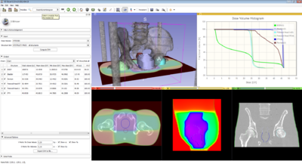
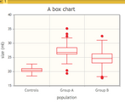
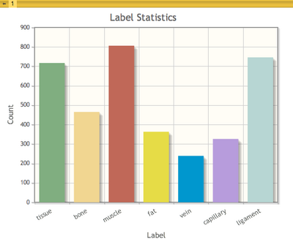
Charting
New
Slicer View for charting
User
Quantitative layouts
Interactive customization
Multiple charts in a scene
Developer
MRML node
Scene serialization
View and layout
http://www.slicer.org/slicerWiki/index.php/Documentation/4.2/Developers/Charts

Slide 3
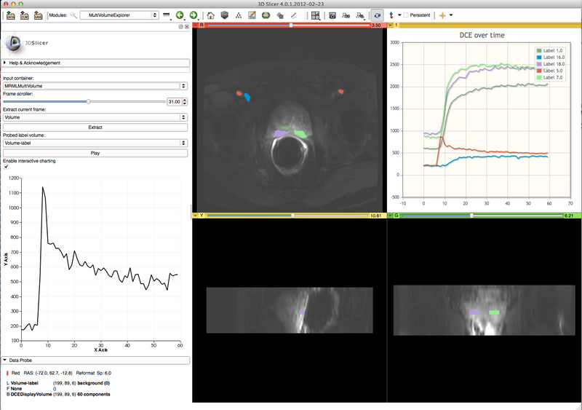
Multivolume
New
Infrastructure for multi-frame data
E.g. DCE, cardiac, vascular
User
DICOM plugin
Cine
Charting
Volume rendering
Developer
Storage (NRRD w/ attributes)
CLI support
http://www.slicer.org/slicerWiki/index.php/Documentation/4.2/Modules/MultiVolumeExplorer

Slide 4
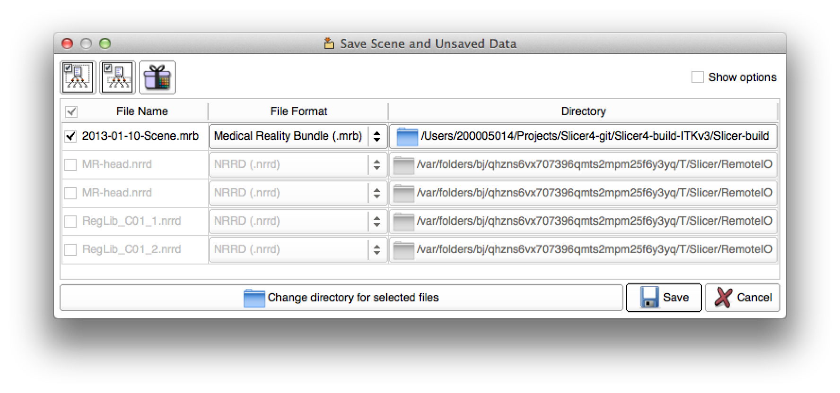
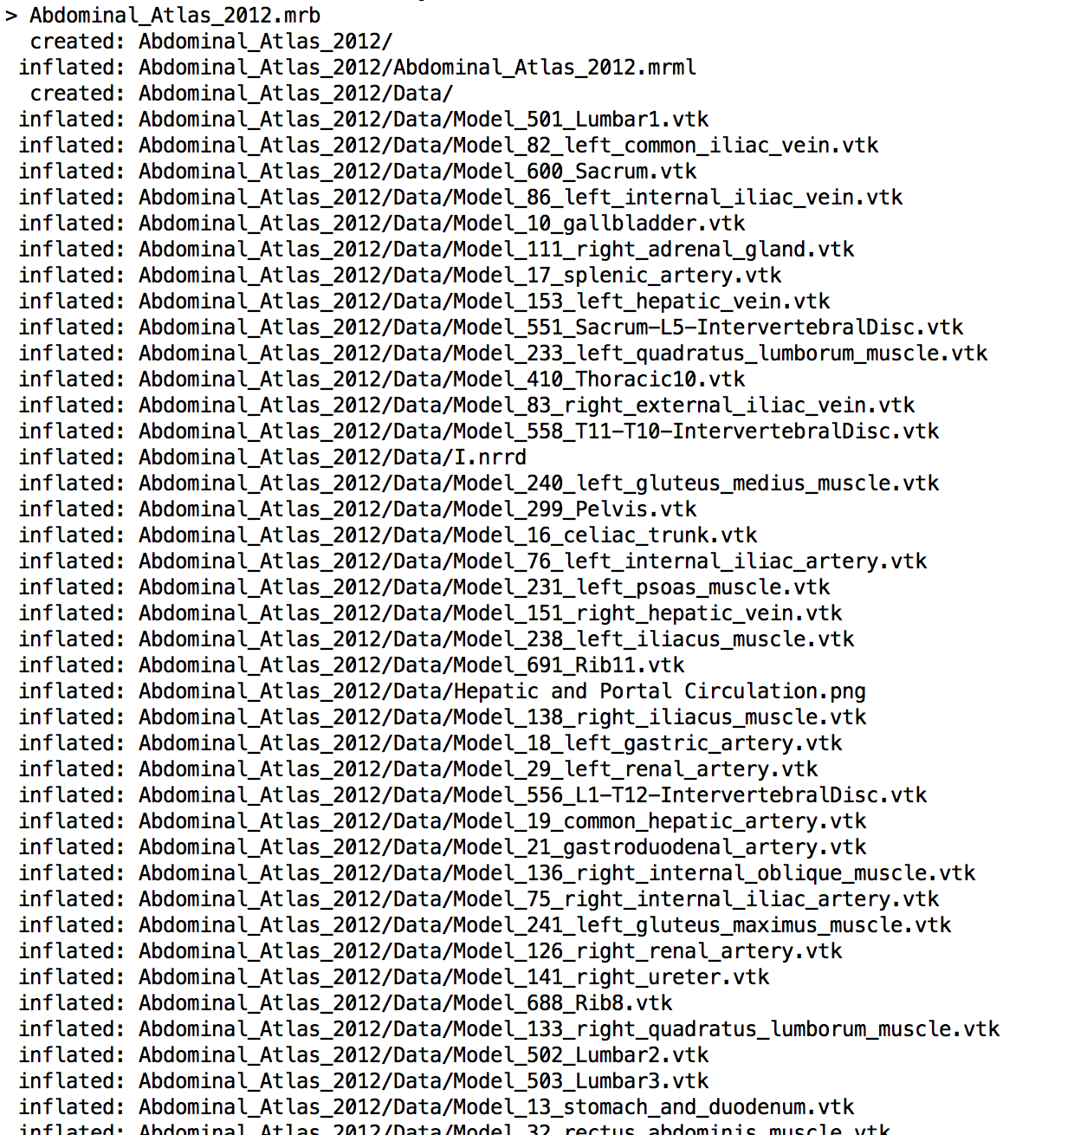
MRB
New
Data bundle representing a scene and all the bulk data
User
Single file scene bundle
Easier to communicate/share results
UI for scene IO largely unchanged
Developer
Zip file
Simplifies writing module test code
E.g. bundle entire atlas (images, models, annotations) in single file

Slide 5
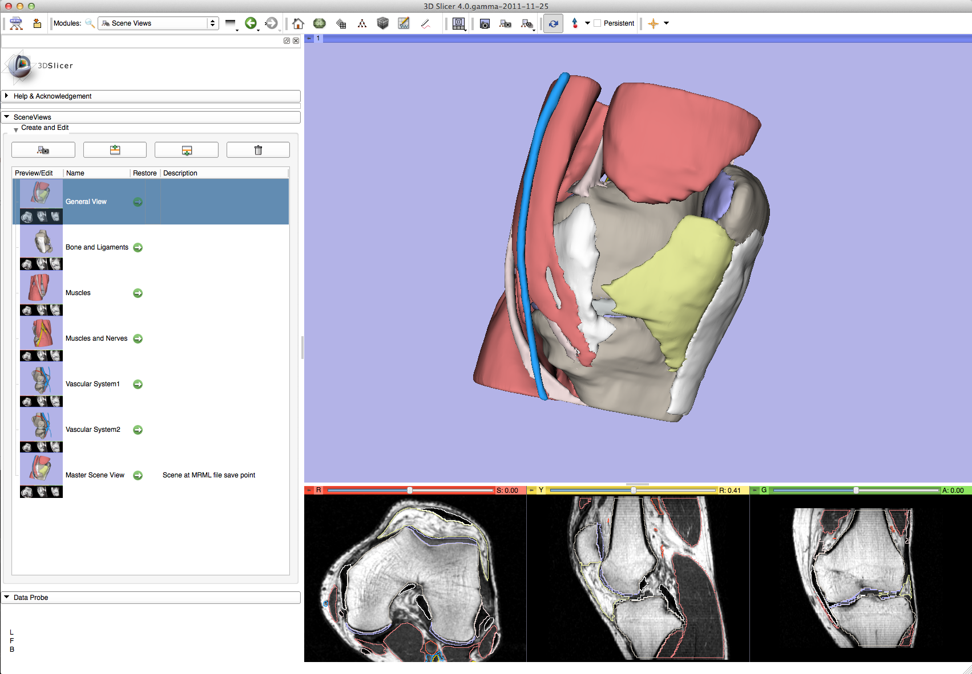
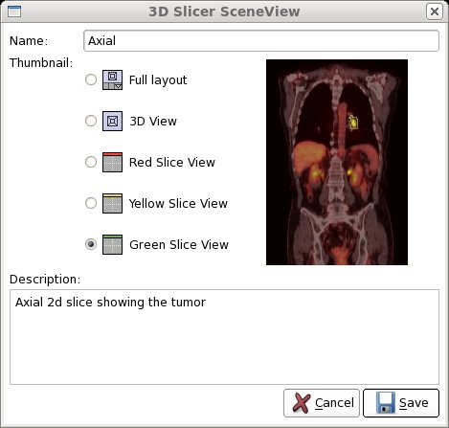
Scene Views
Improved
Snapshot of the state of Slicer
User
Communication tool
Backup – last known good
Developer
Serialized with Scene
Programmatic generation support
http://www.slicer.org/slicerWiki/index.php/Documentation/4.2/Modules/SceneViews

Slide 6
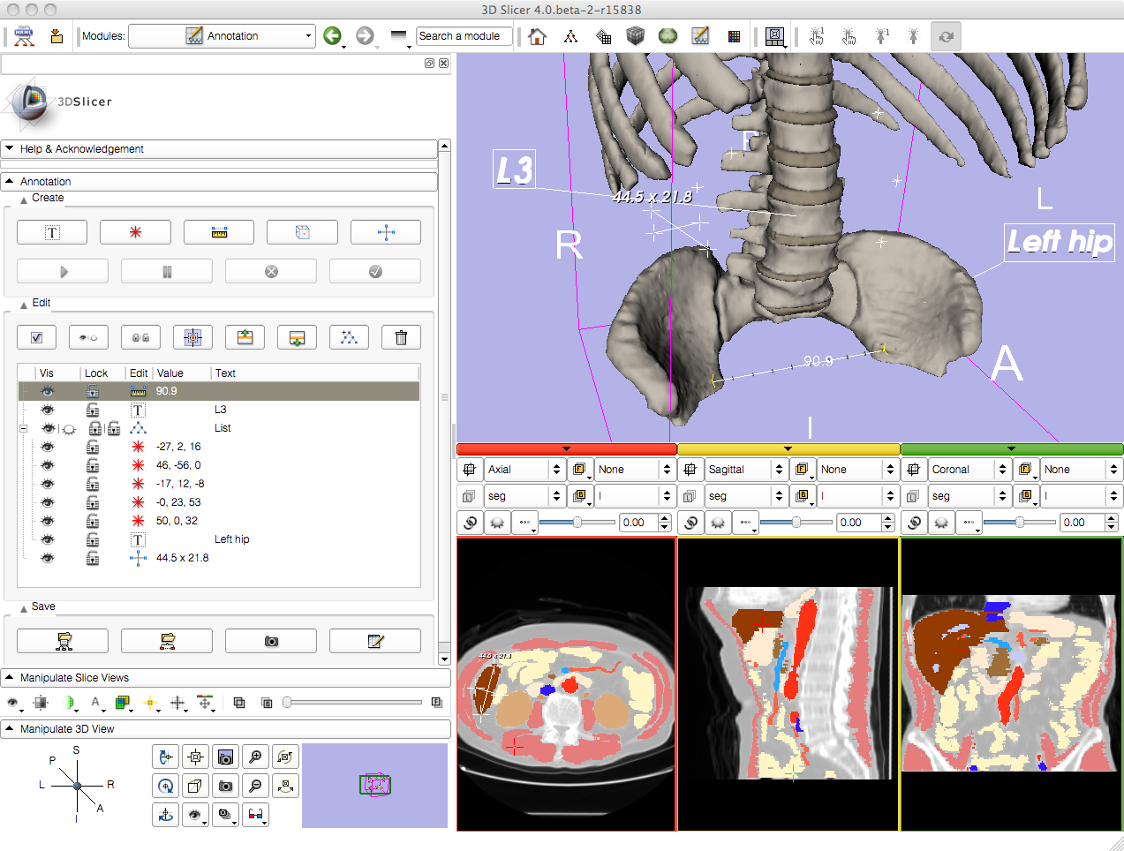
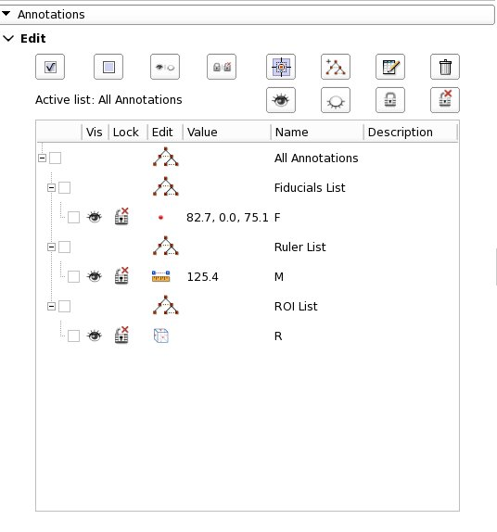
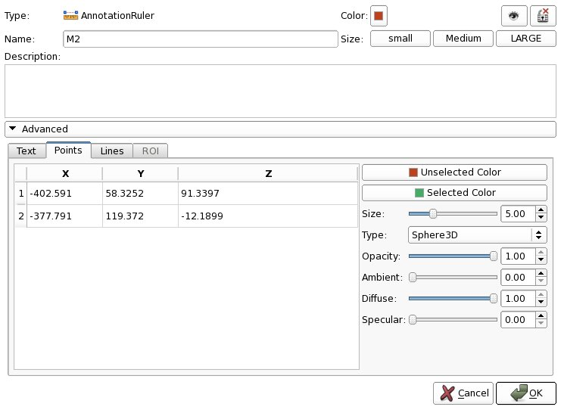
Annotations
Improved
Image markups
User
Fiducials, rulers, ROIs
Seed algorithms
Communicate findings
Developer
Serialization
CLI support
http://www.slicer.org/slicerWiki/index.php/Documentation/4.2/Modules/Annotations

Slide 7
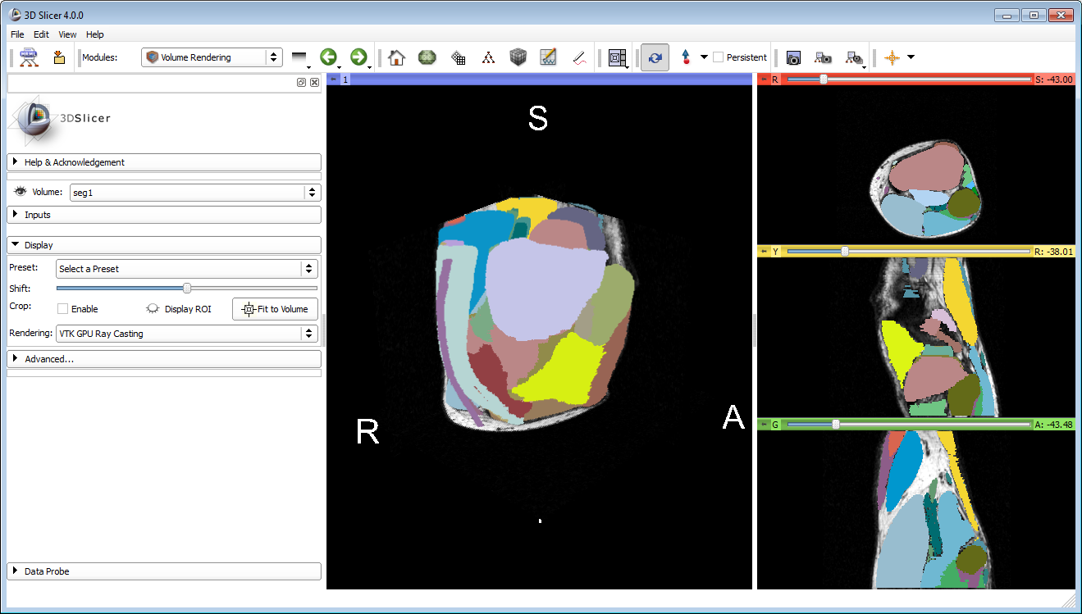
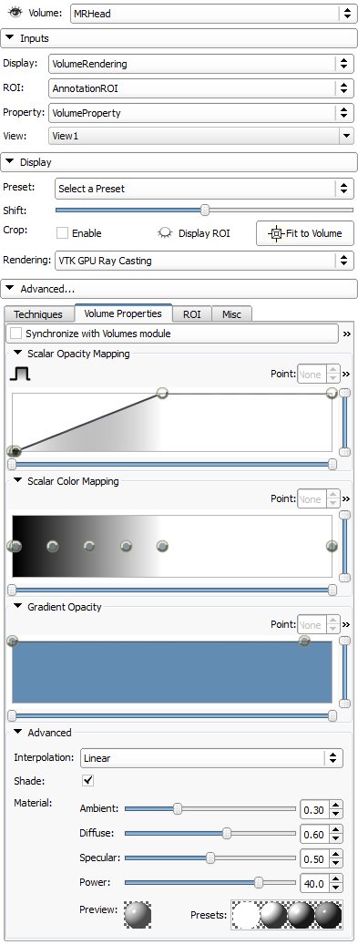
Volume rendering
Improved
3D Visualization
User
Presets
Variety of methods
Scalar, label and multivolume
Works on Ron’s laptop!
WIP – new transfer function editor
Developer
Extensions can register new volume rendering techniques
Programmatic orchestration of volume rendering from modules
http://www.slicer.org/slicerWiki/index.php/Documentation/4.2/Modules/VolumeRendering

Slide 8
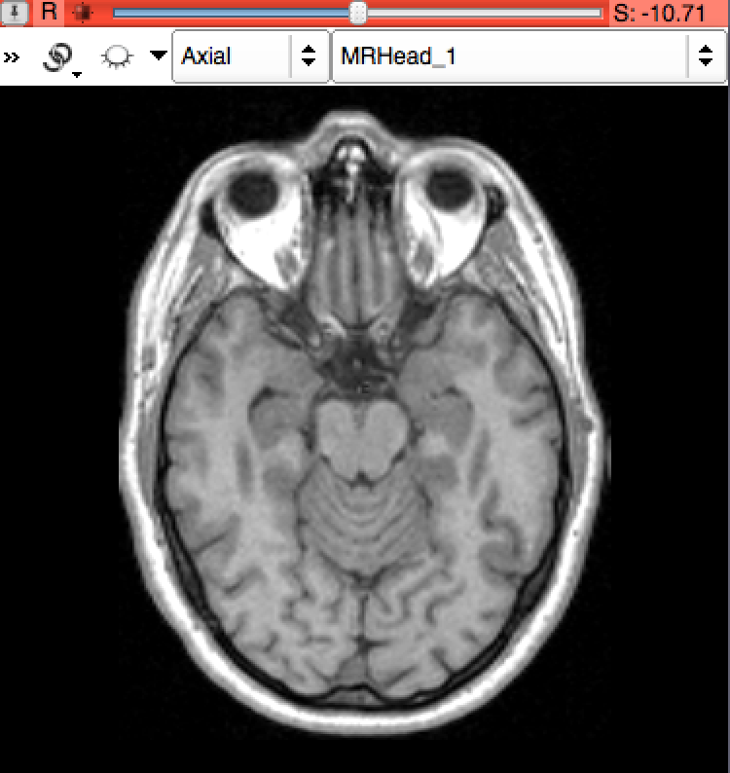
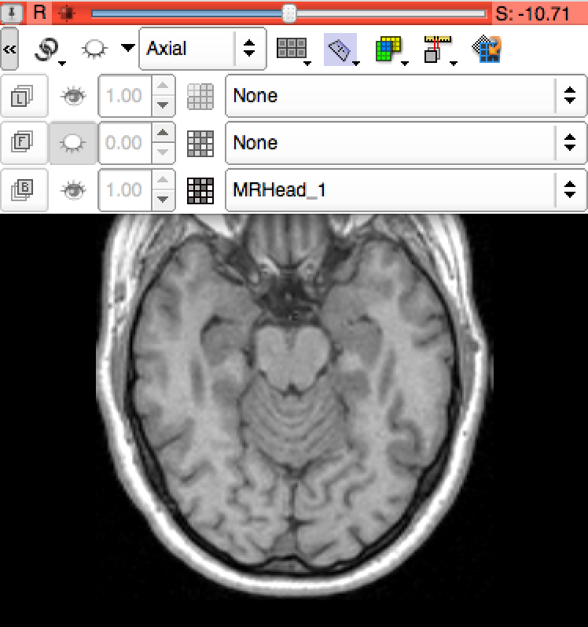
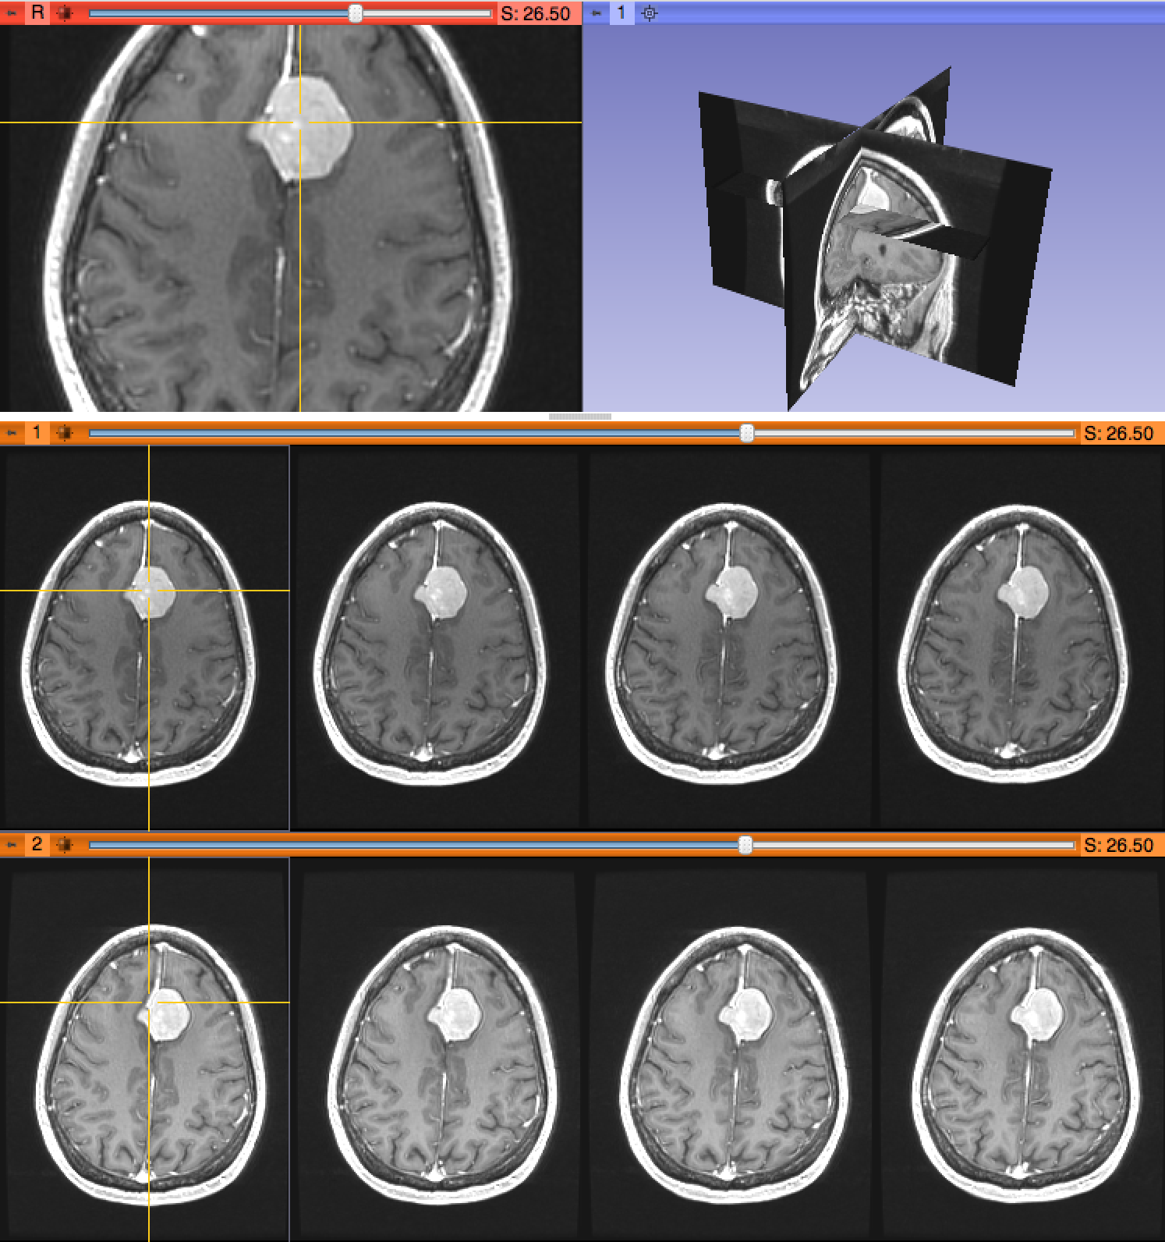
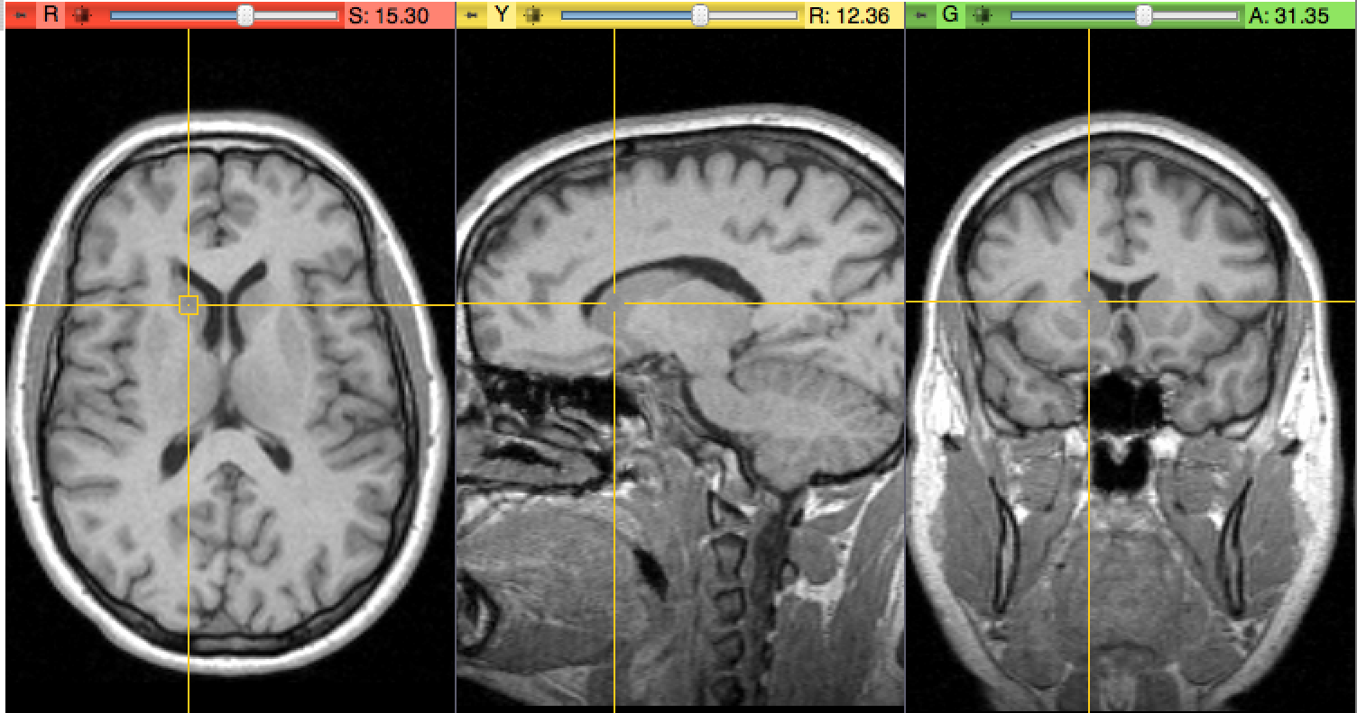
Simplification
Improved
Slice Controllers
Linking, Lightboxes
Crosshairs

Slide 9
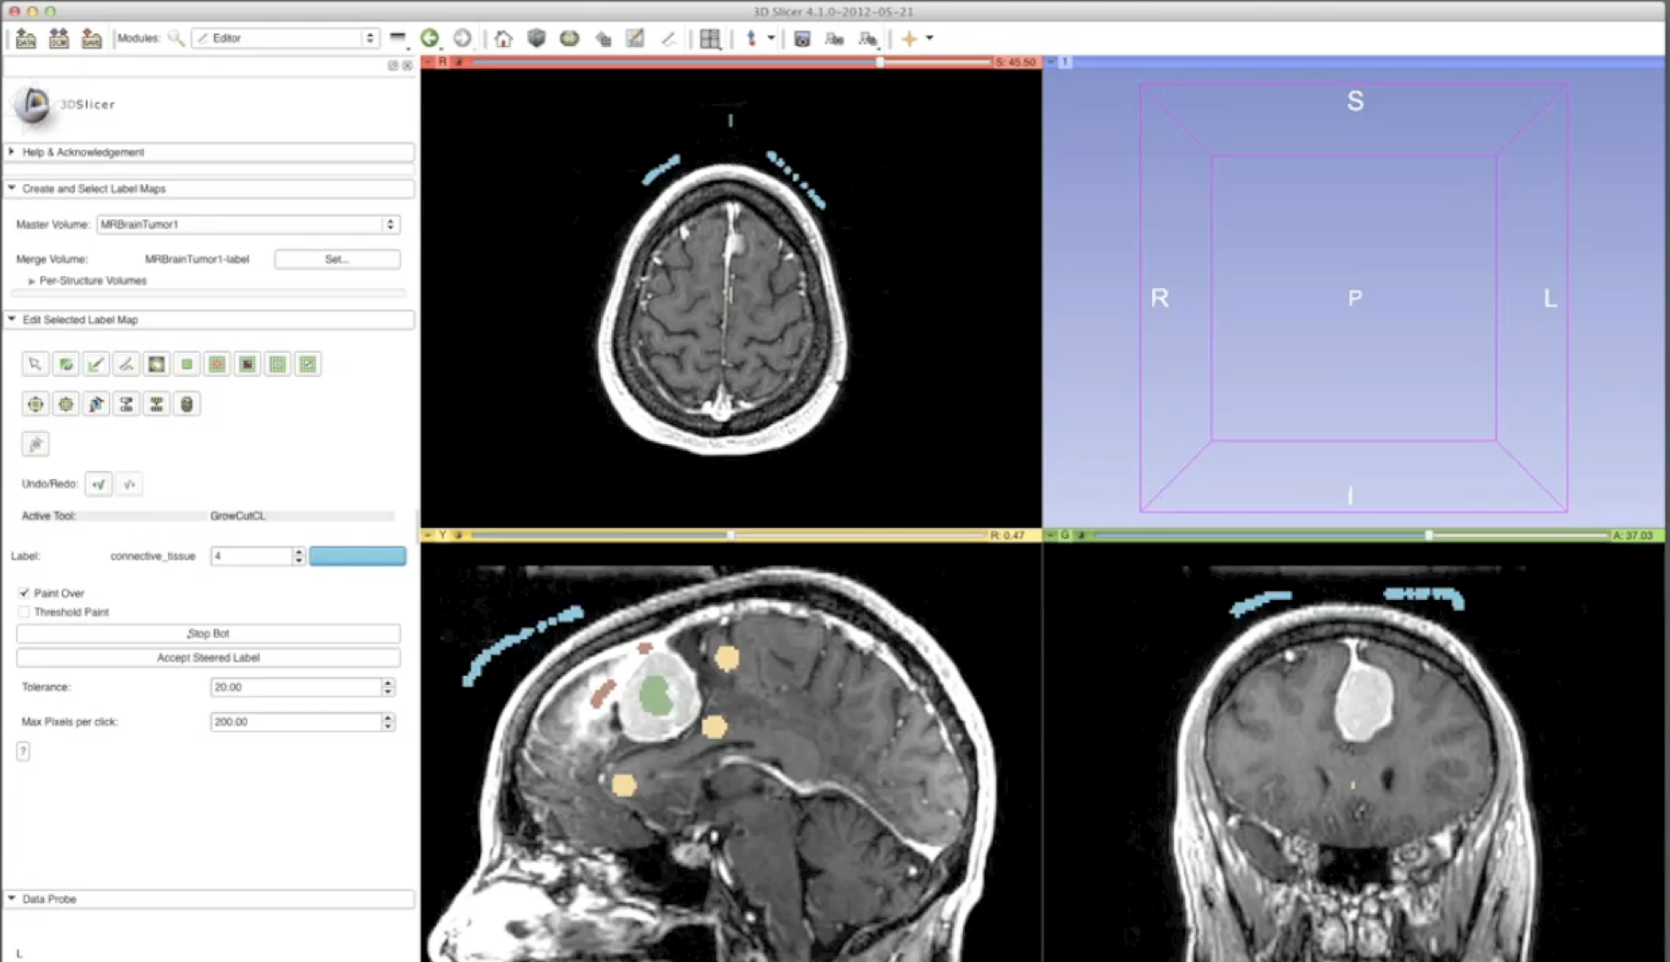
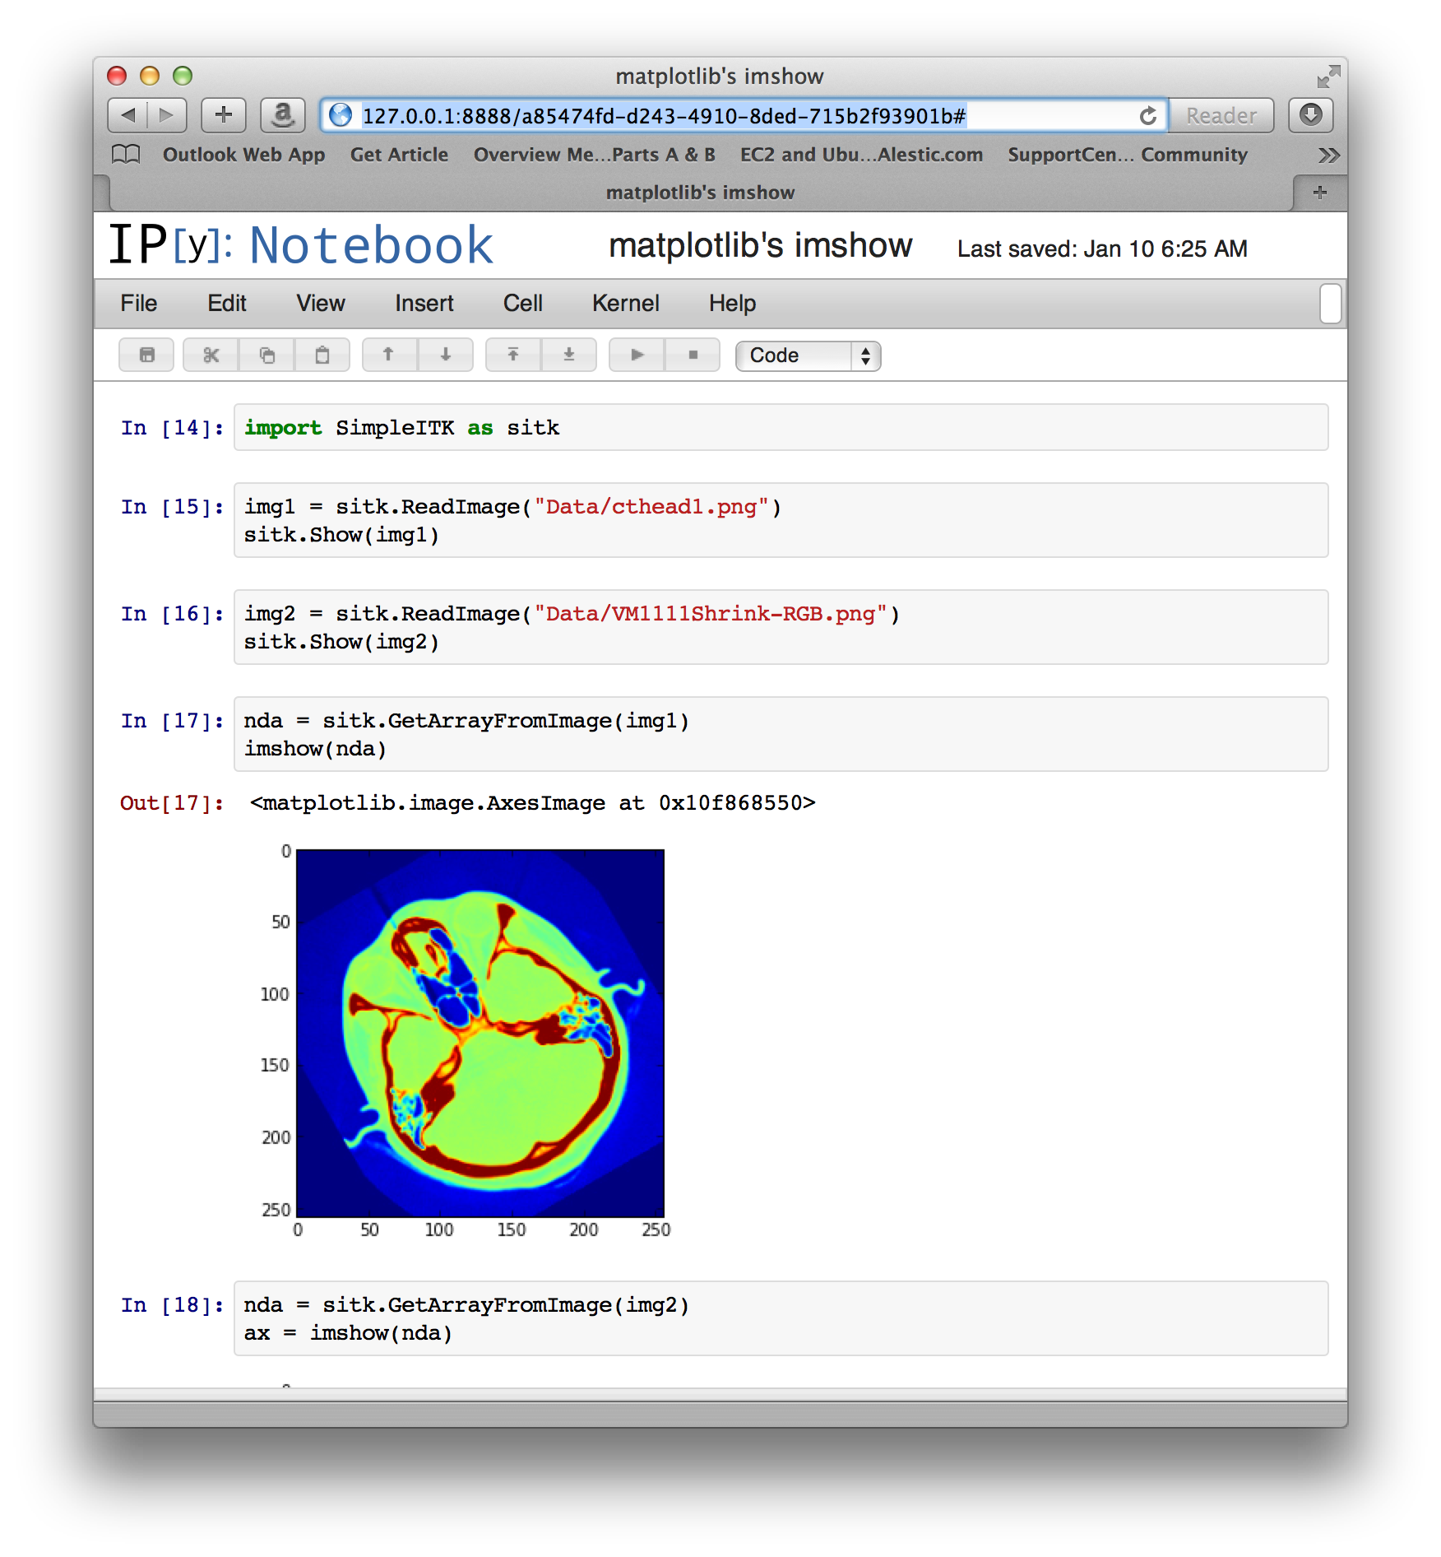
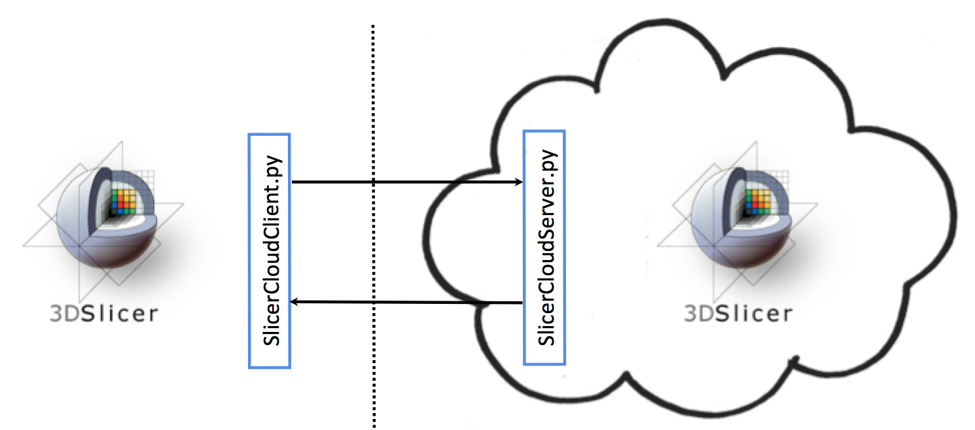
Works in progress
WIP
GPU Editor Extensions
ITKv4 and SimpleITK
Personal Slicer Cloud

